Slide 1
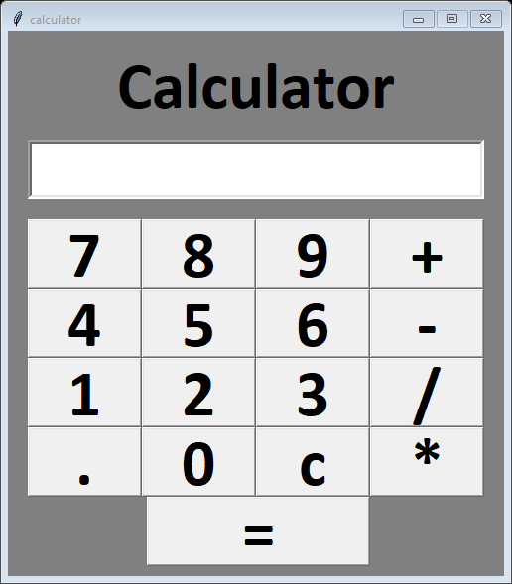
Simple calculator
Using Tkinter python
Submitted By
Nilesh Choudhary
Submitted To
Next Hike
he

Slide 2
Introductions
Calculator : is a simple devise which preformed basic mathematical
operation like addition subtraction division etc.
Tkinter : Tkinter is a standard Python GUI library. Which provide
A set of tools and widgets to create desktop application
with Graphical interface.

Slide 3
Step 1
First of all import Tkinter library T
o store Tkinter library we
create variable calcy
Give a title and set geometry background color and
from tkinter import*
calcy = Tk()

Slide 4
Step 2:
In next step we prepared output box using Entry function
output_box = Entry(calcy, relief='sunken', font=('Calibri',50, 'bold'),bd=4,textvariable=var)
output_box.place(x=20, y=110, height=60, width=460 )

Slide 5
Step 2:
second step we create different buttons
key1= Button(calcy,text="7",font=('Calibri',50, 'bold'),command=lambda:get_data(7))
And so on

Slide 6
Step 4
In next step we generate function for Entry and output function
def get_data(value):
global data
data = data + str(value)
var.set(data)
def equal_data():
global data
total = str(eval(data))
var.set(total)
def clear():
global datad
data = ""
var.set(data)

Slide 7
Calculators ready to use

