Slide 1
Exploratory data analysis
Submitted by
Nilesh Choudhary
Submitted to
Next Hikes

Slide 2
what is
Exploratory data analysis
EDA is a vital step in the data analysis process that entails visually and statistically
analyzing datasets to find patterns, trends, and insights.
The principal goals of exploratory data analysis(EDA) are to detect anomalies in the
dataset and develop recommendations for additional
investigation, thereby guaranteeing a thorough comprehension of the subtleties of the
data

Slide 3
The process we followed.
Import necessary libraries.
import pandas as pd
import numpy as np
import matplotlib.pyplot as plt
import seaborn as sns
And
load the Data
housing_data= pd.read_csv(r'C:\Users\pc\Desktop\project3\housing_data.csv')

Slide 4
The process we followed.
Check for number of row and coloumn
housing_data.shape
General information of data set
housing_data.info()
Infirmation about numric data ie their count mean, mode, mode median, percentile, min, mas etc
housing_data.describe()

Slide 5
The process we followed.
Check for names of column
columns =housing_data.columns
Columns
Replace name of column
housing_data['Foundation']=housing_data['Foundation'].replace({'BrkTil':'Brick & Tile','CBlock':'Cinder Block','PConc':'Poured Contrete'})

Slide 6
The process we followed.
Box plot
num_cols = housing_data1.select_dtypes(include=np.number).columns.tolist()
for col in num_cols:
print(col)
print('Skew :', round(housing_data[col].skew(), 2))
plt.figure(figsize = (15, 4))
plt.subplot(1, 2, 1)
housing_data[col].hist(grid=False)
plt.ylabel('count')
plt.subplot(1, 2, 2)
sns.boxplot(x=housing_data[col])
plt.show()

Slide 7
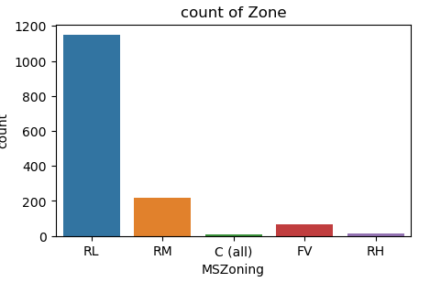
The process we followed.
Count plot
v plt.figure(figsize=(5,3))
sns.countplot(x='MSZoning', data=housing_data1)
plt.title('count of Zone')
plt.show

Slide 8
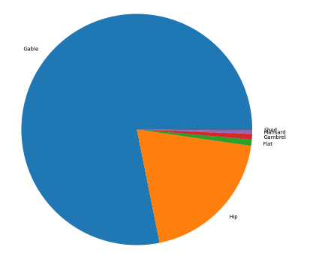
The process we followed.
Pie chart
x=housing_data1['RoofStyle'].value_counts().index
y=housing_data1['RoofStyle'].value_counts().values
plt.figure(figsize=(10,10))
plt.pie(y,labels=x)
plt.title('pei chart distribution for roof style')
plt.show

Slide 9
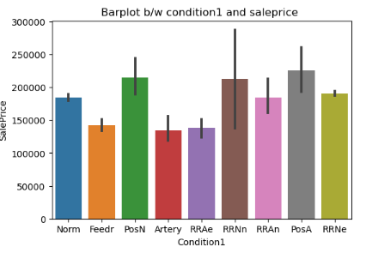
The process we followed.
Bar plot
plt.figure(figsize=(6,4))
sns.barplot(x='Condition1', y='SalePrice', data=housing_data1)
plt.title('Barplot b/w condition1 and saleprice ')
plt.show

Slide 10
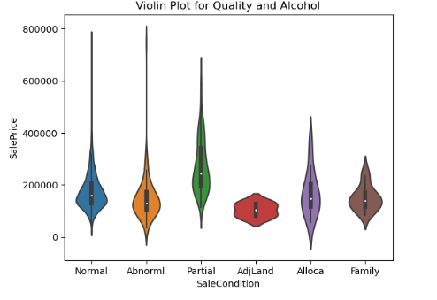
The process we followed.
Violin plot
sns.violinplot(x="SaleCondition", y="SalePrice", data=housing_data1, alpha=0.7)
plt.title('Violin Plot for Quality and Alcohol')
plt.xlabel('SaleCondition')
plt.ylabel('SalePrice')
plt.show()

Slide 11
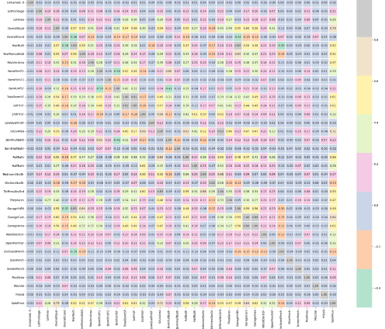
The process we followed.
Violin plot
Heatmap
plt.figure(figsize=(25,20))
sns.heatmap(housing_data1.corr(), annot=True, fmt='.2f', cmap='Pastel2', linewidths=2)
plt.title('Correlation Heatmap')
plt.show()

Slide 12
THANKS

