Slide 1
Information Visualization
Milestone 2
Group 6 : Chen Nili (1901883) , Lin Shixuan (1901849), Wu JiaJie (1901828)

Slide 2
Content
Recap
Visualisation
What how why
Challenges faced
Future works

Slide 3
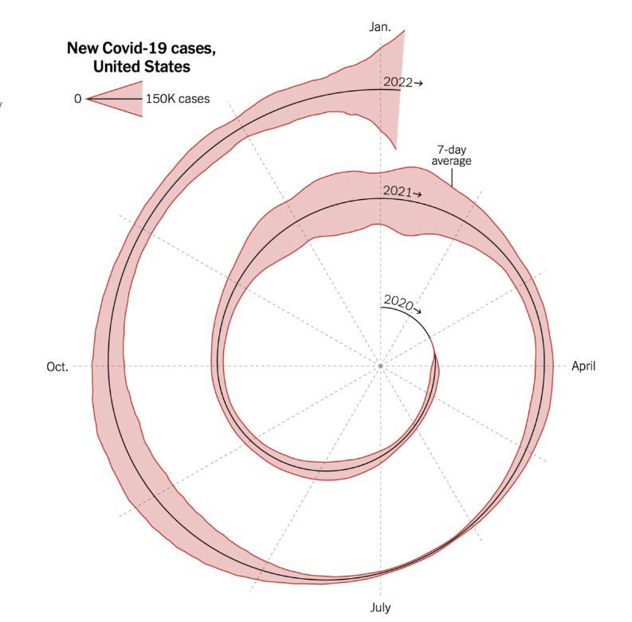
Recap
NYT Storytelling:
"Spiral chart used to convey seasonality (periods) of covid-19 cases through a novel way of presenting the data"
Problems:
Run into difficulty of drill-down specific months/years in the chart, i.e., very little of 2022 is being illustrated
Even though its meant to show an overview of seasonality, the chart is harder to interpret as compared to the typical time-series plot

Slide 4
Suggestions on Visualization 1
Colours could be implemented to each period to break them up and provide better comparison between each period
Since the chart is read from the centre of the spiral, there should be a larger indicator of where a user should begin their initial gaze
The lack of interactivity makes it difficult to drill-down each period’s data points accurately, therefore concepts such as annotation, view manipulation should be implemented
The legend is vague and meaningless. Instead of an area distribution from the center, a bar chart from the origin allows the designer to do a legend with various heights to account for larger/smaller data points.

Slide 5
Solution visualization

Slide 6
What (Data) - “What data the user sees”
The visualisation utilize 2 separate datasets for specific data representation.
Link is the GeoJson file that is used to plot the Hexbin map.
A seven-day rolling average to view new trends
A json file that includes the following data: Daily cases, Daily death, Specific Datetime.
Source: Ourworldindata.org / WashingtonPost

Slide 7
Why (Task) - “User intent to use visualization tools”
The visualization intent is to recreate a dashboard that allows the user to have a quick overview on the topic of Covid-19 cases in United States while providing a more indepth view such as the new cases/death trend and total cases/death.
It features both quick-glance view and a comprehensive view.
Notes:
The dashboard is designed to scroll from top to bottom so that user is able to focus on one visualisation at a time while providing all the necessary information.

Slide 8
How (Idiom) - “How the visualization idioms are constructed”
The dashboard consist of two visualisation:
Hexbin map
Time-Series plot
Each of the visualisation presents different information within the scope of Covid-19. The Hexbin map is used at the top of the dashboard as an overview of cases in the present month, relative to population.
With the use of time series chart we are able to present the flow of the Covid-19 cases, New Case/death Total case/death from Jan 2020 to Jul 2022.

Slide 9
Demonstration

Slide 10
Future improvement
Clearer indicator of the New Case/Death chart
Improving on the Cohesiveness of the dashboard to reduce scrolling

Slide 11
Challenges faced
Integration of leaflet with react
Manipulating to find centroid
Webhooks deployment

Slide 12
Contribution
 | Nili | Alfred | JiaJie
Task | Ideation Development Documentation | Ideation Development Documentation | Ideation Development Documentation

