Slide 1
Visualization Critiques
Milestone 1
Group 6 : Chen Nili (1901883) , Lin Shixuan (1901849), Wu JiaJie (1901828)
Notes:
Pick 2 Visualizations to critique / validate based on data-task-idiom model and suggest improvements
Free to create your own dataset
What dataset is looking at

Slide 2
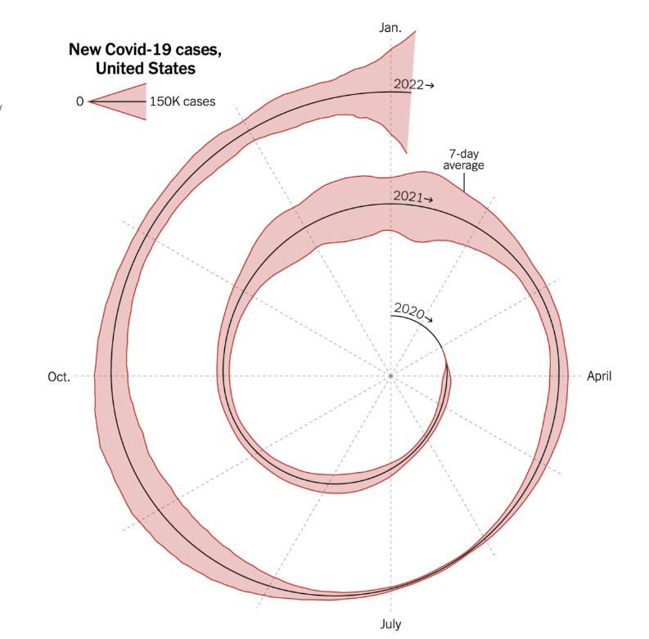
Visualization 1: Coronavirus cases in Spiral Chart
The spiral chart depicts the number of new Covid-19 cases from 2020 to 2022.
Designer incorporates all the months of the year, divided into quadrants on the spiral
The “black line” in the middle of the spiral is not a discriminator, but it draws the outline of the spiral chart vividly. (I.e., backbone)
Clockwise-oriented
Source: https://flowingdata.com/2022/01/07/spiral-graph-to-show-covid-19-cases/

Slide 3
What (Data) - “What data the user sees”
Difficulties
The legend of the chart shows the spike in the number of cases in denominations of 150K but it does not account for other lower denominations
The 7-day average shown in the chart is ambiguous
Notes:
Choosing to critique / validate a good/bad visualization
Death cases base on pp that are fully vaccinated(with booster) , fully vaccinated (without booster) , Non -fully vaccinated
Based on: https://www.nytimes.com/2022/01/06/opinion/omicron-covid-us.html

Slide 4
What (Data) - “What data the user sees”
Difficulties
The month shown are in every quarter, if the user wants to see a specific month they are required to count the months
There are no tooltips provided upon hovering over the visualisation
Notes:
Choosing to critique / validate a good/bad visualization
Death cases base on pp that are fully vaccinated(with booster) , fully vaccinated (without booster) , Non -fully vaccinated
Based on: https://www.nytimes.com/2022/01/06/opinion/omicron-covid-us.html

Slide 5
Why (Task) - “User intent to use visualization tools”
The designer opted for a Spiral Chart representation, which is effective for a time-series data for Covid-19 cases
Characteristics include:
Trend
Seasonality (Day-by-day, period-by-period)
Designer intended to take an artistic route in visualising the covid-19 cases without using a standard linear modelling diagram
The months were split across 12 section, each indicating a month. Despite the spatial restrictions, the designer manage to segment parts of the visualisation to provide more information to the audience
Notes:
As a traveller I would like to view the statistic in graph

Slide 6
How (Idiom) - “How the visualization idioms are constructed”
Expressiveness
The visualisation uses a single colour to represent the entire data flow.
Effectiveness
The accuracy of how many cases are there in a month is very vague as there is no clear indication of the quantitative data.
The visualisation uses month as a Separability principle, however it is still difficult on first glance to locate a specific month and year.

Slide 7
Suggestions on Visualization 1
Colours could be implemented to each period to break them up and provide better comparison between each period
Since the chart is read from the centre of the spiral, there should be a larger indicator of where a user should begin their initial gaze
The lack of interactivity makes it difficult to drill-down each period’s data points accurately, therefore concepts such as annotation, view manipulation should be implemented
The legend is vague and meaningless. Instead of an area distribution from the center, a bar chart from the origin allows the designer to do a legend with various heights to account for larger/smaller data points.

Slide 8
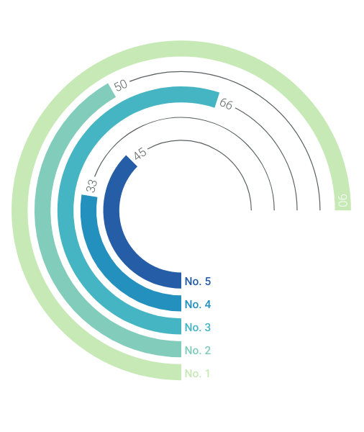
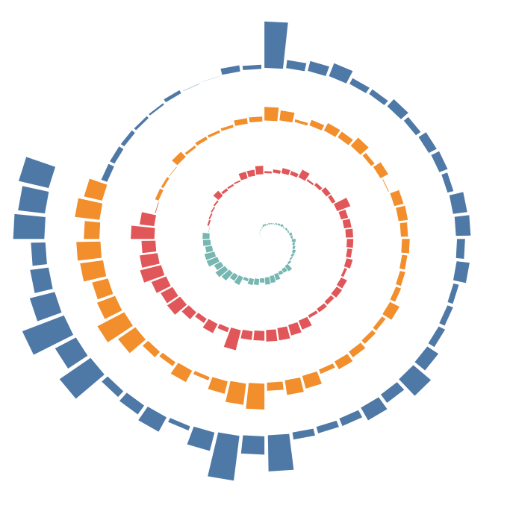
Example Solution for Visualization 1
Spiral Chart with Bar Height to indicate Peak/Lowest point
Radial Chart used to compare different categories, i.e., Infection over Period

Slide 9
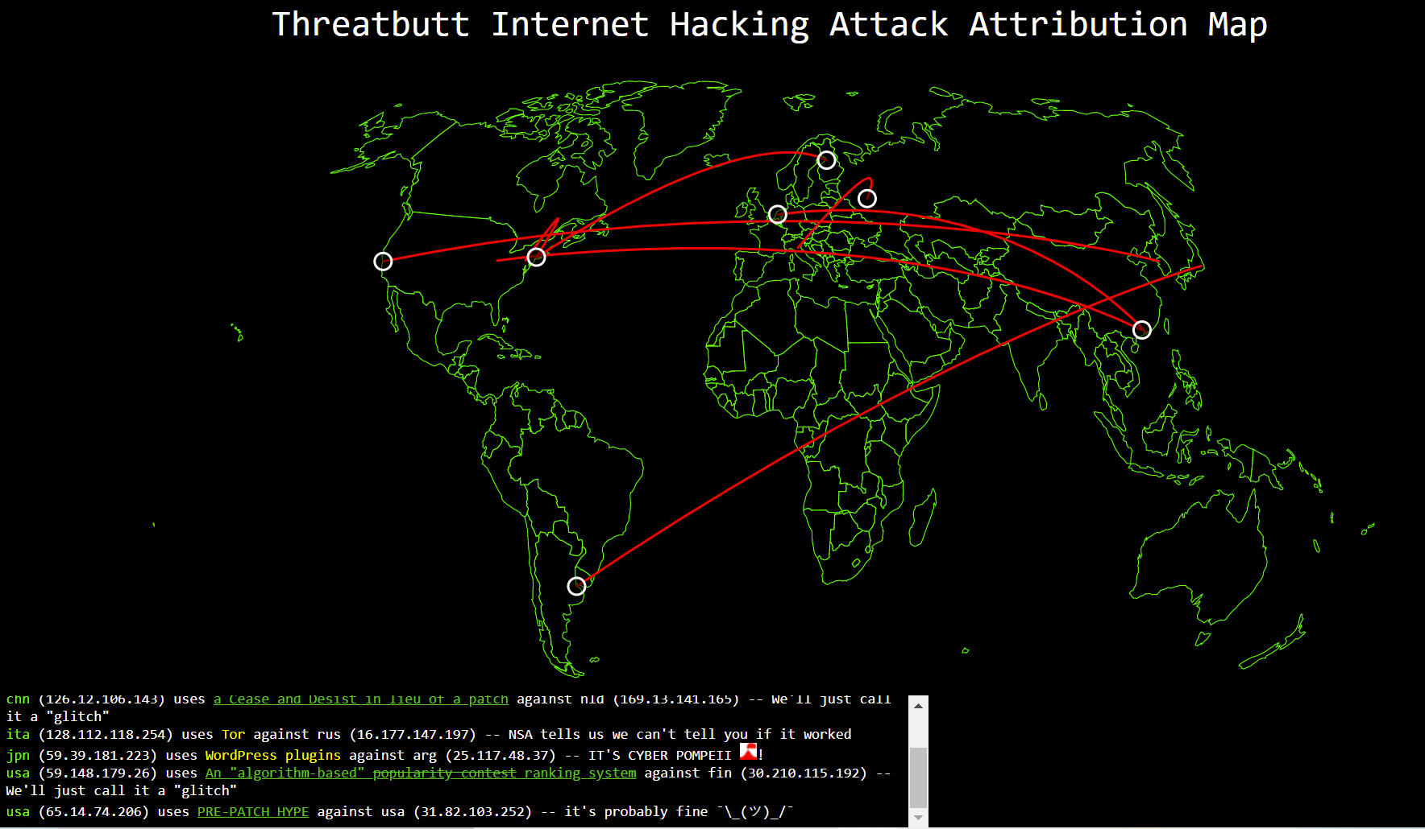
Visualization 2: Internet Hacking Attack Attribution Map
This Internet Hacking Attack Attribution tracks cyber attacks in real time, showing the location and IP address of the source and target of each attack.
It also adds small bits of commentary to indicate the severity of the each attack: Notes such as “We’ll just call it a glitch” indicate small or minor attacks, while things like “It’s cyber Pompeii!” indicate large or widespread attacks.
Source on: https://threatbutt.com/map/
Notes:
This is the visualization 2 that we gonna critique will be the internet hacking attack attribution map \.

Slide 10
What (Data) - “What data the user sees”
Difficulties
The arc line showing in the map only has a red colour, which does not break down the attacks by colour, e.g. red for critical attacks, orange for high severity, blue for medium.
No “hover-over” details on the arc line
The white circle that allows interactivity for user to hover on and view the tooltip. However, the tooltip has a perceived affordance as it disappears at the slightest move of the cursor

Slide 11
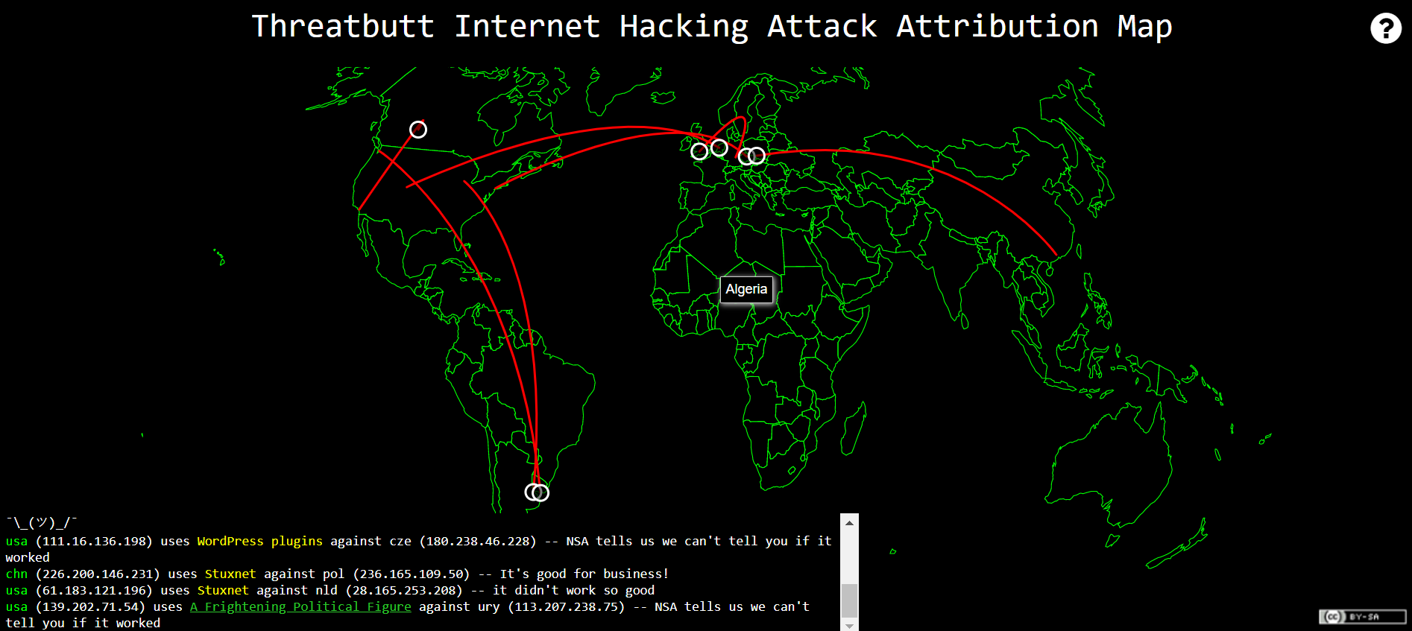
What (Data) - “What data the user sees”
Live attack details like the software is being used to attack with the source, and destination details was shown in a very unclear text format.
Users may see the country name while hovering over it on the map but cannot select it to view more details or zoom in or out on the map.
Notes:
Choosing to critique / validate a good/bad visualization
Death cases base on pp that are fully vaccinated(with booster) , fully vaccinated (without booster) , Non -fully vaccinated

Slide 12
Why (Task) - “User intent to use visualization tools”
The designer wants to design a simple retro-style map. The map and the live feed colour and style look more like a "Command Prompt, " making it very cool and unique.
The designer improve the the user engagement by displaying the severity level for each attack as remark such as "We'll just call it a glitch," indicating small or minor attacks. In contrast, things like "It's cyber Pompeii!" show significant or widespread attacks.

Slide 13
How (Idiom) - “How the visualization idioms are constructed”
Expressiveness
The visualisation uses single color to represent the severity of attack from one country to another.
Effectiveness
The country name displayed in live attack details is in abbreviated form rather than the complete form.
Tooltips and annotation are present, showing encodings of a specific region of the map. However, the usability of the “hover” status is not consistent as it disappears occasionally.

Slide 14
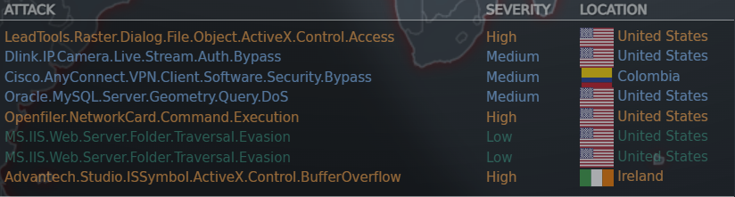
Suggestions on Visualization 2
Different arc line colours indicate the severity level of the attacks.
Live attacks details can be shown in a clear table format.
Hovering over the arc line reveals information on the source and destination country.
The map can be more interactive by allowing users to pick certain countries to see more attack details on the specific country.

Slide 15
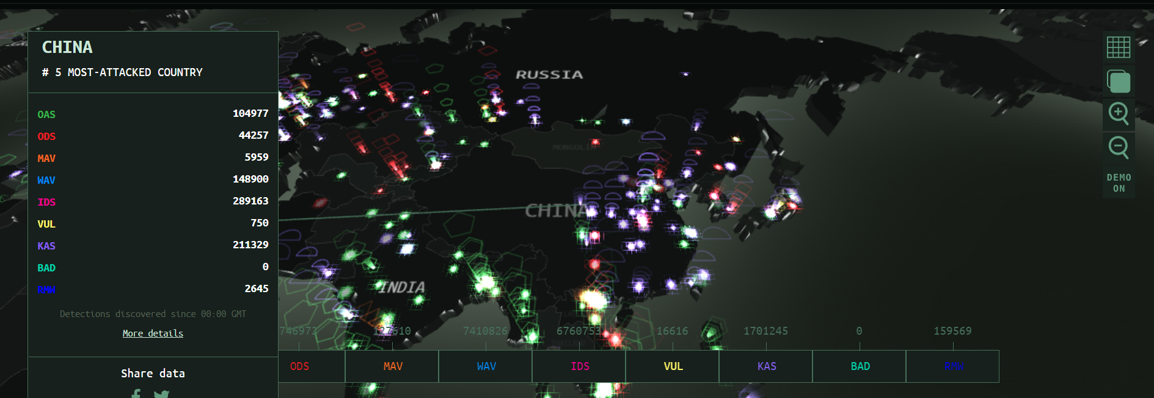
Example Solution for Visualization 2
Kaspersky Real-Time Cyberthreat Map:
Quantifies the type of attack and output on a side panel upon selection

Slide 16
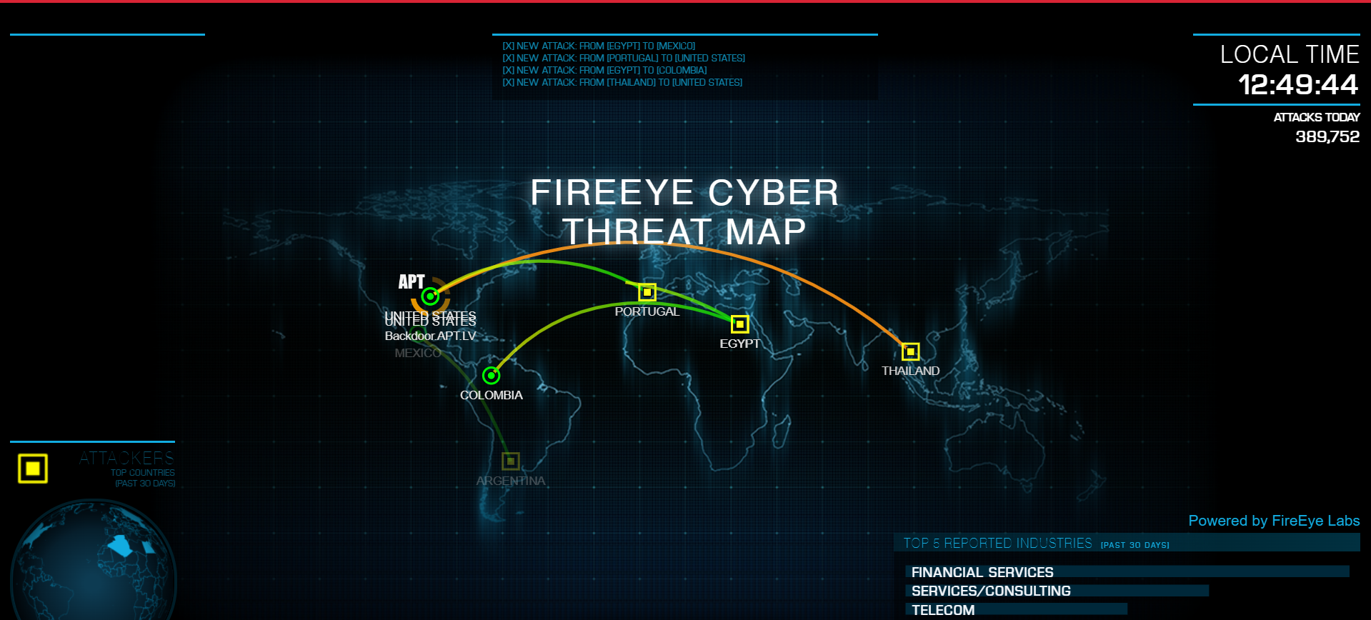
Example Solution for Visualization 2
FireEye Real-Time Threat Map:
Better use of Colours, Distinguish between Attacker/Victim, Severity of Attack Highlighted

Slide 17
THANK YOU !

