Slide 1
Employee Payroll Management System Presented By
Jayashri Shivaji Mankar
Jyoti Babu Pagare
K PavanKumar
Md Faisal
Nikhil Ghadge
Nilima Subhedar
Pallavi Patil
Pulluri Pavani
Sathish K
Uday B C
Vasantha Meruva
Group-2

Slide 2
INDEX
INTRODUCTION
ENVIRONMENT
AUTHENTICATION & AUTHORIZATION
OPERATIONS
SEQUENCE DIAGRAM
ER DIAGRAM
REST APIS TO BE BUILT
OUTPUT PICTURES
REFFERENCES
CONCLUSION

Slide 3
Introduction
Employee payroll management system is basically used to build an application program, that a company uses to manage the records of the employees working in the company.
Only the admin has the legal rights to work with the system. Employees can only log on to the system to see their schedule set by admin, view salary and update profile etc.
The main aim of the project is to pay the employees perfectly Without any delays.

Slide 4
Environment
The system will be developed on any Windows OS machine using J2EE, Hibernate and Spring.
Angular
Server – Apache Tomcat 9
Database – MySQL
JRE 8
Spring Tool Suite
Postman & JUnit

Slide 5
Authentication & Authorization
Authentication:
Any end-user should be authenticated using a unique Email ID and Password.
Authorization:
The operations supported and allowed would be based on the user type. For
example, Administrator has the rights to add employee information and view
employee details. He can also view the employee attendance and leaves details.
Whereas employee can view (Attendance, Time sheet, Salary) and also can update his/her (Profile, Attendance, Leaves).

Slide 6
Operations
Operations
Admin
Employee
Login to Portal
Add/Edit/delete the employees.
Add/Edit/delete the schedule the work.
Add/Edit/delete mark the attendance.
.Add/Edit/delete Leaves and timesheet.
Add/Edit/Delete the Salary.
Login into the application
View his/her schedule set by Admin
View his/her attendance
View Salary
Update Profile

Slide 7
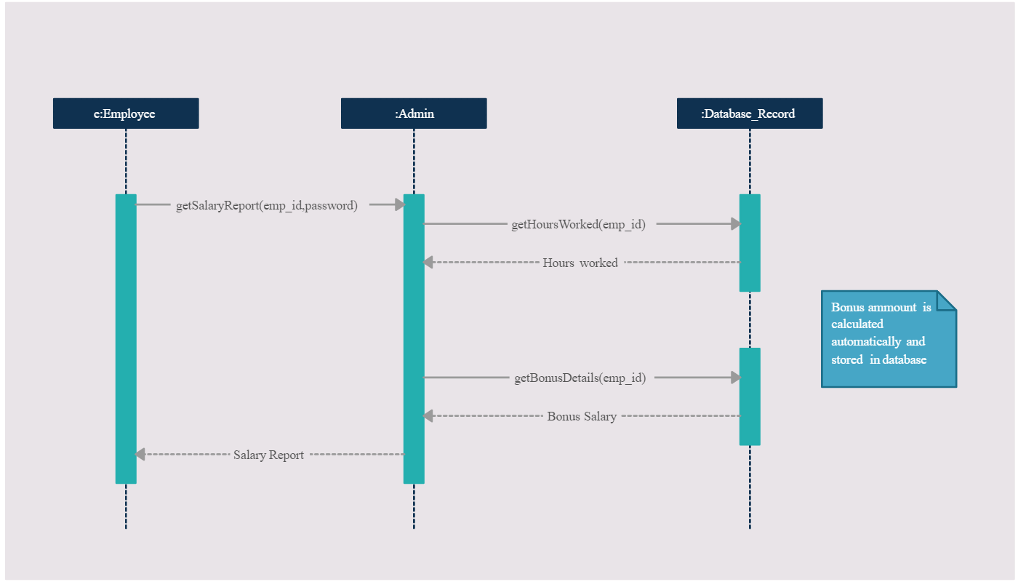
Sequence Diagram

Slide 8
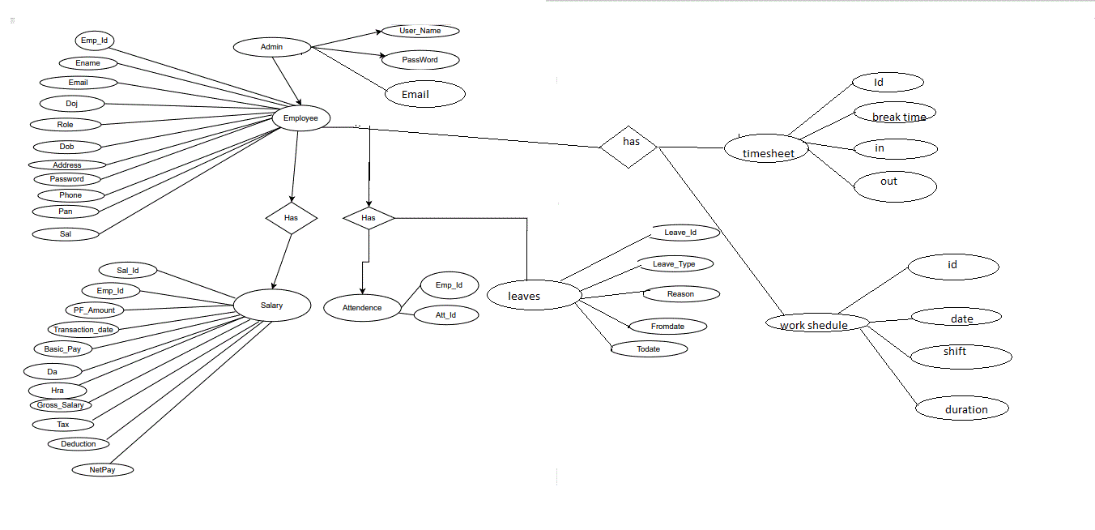
ER Diagram

Slide 9
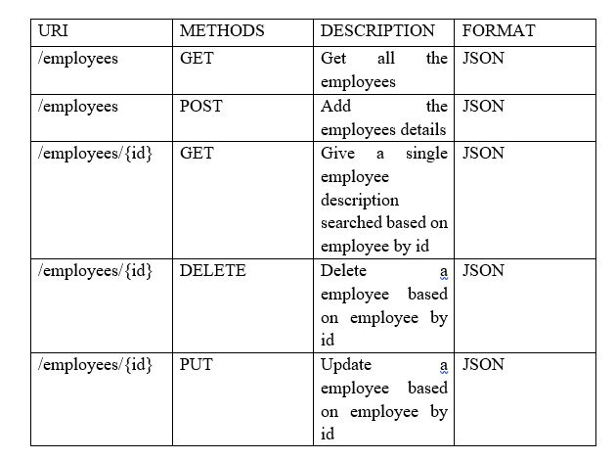
REST APIs to be Built
Employee Entity
a) Will have getAllEmployees method.
b) Add the Employee details method.
c) Will have getEmpById method.
d) Will have deleteEmpById method.

Slide 10
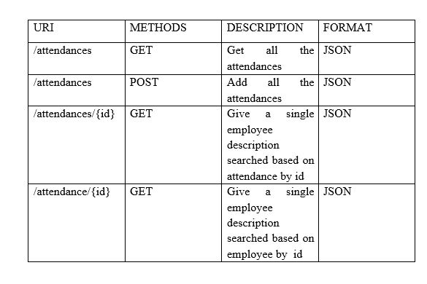
Attendance Entity
a) Will have getAllAttendances method.
b) Add the Attendance details method.
c) Will have getAttendanceById method.
d) Will have getAttendanceByEmployeeId method.

Slide 11
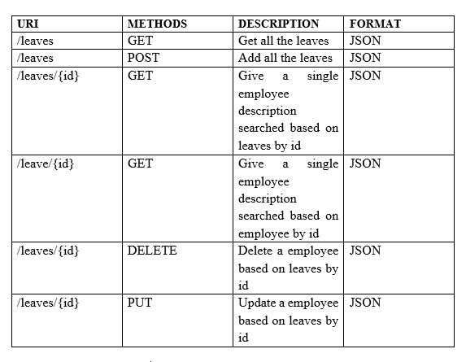
LeaveDetails Entity
a) Will have getLeavesById method.
b) Add the Leaves details method.
c) Will have getAllLeaves method.
d) Will have deleteLeaveById method.
e) Will have fetchLeavesByEmployeeId method.

Slide 12
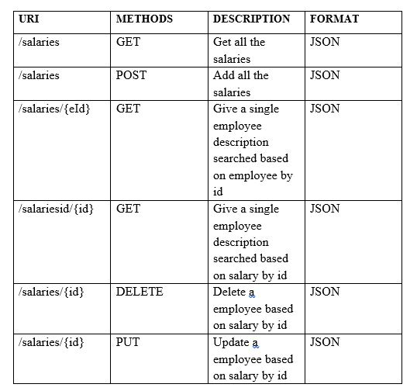
Salary Entity
a) Will have getAllSalaries method.
b) Add the Salary details method.
c) Will have getSalById method.
d) Will have deleteSalById method.
e) Will have fetchSalByEmployeeId method.

Slide 13
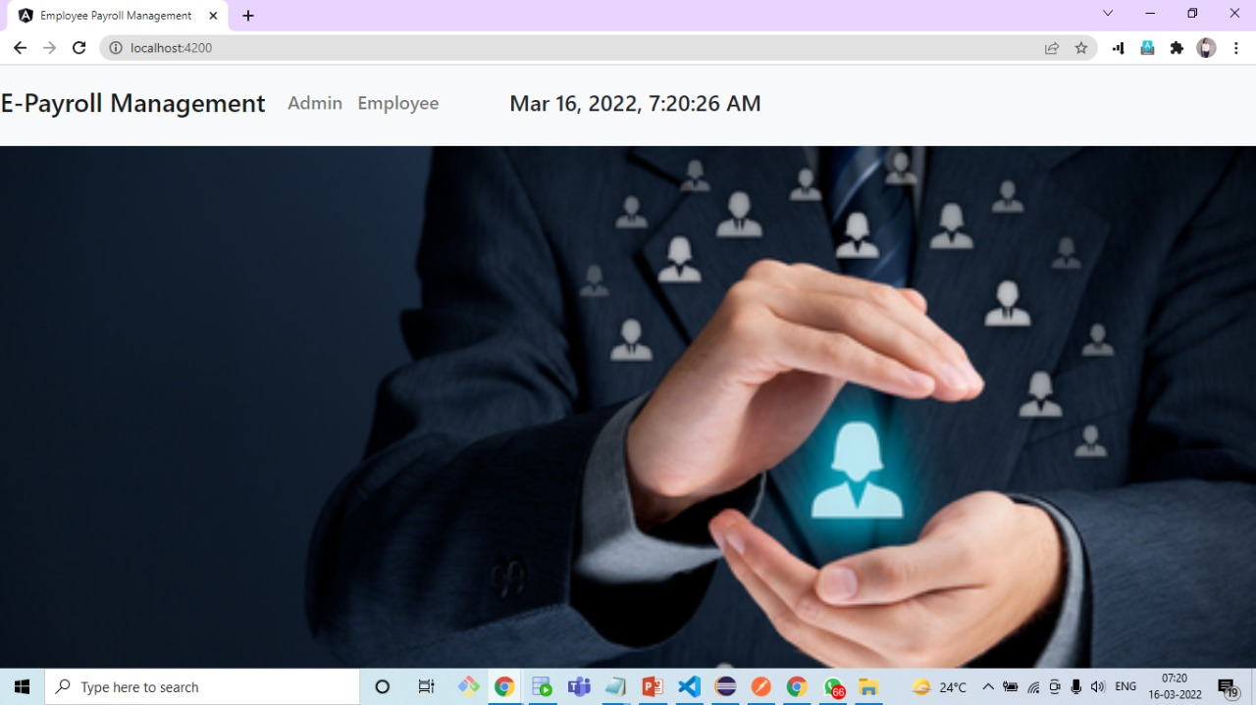
OUTPUT PICTURES

Slide 14
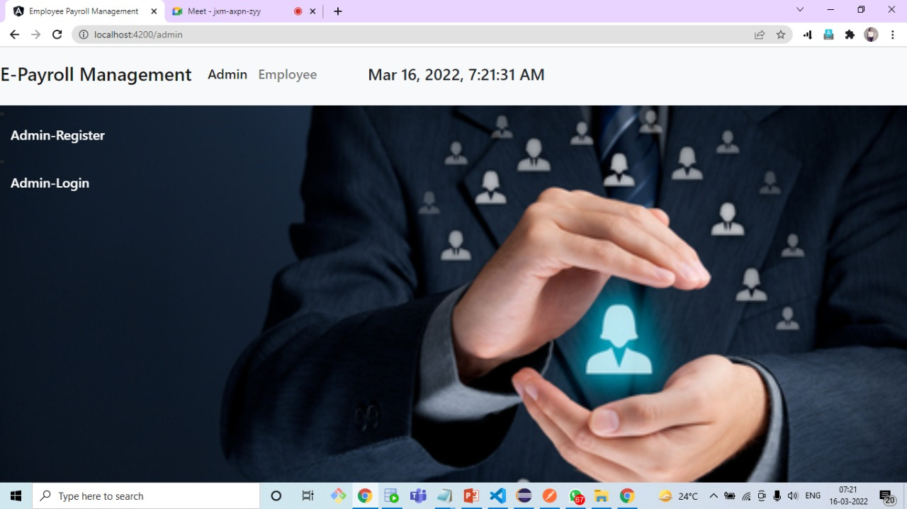

Slide 15
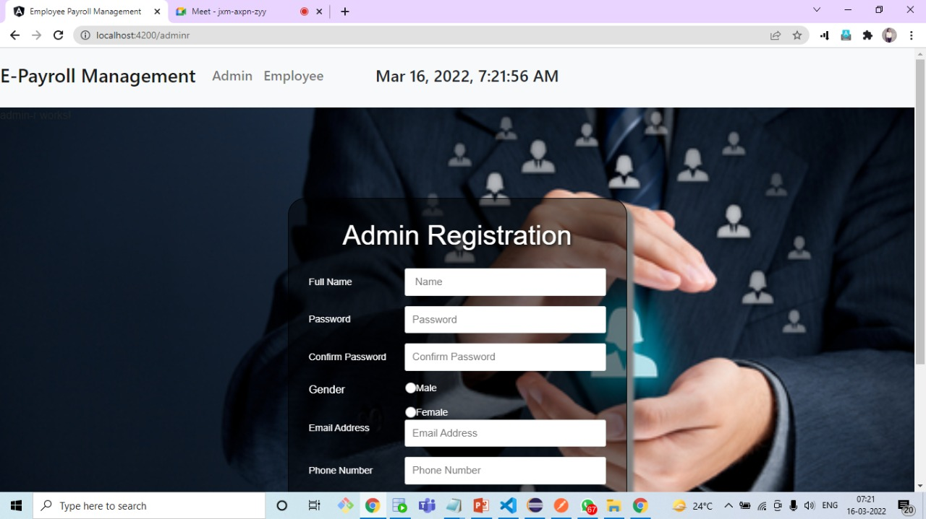

Slide 16
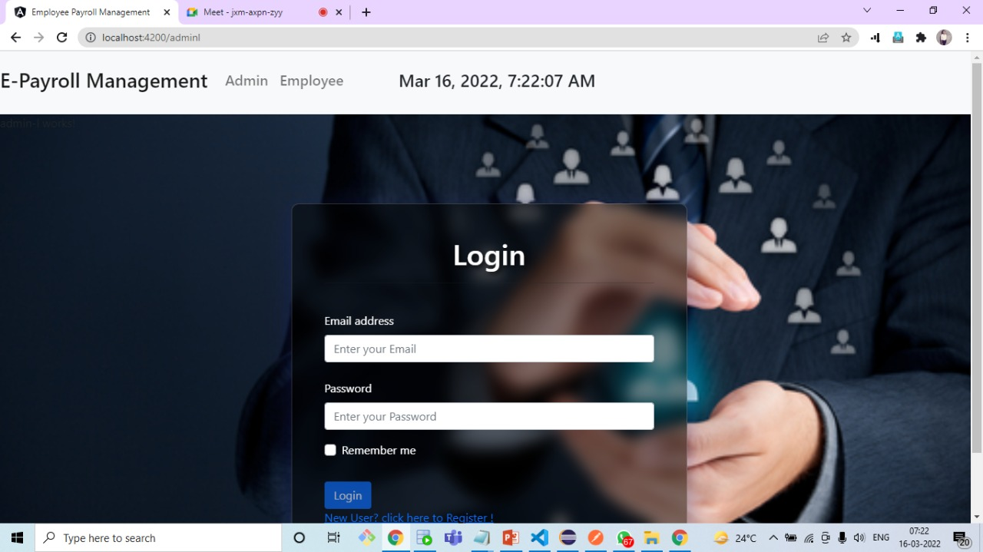

Slide 17
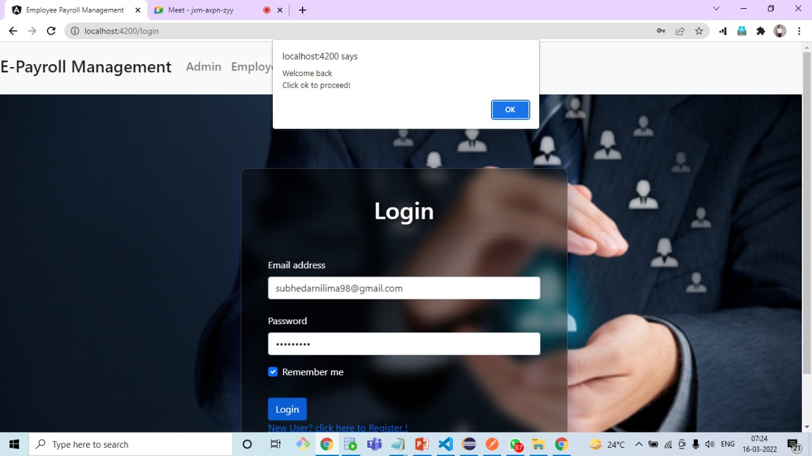

Slide 18
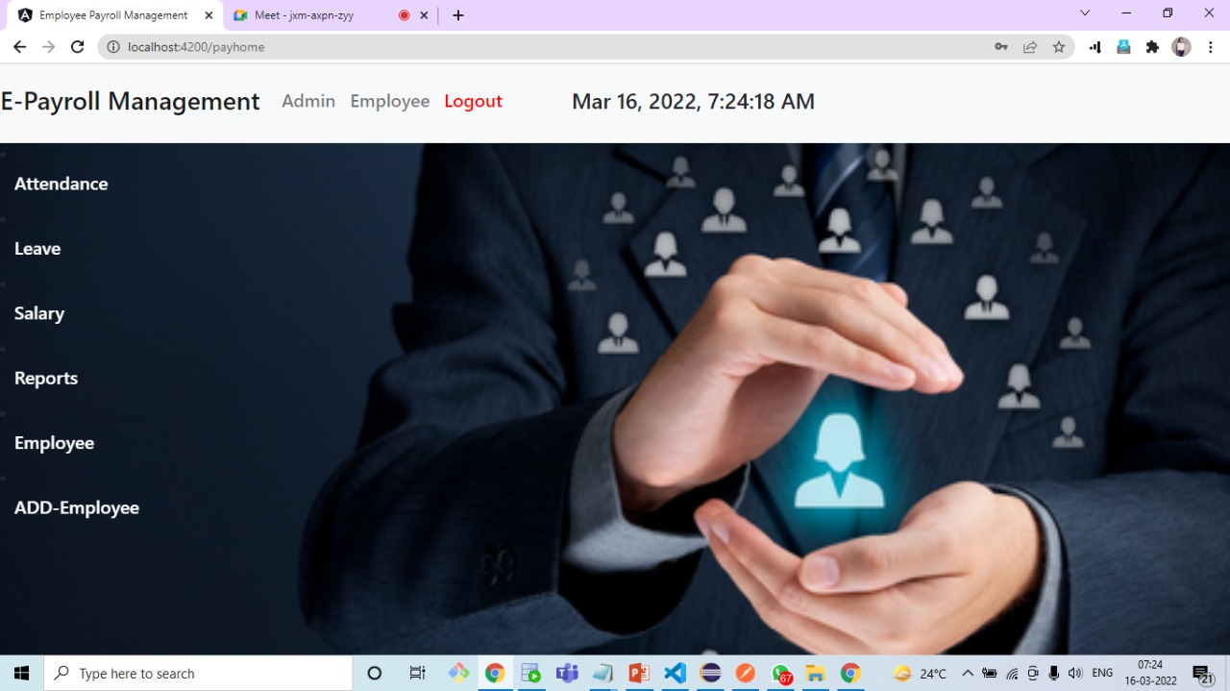

Slide 19
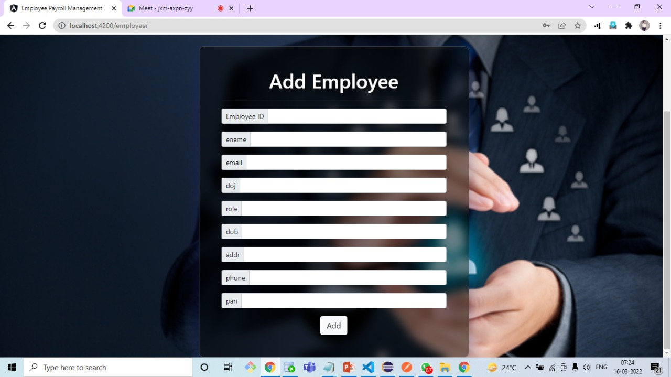

Slide 20
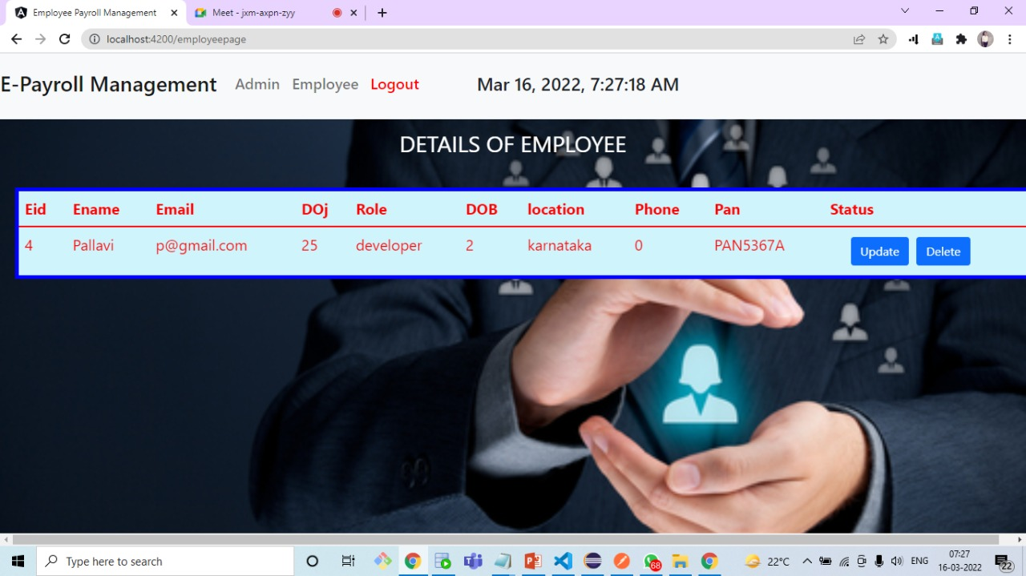

Slide 21
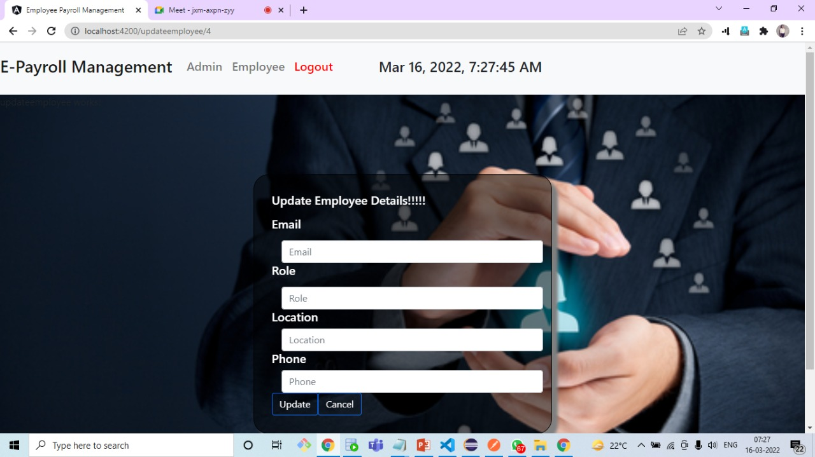

Slide 22
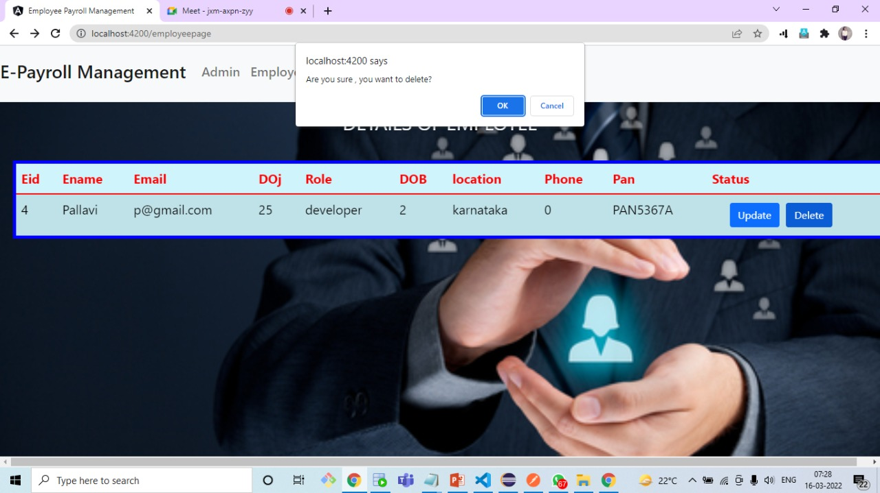

Slide 23
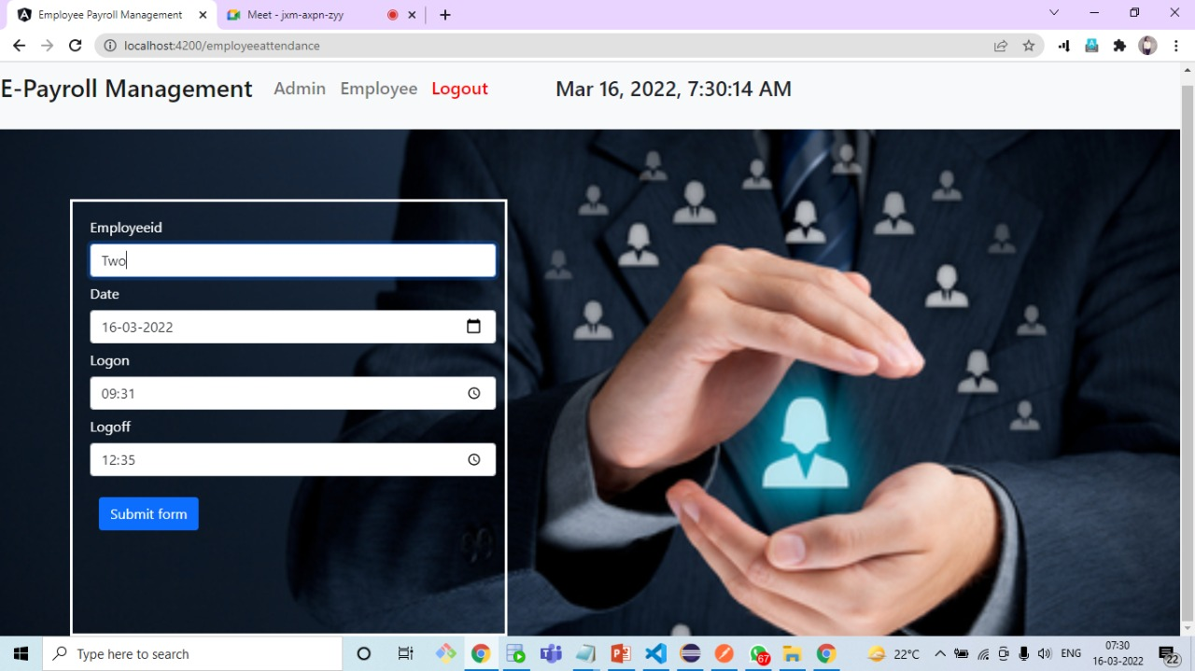

Slide 24
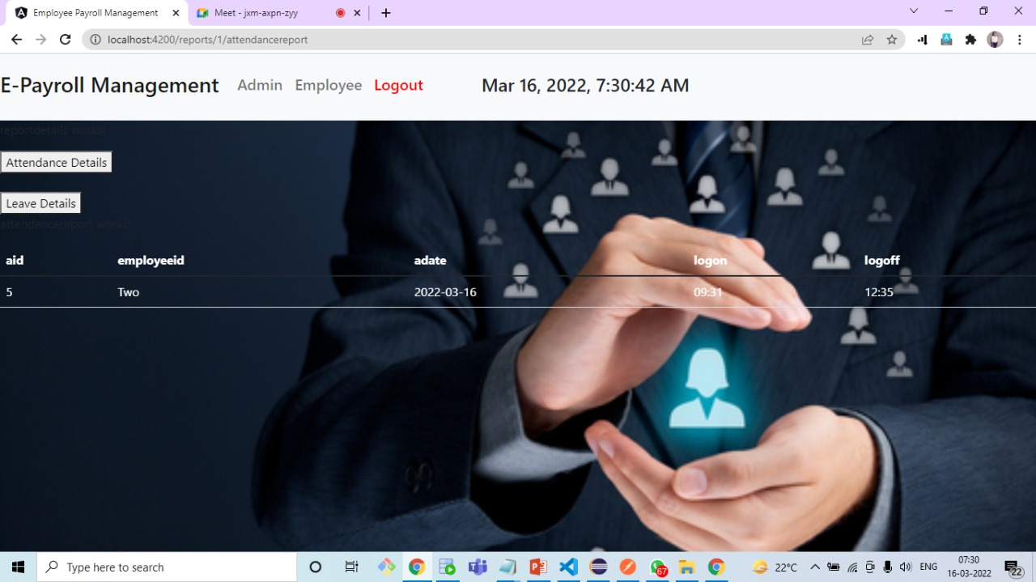

Slide 25
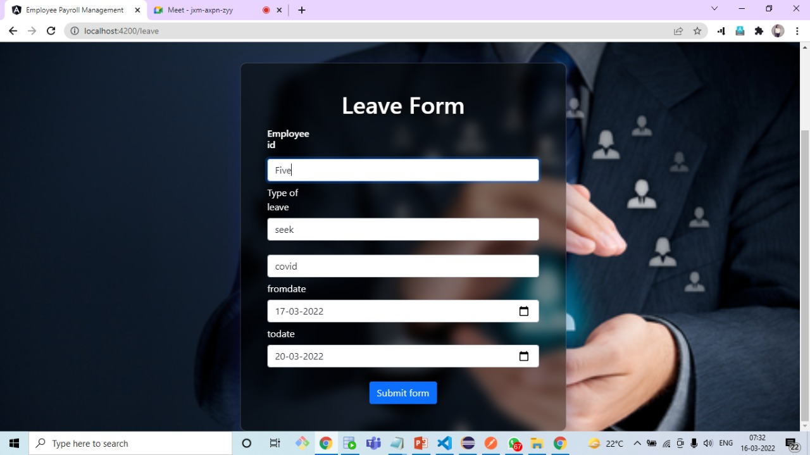

Slide 26


Slide 27
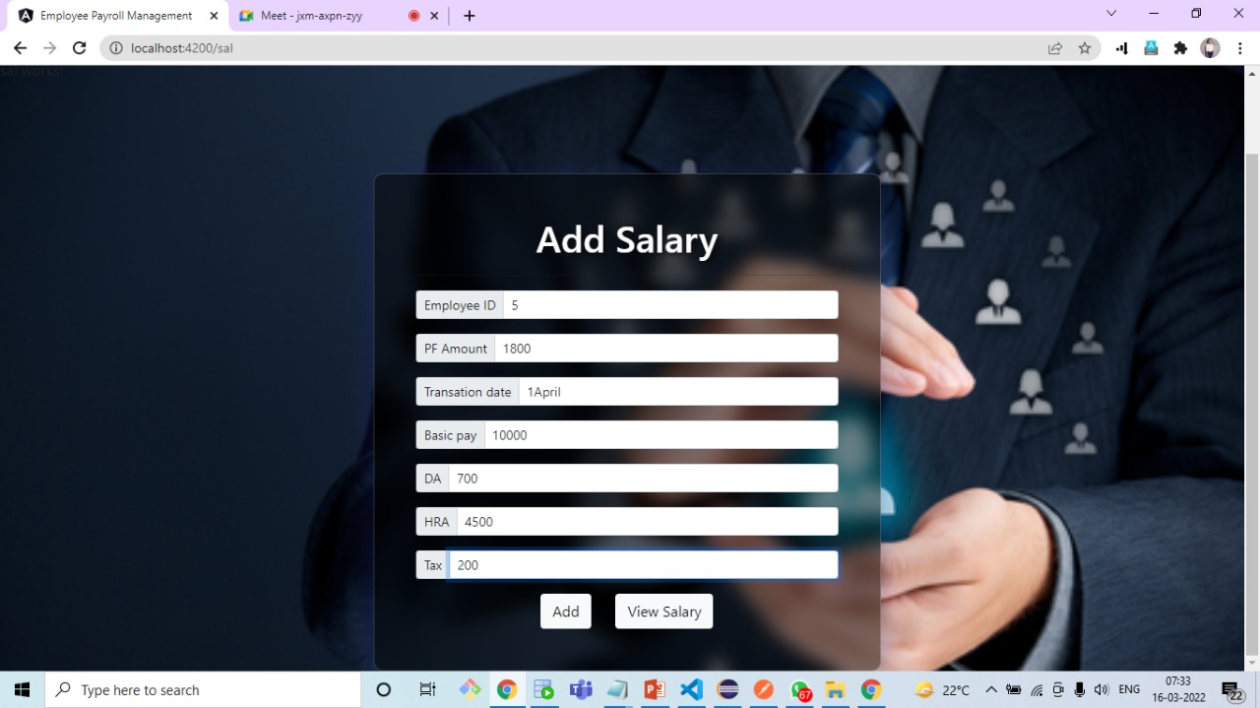

Slide 28
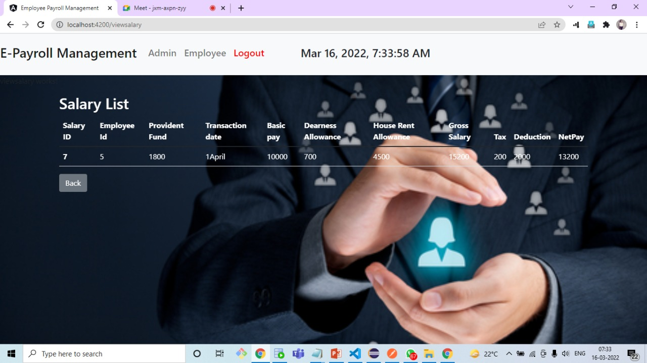

Slide 29
REFFERENCES
[1] Sonal Kasliwal, H.D.Gadade and Sushma Kotkar (2016), Employee Monitoring System , International Journal of Innovative Research in Advanced Engineering (IJIRAE) SSN: 2349-2763, No03, Vol 3, pp. 1-4
[2] Aparna Chandran (2013), Employee Monitoring System, International Journal of Computer Science & Engineering Technology (IJCSET) ISSN: 2229-3345 Vol. 4 No. 04, page 451-452
[3] Shermin Sultana1, Ishrat Jahan Mouri and Asma Enayet1 (2015), A Smart Time And Attendance Tracking System International Journal Of Computer Science, Engineering And Information Technology (Ijcseit), Vol. 5, No.1,

Slide 30
Conclusion
This project is built keeping in mind that it is to be used by only one user that is the admin. According to the requested requirement the admin can add, manipulate, update and delete all employee data in his organization. The required records can be easily viewed by the admin anytime time he wants in an instant. The payment of the employee is based on monthly basis. The main objective of this framework is to save time, make the system cost effective and management records efficiently.
“Payroll Management System” software developed for a company has been designed to achieve maximum efficiency and reduce the time taken to handle the Payroll activity. It is designed to replace an existing manual record system thereby reducing time taken for calculations and for storing data.

Slide 31


