Slide 1

Project Final Defense
On
Typing Speed Test
Prepared by:
Archana Kumari Mandal
Nilima Sardar

Slide 2
Table of content
Introduction
Problem Statement
Objectives
Features
SRS Analysis:
Context Diagram
DFD Level 1
Project Design:
ER Diagram
Implementation:
Technologies used in detail with respect to Project
System Testing:
Test Cases
Gantt Chart
Limitations
Future Enhancement

Slide 3
Introduction
The purpose of this project is to create an interactive typing speed test that can be used to assess and improve typing speed and accuracy.
A typing speed test can be a valuable tool for anyone looking to improve their typing skills, whether for personal or professional reasons.

Slide 4
Problem statement
Reduced productivity
Increased stress
Frustration
Limited job opportunities

Slide 5
Objectives
To help user to type faster.
To help user track their progress.
To help user to retrieve and display user achievements.

Slide 6
Features
Real-time word-per-minute (WPM) calculation.
Randomly generated text for each test.
Language and Level Selection:
A sidebar navigation menu is provided, allowing users to access various sections such as "My Profile”, "Achievements”, "Time Spent”, and "Logout“.

Slide 7
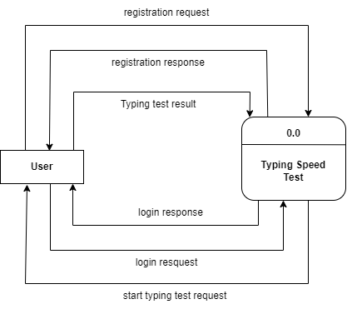
SRS Analysis
Fig: Contex Diagram

Slide 8
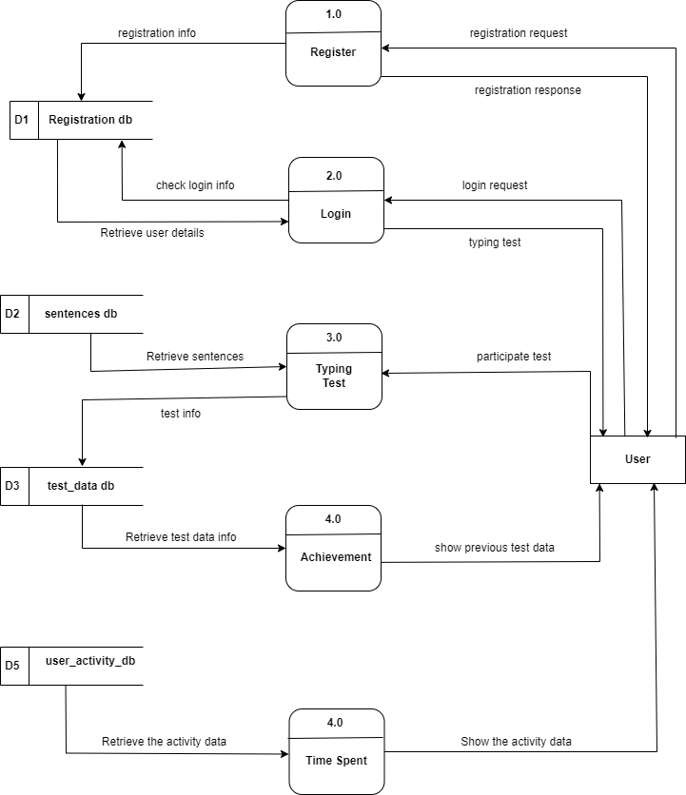
Fig: Level 1 DFD

Slide 9
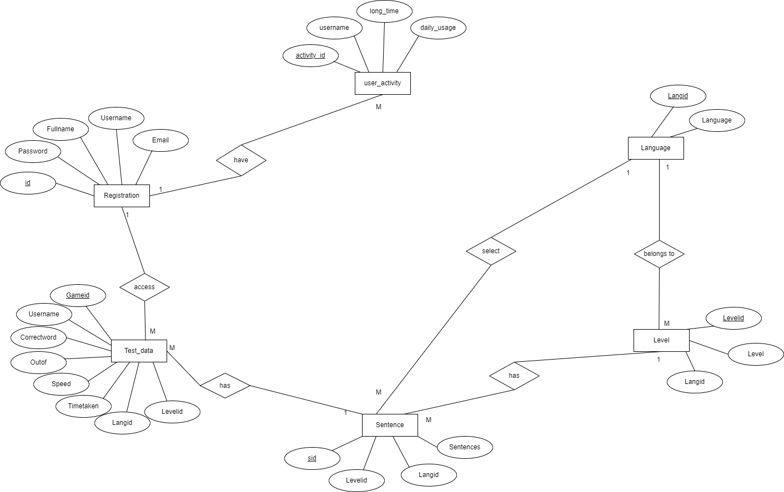
Project Design
Fig: ER Diagram

Slide 10
Implementation
Frontend Tools
HTML 5
CSS 3
JavaScript
Backend Tools
PHP
Server
Apache Server
Case Tool
Font Awesome
VS-code
Draw.io
Database
MYSQL

Slide 11
Gantt Chart
Weeks Work | 1 | 2 | 3 | 4 | 5 | 6 | 7 | 8 | 9
Planning
Requirements Gathering
Design
Implementation
Testing
Documentation
Fig: Gantt Chart

Slide 12
Limitation
While the application may offer randomly generated texts, some users might eventually memorize them, affecting the reliability of the test.
Without user accounts or profiles, users may not have a way to typing test page and to save and track their test results over time.

Slide 13
Future Enhancement
Enhance User Interface.
Leaderboards and Competitions.
Time Slots Management:
Implement features for timed typing tests, allowing users to set their own time limits and track their progress over time.
Multi-Language Support:
Expanding language support would make the application more accessible to a global user base.

Slide 14
Any Queries

