Slide 1
BAMS Hackathon
CaseLens: Persona, Pain and Success Metrics
Persona
- Associate in retail banking / financial operations, Case Managers, Auditors.
Pain
- Case comments are abbreviated (KYC, PEP, LTV, DTI, CBS) across different stages.
- Reviewing multiple cases manually might take considerably longer time.
- Managers need open and stalled counts with average turnaround for a period.
- Auditors need trends and charts, not case-by-case reading.
Success metrics
- Review Time: Considerably faster review time than manual assessment.
- Grounding: 100% of summary lines cite a source (5,808 of 5,808).
- Invented terms refused: 30 of 30. Raw client IDs in output: 0.
- p95 latency: 2.5 seconds per model call.
GitHub Repo: NilkantaBhattacharjee/bams-hackathon-idea

Slide 2
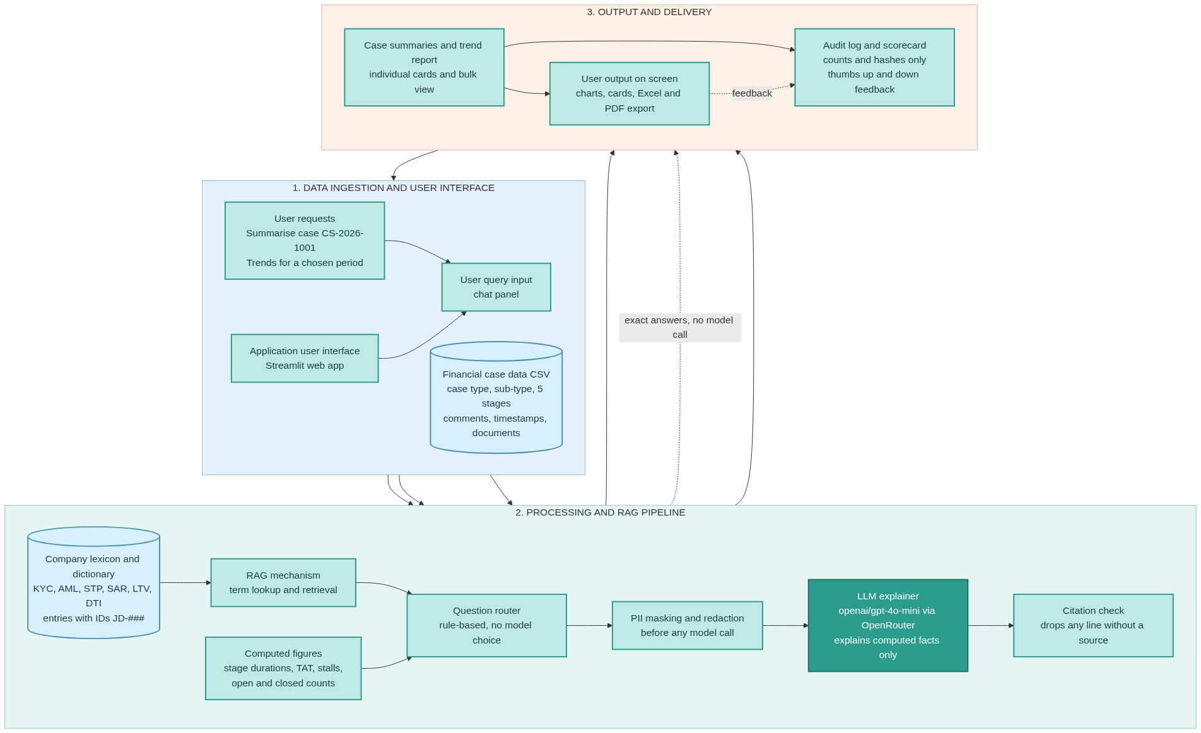

Slide 3
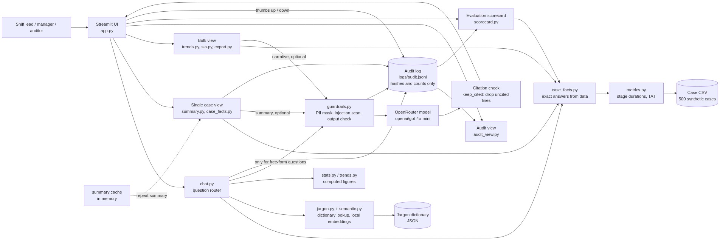
Architecture Flow Diagram

Slide 4
Evaluation Evidence
Check | Target | Result
Grounding (cited summary lines) | 95% or more | 100% (5,808 of 5,808)
Invented terms refused | 100% | 100% (30 of 30)
Raw client IDs in output | 0 | 0
p95 latency per model call | under 5 s | 2.5 s
Live evaluation: summaries | pass | 10 of 10
Live evaluation: chat | pass | 9 of 9
Automated test suite | all pass | 150 of 150
Failure cases fixed: a valid question refused as 'not in glossary'; a time-to-stage answer printing 'nan'. Open: retrieval not measured on real staff questions; feedback not scored.

Slide 5
Risk and Control Notes
Risk | Control in place | Residual
Model invents a definition | Glossary-only answers; 30-term refusal check | Low
Client data sent to model | Masking before every call; personal-data questions refused | Low
Prompt injection | Override-phrase scan; comments treated as data | Low to medium
Uncited claim reaches user | Citation check drops and counts uncited lines | Low
API key exposed | Key in local .env, never logged; key rotated 22 Oct | Low
Users over-trust answers | Decision-support label; thumbs up/down; human decides | Medium
Compliance: all data is synthetic. A real deployment needs a data-protection review, including lawful basis, log retention, and provider data terms.

Slide 6
Cost Estimate and Scalability
Item | Estimate (As per the prototype built)
Model | openai/gpt-4o-mini via OpenRouter
Price used | $0.15 per M input, $0.60 per M output (blended $0.000375 per 1K tokens)
Tokens per summary | about 1,400
Cost per summary | about $0.0005
Cost per 1,000 summaries | about $0.53 (model only)
Infrastructure | Not yet estimated (prototype runs locally)
Scaling: cost grows with summaries requested, not cases stored. Summary cache removes repeat cost. Data moves to the bank's BPM database via read-only connection. Prices must be re-checked before use.

