Slide 1
Project 1
FINA 6333 – Spring 2024 Team 36

Slide 2
Descreptive stastics of returns
metrics | S1_returns | S2_returns | S3_returns | s4_days1 | s4_days2 | s4_days3
mean | 0.000521613 | 0.000380745 | 6.20357e-05 | 0.000503219 | 0.000521344 | 0.000530859
Variance | 0.000119996 | 8.11694e-05 | 3.94367e-05 | 0.000111342 | 0.000106289 | 0.000101925
Standard deviation | 0.0109543 | 0.0090094 | 0.00627986 | 0.0105519 | 0.0103096 | 0.0100958
kurtosis | 1.70486 | 2.13497 | 3.12226 | 1.06971 | 0.981473 | 0.901483
skewness | -0.154435 | -0.0555907 | 0.046007 | -0.256772 | -0.231452 | -0.212529
sharpe ratio | 0.508624 | 0.370213 | -0.274522 | 0.500347 | 0.540013 | 0.566414

Slide 3
Mean Returns:
The mean return shows average return of asset throughout the period. Strategy 1 yields the highest mean return, followed by Strategy 4 (over all day windows). This suggests that Strategy 1 has higher average returns than the others.

Slide 4
Variance and Standard Deviation:
These metrics indicate the risk or volatility associated with each strategy. Strategy 3 has the lowest variance and standard deviation, implying that it is the least risky, while S1 is the most volatile. Lower variance in Strategy 3 indicates more stable returns, but at the expense of lower average returns.

Slide 5
Kurtosis and Skewness:
Strategy 3 has the highest kurtosis, indicating a greater likelihood of extreme returns (either very high or very low) than a normal distribution. The skewness values show that Strategy 1, Strategy 4 (across all days), and Strategy 2 returns are slightly skewed to the left (negative skewness), while S3 has a slight right skew (positive skewness), indicating a tendency for more frequent positive outliers.

Slide 6
Sharpe Ratio:
This ratio compares the performance of an investment to a risk-free asset after accounting for risk. A higher Sharpe ratio suggests better risk-adjusted returns. Strategy4_days3 has the highest Sharpe ratio, indicating that it provides the best risk-adjusted returns among the strategies.

Slide 7
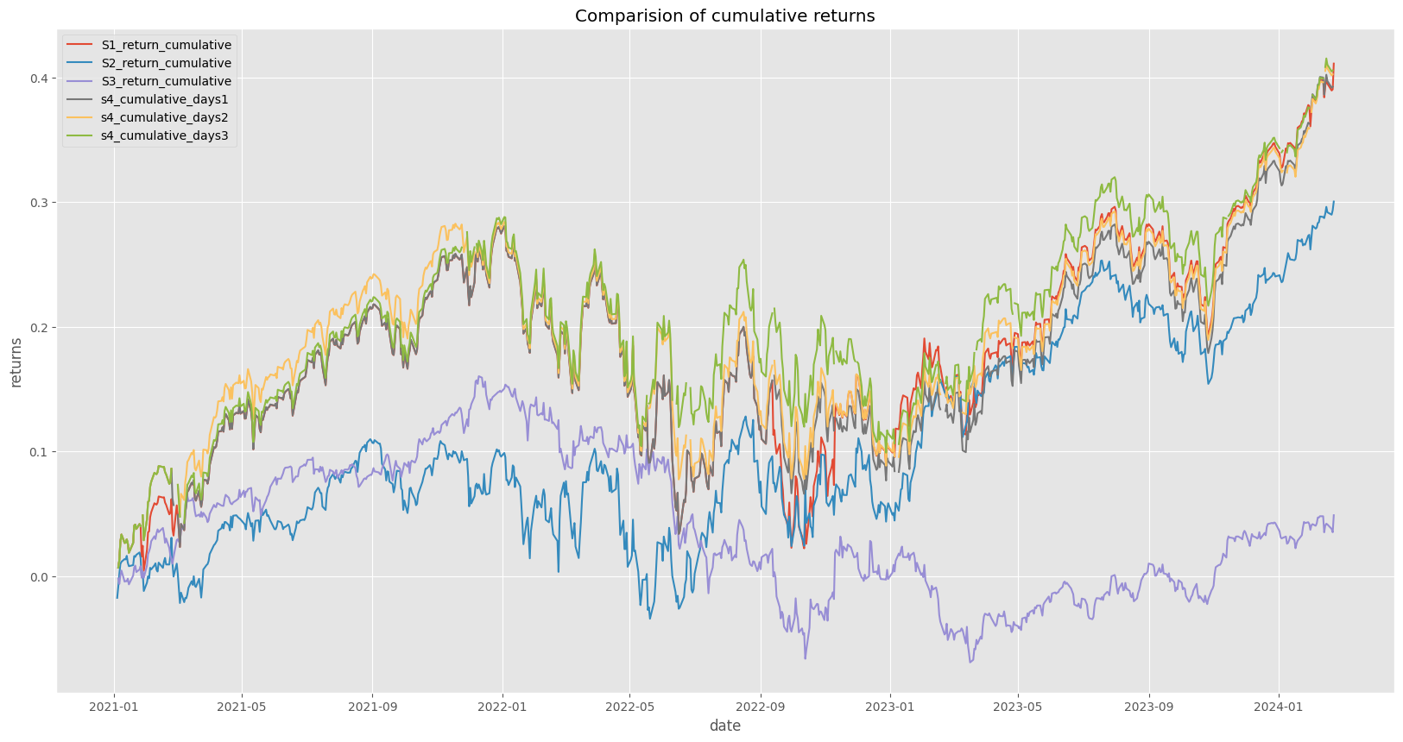
Interpretation of cumulative returns
The cumulative returns graph visually represents the total return over time for each strategy, providing a straightforward comparison of their performance. Strategies showing a steeper slope upwards are delivering better returns over the period analyzed. As we can see Strategy 4 and strategy 1 has outperformed other strategies.

Slide 8
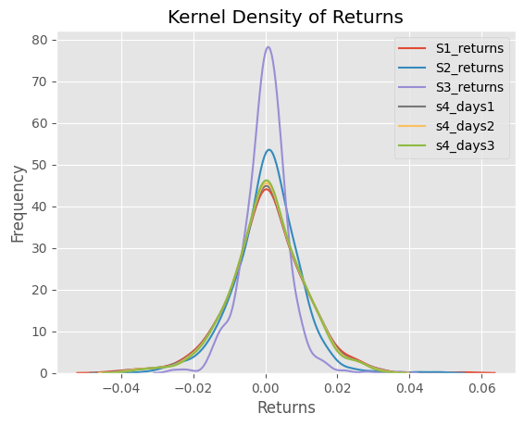
Interpretation of Kernel density plot
Kernel density plot represent the distribution of returns. Risk-averse investors tend to prefer strategies with narrower spreads and higher peaks (such as Strategy 3 and Strategy4_days3) because they suggest lower volatility and more predictable performance. Risk-seeking investors who are willing to accept more uncertainty in exchange for higher returns may prefer strategies with wider spreads (such as Strategy 1).
Overall, Strategy3 and the Strategy4 composite strategy evaluated on day 3 appear to offer a good risk-reward balance, with Strategy3 being the most conservative and Strategy4_days3 having a slightly riskier profile but potentially higher returns.

Slide 9
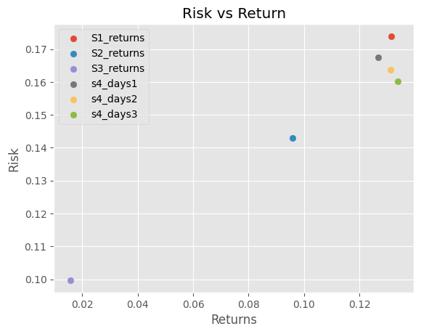
risk return tradeoff
Six strategies (Strategy1, Strategy2, Strategy3, Strategy4_days1, Strategy4_days2, and Strategy4_days3) are displayed in a scatter plot with returns on the x-axis and risk on the y-axis. Higher returns are generally desired, but they frequently entail greater risk. Striking a balance between a reasonable degree of risk and the need for greater returns is the trade-off.
Although it isn’t the lowest on the plot, the strategy designated as s4_days3 appears to have the highest return with a moderate amount of risk and is well-balanced in light of its return. Although it isn’t at the very top, its placement in the upper right quadrant suggests a higher return without the highest risk, which may be appealing.

Slide 10
Value at risk(VaR)
confidence | S1_returns | S2_returns | S3_returns | s4_days1 | s4_days2 | s4_days3
0.9 | -0.0124803 | -0.0107961 | -0.00728079 | -0.0122967 | -0.012041 | -0.0118236
0.95 | -0.0173207 | -0.0150449 | -0.011212 | -0.0167693 | -0.0164642 | -0.0158843
0.99 | -0.0298092 | -0.0245742 | -0.0151905 | -0.0290971 | -0.0289709 | -0.0282886
It represents the maximum loss that can be expected over a given time period and confidence level. Strategy3 consistently has the lowest VaR across all confidence levels, indicating the lowest expected loss in adverse market conditions.

Slide 11
conditional value at risk(CVaR)
confidence | S1_returns | S2_returns | S3_returns | s4_days1 | s4_days2 | s4_days3
0.9 | -0.0198611 | -0.0166415 | -0.00747038 | -0.0144656 | -0.0149406 | -0.0151797
0.95 | -0.0249339 | -0.020238 | -0.00853434 | -0.0181663 | -0.0186956 | -0.0188489
0.99 | -0.0366529 | -0.0291582 | -0.0102922 | -0.0262316 | -0.0268309 | -0.0269983
The Conditional Value at Risk (CVaR) is an average of losses that exceed the VaR threshold. Strategy3, like VaR, has the lowest CVaR, indicating that in worst-case scenarios (beyond the VaR threshold), Strategy3’s losses will be less severe than those of the other strategies.

Slide 12
Real-world Limitations
Market Conditions: The performance metrics are historical, so they may not accurately predict future returns. Market conditions change, and successful strategies may no longer be effective in the future.
Liquidity Risk: Certain strategies may experience liquidity issues, limiting their ability to execute trades at desired prices for intraday strategies.

Slide 13
Real-world Limitations
Transaction Costs: It can have a significant impact on net returns, particularly for frequent trading strategies.
Model Risk: The assumptions used to calculate VaR and CVaR may not be accurate in all market conditions, resulting in under or overestimation of risk measures.

Slide 14
Best Overall Strategy
Given the trade-off between returns and risk, Strategy4_days3 appears to be the best overall strategy. It has higher mean returns (compared to the highest), the best Sharpe ratio (indicating superior risk-adjusted returns), and reasonable risk metrics (VaR and CVaR) than the others. However, the choice of the “best” strategy is also determined by the investor’s risk tolerance, investment horizon, and specific objectives.
The reason s4_days3 is beneficial is that it provides a greater return at a moderate risk. Although it is not the strategy with the lowest risk in absolute terms, it successfully manages risk and return.

Slide 15
Conclusion
In conclusion, while Strategy4_days3 produces promising results based on the analysis, investors should consider real-world constraints and their personal investment profile before implementing any strategy. Continuous monitoring and adjustment in response to changing market conditions are also required to ensure the effectiveness of any investment strategy.

