Slide 1
Synchronization Primitives.
Outline.
1. Introduction.
2. Critical Section Problem.
3. Synchronization Primitives.
4. Issues.
5. More Synchronization Primitives by Sumedh.

Slide 2
Synchronization.
Synchronization allows concurrent threads of execution to communicate and coordinate information about their relative state.
Two Types
1. Mutual Exclusion:
Ensures that a group of atomic actions, called a critical section, cannot be executed by more than one thread at a time.
That is, a critical section must be executed as an atomic action.
2. Conditional Synchronization:
Ensures that the state of a program satisﬁes a particular condition before some action occurs.
Example: Withdrawal and Deposit from bank account.
Here The list must not be in an empty condition when method withdraw is allowed to remove an item, and mutual exclusion is required for ensuring that deposited items are not lost and are not withdrawn more than twice.

Slide 3
Critical Section Problem
A code segment that accesses shared variables (or other shared resources) and that has to be executed as an atomic action is referred to as a critical section.
The critical section problem involves a number of threads that are each executing the following code:
while (true) {
Entry-section
critical section // accesses shared variables or other shared resources.
exit-section
noncritical section // a thread may terminate its execution in this section.
}
The entry- and exit-sections that surround a critical section must satisfy the following correctness requirements.

Slide 4
Critical Section Problem
A code segment that accesses shared variables (or other shared resources) and that has to be executed as an atomic action is referred to as a critical section.
The critical section problem involves a number of threads that are each executing the following code:
while (true) {
Entry-section
critical section // accesses shared variables or other shared resources.
exit-section
noncritical section // a thread may terminate its execution in this section.
}
The entry- and exit-sections that surround a critical section must satisfy the following correctness requirements.

Slide 5
Correctness Requirements for Critical Section Problem.
1. Mutual Exclusion - If process P_{i} is executing in its critical section, then no other processes can be executing in their critical sections
2. Progress - If no process is executing in its critical section and there exist some processes that wish to enter their critical section, then the selection of the processes that will enter the critical section next cannot be postponed indefinitely
3. Bounded Waiting - A bound must exist on the number of times that other processes are allowed to enter their critical sections after a process has made a request to enter its critical section and before that request is granted
Assume that each process executes at a nonzero speed
No assumption concerning relative speed of the N processes.
Absence of Deadlock, Livelock and starvation.

Slide 6
Synchronization Primitives.
Semaphores.
Locks (mutual exclusion)‏.
Condition variables.
Monitors.

Slide 7
Semaphores
A counting semaphore is a synchronization object that is initialized with an integer value and then accessed through two operations, named P and V or down and up or wait and signal.
Consider a semaphore s.
Initialized to 1 with an empty queue.
P(s): If s>0 then decrement s. Otherwise, block the thread that attempted to perform P(s).
V(s): If another thread is blocked on a call to P(s), unblock it. Otherwise, increment s.
Thread-1 Thread-2 Thread-3
s.P(); s.P(); s.P();
/*Use resource*/ /*Use resource*/ /*Use resource*/
s.V(); s.V(); s.V();

Slide 8
Semaphores
Example:
Before entering critical section, execute P(s).
  If no other thread is in critical section, s will have value 1, so it will be decremented and thread can enter into critical section.
  Otherwise, thread blocks.
When exiting critical section, execute V(s).
If other threads are blocked on s, unblock one of them that are in the waiting queue. That thread can now enter the critical section.
If no other threads are waiting, s is incremented to take on value 1. This will allow another thread to enter without blocking at some point in the future.
Public void P(){
  if(permit > 0) permit --;
  else wait until permit becomes positive.
}
Public void V(){ Permit++; //Return permit to the pool. }

Slide 9
Binary Semaphore and Locks.
Mutex as a counting Semaphore or binary semaphore.
A binary semaphore must be initialized with the value 1 or 0, and the completion of P() and V() operations must alternate
Lock – Synchronization object used to solve the critical section problem. (Locks can provide mutual exclusion but not condition synchronization.)
The operations on a lock are named lock() and unlock().
semaphore named mutex is initialized with the value 1
Thread1 Thread2
mutex.P(); mutex.P();
/* critical section */ /* critical section */
mutex.V(); mutex.V();
mutexLock mutex;
Thread1 Thread2
mutex.lock(); mutex.lock();
/* critical section*/ /* critical section*/
mutex.unlock(); mutex.unlock();

Slide 10
Binary Semaphore and Locks.
Consider locks on doors that have only one key. Someone obtains key, is able to unlock (“acquire”) the lock. Others must wait for the key to be released before they can unlock the lock themselves.
Locks can be implemented using semaphores.
The owner for successive calls to lock() and unlock() must be the same thread. But successive calls to P () and V () can be made by different threads.
Since locks are more ﬂexible when it comes to calling methods, we will typically use locks instead of semaphores to create lockable objects

Slide 11
Bounded-Buffer Problem
Just the producer-consumer problem
Size n buffers, each can hold one item
Semaphore fullSlots initialized to the value 0
Semaphore emptySlots initialized to the value n.

Slide 12
Example: Bounded buffer using Semaphore.
int buffer[ ] = new int[n];
countingSemaphore emptySlots(n);
countingSemaphore fullSlots(0);
Producer {
int in = 0;
int item;
/* produce item */
/*Wait if there is no empty slot*/
emptySlots.P();
buffer[in] = item;
in = (in + 1) % n;
/*Signal that slot was filled*/
fullSlots.V();
}
Consumer {
int out = 0;
int item;
/*Wait if there are no full slots*/
fullSlots.P();
item = buffer[out];
out = (out + 1) % n;
/*Signal that slot was emptied*/
emptySlots.V();
/* consume item */
}

Slide 13
Implementation Available in C++
Java – built-in synchronization constructs, likes wait, notify and synchronized.
Win32 - Win32 provides four types of objects that can be used for thread synchronization:
Mutex
CRITICAL SECTION
Semaphore
Event
PTHREADS:
Mutex
POSIX Semaphore

Slide 14
Monitors
Monitors support data encapsulation and information hiding and are adapted easily to an object oriented environment.
Def: A monitor encapsulates shared data, all the operations on the data, and any synchronization required for accessing the data.
A monitor has separate constructs for mutual exclusion and condition synchronization. In fact, mutual exclusion is provided automatically by the monitor’s implementation.
A monitor has an entry queue to hold the calling threads that are waiting to enter the monitor.
Condition synchronization is achieved using condition variables and operations wait() and signal().

Slide 15
Monitors
Important feature of monitors beyond encapsulation is introduction of condition variables.
Condition variables allow threads to signal each other.
Beyond simple lock semantics.
Condition variable signaling:
  A thread may be executing within a monitor routine and reach a state where it must block and yield the monitor to allow another thread to access it so it can later pick up where it left off and continue.

Slide 16
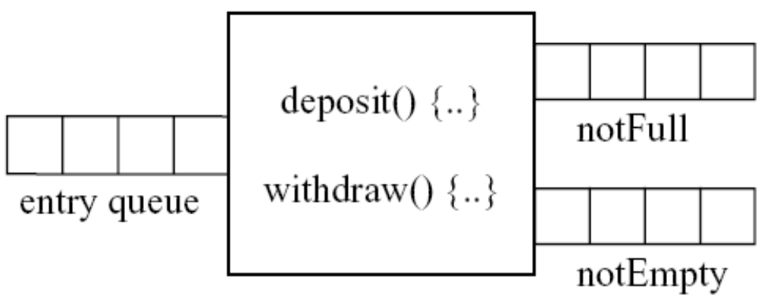
Monitor Example – Bounded Buffer
Entry queue and the queues associated with condition variables notFull and notEmpty.
A thread that is executing inside a monitor method blocks itself on condition variable cv by executing CV.Wait(). Example: notEmpty.Wait() and notFull.Wait().
A thread blocked on condition variable cv is awakened by the execution of
cv.signal(). Example: notEmpty.signal() and notFull.signal().

Slide 17
Monitor Example – Bounded Buffer
class boundedBuffer extends monitor
{
private int fullSlots = 0; // number of full slots in the buffer
private int capacity = 0; // capacity of the buffer
private int[] buffer = null; // circular buffer of ints
private int in = 0, out = 0;
private conditionVariable notFull = new conditionVariable();
private conditionVariable notEmpty = new conditionVariable();
public boundedBuffer(int bufferCapacity ) {
capacity = bufferCapacity;buffer = new int[bufferCapacity];
}
public void deposit (int value) {
while (fullSlots == capacity)
notFull.wait();
buffer[in] = value;
in = (in + 1) % capacity; ++fullSlots;
notEmpty.signal(); //alternatively
if (fullSlots == 1)
notEmpty.signal();
}
public int withdraw() {
int value;
while (fullSlots == 0)
notEmpty.wait();
value = buffer[out];
out = (out + 1) % capacity; --fullSlots;
notFull.signal(); //alternatively:
if (fullSlots == capacity–1) notFull.signal();
return value; }

Slide 18
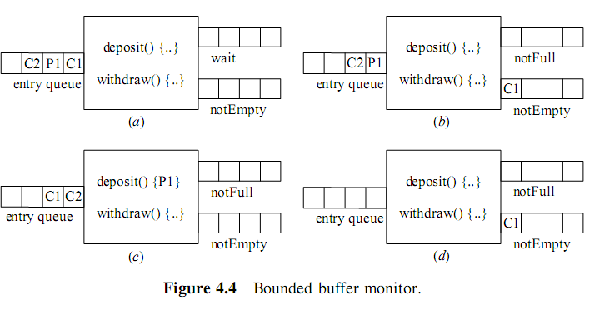
Monitor Example – Bounded Buffer.
Solution Explained.

Slide 19
Correctness or Issues.
Concurrency introduces a family of correctness problems that can arise due to interactions between threads of execution that are:
Executing at the same time.
Interleaved in an unpredictable manner.
Relative timing of the sequences of operations are unpredictable, so bugs can be transient, or manifest in ways that are very difficult to track down and reproduce.
Deadlock, Livelock, Starvation and Nondeterminism.

Slide 20
Deadlock
Deadlock results from a cyclical chain of dependencies.
A depends on B, B depends on C, and C depends on A.
Often results from a misuse of concurrency control constructs.
A holds lock that B wants, B holds lock that C wants, C holds lock that A wants.
Possible to observe when a program “freezes”, and simply ceases to make progress.

Slide 21
Deadlock
Deadlock is similar to a race, in that a program may execute correctly sometimes, but under certain circumstances the relative ordering of threads of execution will cause the program to hang.
Like races, this is due to unenforced (or improperly enforced) dependencies within the program between concurrent threads of execution.

Slide 22
Livelock
Similar to deadlock, but instead of freezing, a program enters into an endless cycle of operations that it cannot continue past.
Example: Acquire lock 1, attempt to acquire lock 2 and fail, release lock 1, retry.
Livelock is detectable, but can be less obvious from simple observation than deadlock due to the fact that the program counter doesn’t freeze.
It does enter a repeating cycle though.

Slide 23
Livelock
If multiple threads of execution are started, we expect that they will all eventually finish.
Often we will go further, and assume that during any reasonable interval of time (such as 1 second), all concurrent threads will make some progress.
When a system or program ensures that this property holds, we say is ensures liveness.

Slide 24
Starvation.
A thread of execution will starve if it ceases to make progress in the presence of others.
Example: a program that is continuously preempted by others and never allowed to execute.
Priority and aging schemes can be used to ensure that starvation does not occur due to a scheduler.
Queuing disciplines (such as FIFO) can guarantee starvation will not occur due to synchronization primitives.

Slide 25
Nondeterminism.
Not always a problem – some algorithms can exploit nondeterminism to their advantage.
Example: concurrent queries to multiple search engines, return whichever result returns first.
Nondeterminism is an inherent property of parallel systems, and must be kept in mind at all times.
Both for positive and negative reasons.

Slide 26
Questions...?

Slide 27
More synchronization primitives...
Memory barriers
Atomic primitives (get/set, increment, add)‏
Compare and swap
Load-link/Store-conditional
Futexes in Linux
Read-Copy-Update (RCU)‏
Transactional memory, STM – like GFE transactions

Slide 28
Memory Barriers
Enforces ordering constraint across multiple CPUs/cores, or CPU to external devices
“Double-checked locking is broken”
Compiler can still reorder statements
Volatile in C/C++: only a compiler barrier; need explicit barriers like ACE_Barrier
Volatile in Java/C#: both compiler barrier and memory barrier
Library/Kernel monitors/mutexes etc. apply the memory barrier appropriate to the architecture

Slide 29
Memory Barriers contd...
Read barriers: reads before the barrier will be ordered w.r.t. reads after the barrier
Data-dependency barriers: partial ordering on interdependent loads only (e.g. first load retrieves an address to be used by second)‏
Write barriers: writes ordered (usually paired with one of the two above)‏
General barriers (full fence in x86/x64)‏
No guarantee of completion of operation after barrier instruction rather only ordering

Slide 30
Atomic primitive operations
AtomicInteger etc. in Java (similar in ACE)‏
get/set can be achieved with volatile, but atomic increment/decrement/add cannot be since it involves both get and set
A simple (inefficient) implementation:
public class AtomicInteger {
private int v;
public synchronized int get() { return v; }
public synchronized void set(int i) { v = i; }
public synchronized int incrementAndGet() { return ++v; }
...
}

Slide 31
Atomic primitive operations contd.
Implementation not efficient at all
Blocking – in general if a thread happens to stall after acquiring lock due to some reason all other threads will stall
Priority-inversion can happen even here
Later we shall see a lock-free implementation (actually wait-free)‏

Slide 32
Atomic read-update-write ops
test-and-set: atomically check if boolean is false (0) then set to true (1) – can be used for spinlocks (Maurice Herlihy's consensus number 2)‏
fetch-and-add: increments and returns old value atomically like AtomicInteger.getAndIncrement (consensus number 2)‏
compare-and-swap (CAS): update value of a memory location to given value iff it matches given expected value; most commonly used primitive that is more general than all those above (consensus number infinite)‏
Double CAS (CAS2) – not supported by most processors, so not discussed further

Slide 33
CAS
Commonly used for lock-free (at least one thread makes progress) and wait-free (all threads make progress) algorithms
AtomicInteger revisited:
public class AtomicInteger {
private volatile int v;
public int incrementAndGet() {
int oldVal, newVal;
do {
oldVal = v;
newVal = oldVal + 1;
} while (compareAndSwap(&v, oldVal, newVal) != oldVal);
return newVal;
}
}

Slide 34
CAS contd.
Spinlocks and read-write spinlocks are straightforware
In combination with OS-level primitives to make a thread wait and notify it, can be used to implement mutexes, semaphores etc. efficiently (e.g. see JDK5's ReentrantLock)‏
Advantage is that there is no blocking if lock is not held by another thread e.g. keep a lock state variable, check locked, if not locked lock and set, if cannot set then wait to be notified
ABA problem: CAS succeeds due to an update such that pointer is same so appears like nothing has changed
ABA solutions: counter for number of updates, tokens (hazard pointers), load-linked/store-conditional where store will succeed only if no intervening store

Slide 35
CAS contd.
JDK5's concurrent data-structures mostly use CAS primitives to provide wait-free algos
JDK5 implementations ignore ABA since GC will not have the problem of recycled addresses
ConcurrentLinkedQueue example:
in enqueue need to update both the next pointer of tail, as well as tail pointer atomically
wait-free implementation allows tail to lag and updates it only periodically, so to reach the actual tail it has to first do next, next in loop till end is not hit
same for head in dequeue
actual implementation more complex (see JDK5's impl.)‏

Slide 36
CAS (lock-free) contd.
Spinning not good if operation can take long time – then go for something like JDK5's LockSupport.park that works nicely with CAS
SQLFabric has its own read-write lock SqlfReentrantReadWriteLock that avoids thread-affinity since it is taken on remote node
Higher-level usage: SQLFabric's local sorted indexe (SortedMap2Index) is completely wait-free – e.g see SortedMap2IndexInsertOperation
Honorary mention: CountDownLatch, CyclicBarrier

Slide 37
Futexes
Short for Fast User-space Mutex: building block for efficient higher-level mutex, semaphore etc.
Wait-queue attached to an integer
Semaphore-like semantics where integer can be incremented and processes wait for it to become positive
Only operations on the wait-queue are system calls else only atomic operations on the integer
Somewhat like Atomic state + LockSupport in java

Slide 38
Read-Copy-Update
Efficient alternative to reader-writer lock

Slide 39
Some references
Memory Barriers: a Hardware View for Software Hackers
Linux kernel docs on memory barriers: http://www.mjmwired.net/kernel/Documentation/memory-barriers.txt
Wait-free synchronization
Futexes are tricky

