Slide 1
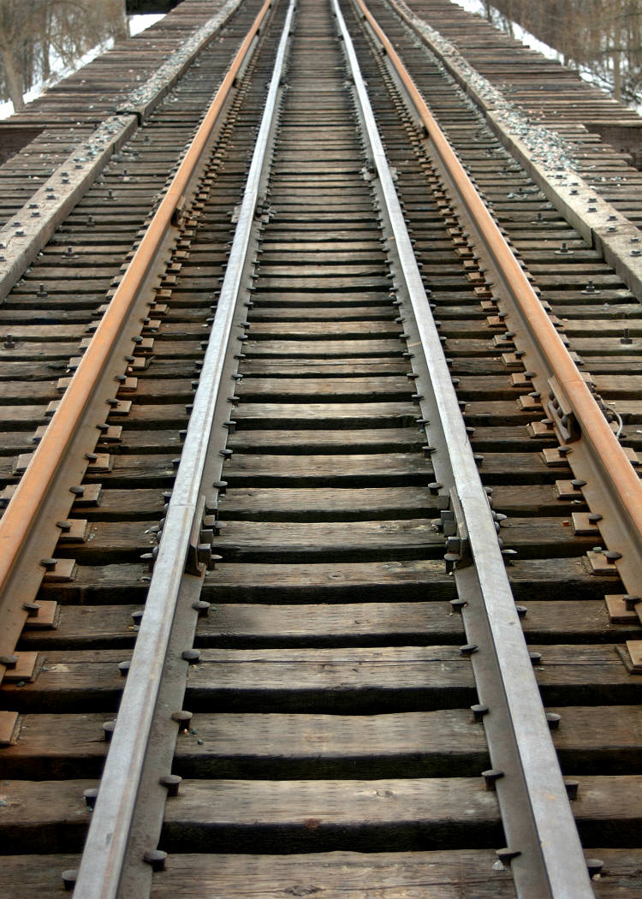
Lecture 1: Coordinate Systems and Vectors intro
References:
Chapter 2

Slide 2
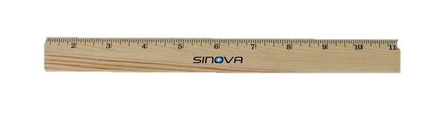
Frames of Reference
Types:
Euclidean / Rectangular (used 99% of this class)
Polar
Hyperbolic, Logartithmic, etc.
Requirements:
Origin
Axis (or axes)
Scale
Direction
Two types of measurements:
Absolute position (relative to orientation) – a Point
Relative distance – an Offset (or Vector)
Note how a Point and Vector are related
Examples
1D
2D
3D
Right vs. Left Handed Systems

Slide 3

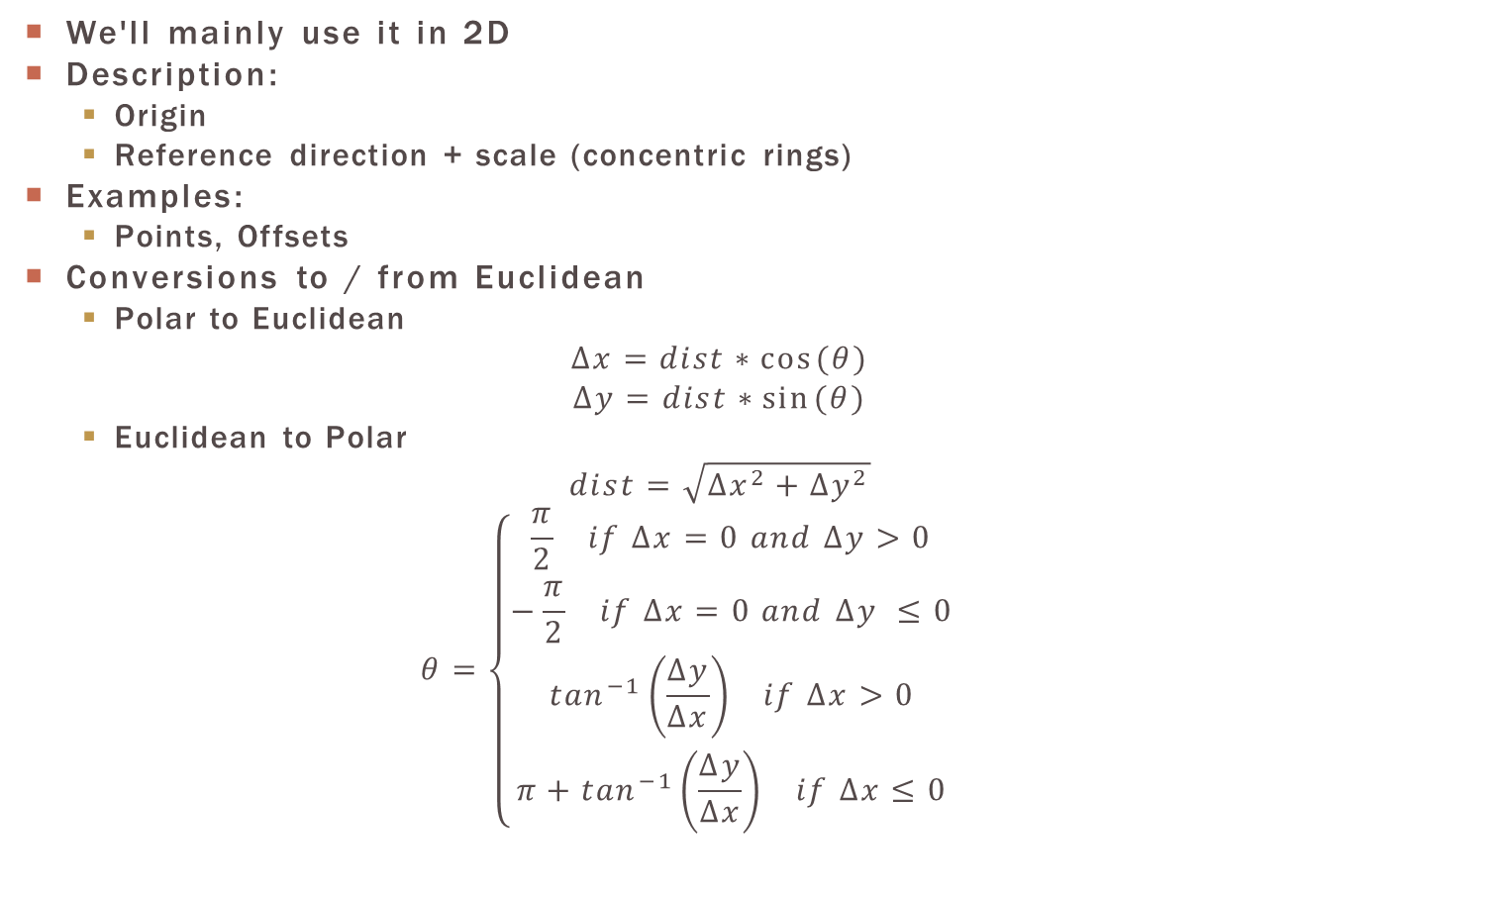
Polar C.S.
We'll mainly use it in 2D
Description:
Origin
Reference direction + scale (concentric rings)
Examples:
Points, Offsets
Conversions to / from Euclidean
Polar to Euclidean
$$∆x=dist∗cos⁡(θ)$$
$$∆y=dist∗sin⁡(θ)$$
Euclidean to Polar
$$dist=\sqrt{{∆x}^{2}+{∆y}^{2}}$$
$$θ=\left\{\begin{matrix}\begin{matrix}\begin{matrix}\frac{π}{2} if ∆x=0 and ∆y>0 \\ −\frac{π}{2} if ∆x=0 and ∆y ≤0\end{matrix} \\ \begin{matrix}\tan^{−1}\left(\frac{∆y}{∆x}\right) if ∆x>0 \\ π+\tan^{−1}\left(\frac{∆y}{∆x}\right) if ∆x≤0\end{matrix}\end{matrix} & \end{matrix}\right.$$
$$or math.atan2\left(∆y,∆x\right)in python$$

Slide 4
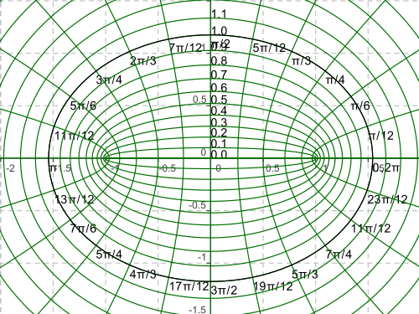
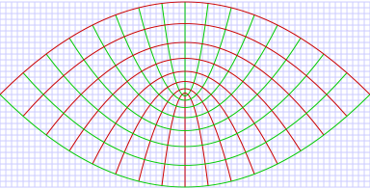
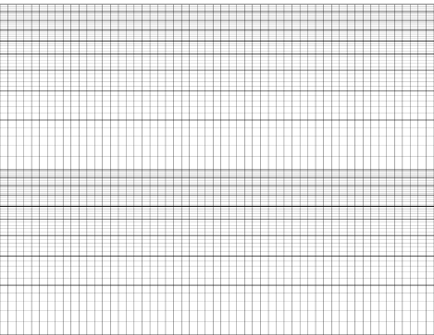
Other 2D coordinate Systems (we aren't using these☺)
Elliptical
Parabolic
Logarithmic
…

Slide 5

VECTORS in the dictionary
Biology: pathogen transmission route (e.g. fleas / rats in Black Plague)
Computer Science: an array (list) of data (e.g. my_vals[7])
Despicable Me: the bad-guy
Math / Physics: a quantity, represented by an arrow, indicating direction and magnitude
head
tail
Length, (aka magnitude) (a scalar)

Slide 6
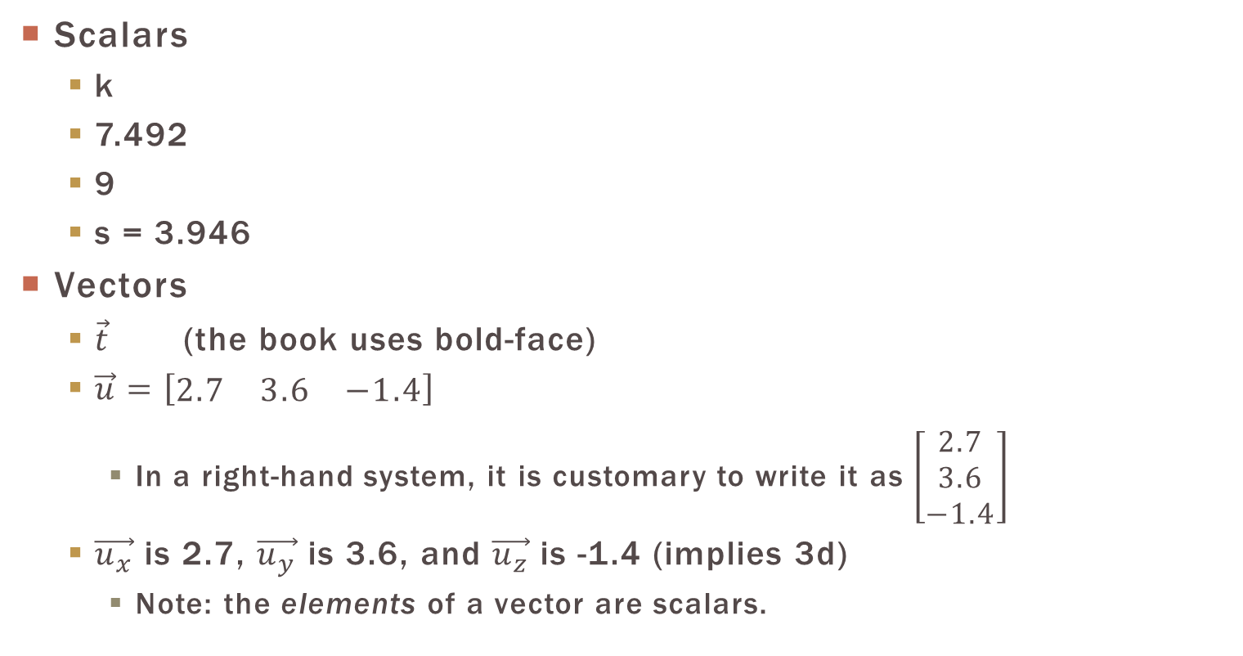
Vector Notation
Scalars
k
7.492
9
s = 3.946
Vectors
$\vec{t}$ (the book uses bold-face)
$\vec{u}=\left[\begin{matrix}2.7 & 3.6 & −1.4\end{matrix}\right]$
In a right-hand system, it is customary to write it as $\left[\begin{matrix}2.7 \\ 3.6 \\ −1.4\end{matrix}\right]$
$\vec{u_{x}}$ is 2.7, $\vec{u_{y}}$ is 3.6, and $\vec{u_{z}}$ is -1.4 (implies 3d)
Note: the elements of a vector are scalars.

Slide 7

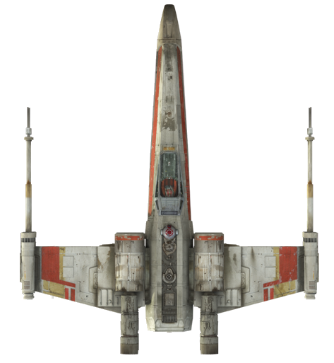
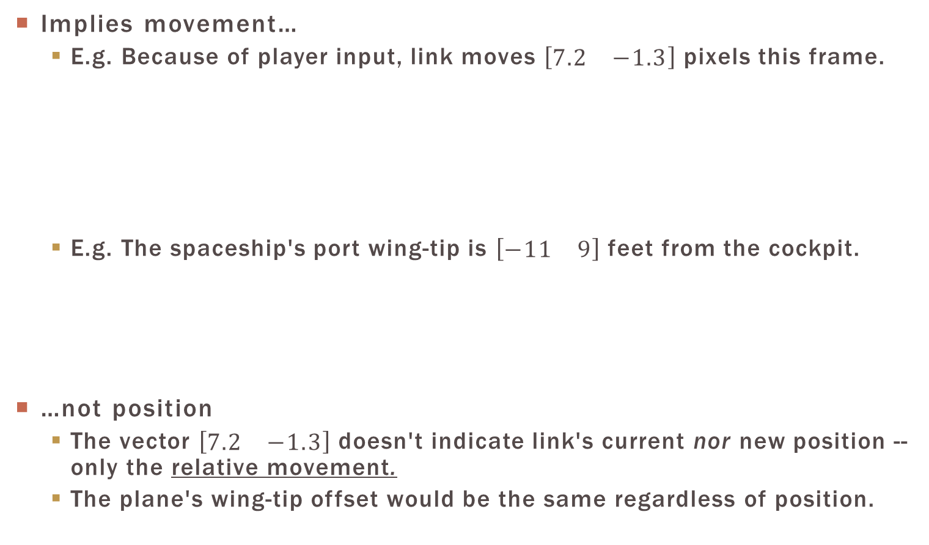
Vectors conceptually
Implies movement…
E.g. Because of player input, link moves $\left[\begin{matrix}7.2 & −1.3\end{matrix}\right]$ pixels this frame.
E.g. The spaceship's port wing-tip is $\left[\begin{matrix}−11 & 9\end{matrix}\right]$ feet from the cockpit.
…not position
The vector $\left[\begin{matrix}7.2 & −1.3\end{matrix}\right]$ doesn't indicate link's current nor new position -- only the relative movement.
The plane's wing-tip offset would be the same regardless of position.
x
-1.3
y
7.2
9
-1

Slide 8
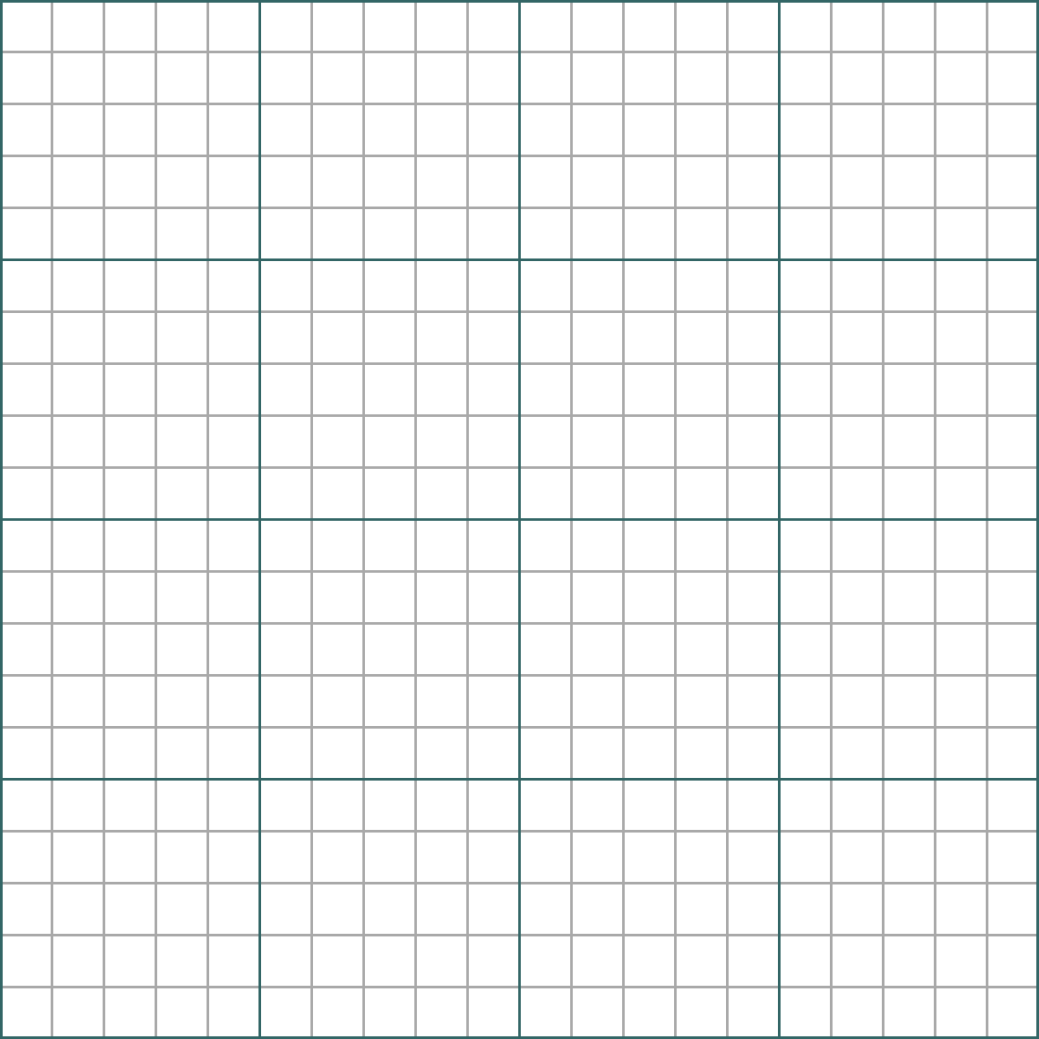
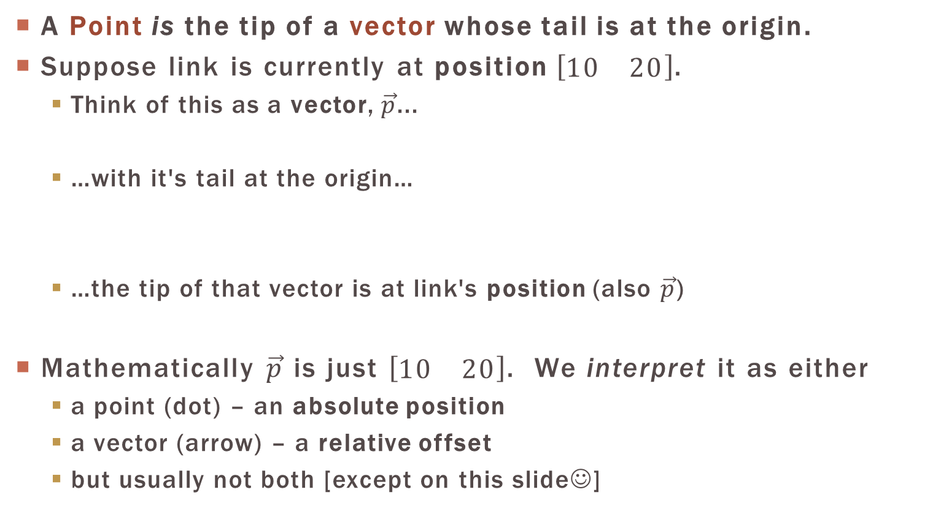


(absolute) position & Vectors
A Point is the tip of a vector whose tail is at the origin.
Suppose link is currently at position $\left[\begin{matrix}10 & 20\end{matrix}\right]$.
Think of this as a vector, $\vec{p}$...
…with it's tail at the origin…
…the tip of that vector is at link's position (also $\vec{p}$)
Mathematically $\vec{p}$ is just $\left[\begin{matrix}10 & 20\end{matrix}\right]$. We interpret it as either
a point (dot) – an absolute position
a vector (arrow) – a relative offset
but usually not both [except on this slide☺]
$$\vec{p}$$
$$\vec{p}$$

Slide 9

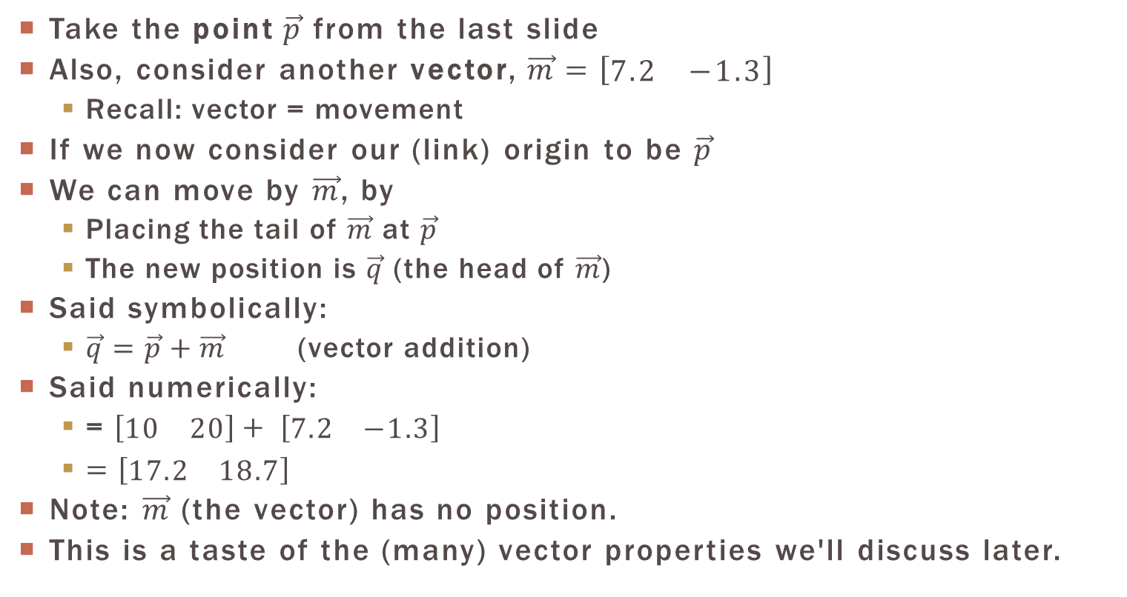



(absolute) position & Vectors
Take the point $\vec{p}$ from the last slide
Also, consider another vector, $\vec{m}=\left[\begin{matrix}7.2 & −1.3\end{matrix}\right]$
Recall: vector = movement
If we now consider our (link) origin to be $\vec{p}$
We can move by $\vec{m}$, by
Placing the tail of $\vec{m}$ at $\vec{p}$
The new position is $\vec{q}$ (the head of $\vec{m}$)
Said symbolically:
$\vec{q}=\vec{p}+\vec{m}$ (vector addition)
Said numerically:
= $\left[\begin{matrix}10 & 20\end{matrix}\right]+ \left[\begin{matrix}7.2 & −1.3\end{matrix}\right]$
$=\left[\begin{matrix}17.2 & 18.7\end{matrix}\right]$
Note: $\vec{m}$ (the vector) has no position.
This is a taste of the (many) vector properties we'll discuss later.
$$\vec{m}$$
$$\vec{q}$$
$$\vec{p}$$
$$\vec{m}$$

