Slide 1

Quality Engineering
11

Slide 2
Quality Engineering
The discipline of engineering concerned with the principles and practice of product and service quality assurance and control.
Goal is to meet or exceed quality expectations through the selection and execution of appropriate QA activities while minimizing the cost and other project risks under the project constraints.
In order to ensure that quality goals are met through the selected QA activities, various measurements need to be taken parallel to the QA activities themselves.

Slide 3
Scope and Content Hierarchy
Software Quality Engineering
Quality Assurance
Testing

Slide 4
Quality Engineering Process
There are 03 major groups of activities in the Quality Engineering process;
pre-quality assurance activities
in-quality assurance activities
post-quality assurance activities

Slide 5
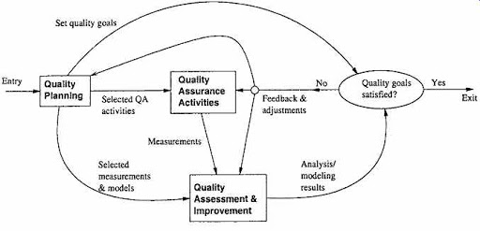

Slide 6
Activities and Process 1/3
Pre-QA activities: Quality Planning The activities that should be carried out before carrying out the regular QA activities.
Set specific quality goals
Form an overall strategy, which includes;
Select appropriate QA activities to perform
Choose appropriate quality measurements and models to provide feedback, quality assessment and improvement.

Slide 7
Activities and Process 2/3
In-QA activities: Executing Planned QA activities and handling discovered defects.
Post-QA activities: Quality measurement, assessment and improvement. The activities carried out after normal QA activities have started but not as part of these normal activities. Primary purpose is to provide quality assessment and feedback so that various management decisions can be made and possible quality improvement initiatives can be carried out.

Slide 8
Activities and Process 3/3
Pre-QA quality planning activities play a leading role in this quality engineering process.
Although the execution of selected QA activities usually consumes the most resources.
Quality goals need to be set so that can manage the QA activities and stop them when the quality goals are met.
QA strategies need to be selected, before carrying out specific QA activities, collect data, perform analysis, and provide feedback.

Slide 9
Quality Engineering Process
There are two kinds of feedback in this quality engineering process,
Short term direct feedback to the QA activities
The short term feedback to QA activities typically provides information for progress tracking, activity scheduling, and identification of areas that need special attentions.
Long-term feedback to the overall quality engineering process.
Feedback to quality planning so that necessary adjustment can be made to quality goals and QA strategies.
Feedback to the quality assessment and improvement activities.

Slide 10
QE and Quality Improvement Paradigm (QIP)
Quality improvement was achieved through measurement, analysis, feedback, and organizational support.
Includes 03 interconnected steps:
Understanding
Assessing
Packaging

Slide 11
QE and Quality Improvement Paradigm (QIP)
To understand the baseline so that improvement opportunities can be identified and clear, measurable goals can be set. All future process changes are measured against this baseline.
To introduce process changes through experiments, pilot projects, assess their impact, and fine tune these process changes.
To package baseline data, experiment results, local experience, and updated process as the way to infuse the findings of the improvement program into the development organization.

Slide 12
Quality Planning
Includes setting quality goals and forming a QA strategy.
The general steps include:
Setting quality goals by matching customer’s quality expectations with what can be economically achievable by the organization.
Identify quality views and attributes meaningful to target customers and users.
Select direct quality measures that can be used to measure the selected quality attributes from customer’s perspective.
Quantify these quality measures to set quality goals while considering the market environment and the cost of achieving different quality goals.

Slide 13
Quality Assessment and Improvement
Primary purpose of these activities is to provide quality assessment and feedback so that various management decisions, such as product release, can be made and possible quality and process improvement initiatives can be carried out.
The major activities in this category include:
Measurement
Analysis and modeling
Providing feedback and identifying improvement potentials
Follow-up activities

Slide 14
Quality Engineering in Software Process 1/2
Quality Planning
Setting quality goals
Select quality assurance strategies
Making adjustments based on feedback
Quality Assurance
QA Phase: Testing
Quality gates: at phase transition pairs.
Other QA activities scattered over all phases.
Quality Assessment and Improvement
INPUT: measurement from QA and development activities
OUTPUT: quality assessment and other analysis results

Slide 15
Quality Engineering in Software Process 2/2
All these activities typically last over the whole development process, with different sub activities carried out in different phases.
This is particularly true for the QA activities, with testing in the test phase, various reviews or inspections at the transition from one phase to its successor phase, and other QA activities scattered over other phases.
Minor modifications are needed to integrate quality engineering activities into other development processes.

Slide 16
Effort Profile 1/3
The effort distribution among the three is not constant over time because of the process characteristics and the shifting focus over time.
Some key factors that affect and characterize the effort profile, or the effort distribution over time, include:
Quality planning drives and should precede the other two groups of activities.
At the beginning part of product development, quality planning should be the dominant part of quality engineering activities.

Slide 17
Effort Profile 2/3
Occasional adjustments to the quality goals and selected quality strategies might be applied, but only a small share of effort it is needed.
Measurement and quality assessment activities start after selected QA activities are well under way.
At the early part of the development process, small amounts of such activities are carried out to monitor quality progress.
But they are not expected to be used to make major management decisions such as product release.
In the overall shape and pattern, the effort profile for these activities follows that for the collective QA activities above, but with a time delay and a heavier load at the tail-end.

Slide 18
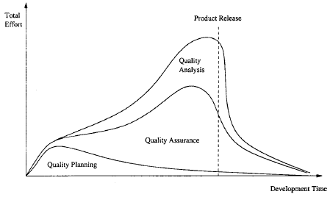

Slide 19
Effort Profile 3/3
Waterfall process would see more dominance of quality planning in the beginning, and dominance of testing near product release, and measurement and quality assessment activities peak right before product release.
Other development processes, such as incremental, iterative, spiral, and extreme programming processes, would be associated with curves that vary less between the peaks and valleys.

