Slide 1

TCS2212: Accounting for Technologists
K.K.N.B. Adikaram
Faculty of Technology
University of Ruhuna

Slide 2

General Journal
ICT/ BST -10.09.2024
ET -13.09.2024

Slide 3
Learning Outcomes
At the end of this lesson, the student will be able to,
Describe the nature and functions of General Journal
List the types of transactions and events related to the general journal
Record transactions in the general journal
Post general journal entries into the ledger

Slide 4
Primary Books (Reminding……)
Transactions extract from source documents are initially record in primary books.
Transactions in similar category are recorded in separate primary books.
Transactions are recorded in a chronological order.

Slide 5
Introduction
Purchase Journal, sales Journal, return inwards and return outwards journals are used to record only one type of transaction.
Hence, they are known as specialized journals.
Example :- Sales Journal is used to record only credit sales of trade goods.

Slide 6
Introduction Cont….
There may be some other transactions other than the transactions recorded in those journals.
These transactions cannot be recorded in these journals.
Purchase of a machine on credit basis to be used in the business.
Purchase of a land on credit basis to expand the business activities.
Owner uses goods of the business for his own purpose.

Slide 7
General Journal
These transactions should be recorded in a separate prime entry book.
The prime entry book used to record these transactions is known as the General Journal.
Accordingly, transactions that are not recorded in other prime entry books are recorded at first in the General Journal.
The source document used in recording transactions in the General Journal is the journal voucher.

Slide 8
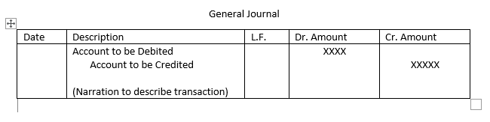
General Journal - format

Slide 9
General Ledger Transactions
Opening entries – opening balances of assets and liabilities at the beginning of a year.
The purchase and sales of fixed assets on credit – Acquisition and sell off fixed assets on credit basis.
Rectification entries – corrections to be rectified
Transfer entries - amount is to be transferred from one account to another
Closing entries – Closing entries to be done at the end of the year. The nominal accounts will be transferred to the profit and loss account through journal entries.
Adjusting entries - the amounts of expenses or incomes to be adjusted at the end of the year. (e.g. accruals)

Slide 10
Transactions Related With The General Journal
Opening balances for statement of financial position
Acquisitions and disposals of noncurrent assets
Correction of errors
Transfer entries – If some amount is to be transferred from one account to another, the transfers will be made through a journal entry.
Closing entries – At the end of the year the profit and loss account has to be prepared. For this purpose the nominal accounts will be transferred to this account. This is done through journal entries called closing entries.
Adjusting entries- At the end of the year the amounts of expenses or incomes may have to be adjusted for amounts paid or received in advance or for amounts not yet settled in cash.

Slide 11
Exercise 1
Given below are the opening balances of ABC Traders as at 1/1/2020
Land and Buildings 500,000
Furniture 100,000
Debtors 30,000
Cash in Hand 50,000
Creditors 100,000
Bank loan 150,000
Capital 430,000

Slide 12
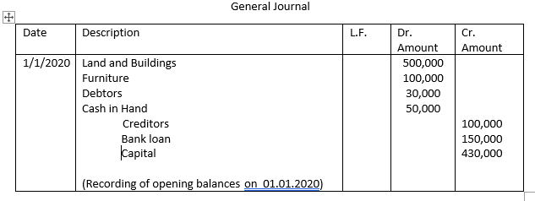

Slide 13
Exercise 2
05/02/2024 -bought a machine on credit from Ranil traders for
Rs. 50 000.
31/12/2024 - identified that the motor car purchased for Rs.150 000 has been debited to purchase account.
31/12/2024 - balance of the rent account Rs.2000 transferred to profit and loss account.

Slide 14
Date | Voucher No. | Description | L.F. | Dr. | Cr.
5/2/2022 |  | Machinery account Ranil traders (Purchase of machinery from Ranil traders) |  | 50 000 | 50 000
31/12/2022 |  | Motor vehicle Account Purchase Account (Rectified the error caused by recording the purchase of motor car in the purchase account) |  | 150 000 | 150 000
31/12/2022 |  | Profit and loss account Rent account (Transferred the balance of the rent account into P/L account) |  | 2000 | 2000

Slide 15
Exercise 3
15/03/2020 A vehicle bought on credit from ABN Ltd. for Rs.350,000.
05/07/2020 Cash sales of Rs. 10,000 has recorded as credit sales.
31/12/2020: Balance of the salary account Rs. 4,000 transferred to profit and loss account.
31/12/2020: Balance of the rent income account Rs. 6,000 transferred to profit and loss account.

Slide 16
Thank you!

