Slide 1
WPF Standardization

Slide 2
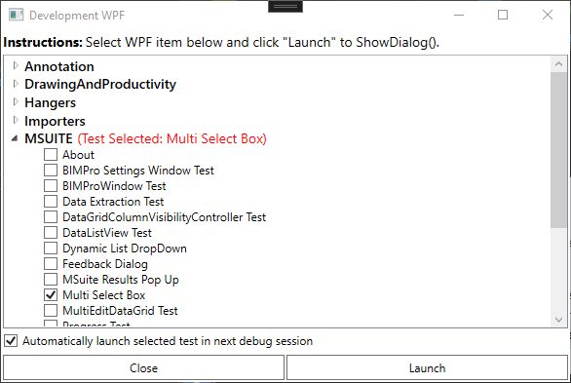
Development WPF
Separate Windows WPF application used for any development of WPF controls outside of Revit
Easy way to develop UI’s or UserControls
Provides a simple way to use mock data to test forms.

Slide 3
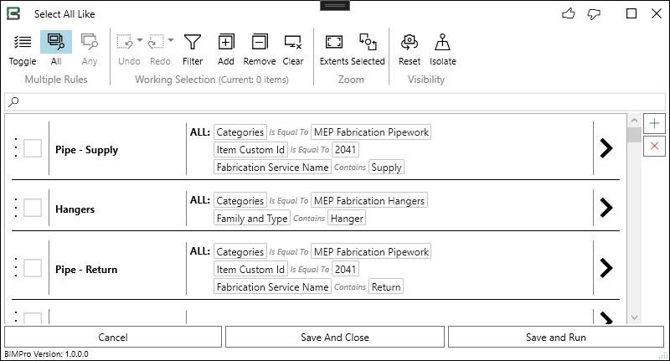
BIMPro Window
Standard window all of our UI’s are contained in
Custom title bar with feedback buttons
Resize grip
Version of .addin displayed

Slide 4
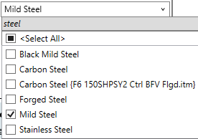
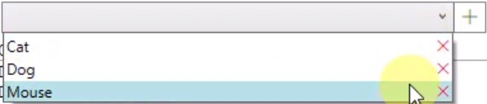
Multi-Select Box
Combobox with multi-edit built in
Search Enabled
Can “select all/none”
Two-way binding with SelectedItems Property.
Dynamic List Drop-down
Combobox that allows for additional entries by user
Dynamically updates ItemsSource
Two-way binding with SelectedValue Property.

Slide 5
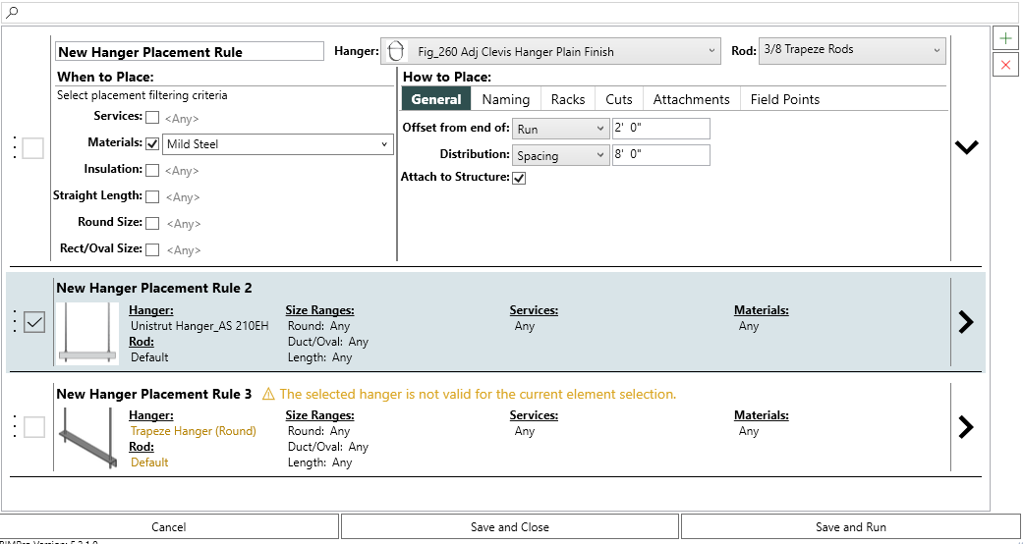
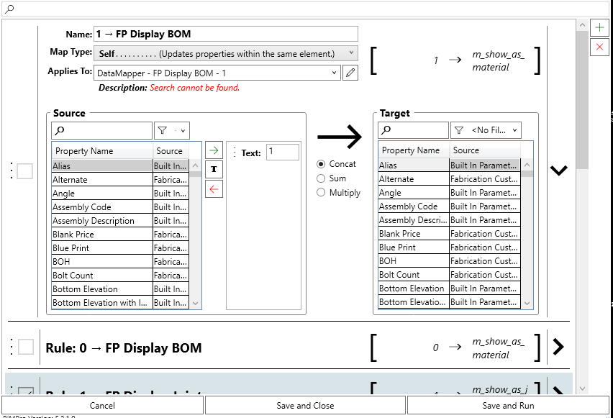
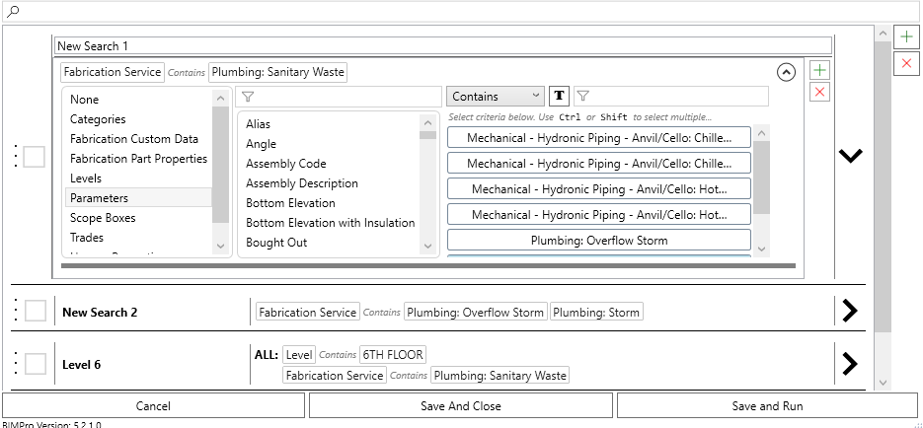
BIMPro Settings Listbox
Standard window all of our UI’s are contained in
Custom title bar with feedback buttons
Resize grip
Version of .addin displayed

