Slide 1

Preseason Climate Controls on Summer Fire Weather in Manitoba
Niloofar Raeispour
Instructor: Dr. Donghoon Lee
CIVL-7740-T05 Course Project
Fall 2025

Slide 2

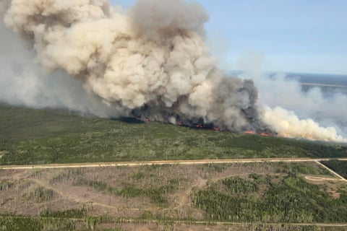
Background and Objectives
Wildfire risk is increasing in many parts of Canada, including Manitoba.
Fire Weather Index (FWI)
is a standard index that combines temperature, wind, humidity, and precipitation to describe fire danger.
Objectives of this project:
Analyze seasonal behavior of FWI for spring (MAM) and summer (JJA) in Manitoba.
Examine correlations between FWI and key meteorological variables.
Build and compare predictive models of FWI using local climate variables and ENSO.
Figure1 :Manitoba, Canada. 27 May 2025
https://www.theguardian.com
Notes:
In recent years we’ve seen more attention on wildfires in Canada. both because of the direct fire damage and also smoke and air quality impacts.
Operationally, agencies often use indices like the Fire Weather Index, or FWI, to monitor and forecast fire danger during the season.
As you know, acting fast and preparation for this such event can reduce the damage
What is less clear is:
Can we use information from before the fire season, especially spring, to say something about how bad the summer fire weather might be?
So the main research question in this project is:
Do preseason conditions in March–May—temperature, humidity, wind, precipitation, and ENSO—contain useful predictive information about high FWI days in June–August?

Slide 3
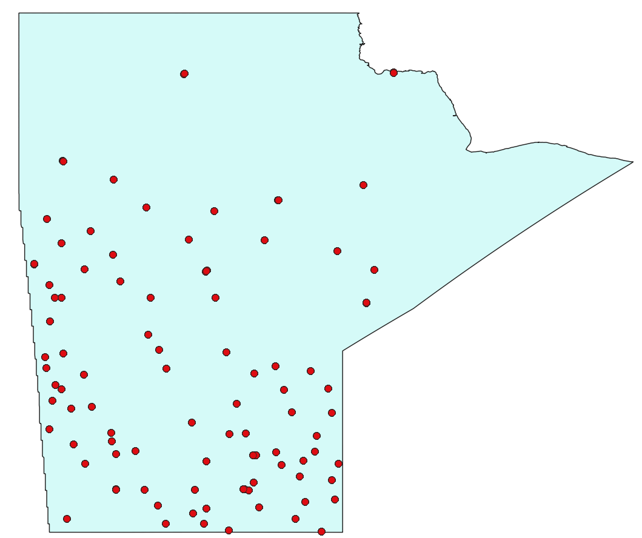
Datasets and Variables
Source: Canadian Wildland Fire Information System (CWFIS) daily data.
Region: Stations located inside Manitoba only.
Time period:1953- 2025.
Main variables used:
Fire Weather Index (FWI)
Air temperature (T, Temp)
Relative humidity (RH)
Wind speed (Ws)
Precipitation (Precip,P)
ENSO index (Niño 3.4) from global climate databases
Figure 2: Manitoba Weather Stations

Slide 4
Methods
Data
QC & Filtering
Seasonal aggregation
FWI Classes
Models & Evaluation
Pre-processing
Performed quality control by removing incomplete records and years with substantial missing data.
Aggregated daily values to seasonal means for each station and year:
  Spring: March-April-May (MAM)
  Summer: June-July-August (JJA)
Converted continuous seasonal FWI into categorical fire-danger classes using predefined FWI thresholds (“High” if FWI > 20).
Analysis and modelling
Quantified relationships between seasonal FWI and predictors using correlation analysis.
Split the data into training and test sets using 2010 as the cutoff year
Developed and compared four classification models for seasonal FWI classes:
  Dummy Stratified Classifier
  Logistic Regression
  Random Forest Classifier
  Gradient Boosting Classifier

Slide 5
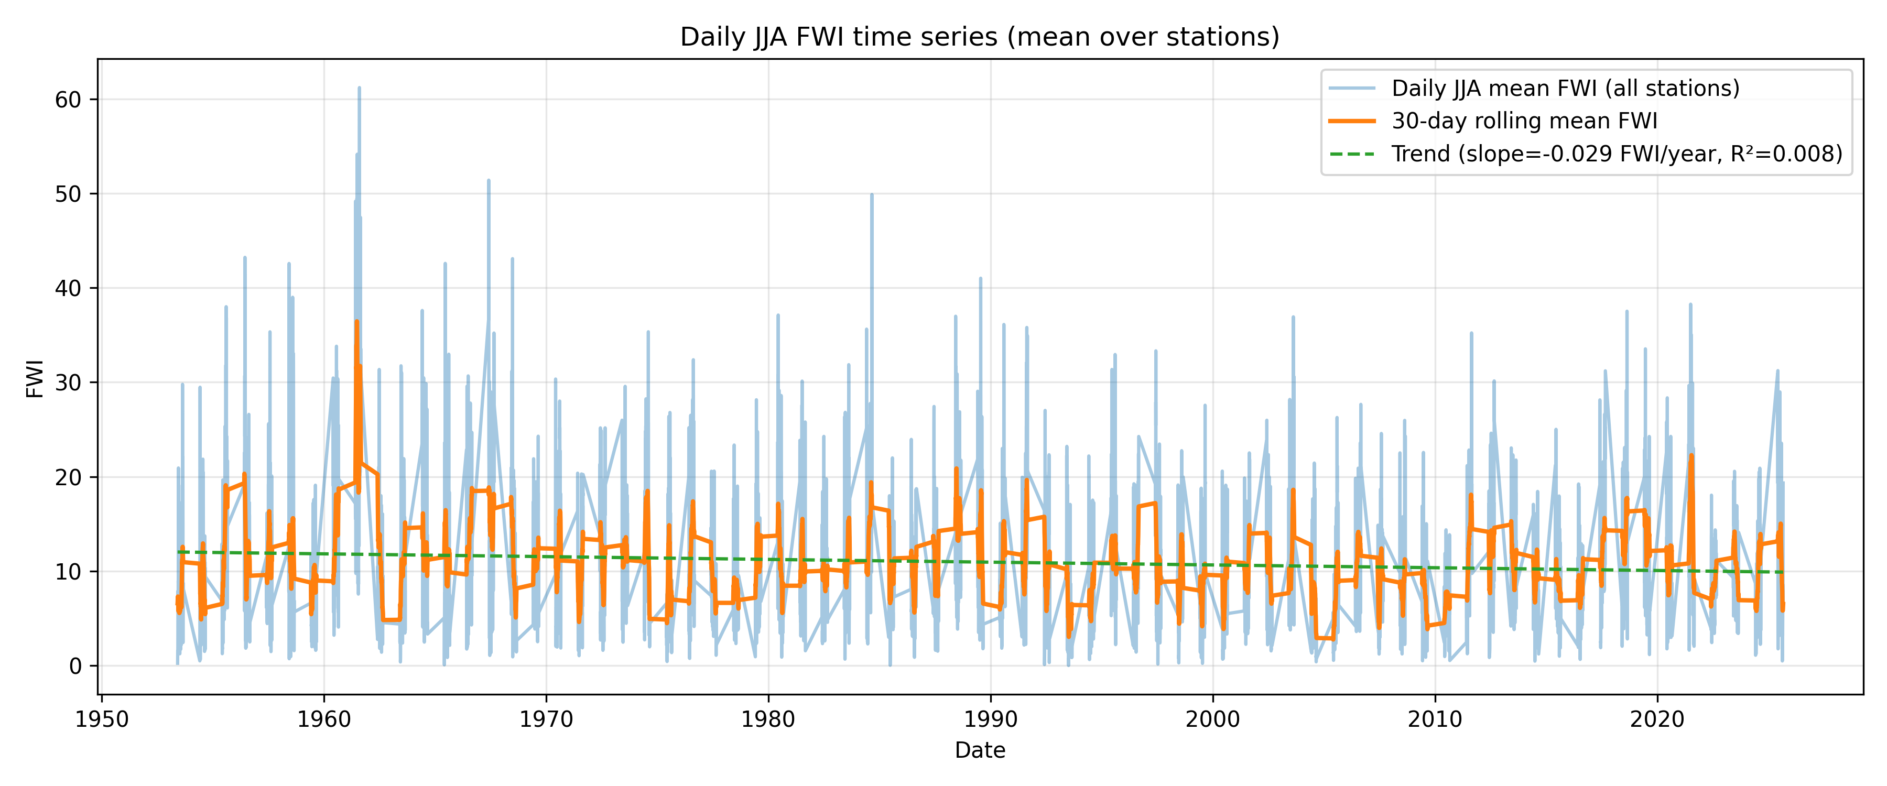
Timeseries
FWI:
Figure 3: Summer FWI Timeseries

Slide 6
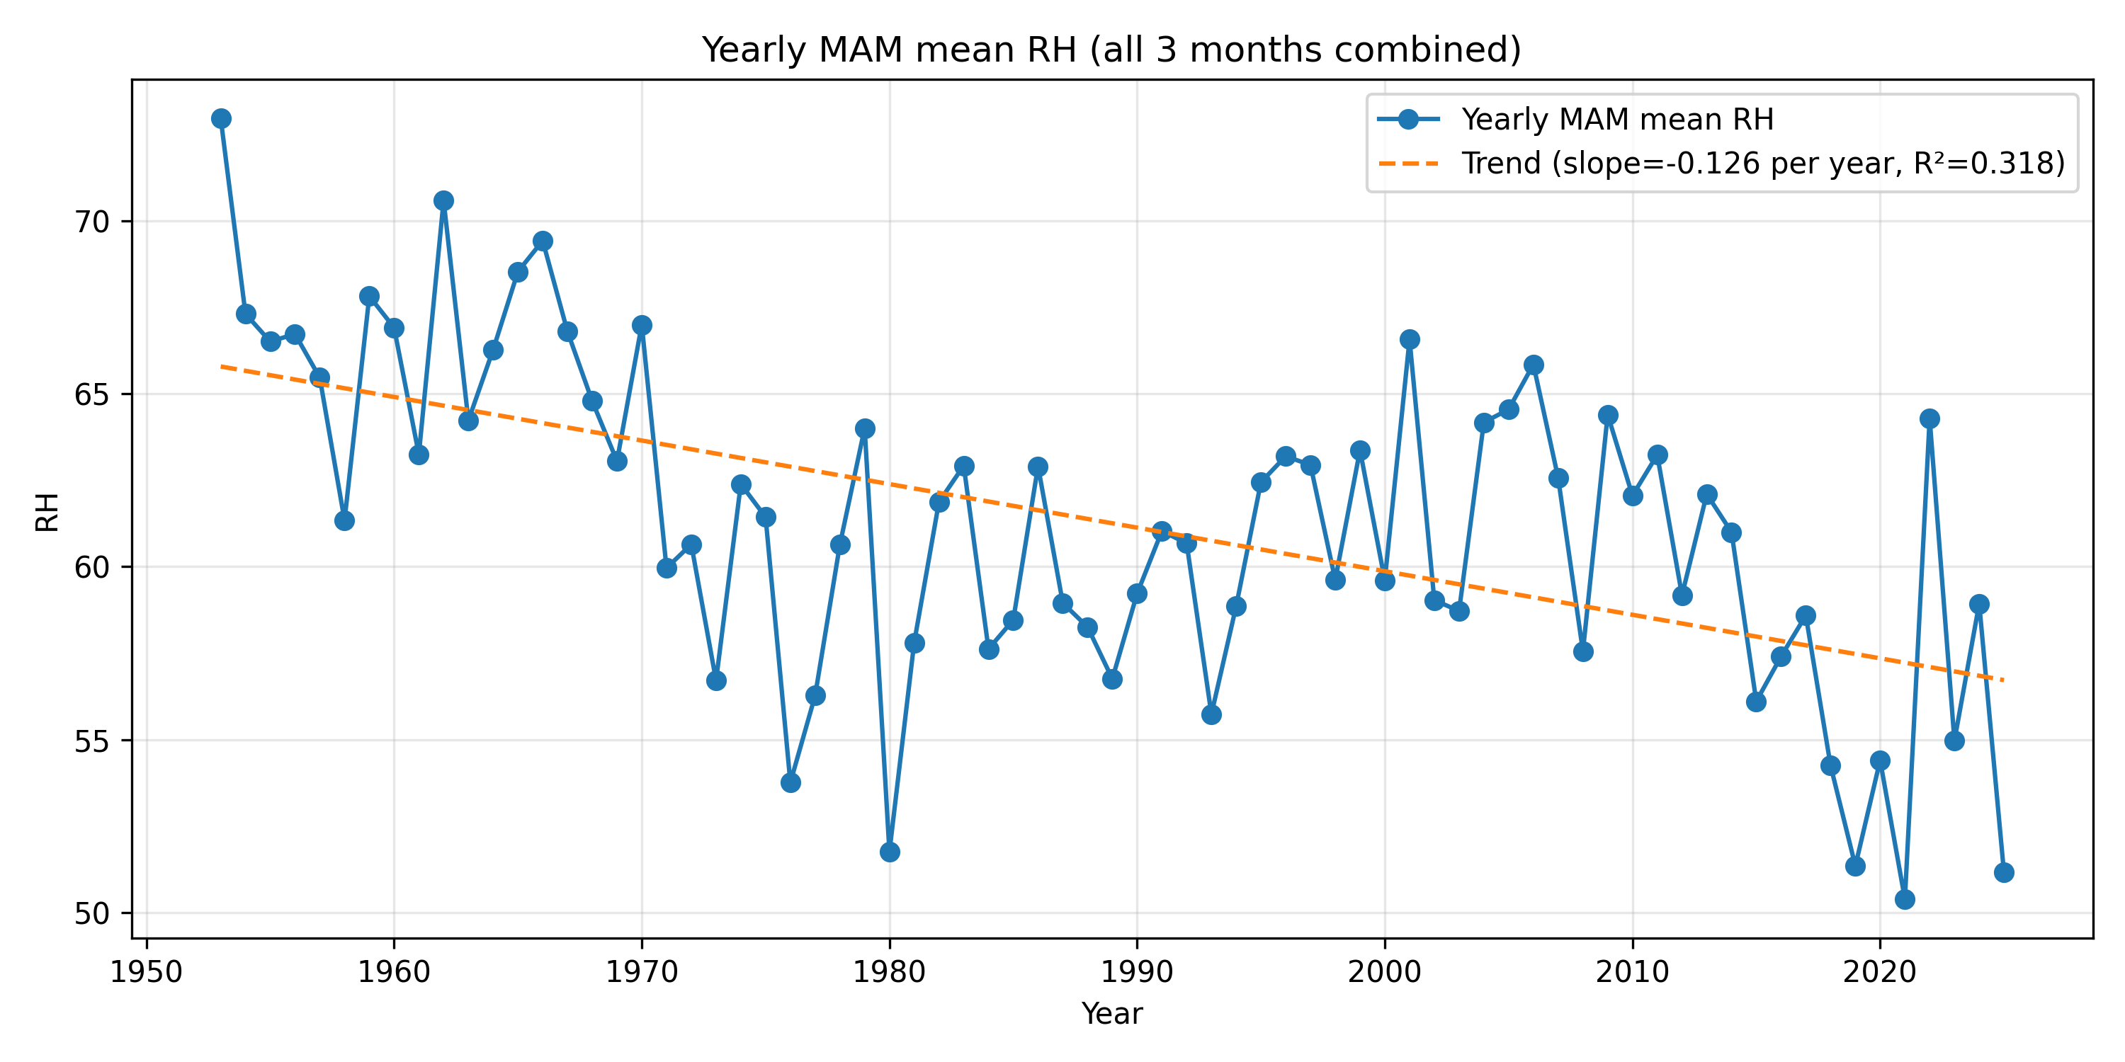
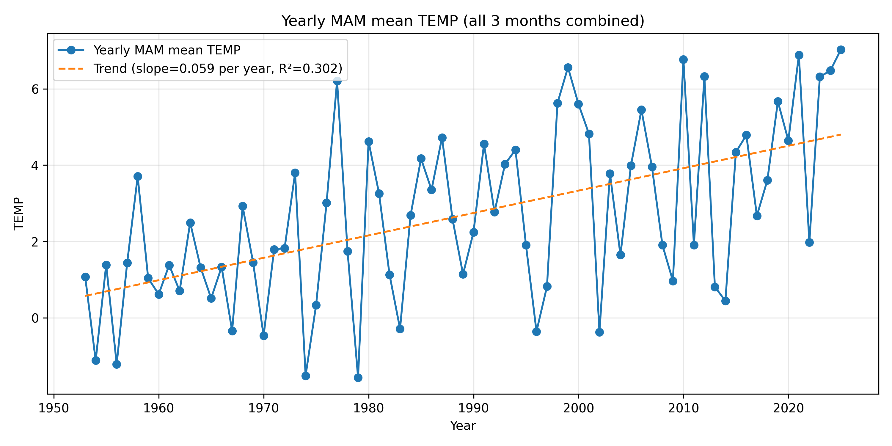
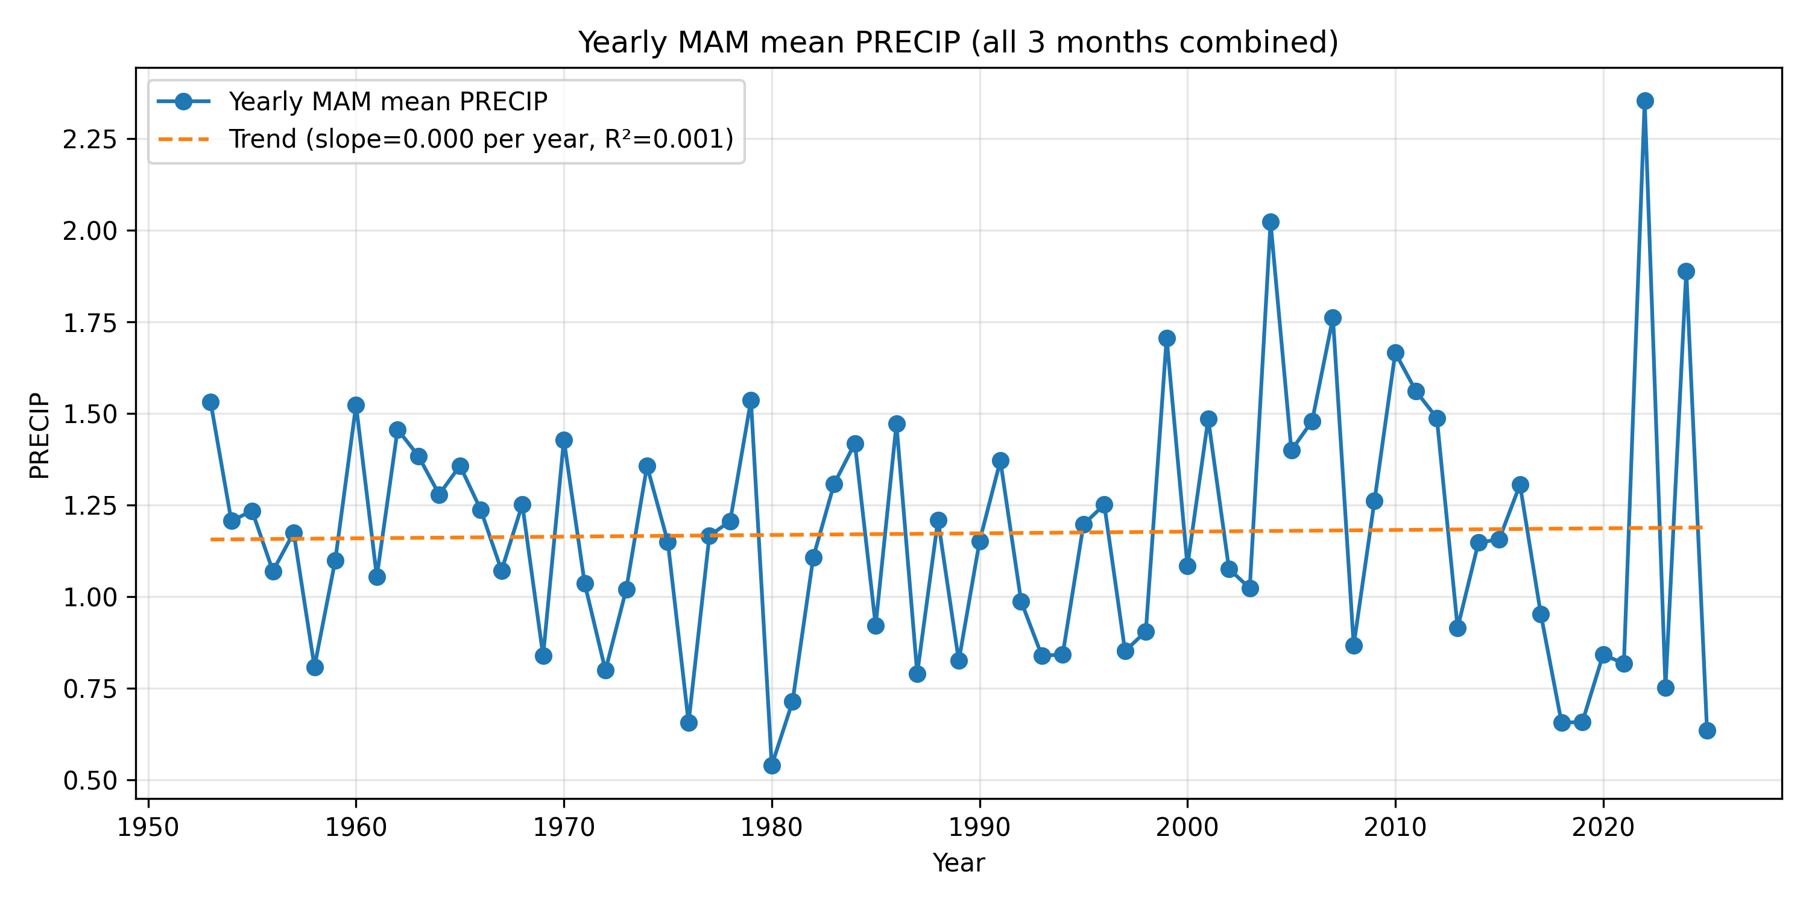
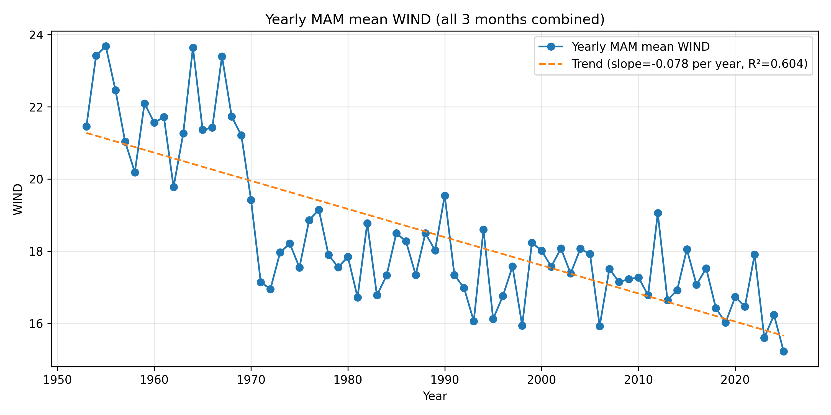
Timeseries
Figure 4: Spring Climate variables Timeseries

Slide 7
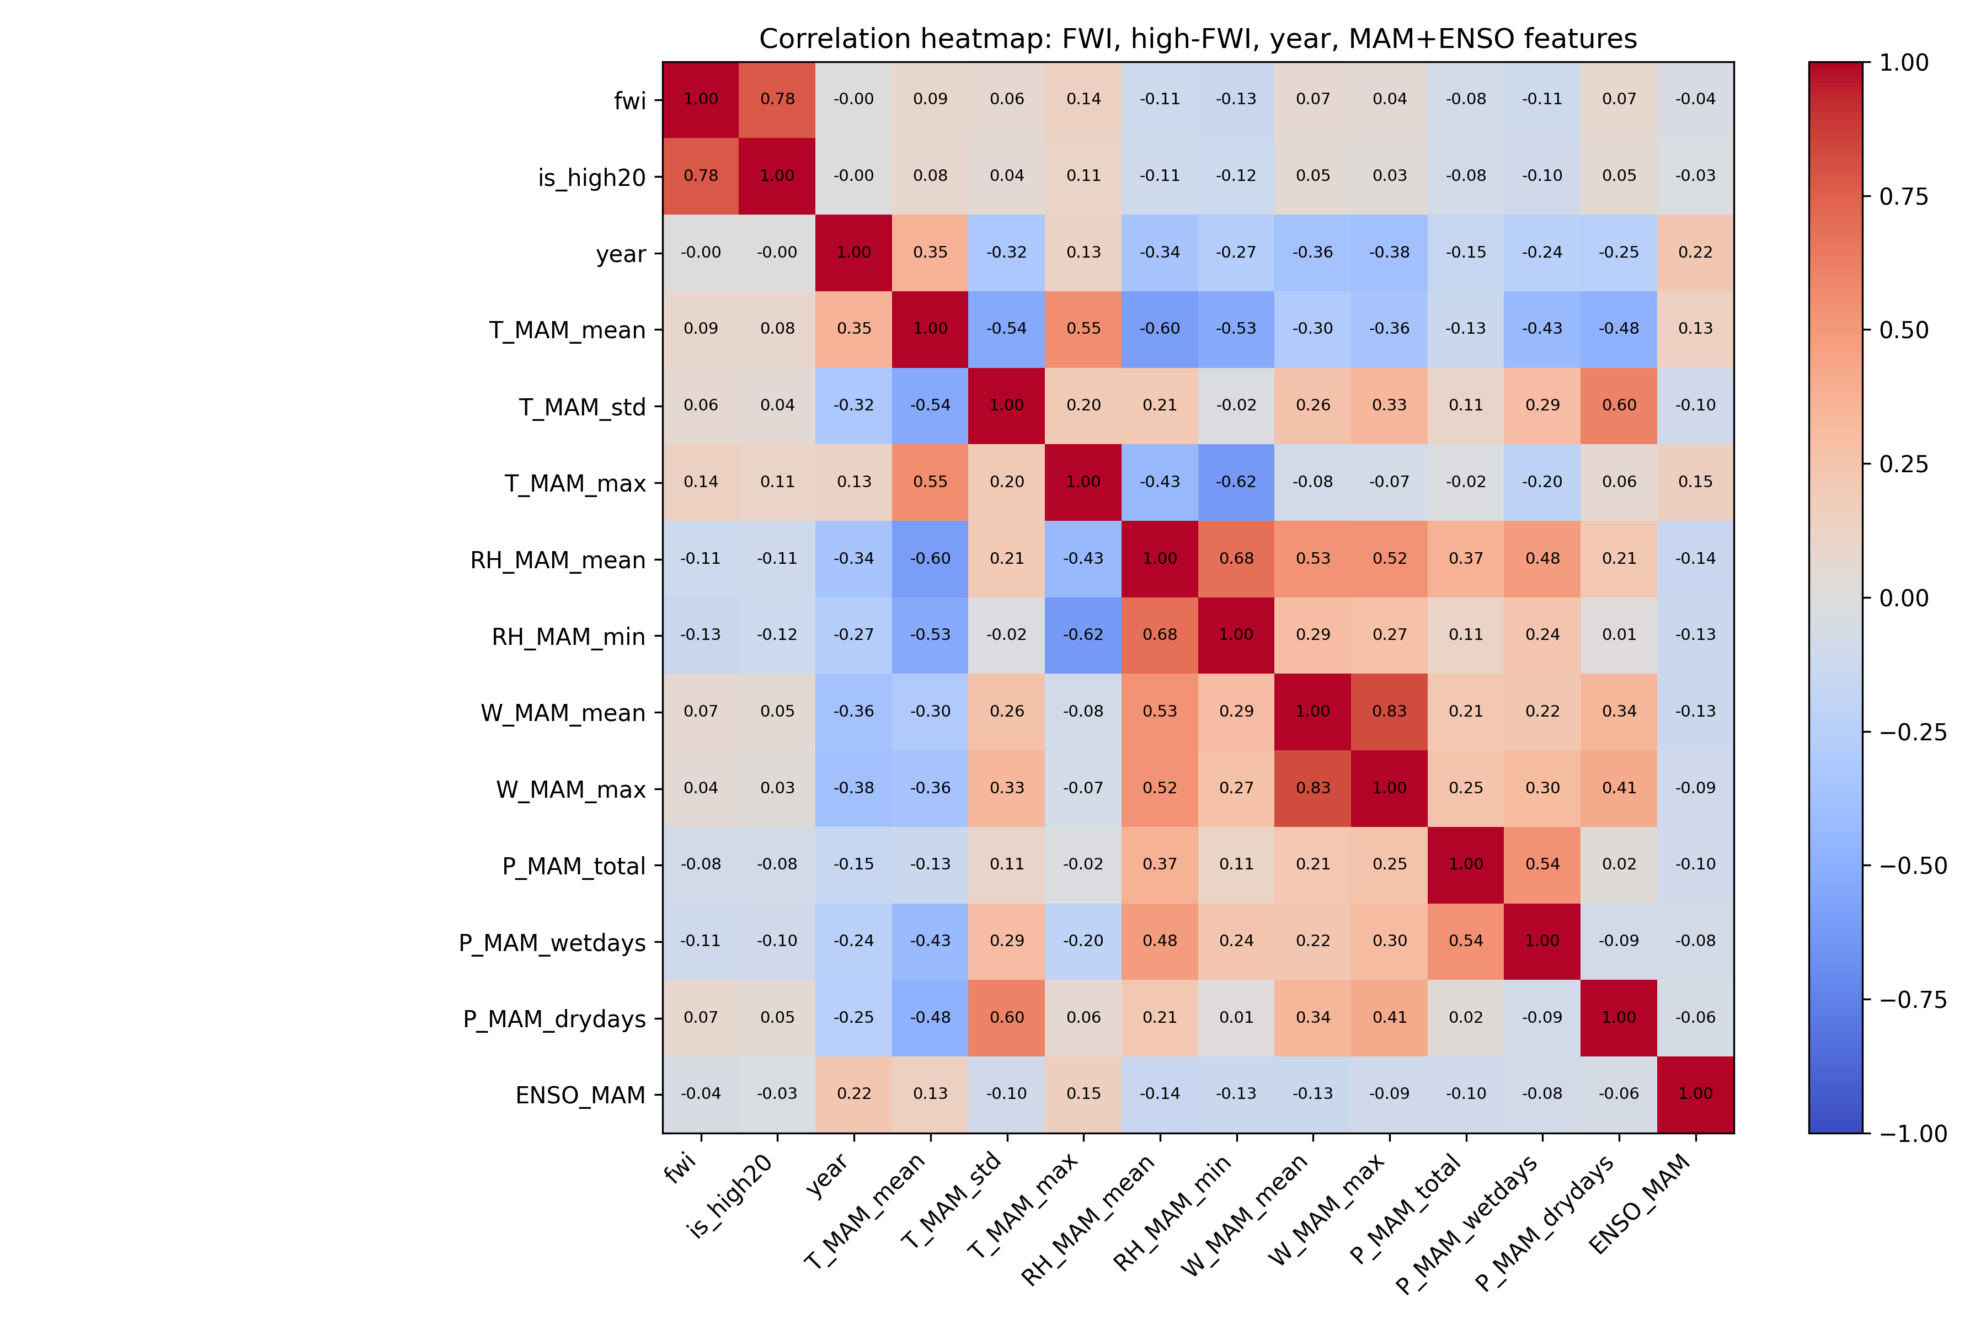
Correlation
FWI has weak positive correlation with spring temperature/wind and weak negative correlation with humidity/precipitation
ENSO has near-zero correlation with FWI in MAM.
Predictors are strongly inter-correlated (T vs RH)
Figure 5: Correlation Heatmap

Slide 8
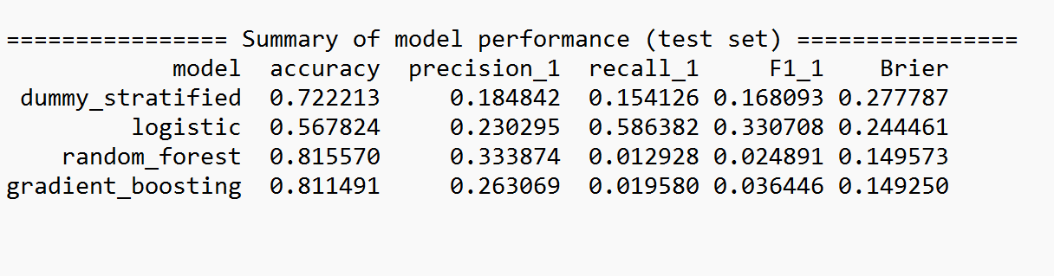


Model Summary (MAM)
Accuracy: Fraction of all days predicted correctly.
Precision: Among days predicted high FWI, how many were actually high.
Recall: Among days that were actually high FWI, how many the model caught.
F1-score: Single number that balances precision and recall (higher = better).
Brier score: Error of predicted probabilities for high FWI (mean squared error; lower = better).
Chosen model: Logistic regression
It has the best recall and F1 for high-FWI cases, so it actually detects dangerous days, even though its overall accuracy is lower than the tree models
Figure 6: Model Summery table (MAM variables)

Slide 9
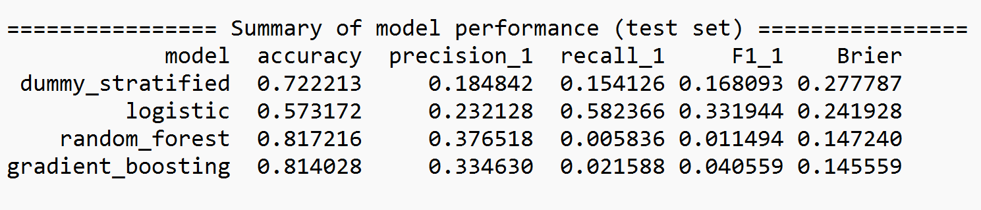





Model Summary (MAM+ ENSO)
Adding ENSO gives only a very small improvement to the logistic model; most of the predictive power still comes from local spring variables.
Figure 7: Model summary table (MAM+ ENSO)

Slide 10
Conclusion
1. Seasonal FWI in Manitoba is highly variable long-term trends are weak at the provincial scale.
2. Spring FWI is slightly higher in warmer, drier, windier springs, but correlations with individual variables are modest.
3. Because high-FWI days are rare, tree models look good on accuracy but hardly ever predict the high class.
4. Logistic regression gives the best balance for high-FWI detection
5.Adding ENSO only slightly changes model performance

Slide 11
Future Work
Apply imbalance handling techniques (class weights, resampling) and improve probability calibration.
Explore additional predictors such as soil moisture, vegetation indices and other climate indices to increase forecast skill for dangerous fire weather seasons.
Calculate the accuracy per station to investigate the reason and results

Slide 12
References
https://cwfis.cfs.nrcan.gc.ca/background/summary/fwi
Van Wagner, C. E. (1987). Development and structure of the Canadian Forest Fire Weather Index System. Canadian Forestry Service, Forestry Technical Report.
Vitolo, C., Di Giuseppe, F., Krzeminski, B., & San-Miguel-Ayanz, J. (2019). A 1980–2018 global fire danger re-analysis dataset for the Canadian Fire Weather Indices. Scientific Data, 6, 196. https://doi.org/10.1038/sdata.2019.32
Di Giuseppe, F., Vitolo, C., Barnard, C., Libertá, G., Maciel, P., San-Miguel-Ayanz, J., et al. (2024). Global seasonal prediction of fire danger. Scientific Data, 11, 128. https://doi.org/10.1038/s41597-024-02948-3 Nature+1
Bedia, J., Golding, N., Casanueva, A., Iturbide, M., Buontempo, C., & Gutiérrez, J. M. (2018). Seasonal predictions of Fire Weather Index: Paving the way for their operational applicability in Mediterranean Europe. Climate Services, 9, 101–110. https://doi.org/10.1016/j.cliser.2017.04.001 ScienceDirect+1
Shmuel, A., Lazebnik, T., Heifetz, E., Glickman, O., & Price, C. (2025). Fire weather indices tailored to regional patterns outperform global models. npj Natural Hazards, 2, 74. https://doi.org/10.1038/s44304-025-00126-y Nature
Chen, Y., Morton, D. C., Andela, N., Giglio, L., & Randerson, J. T. (2016). How much global burned area can be forecast on seasonal time scales using sea surface temperatures? Environmental Research Letters, 11, 045001.

