Slide 1
We need your consent to proceed
This research project is conducted at Ghent University and Université libre de Bruxelles. In this experiment, you will play a simple decision-making game. The data we collect during the experiment are not linked to any potentially identifying information. These data will solely be used for research purposes. Anonymized data from the study will be registered and archived at a trusted public data repository to make them available to other researchers in line with current data sharing practices. You are free to stop the experiment by closing your browser window at any time. Non-participation or withdrawal from the study will not be of any disadvantage to you. If you have any questions, you can contact Zhang Chen at zhang.chen@ugent.be and/or Nilosmita Banerjee at nilosmita.banerjee@ulb.be.
By clicking “I agree” (scroll down if you don’t see the button), you affirm that you are at least 18 years of age, which is the minimum age to participate in this study, and that you understand the nature of your participation in this research. If you do not wish to participate, please close this window.

Slide 2
Welcome! In this experiment, you will play a simple decision-making game. You can use the computer mouse (recommended) or the touchpad to play this game. The whole experiment will take around 15 minutes.
IMPORTANT: Do not refresh the page during the experiment. Refreshing the page will restart the experiment from the beginning.

Slide 3
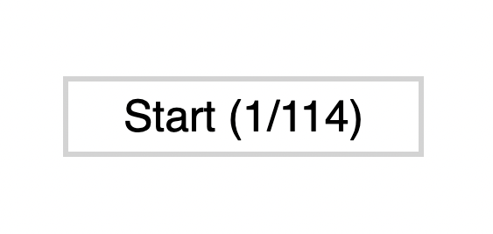
At the beginning of each trial, you will see a Start button (see above), with the total number of trials (in this e.g., 114) and the current trial number. Whenever you are ready, click on this button to start a trial.

Slide 4
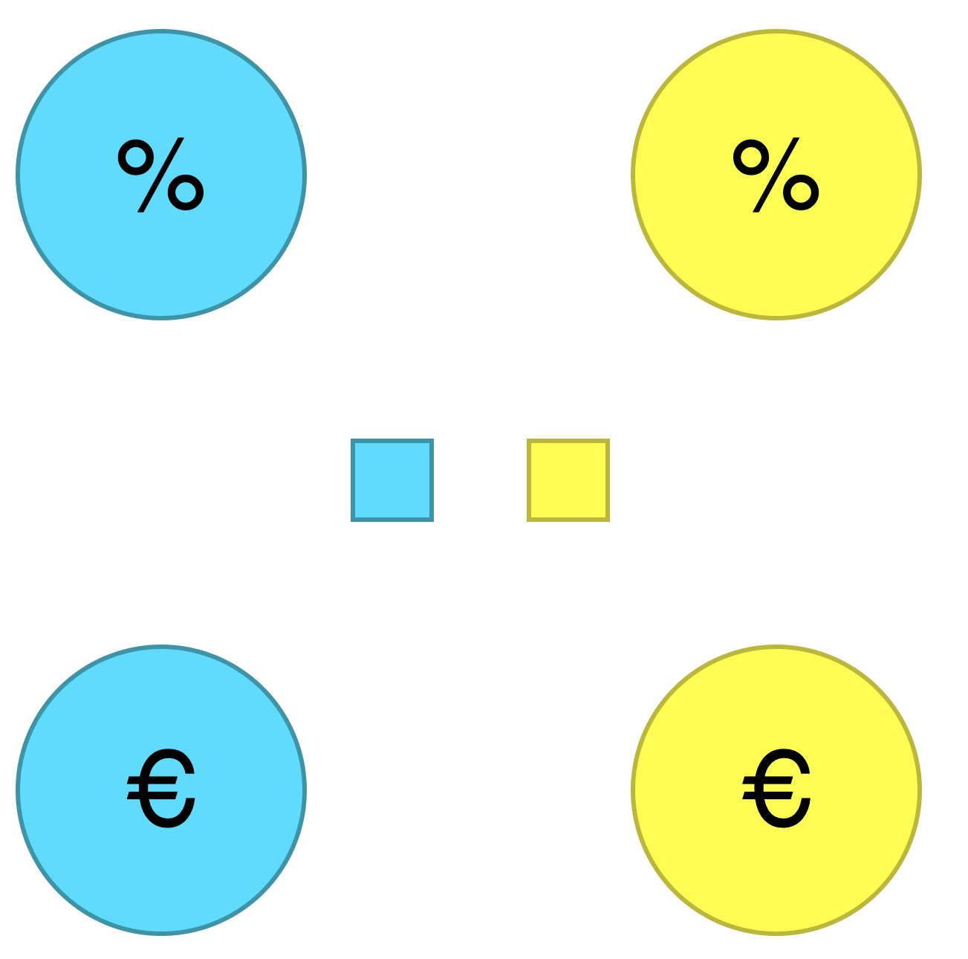
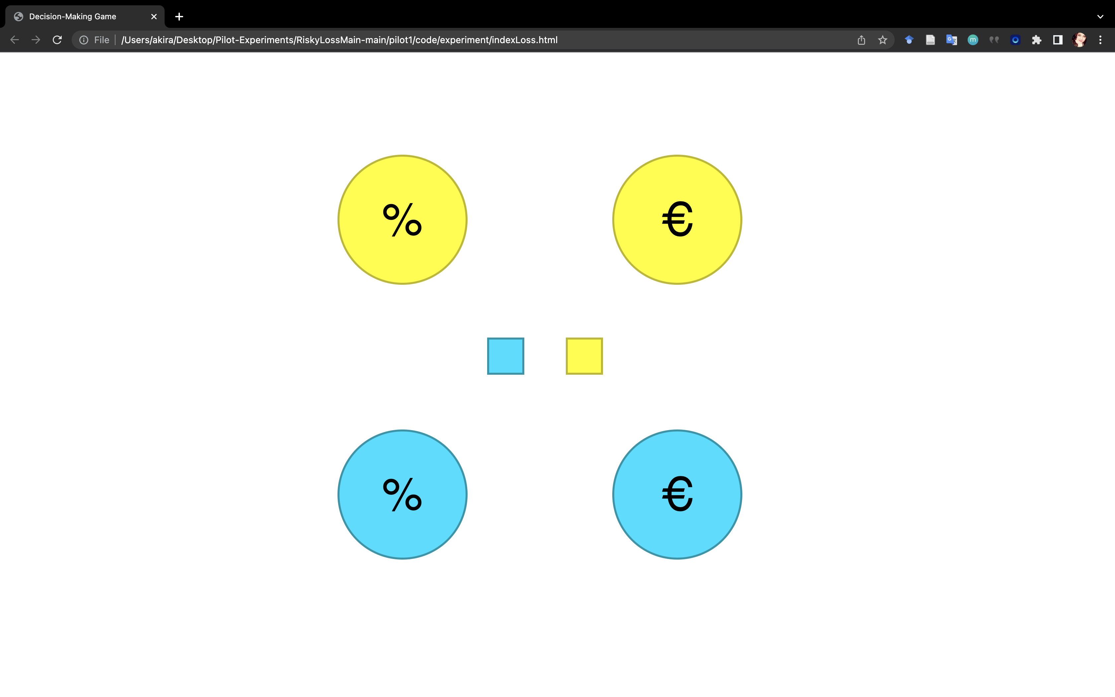
You will then see four circles presented on screen in 2 orientations (see Fig 1 & 2) presenting you with two gamble options:
Blue Gamble (indicated by the blue circles).
Yellow Gamble (indicated by the yellow circles).
Fig. 1: Left-Right orientation
Fig. 2: Top-Down orientation

Slide 5
Each gamble will present you with two pieces of information:
Amount information: Indicated by the € symbol. This circle tells you how many Euro cents you may loss (or not lose) in the current trial.
Probability information: Indicated by the % symbol. This circle tells you the probability of losing (or not losing) the amount indicated in the amount circle.

Slide 6
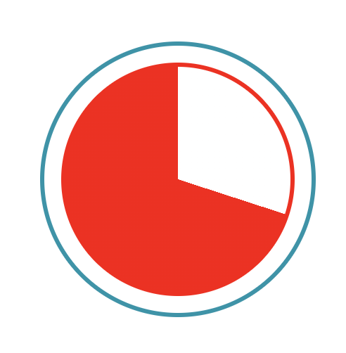
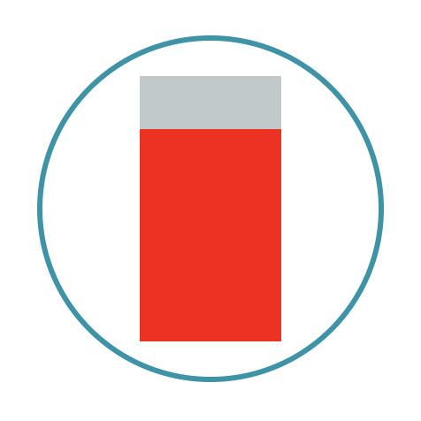
To see the amount and probability information, you need to move the mouse cursor inside each of the circles. You can do this for each gamble (Blue and Yellow) for each circle (amount and probability information) as many times as you would like.
Upon placing the mouse cursor inside the probability information circle you will see a pie-chart indicating the probability information in the colored part of the pie-chart (i.e., red part).
Likewise, upon placing the mouse cursor inside the amount information circle you will see a gray bar, with part of it colored red. The higher the red part, the more money you may lose. The total height of the gray bar is 100 cents (1 Euro).
The pie-chart (situated within the probability information circle) conveys the probability of losing the amount depicted in the amount bar (situated within the amount circle).

Slide 7
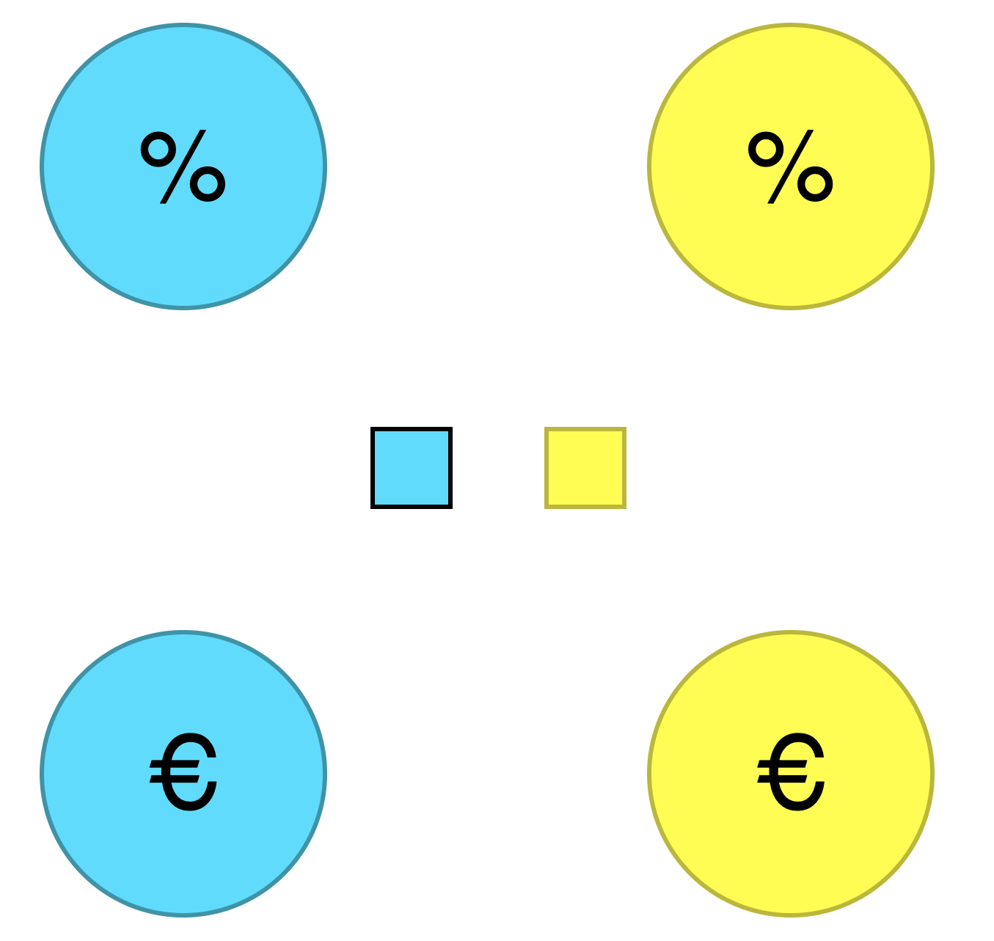

To chose a gamble of your choice click on the buttons presented in the middle of the screen in Blue (for selecting Blue gamble) and Yellow (for selecting the Yellow gamble).

Slide 8
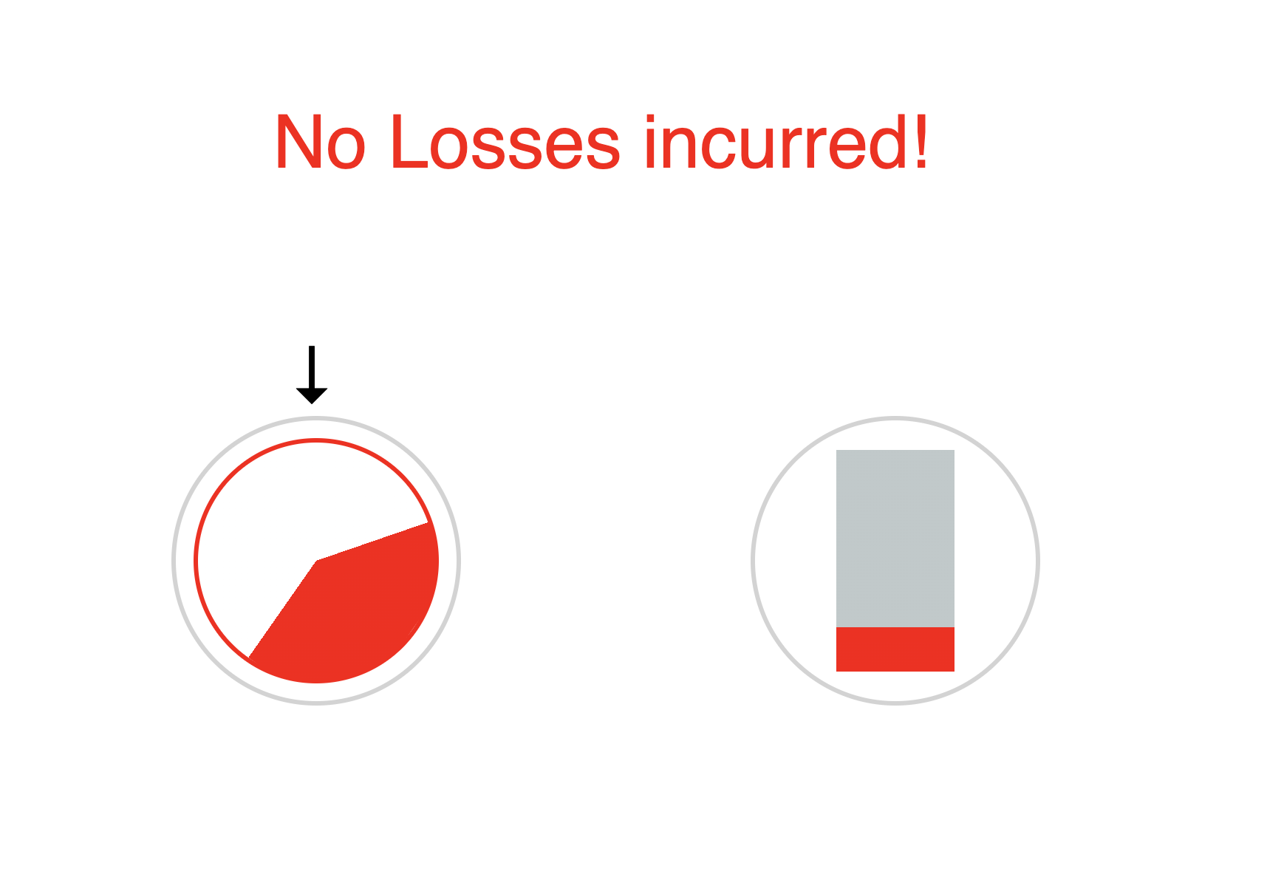
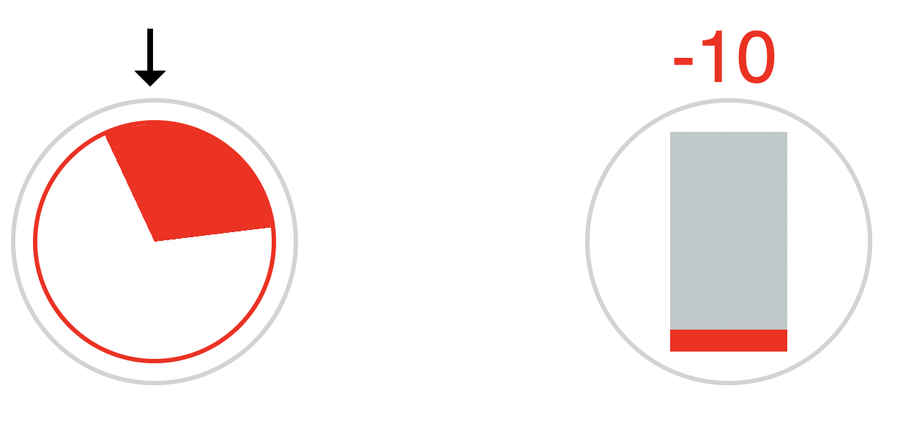
Following clicking on a gamble of your choice you will be directed to a screen in which you will view the probability and amount information of the chosen gamble. Upon landing on this page, the pie-chart will spin for approximately 1500 ms. Once the pie-chart stops spinning if the colored part is under the arrow (e.g., Fig 2) then you will have incurred a loss corresponding to the amount indicated in the amount bar.
Contrarily, if the pie-chart stops with the white part is under the arrow (e.g., Fig 1) then you will have incurred no losses (i.e., the amount indicated in the amount bar will not be deducted from your total).
Fig. 1: No Losses Outcome
(Outcome possibility – 1)
Fig. 2: Loss Outcome
(Outcome possibility – 2)

Slide 9
If there is anything unclear about the rules, you can go back to the previous (by pressing the previous button below) pages and read them again.
You will first get 6 trials to get familiar with the task. The results from these practice trials do not count.

Slide 10
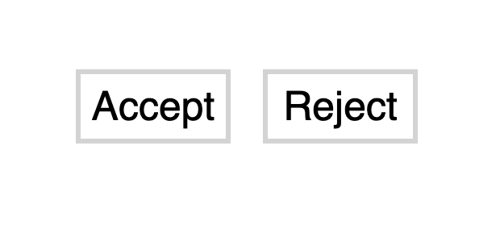
After you have seen both the win and loss amount, two choice options will appear on screen (see above). Note that you can continue checking the win and loss amount, if you have not made up your mind yet. You need to decide whether you want to play the current game. If you want to play it, click on Accept. If you do not want to play, click on Reject.

Slide 11
Fig. 1: Left-Right orientation
Fig. 2: Top-Down orientation
You will then see four circles presented on screen presented in 2 orientations (see Fig 1 & 2).
One circle is green, and contains the letter W (above, left). This circle tells you how many British pence you may win in the current trial.
The other circle is red, and contains the letter L (above, right). This circle tells you how many British pence you may lose in the current trial.

Slide 12


To see the win amount, you need to move the mouse cursor into the green circle. You will see a gray bar, with part of it colored green. The higher the green part, the more money you may win. The total height of the gray bar is 100 pence (1 pound).
Likewise, to see the loss amount, you move the mouse cursor into the red circle. The higher the red part, the more money you may lose. The total height of the gray bar is 100 pence.

Slide 13
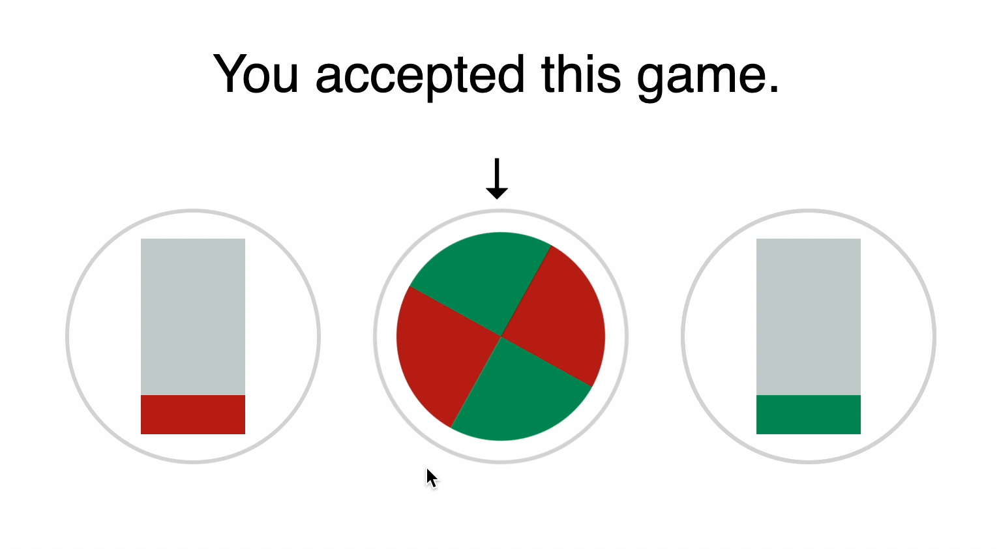
If you accept the game, there is a 50% chance of winning and 50% chance of losing. The outcome will be determined by a spinning wheel (see above). If the arrow ends up pointing at green, you win and will get the money in the green bar. If the arrow ends up pointing at red, you lose the money in the red bar.
If you reject the game, you will not win or lose any money (thus, you get 0).

Slide 14
That was the practice. The rules for the real task are the same. You will now play 114 trials in total. At the end of the experiment, the program will randomly pick 10 trials, and add up the money on these 10 trials. You can win a maximum of 1 British pound as bonus. In case your total is 0 or negative, you will not get any bonus.
We did not include any breaks. However, feel free to take short breaks between trials, if necessary. Good luck!
IMPORTANT: Do not refresh the page during the experiment. Refreshing the page will restart the experiment from the beginning.

