Slide 1
We need your consent to proceed
This research project is conducted at Université libre de Bruxelles and Ghent University. In this experiment, you will play a simple decision-making game. The data we collect during the experiment are not linked to any potentially identifying information. These data will solely be used for research purposes. Anonymized data from the study will be registered and archived at a trusted public data repository to make them available to other researchers in line with current data sharing practices. You are free to stop the experiment by closing your browser window at any time. Non-participation or withdrawal from the study will not be of any disadvantage to you. If you have any questions, you can contact Nilosmita Banerjee at nilosmita.banerjee@ulb.be and/or Zhang Chen at zhang.chen@ugent.be.
By clicking “I agree” (scroll down if you don’t see the button), you affirm that you are at least 18 years of age, which is the minimum age to participate in this study, and that you understand the nature of your participation in this research. If you do not wish to participate, please close this window.

Slide 2
Welcome! In this experiment, you will play a simple decision-making game. You can use the computer mouse (recommended) or the touchpad to play this game. The whole experiment will take around 15 minutes.
IMPORTANT: Do not refresh the page during the experiment. Refreshing the page will restart the experiment from the beginning.

Slide 3
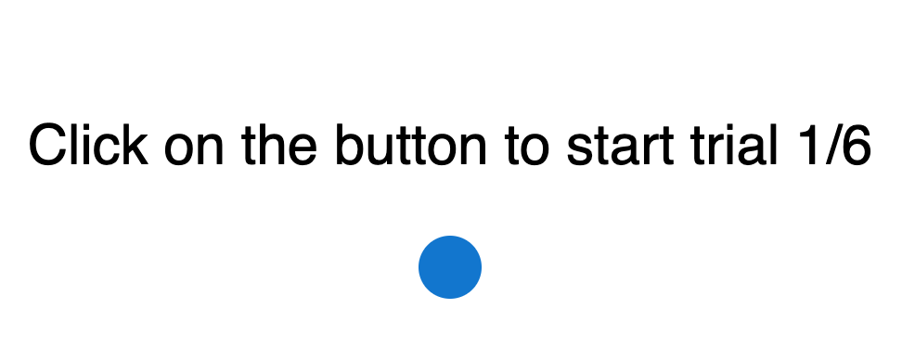
At the beginning of each trial, you will see a Start button (see above), with the total number of trials (in this example, 6 trials) and the current trial number. Whenever you are ready, click on this button to start a trial.

Slide 4
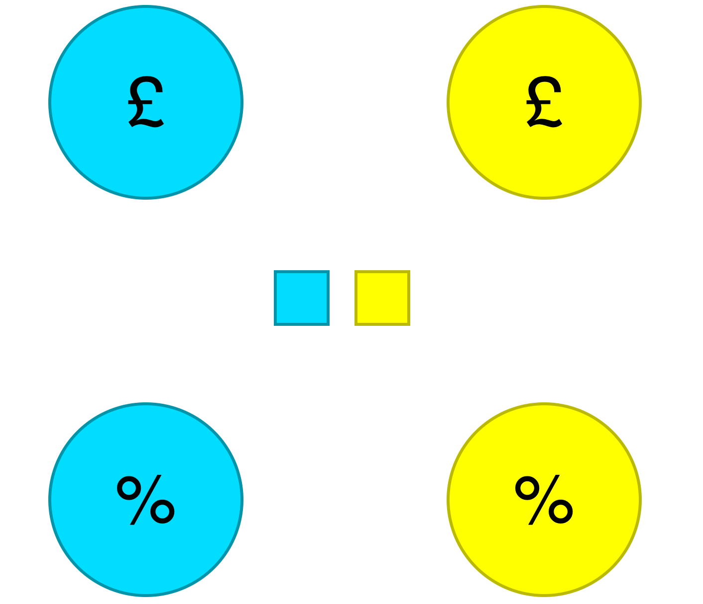
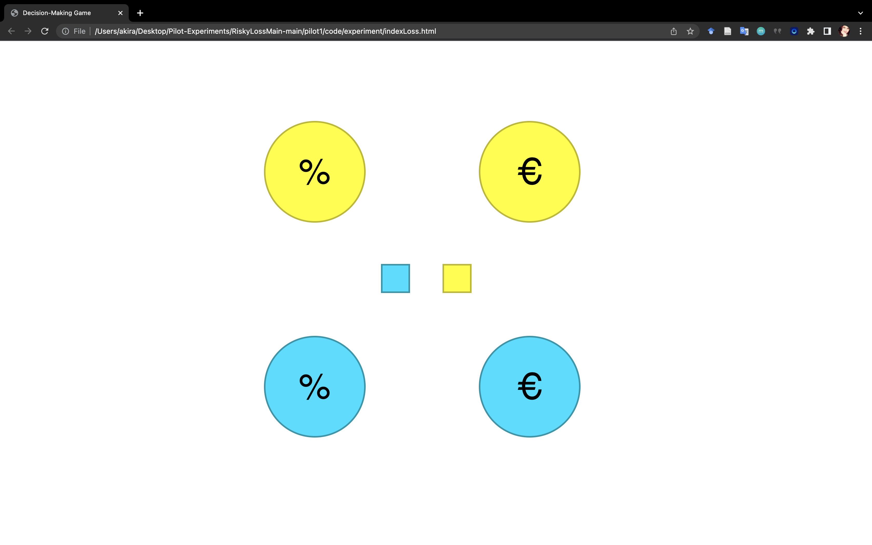
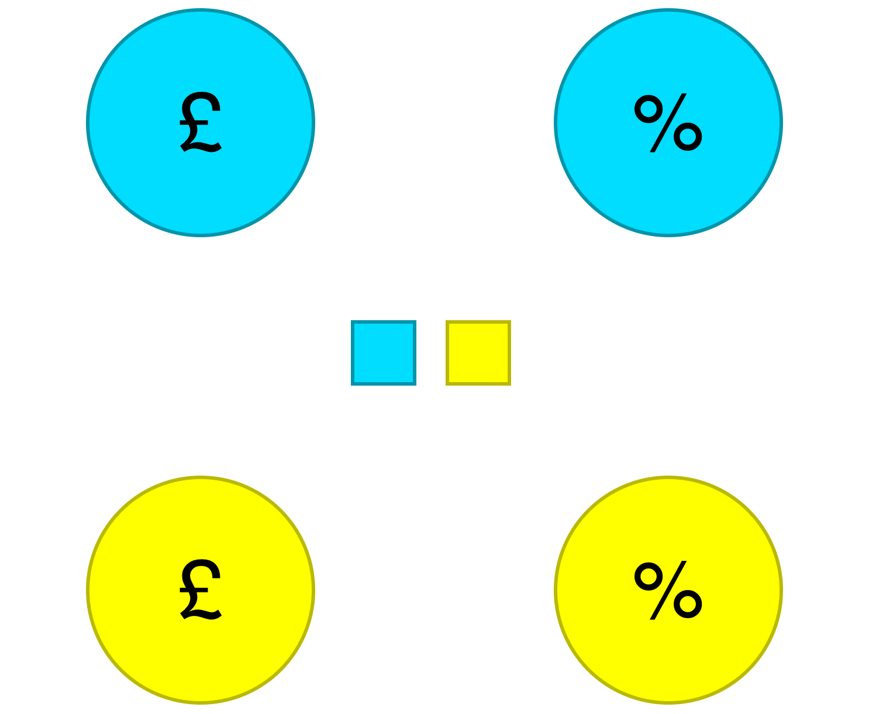
You will then see two options, a blue option and a yellow option. Each option will have two circles, colored either blue or yellow.
The two options will be shown either horizontally from left to right (Fig. 1) or vertically from top to bottom (Fig. 2).
Fig. 1: Left-Right orientation
Fig. 2: Top-Down orientation

Slide 5
Each option will contain two pieces of information, shown in two circles:
Amount circle: Indicated by the £ symbol. This circle tells you how many British pence you may win for a certain option.
Probability circle: Indicated by the % symbol. This circle tells you the probability of winning for a certain option.
Amount circle
Probability circle

Slide 6


To see the win amount and win probability of an option, you need to move the mouse cursor inside each of the circles.
For instance, when you move the mouse cursor inside the amount circle, you will see a gray bar, with part of it colored green. The higher the green part, the more money you may win. The total height of the bar is 100 pence (1 Pound).
The example below shows that if you choose the yellow option, you may win 30 British pence.
Move the cursor inside an amount circle to see how much you may win

Slide 7
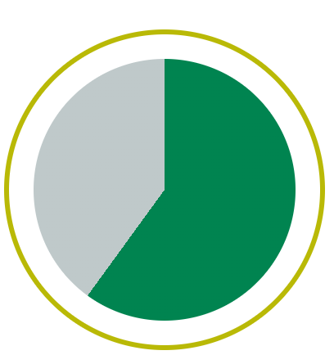
Similarly, when you move the mouse cursor inside the probability circle, you will see a gray pie-chart, with part of it colored green. The larger the green part, the higher your chance of winning.
The example below shows that if you choose the yellow option, you have about 60% chance of winning.
Move the cursor inside a probability circle to see the chance of winning

Slide 8
Together, in this example, if you choose the yellow option, you will have a 60% chance of winning 30 British pence (see below).
The blue option will have a different chance of winning a different amount. You can see the amount and probability of the blue option in the same way.
You can move the mouse cursor inside the circles for as many times as you want.
Amount circle
Probability circle

Slide 9

You need to decide which option you want to choose. To choose an option, click on one of the buttons in the middle of the screen (click on the blue button to select the blue option, and the yellow button to select the yellow option).
Suppose in this example you choose the yellow option. You click on the yellow button (see below).

Slide 10
The selected option will then be shown. The pie-chart will start spinning and stop after a while. If the arrow ends up pointing at the green region, you win the amount depicted in the amount circle (e.g., Fig 1).
Contrarily, if the arrow ends up pointing at the gray region, then you do not win any money (e.g., Fig 2).
+30
0
Fig. 1: You win!
Fig. 2: You do not win.

Slide 11
If there is anything unclear about the rules, you can go back to the previous pages (by pressing the previous button below) and read them again.
You will first get 6 trials to get familiar with the task. The results from these practice trials do not count.

Slide 12
That was the practice. The rules for the real task are the same. You will now play 114 trials in total. At the end of the experiment, the program will randomly pick 10 trials, and add up the money on these 10 trials. You can win a maximum of 1 British pound as bonus. In case your total is 0 or negative, you will not get any bonus.
We did not include any breaks. However, feel free to take short breaks between trials, if necessary. Good luck!
IMPORTANT: Do not refresh the page during the experiment. Refreshing the page will restart the experiment from the beginning.

