Slide 1
Feedforward neural network
Simulate episodes (~ 10,000 steps), store $T(s_{t},a,r,s_{t+1})$.

Slide 2
Feedforward neural network
Simulate episodes (~ 10,000 steps), store $T(s_{t},a,r,s_{t+1})$.
Network Architecture: $input=29,h_{2}=100,h_{3}=100,output=4$

Slide 3
Feedforward neural network
Simulate episodes (~ 10,000 steps), store $T(s_{t},a,r,s_{t+1})$.
Network Architecture: $input=29,h_{2}=100,h_{3}=100,output=4$
Loss function: $Q_{a}-[r+γ.max(Q_{next})]$

Slide 4
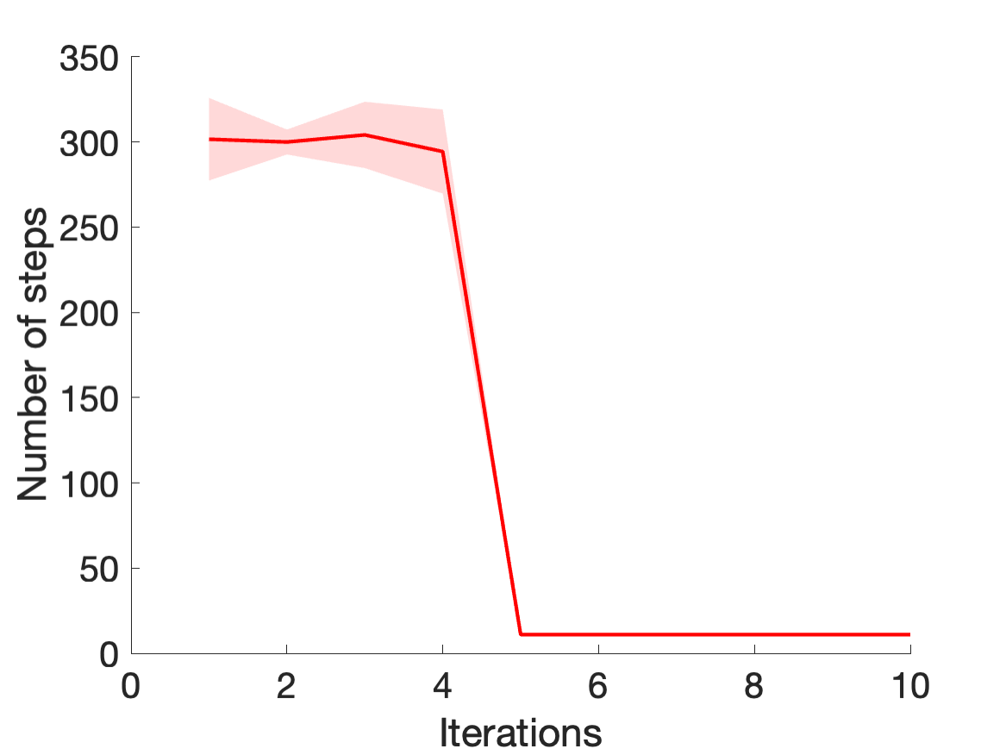
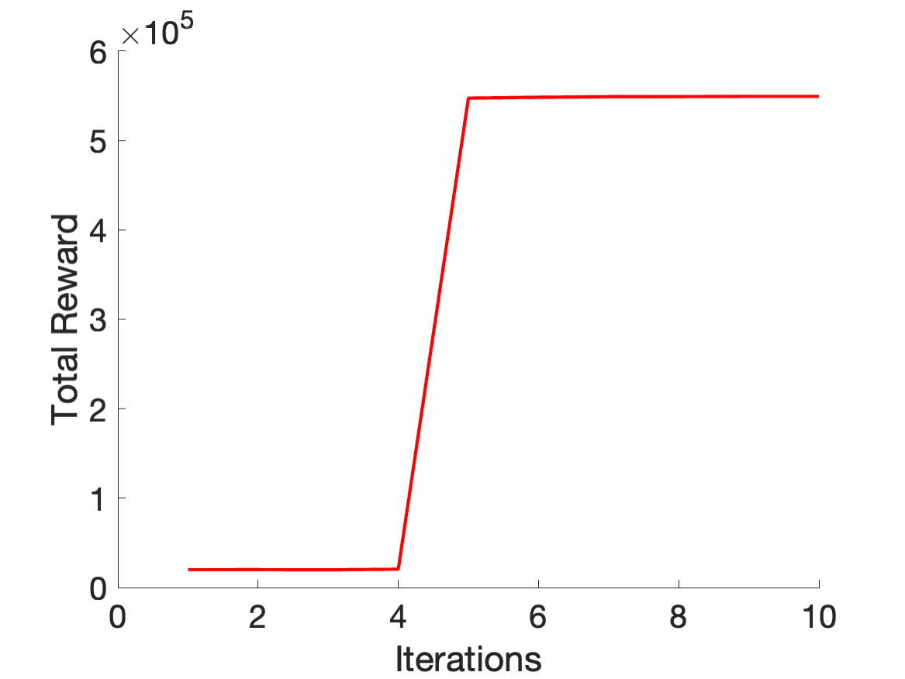
Feedforward neural network
Simulate episodes (~ 10,000 steps), store $T(s_{t},a,r,s_{t+1})$.
Network Architecture: $input=29,h_{2}=100,h_{3}=100,output=4$
Loss function: $Q_{a}-[r+γ.max(Q_{next})]$

Slide 5
Quantifying conjunctive representation:

Slide 6
Quantifying conjunctive representation:
Disentanglement
(Chen 2018)

Slide 7
Quantifying conjunctive representation:
$$f(Shape)$$
OR
$$f(Color,Shape)$$
$$f(Color)$$
$$f(Color,Shape)$$
Mutual Information Gap
Disentanglement
(Chen 2018)

Slide 8
Quantifying conjunctive representation:
$$f(Shape)$$
OR
$$f(Color,Shape)$$
$$f(Color)$$
$$f(Color,Shape)$$
$$\frac{1}{k}\overset{k}{\underset{k=1}{∑}}\frac{1}{H(v_{k})}(I_{n}(z_{j_{k}};v_{k})-max_{j=j_{k}}I(z_{j};v_{k}))$$
Mutual Information Gap
Disentanglement
(Chen 2018)

Slide 9
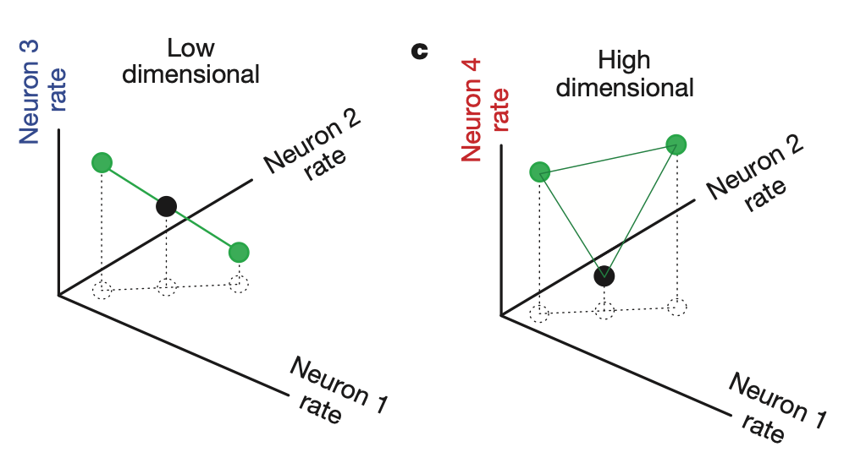
Quantifying conjunctive representation:
$$f(Shape)$$
OR
$$f(Color,Shape)$$
$$f(Color)$$
$$f(Color,Shape)$$
$$\frac{1}{k}\overset{k}{\underset{k=1}{∑}}\frac{1}{H(v_{k})}(I_{n}(z_{j_{k}};v_{k})-max_{j=j_{k}}I(z_{j};v_{k}))$$
Mutual Information Gap
Variance Explained
Disentanglement
(Chen 2018)
Dimensionality
(Rigotti 2013)

Slide 10
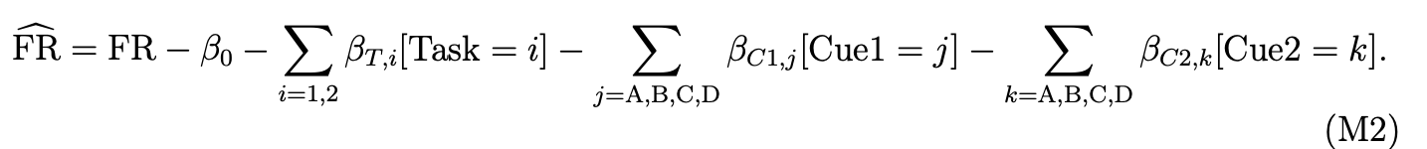
Quantifying conjunctive representation:
$$f(Shape)$$
OR
$$f(Color,Shape)$$
$$f(Color)$$
$$f(Color,Shape)$$
$$\frac{1}{k}\overset{k}{\underset{k=1}{∑}}\frac{1}{H(v_{k})}(I_{n}(z_{j_{k}};v_{k})-max_{j=j_{k}}I(z_{j};v_{k}))$$
Mutual Information Gap
Variance Explained
Disentanglement
(Chen 2018)
Dimensionality
(Rigotti 2013)

Slide 11
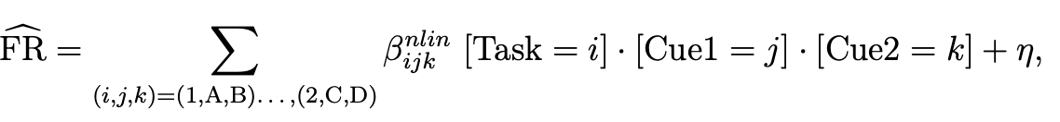
Quantifying conjunctive representation:
$$f(Shape)$$
OR
$$f(Color,Shape)$$
$$f(Color)$$
$$f(Color,Shape)$$
$$\frac{1}{k}\overset{k}{\underset{k=1}{∑}}\frac{1}{H(v_{k})}(I_{n}(z_{j_{k}};v_{k})-max_{j=j_{k}}I(z_{j};v_{k}))$$
Mutual Information Gap
Variance Explained
Disentanglement
(Chen 2018)
Dimensionality
(Rigotti 2013)

Slide 12

Next Step: Moving Closer to Biological case
Time Step 1
Time Step 2
Time Step 3
Loc Unit
Loc Unit
Loc Unit
Odor Unit

Slide 13
Next Step: Moving Closer to Biological case
Time Step 1
Time Step 2
Time Step 3
Loc Unit
Loc Unit
Loc Unit
Odor Unit
Loc Unit
Loc Unit
Loc Unit
Odor Unit

Slide 14
Next Step: Moving Closer to Biological case
For n iterations:
Run the agent in the arena for 2500 steps and store $T(s_{t},a,r,s_{t+1})$
Forward pass the model on each step and store action Q values for each time step.
Train a simple RNN on sequences of fixed length ( e.g. 20 steps)
Use the stored action Q values for each state and the output of the RNN to calculate the loss function.

