Slide 1
LIDOCAINE
INJECTION, USP
20 mg/ml
2mL Rx-only

Slide 2
LIDOCAINE
INJECTION, GSP
20 mg/ml
2mL Rx-only

Slide 3
LIDOCAINE
INJECTION, FSP
20 mg/ml
2mL Rx-only

Slide 4
LIDOCAINE
INJECTION, KSP
20 mg/ml
2mL Rx-only

Slide 5
LIDOCAINE
INJECTION, QSP
20 mg/ml
2mL Rx-only

Slide 6
LIDOCAINE
INJECTION, DSP
20 mg/ml
2mL Rx-only

Slide 7
LIDOCAINE
INJECTION, LSP
20 mg/ml
2mL Rx-only

Slide 8
LIDOCAINE
INJECTION, CSP
20 mg/ml
2mL Rx-only

Slide 9
LIDOCAINE
INJECTION, iSP
20 mg/ml
2mL Rx-only

Slide 10
LIDOCAINE
INJECTION, YSP
20 mg/ml
2mL Rx-only

Slide 11
LIDOCAINE
INJECTION, ZSP
20 mg/ml
2mL Rx-only

Slide 12
LIDOCAINE
INJECTION, VSP
20 mg/ml
2mL Rx-only

Slide 13
LIDOCAINE
INJECTION, XSP
20 mg/ml
2mL Rx-only

Slide 14
LIDOCAINE
INJECTION, MSP
20 mg/ml
2mL Rx-only

Slide 15
Home
Chart
Financial
Insurance
Documents
Medication
Lab
EMERGENT
– IMMEDIATE –
Vital Signs
Blood Pressure: 140/90 mmHg
Pain level: 7 / 10
Respiratory Rate: 35 breaths/min
Weight: 75 kg
Oxygen Saturation: 95 %
Height 175 cm
Heart Rate: 120 bpm
HPI:
Jon Doh, a 28-year-old previously healthy male, presents to the emergency department with a sudden onset of severe central chest pain, which he describes as a 7/10 “crushing” sensation. The pain began approximately one hour ago while he was jogging and has been constant since. It radiates to his left shoulder and is accompanied by marked shortness of breath. He reports feeling lightheaded and sweaty, with palpitations. He denies any previous episodes of similar pain, recent trauma, fever, or cough. Only uses PRN medications such as sumatriptan or salbutamol and has no known chronic health issues. He denies smoking but occasionally drinks alcohol recreationally. There is no family history of early heart disease. He works a desk job and exercises irregularly. On arrival, he appears visibly distressed, breathing rapidly, and clutching his chest.

Slide 16
%SpO2
PRbpm
99
72

Slide 17
%SpO2
PRbpm
99
42

Slide 18
%SpO2
PRbpm
99
22

Slide 19
%SpO2
PRbpm
99
12

Slide 20
%SpO2
PRbpm
99
32

Slide 21
%SpO2
PRbpm
99
52

Slide 22
%SpO2
PRbpm
99
62

Slide 23
%SpO2
PRbpm
99
82

Slide 24
%SpO2
PRbpm
99
92

Slide 25
%SpO2
PRbpm
99
91

Slide 26
%SpO2
PRbpm
99
93

Slide 27
%SpO2
PRbpm
99
94

Slide 28
%SpO2
PRbpm
99
95

Slide 29
%SpO2
PRbpm
99
96

Slide 30
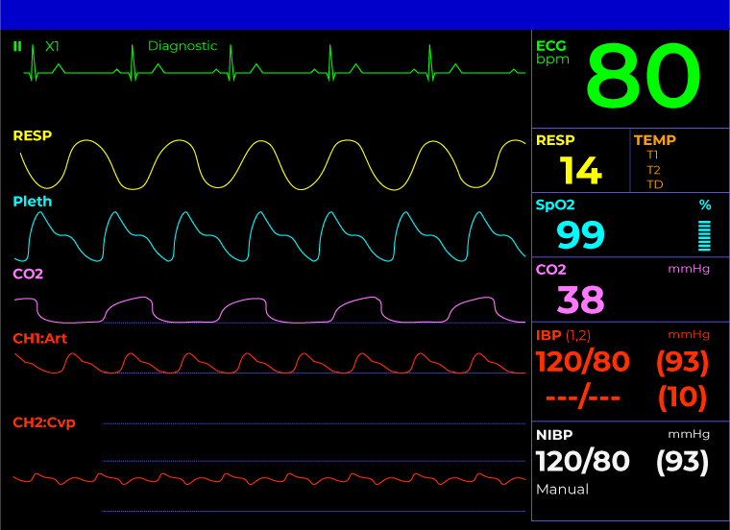
ECG
bpm
80
TEMP
SpO2
%
99
CO2
mmHg
38
IBP
mmHg
120/80 (93)
NIBP
mmHg
120/80 (93)

Slide 31
ECG
bpm
80
TEMP
SpO2
%
99
CO2
mmHg
38
IBP
mmHg
120/80 (93)
NIBP
mmHg
120/80 (93)

