Slide 1
Cyclistic_powerpoint
File created on: 3/1/2022 8:16:15 AM

Slide 2
TABLE OF CONTENT
INTRODUCTION
DATA INSIGHTS
SUMMARY
RECOMMENDATIONS
APPENDIX

Slide 3
“How do annual members and casual riders use Cyclistic bikes differently?”
Comparing the differences between casual riders and annual members in their usage of Cyclistic bike services
An analysis of 12 months of inhouse trip data from the Cyclistic bike share company based in Chicago
This analysis will assist future marketing strategies on converting casual riders to annual members

Slide 4

Insights from a full year's data April 2019 ~ Arpil 2020
Let’s dive in!

Slide 5
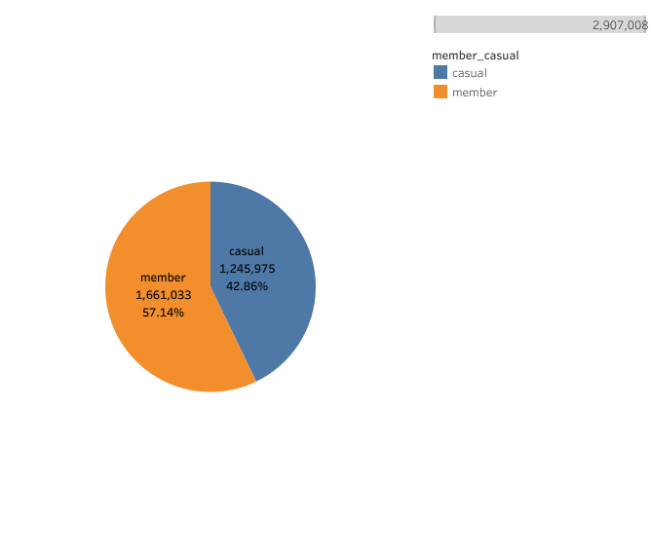
Total ride share for each user group
Insight #1
Members take 14% more trips than casual riders

Slide 6
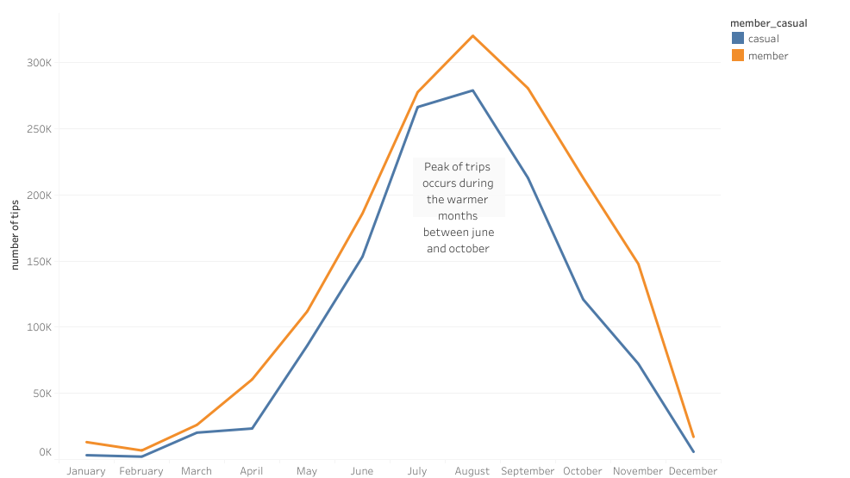
Trip distribution per month
Insight #2
Most trips are taken between
June and October

Slide 7
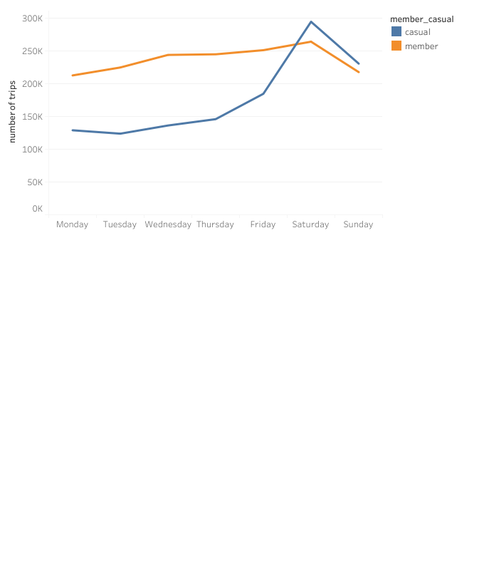
Trip distribution per WEEK
Insight #3
Casual riders take more trips during the weekend
Annual member trips are more evenly spread out during the week

Slide 8
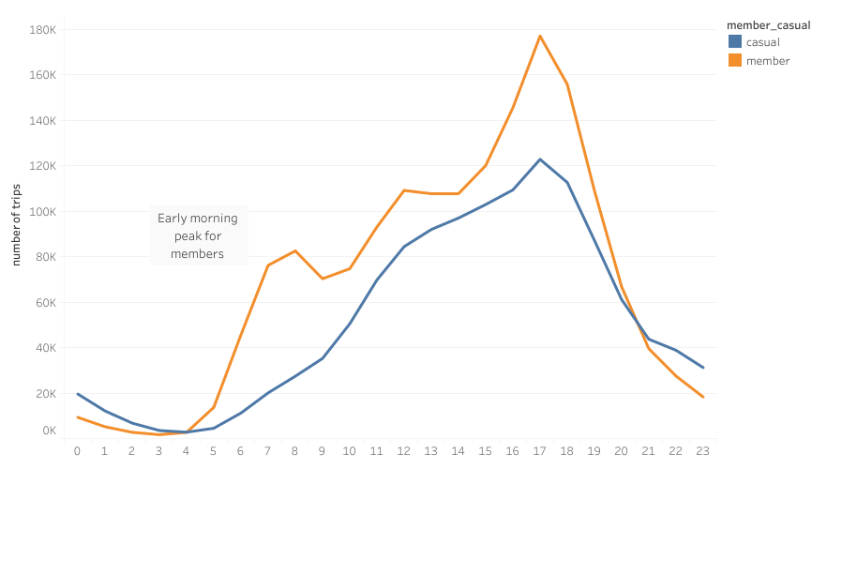
Trip distribution per day
Insight #4
Both groups take most trips between 16:00 and 19:00
There is an early morning peak for members

Slide 9
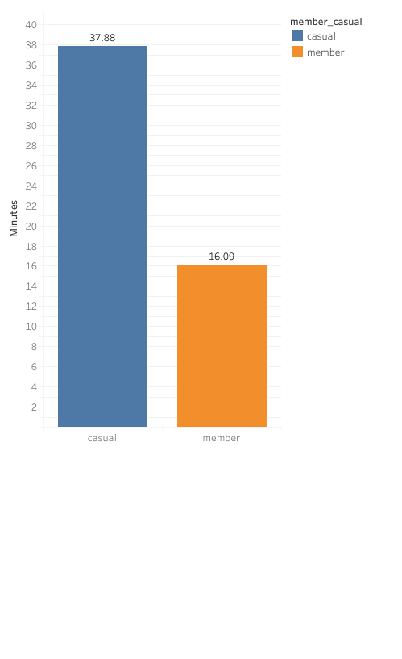
Average ride length
Insight #5
Casual riders take 2.3 times longer trips than members

Slide 10
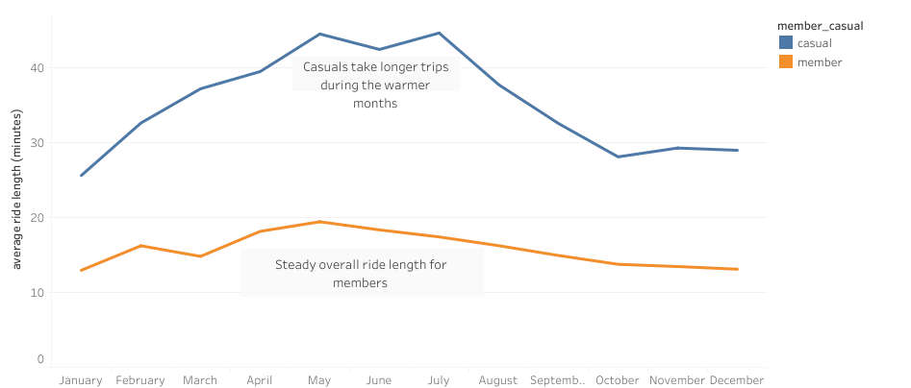
Average ride length per month
Insight #6
Casual riders take significantly longer trips between may and august
Member trips trip duration stay relatively the same throughout the year

Slide 11
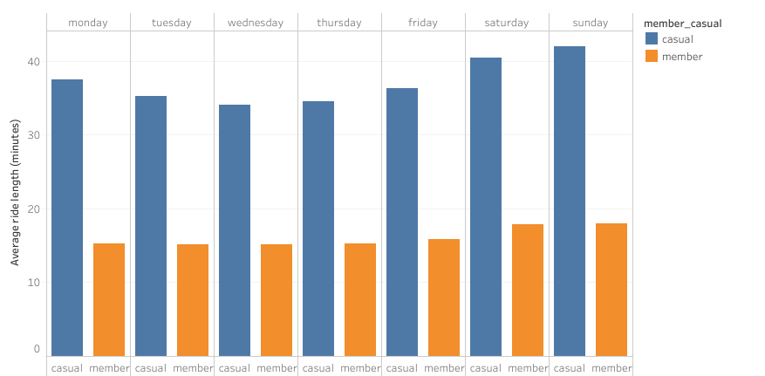
Insight #7
Casual riders take significantly longer trips every day of the week compared to members
Casual riders take the longest trips during the weekend
Average ride length per weekday

Slide 12
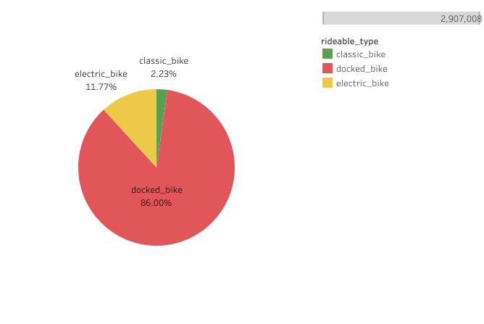
Insight #8
The docked bike is the most used bike type
Bike type distribution

Slide 13
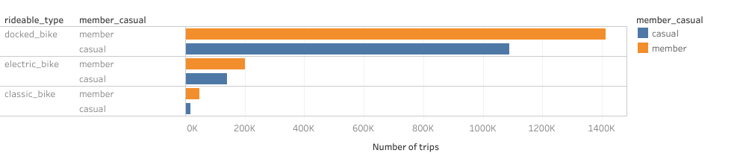
Bike type distribution per group
Insight #9
The classic bike is the least used bike type by both groups
But casual riders

Slide 14

SUMMARY
Bussines task:
How do annual members and casual riders use Cyclistic bikes differently?
Trip comparison
Members take 14% more trips than casual riders
Most trips are taken between June and October
Casual riders take more trips during the weekend
Both groups take most trips between 16:00 and 19:00 but there is an early morning peak for members
Ride length comparison
Casual riders take 2.3 times longer trips than members
Casual riders take significantly longer trips between may and august
Member trips trip duration stay relatively the same throughout the year
Bike-type comparison
The docked bike is the most used bike type
The classic bike is the least used bike type by both groups

Slide 15
Top 3 recommendations:
1. Introduce a weekend-only membership at a different price point than the full annual membership to entice casual users towards a full annual membership that is valid from Fridays to Sundays.
2. Introduce a half year only membership from May to October instead of the full year annual membership.
3. Combining the above-described recommendations, a third option would be to create a half year only membership that is only valid on Friday to Sunday.

Slide 16
To the marketing department
To effectively design future marketing strategies please keep in mind:
Between May and October most trips occur, peaking between July and September
On Friday, Saturday and Sundays most trips occur. Peaking on Saturday
Most trips start around 17:00 in the afternoon
In the appendix you will find the top 20 most used start/end stations and the most popular routes for casual riders

Slide 17
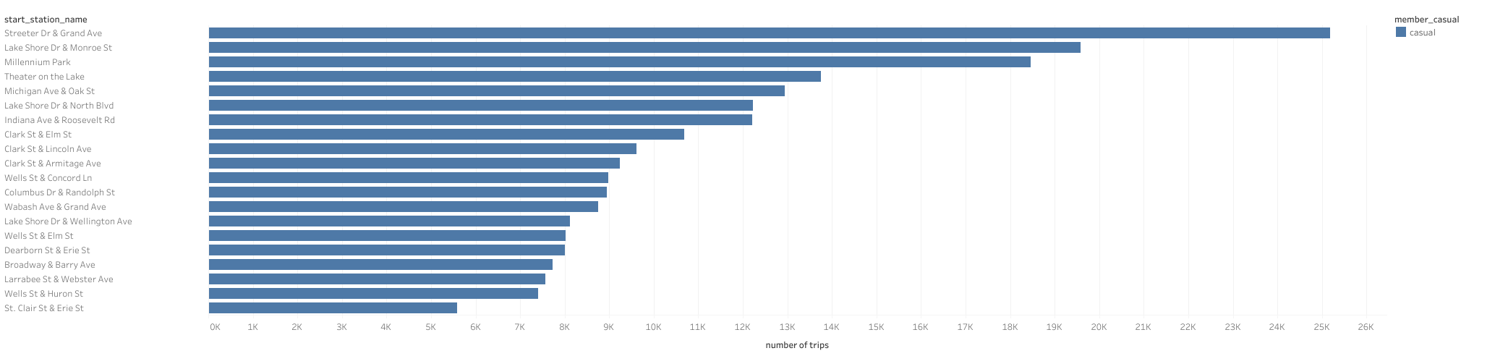

Slide 18
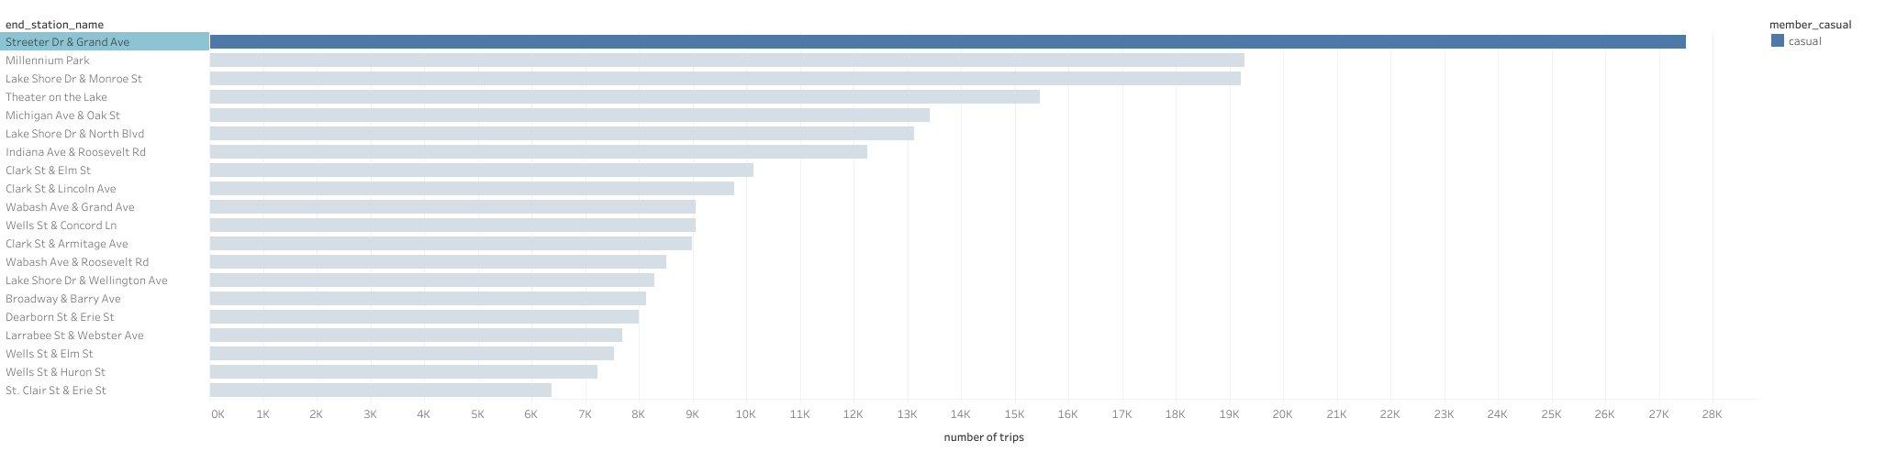

Slide 19
