Slide 1
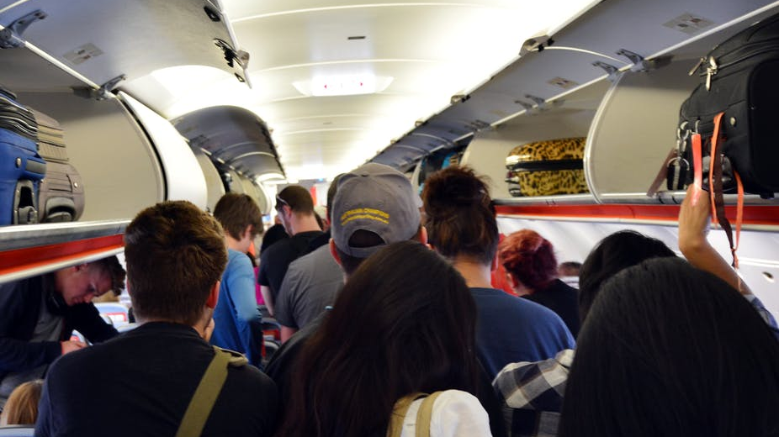
Airplane Boarding
Boarding as a Major Bottleneck
“Reducing passenger boarding time in airplanes: A simulation based approach” - H. Van Landeghem, A. Beuselinck
The Steffen Method vs. Common Methods
Agent-Based Boarding Model
Variable Airplane Specifications
Goals:
Realistic Boarding Simulation
Reproduce Landeghem and Beuselinck’s results and compare to Steffen Method
Gain insight on efficiency of various boarding techniques
Image: https://images.theconversation.com/files/65277/original/image-20141124-1034-fqtt8l.jpg?ixlib=rb-1.1.0&q=45&auto=format&w=926&fit=clip Date Accessed: 8.10.18
Papers: Landeghem, H Van, and A Beuselinck. “Reducing Passenger Boarding Time in Airplanes: A Simulation Based Approach.” European Journal of Operational Research, vol. 142, no. 2, Oct. 2002, pp. 294–308., doi:10.1016/s0377-2217(01)00294-6.
Steffen, Jason H. “Optimal Boarding Method for Airline Passengers.” Journal of Air Transport Management, vol. 14, no. 3, 2008, pp. 146–150., doi:10.1016/j.jairtraman.2008.03.003.

