Slide 1
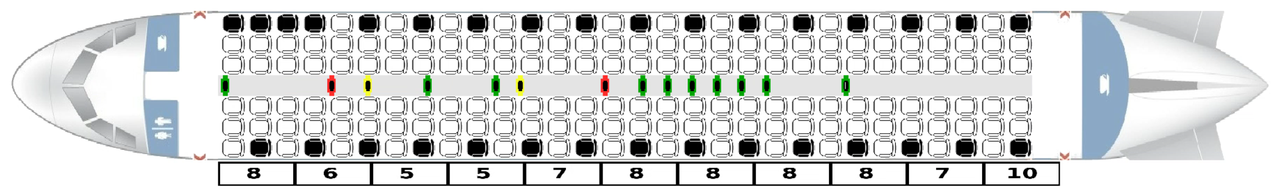
Airplane Boarding
Analysing different boarding methods using an Agent-Based model

Slide 2
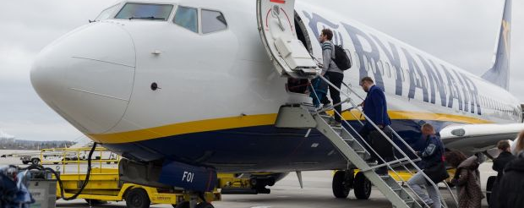
Introduction
Notes:
Relevance:
Business model budget airlines
More efficient use of planes and gates
Economical benefits
Minimizing Turn Time
Boarding as a main bottleneck
Boarding is often inefficient
How can we optimize?
Next slide methods and beus

Slide 3
Literature
“Reducing passenger boarding time in airplanes: A simulation based approach” H. Van Landeghem, A. Beuselinck
Agent-based model
Average plane
Compares different boarding methods
”Optimal boarding method for airline passengers.” J. H. Steffen
Proposes new boarding method
Supposedly fastest

Slide 4
Main Contributions
Reproduce H. Van Landeghem’s and A. Beuselinck’s results

Slide 9
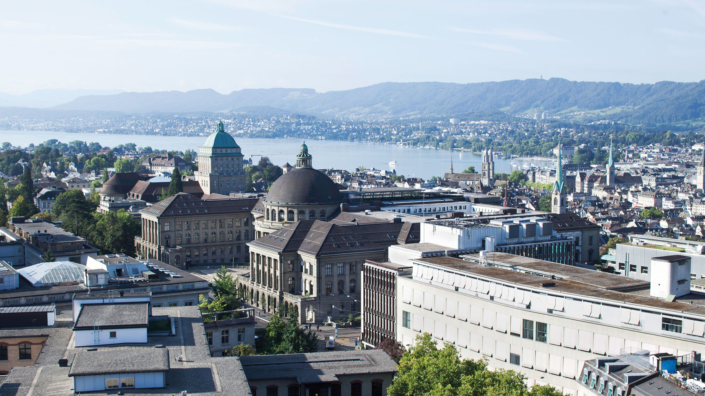

Slide 14
Contact information and credits
ETH Zurich
Organisational unit
Street address
Postcode City
www.ethz.ch/en.html
Publisher: Organisational unit of ETH Zurich
Design: Designer Name
Images: Credit (slide xx), Credit (slide xx)
© ETH Zurich, December 2013

Slide 15
https://www.irishtimes.com/business/transport-and-tourism/ryanair-punctuality-worsens-as-complaint-volumes-increase-1.3182401

