Slide 1






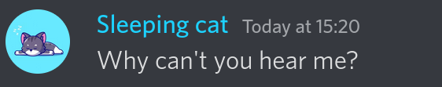
Leveling
Members earn xp by sending messages and speaking in voice channels
+1
+1
+0
+1

Slide 2
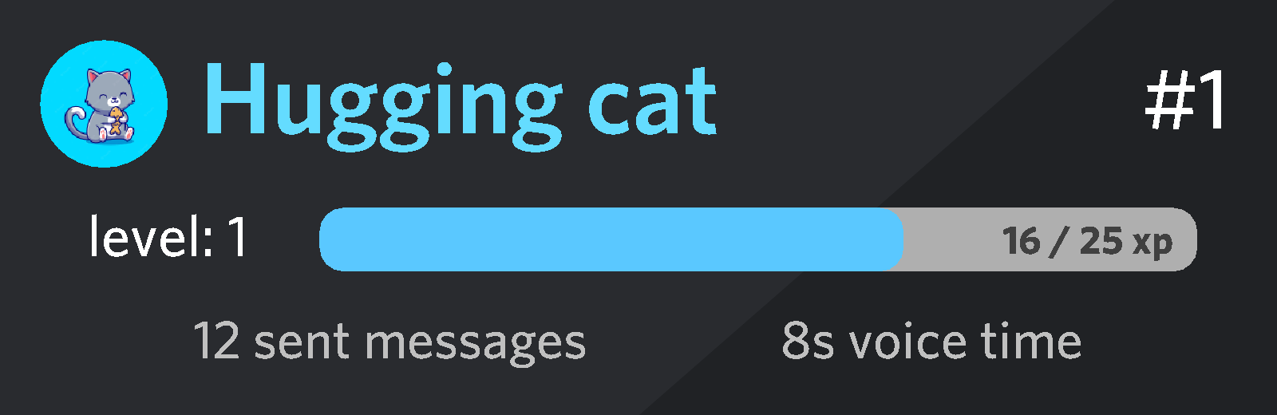
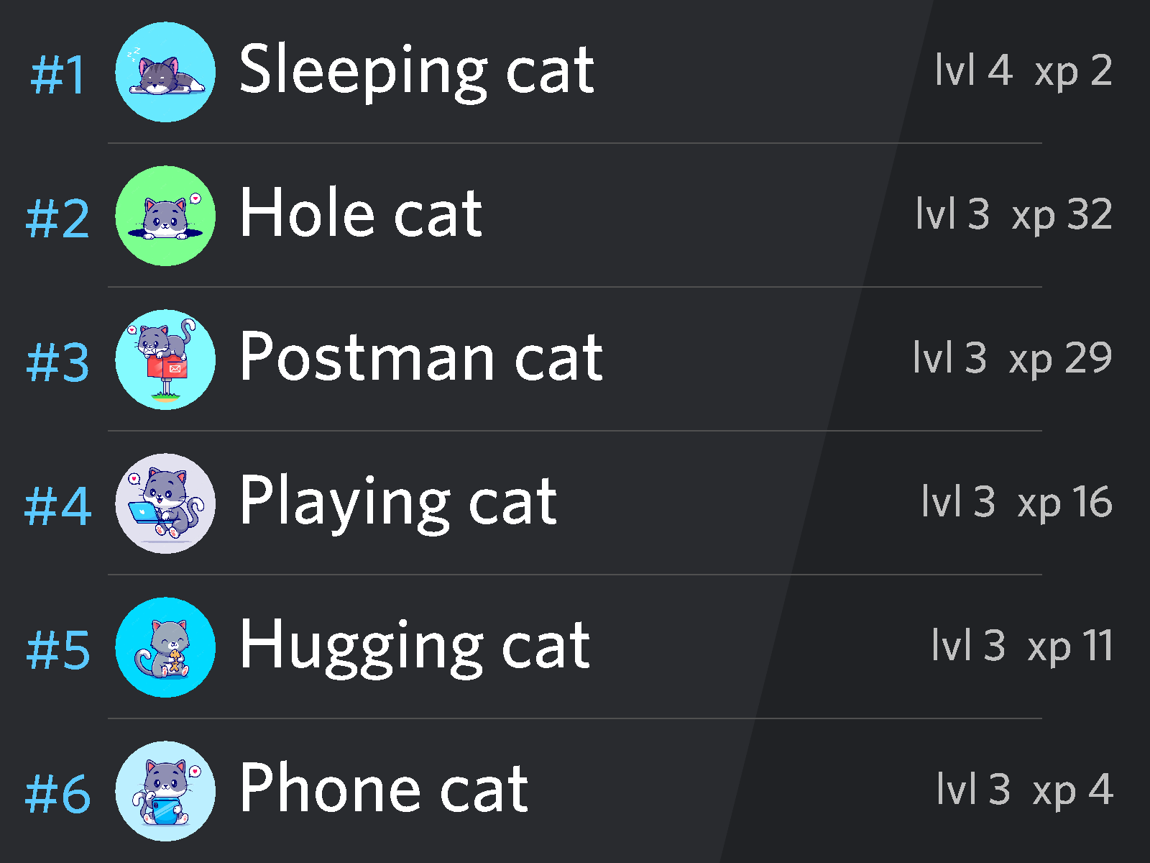
Check the stats of anyone
Look at the leaderboards

Slide 3
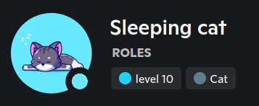

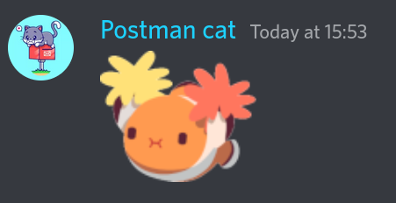
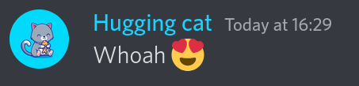
Reward your most active members with exclusive roles
And give them access to new channels

Slide 4
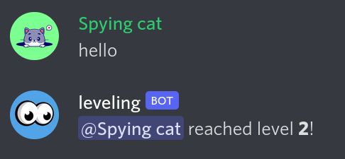


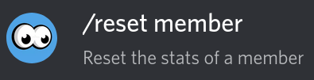
Add a level up message
Manage your members xp

Slide 5
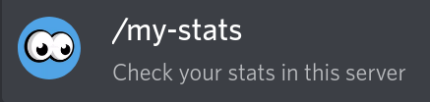





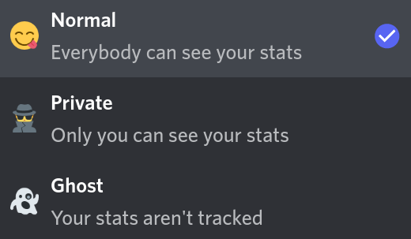
Easy-to-use with discord commands and buttons
Stop playing whenever you want

Slide 6
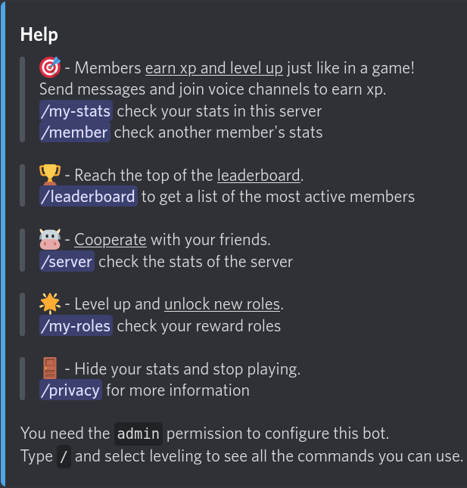
Add the bot and use /help to get started

