Slide 1
Identifying Nearby Molecules through Fingerprint Bit Flipping
Final Presentation
Nils Dunlop, Francisco Erazo, Qi Chen
Supervisor: Shirin Tavara, Christian Tyrchan

Slide 2
Agenda
Terminology
MolForge
Research problems 1 & 2
Literature review
Methodology research problem 1
Results for research problem 1
Valid, invalid and unique SMILES
1 Bit flipping
2 Bit flipping
4 Bit flipping
8 Bit flipping
Relation to Atoms and Molecular weight
Methodology for research problem 2
Results for research problem 2
Conclusions
Notes:
We are gonna to divide our presentation into 7 part

Slide 3
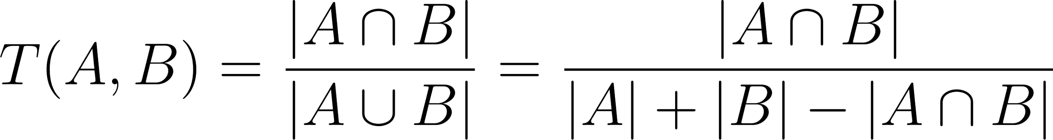
Terminology
SMILES = Cn1c(=O)c2c(ncn2C)n(C)c1=O
Fingerprints (ECFP4) = [0 0 1 … 0 1 0]
Tanimoto Similarity
MutiDimensional Scaling (MDS) = Dimensionality reduction technique that preserves distances between points.

Slide 4
Terminology
COX-2 inhibitors = class of drugs used for treating pain and inflammation.
Janus Kinase inhibitors = class of drugs that block JAK enzymes to treat autoimmune and inflammatory diseases.
Molecular Weight = the sum of atomic weights of all atoms in a molecule.

Slide 5
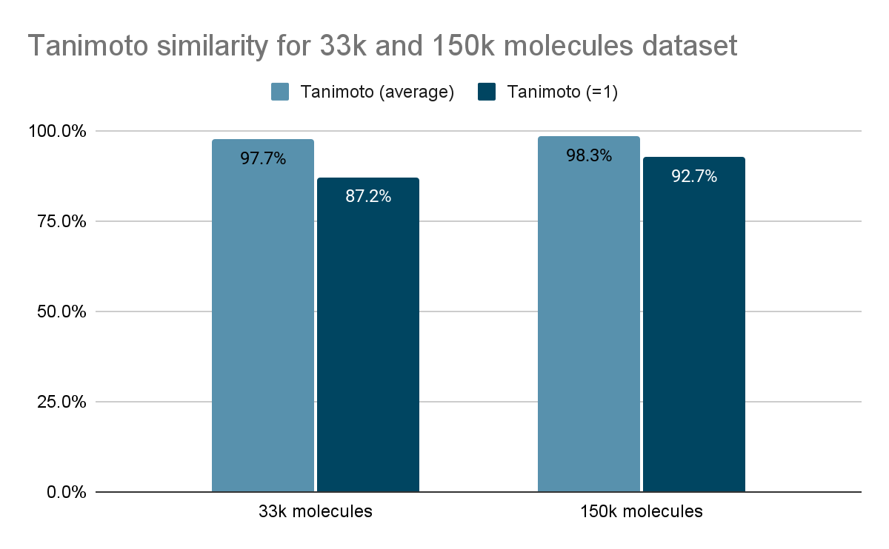
MolForge
We increased the test set from 33k molecules (mid-term presentation) to 150k molecules in order to evaluate the reconstruction capability of MolForge.

Slide 6

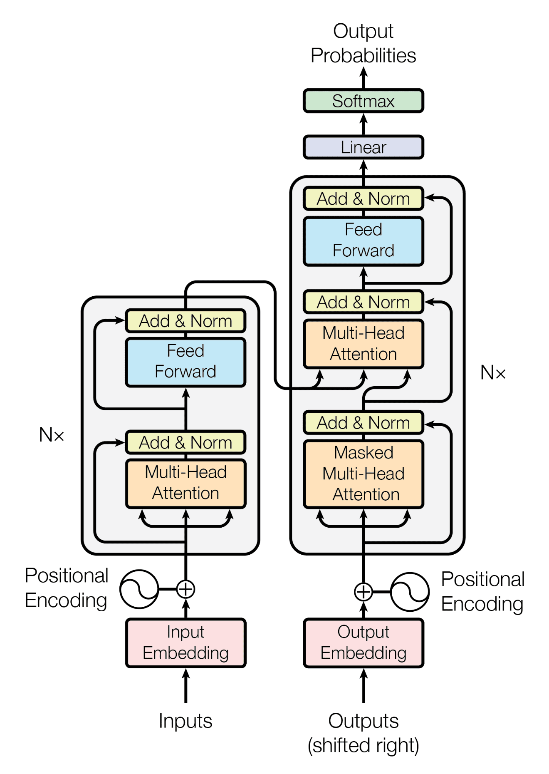





Research problem 1 - Nearby molecules
MolForge

Slide 7





Research problem 2 - Molecular pathway
Molecule # 1
Molecule # 2
Step # 1
Step # 2
Step # 3

Slide 8
Literature review findings
Paper | Method | Method | Dataset | Key Results
Bit Silencing in Fingerprints (Wang and Bajorath, 2008) | "Bit silencing" to assess the contribution of each bit in molecular fingerprints to similarity search performance. | MACCS (166 structural fragments) Hit rate profile Weight vector Weighted Tanimoto Similarity | 21 activity classes from MDDR (Molecular Drug Data Report) 5000 compounds randomly selected from ZINC as background set | Average hit rate increased from 5% (conventional Tc) to 12% (bw_Tc) Average recovery rate increased from 8% to 20% Not all bits are equally useful For 8 classes where Tc failed to identify active compounds, bw_Tc achieved hit rates up to 20% and recovery rates up to 40%

Slide 9
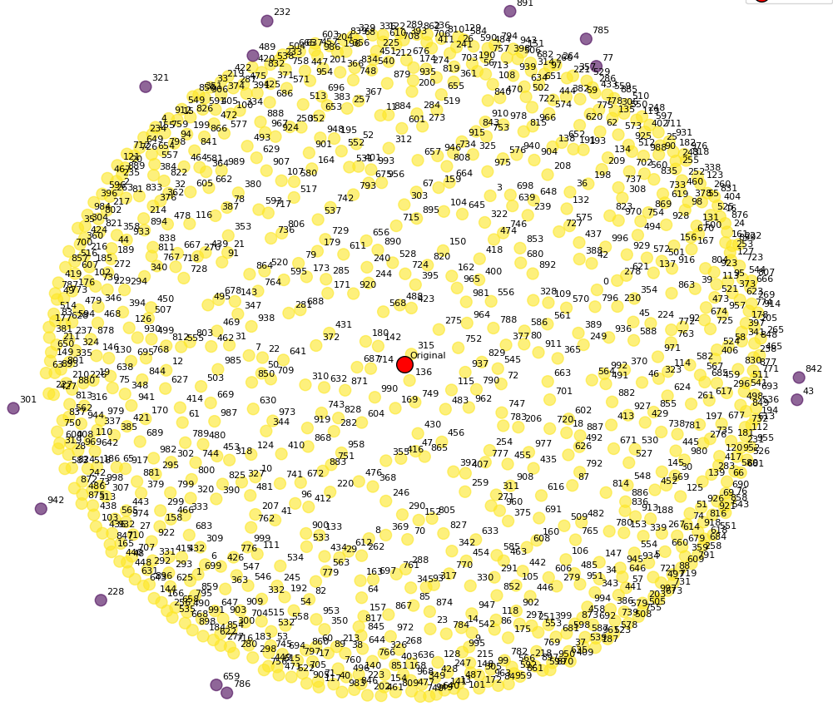
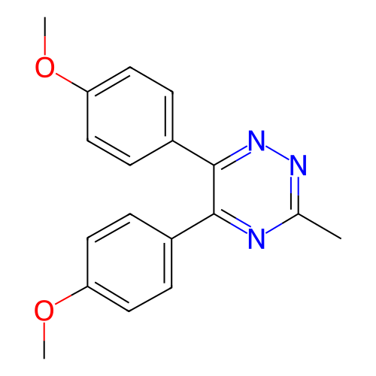
Methodology - Nearby molecules
Flipped ECFP4 fingerprint bits (1, 2, 4, 8, 128, 1024) times to examine nearby molecules
Reduced dimensionality for singular flips by flipping only 10, 100, 1000 and 2048 bits
Used MolForge to predict SMILES from modified fingerprints
Calculated Tanimoto similarity between original and generated fingerprints
Visualized similarity using MDS (Multi-Dimensional Scaling)

Slide 10

Results - valid and invalid SMILES
As the size of the bit group increases, so the number of invalid SMILES
Compound | 1 bit | 2 bits | 4 bits | 8 bits | 128 bits | 1024 bits
Parecoxib | 2048 | 1024 | 512 | 255 | 12 | 0
Celecoxib | 2048 | 1024 | 512 | 256 | 8 | 0
Cimicoxib | 2048 | 1024 | 512 | 256 | 11 | 1
Deracoxib | 2047 | 1023 | 511 | 256 | 13 | 0
Anitrazafen | 2048 | 1024 | 508 | 206 | 7 | 0
Expected # FPs | 2048 | 1024 | 512 | 256 | 16 | 2
# of valid SMILES
Compound | 1 bit | 2 bits | 4 bits | 8 bits | 128 bits | 1024 bits
Parecoxib | 0.00% | 0.00% | 0.00% | 0.39% | 25.00% | 100.00%
Celecoxib | 0.00% | 0.00% | 0.00% | 0.00% | 50.00% | 100.00%
Cimicoxib | 0.00% | 0.00% | 0.00% | 0.00% | 31.25% | 50.00%
Deracoxib | 0.00% | 0.10% | 0.20% | 0.00% | 18.75% | 100.00%
Anitrazafen | 0.00% | 0.00% | 0.78% | 19.53% | 56.25% | 100.00%
% of invalid SMILES

Slide 11
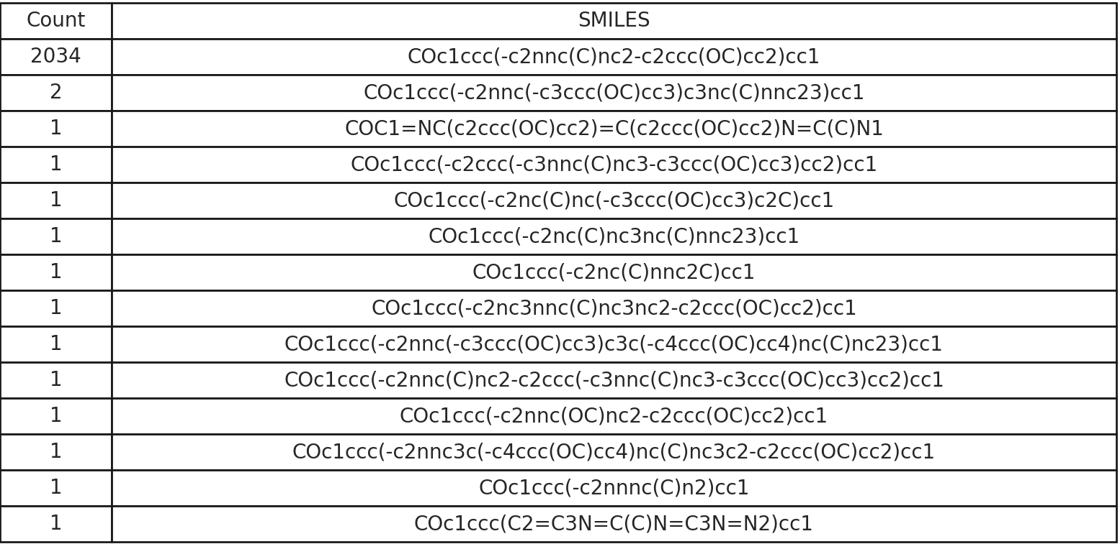
Results - unique SMILES
As the size of the bit group increases, the number of unique SMILES increase until a certain point.
Compound | 1 bit | 2 bits | 4 bits | 8 bits | 128 bits | 1024 bits
Parecoxib | 8 | 8 | 11 | 63 | 12 | 0
Celecoxib | 3 | 3 | 5 | 52 | 8 | 0
Cimicoxib | 4 | 3 | 4 | 19 | 11 | 1
Deracoxib | 3 | 2 | 5 | 39 | 13 | 0
Anitrazafen | 14 | 24 | 61 | 115 | 7 | 0
Anitrazafen 1 Bit Change 2048 SMILES

Slide 12
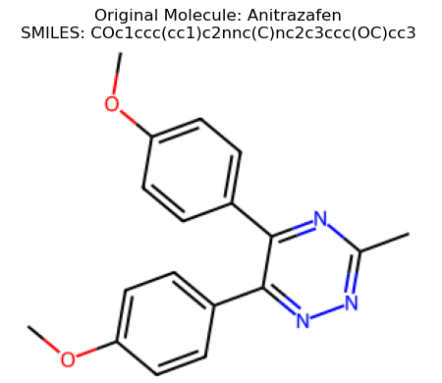
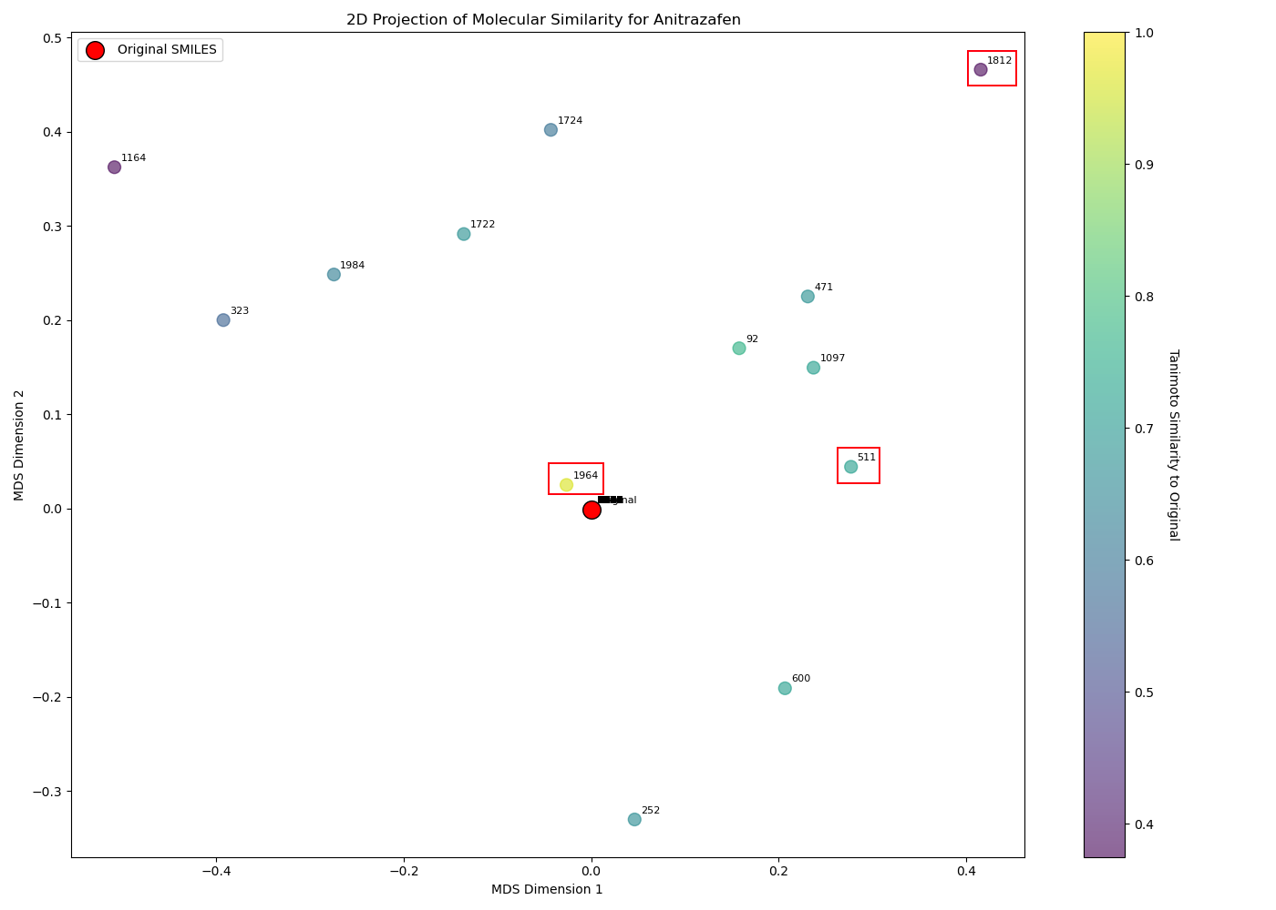
Anitrazafen - MDS - 1 bit flipped
Original Molecule
Generated Molecules
Overlapping SMILES: 2034, Unique SMILES: 14 (PubChem: 1)
Notes:
Compound CID: 12676609
SMILES: COc1ccc(-c2nnc(OC)nc2-c2ccc(OC)cc2)cc1
Formula: C18H17N3O3

Slide 13
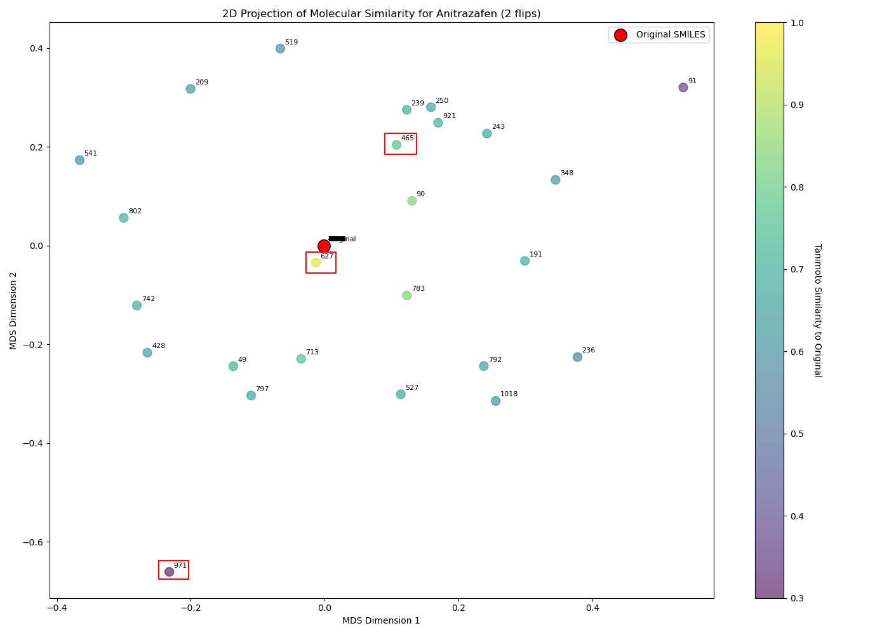
Anitrazafen - MDS - 2 bits flipped
Original Molecule
Generated Molecules
Overlapping SMILES: 1000, Unique SMILES: 24 (PubChem: 3)
Notes:
Compound CID: 137797151
SMILES: COc1ccc(-c2nnc(C)nc2C)cc1
Formula: C12H13N3O
Compound CID: 59944238
SMILES: Cc1nnc2nc(C)nnc2n1
Formula: C6H6N6
Compound CID: 12676609
SMILES: COc1ccc(-c2nnc(OC)nc2-c2ccc(OC)cc2)cc1
Formula: C18H17N3O3

Slide 14
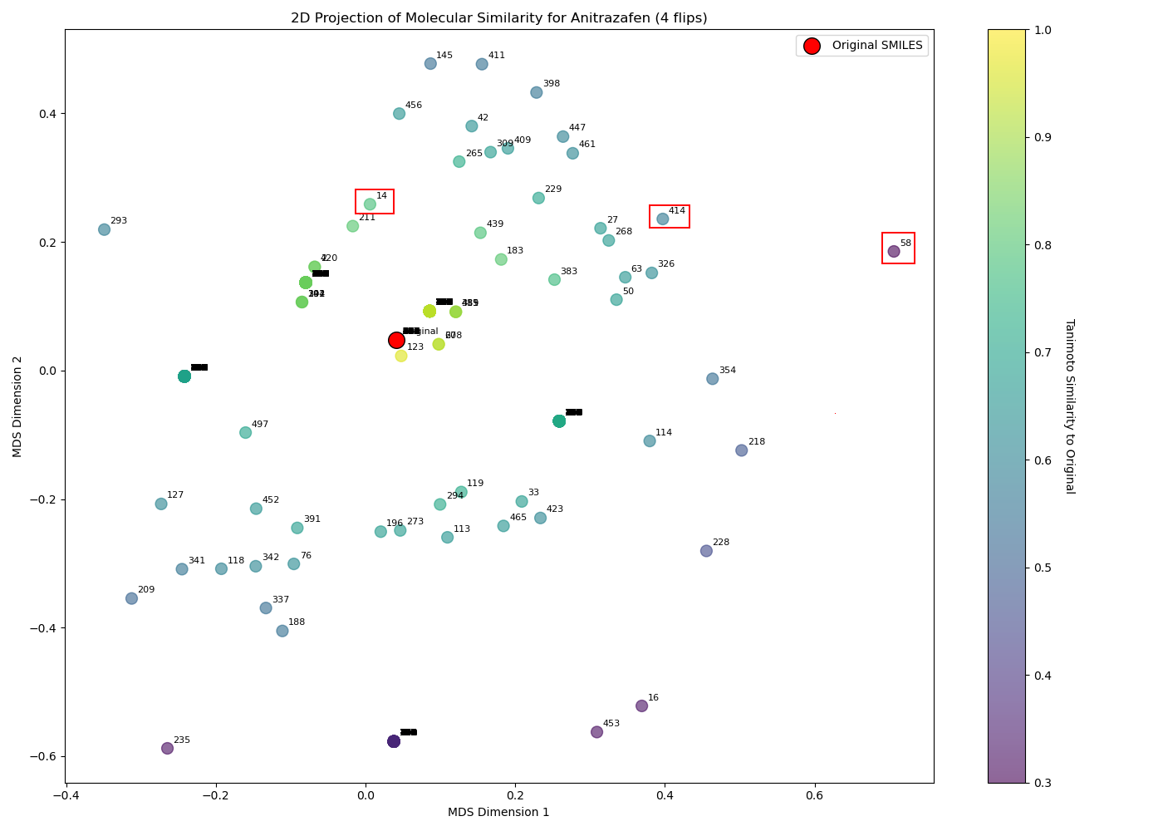
Anitrazafen - MDS - 4 bits flipped
Original Molecule
Generated Molecules
Overlapping SMILES: 451, Unique SMILES: 61 (PubChem: 2)
Notes:
Compound CID: 59944238
SMILES: Cc1nnc2nc(C)nnc2n1
Formula: C6H6N6
Compound CID: 12676609
SMILES: COc1ccc(-c2nnc(OC)nc2-c2ccc(OC)cc2)cc1
Formula: C18H17N3O3

Slide 15
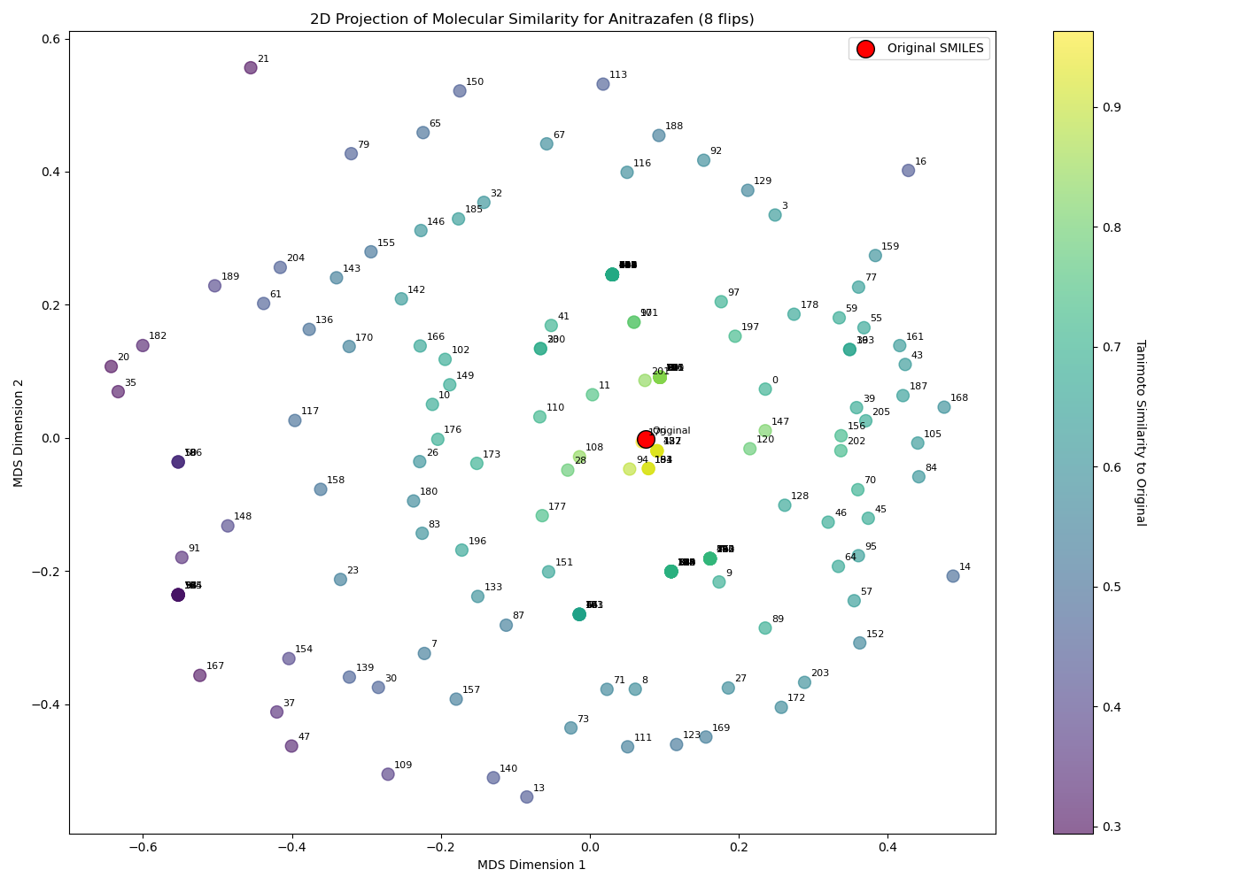
Anitrazafen- MDS - 8 bits flipped
Original Molecule
Generated Molecules
Overlapping SMILES: 141, Unique SMILES: 115 (PubChem: 1)
Notes:
Compound CID: 59944238
SMILES: Cc1nnc2nc(C)nnc2n1
Formula: C6H6N6

Slide 16
Anitrazafen- MDS - 128 bits flipped
Original Molecule
Generated Molecules

Slide 17
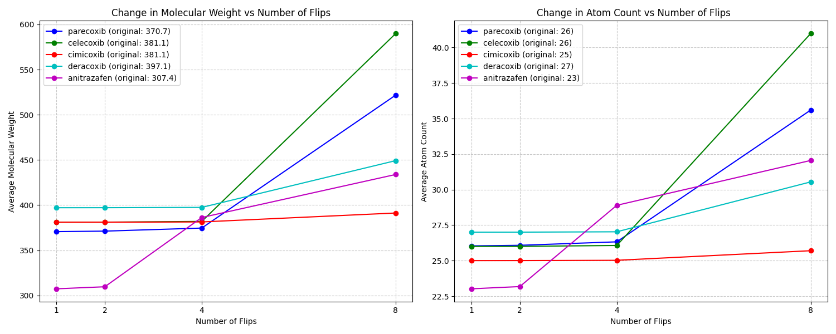
Atoms and Molecular Weight
Increasing fingerprint bit flips raised average atom and molecular weight

Slide 18
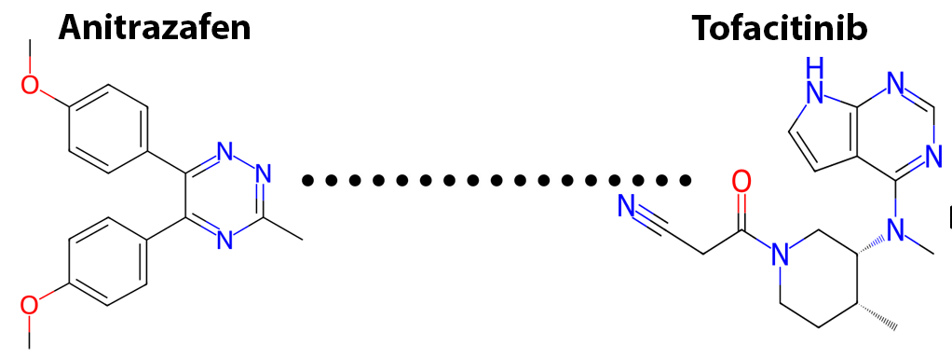
Methodology - Molecular pathway
Studied pathway from COX-2 (Anitrazafen) → Janus Kinase inhibitor (Tofacitinib)
Modified Anitrazafen’s fingerprint bits by adding and removing step-by-step
Predicted SMILES at each modification stage using MolForge
Reached Tofacitinib Fingerprint by adjusting Anitrazafens bits
Calculated Tanimoto similarity to both starting molecules

Slide 19
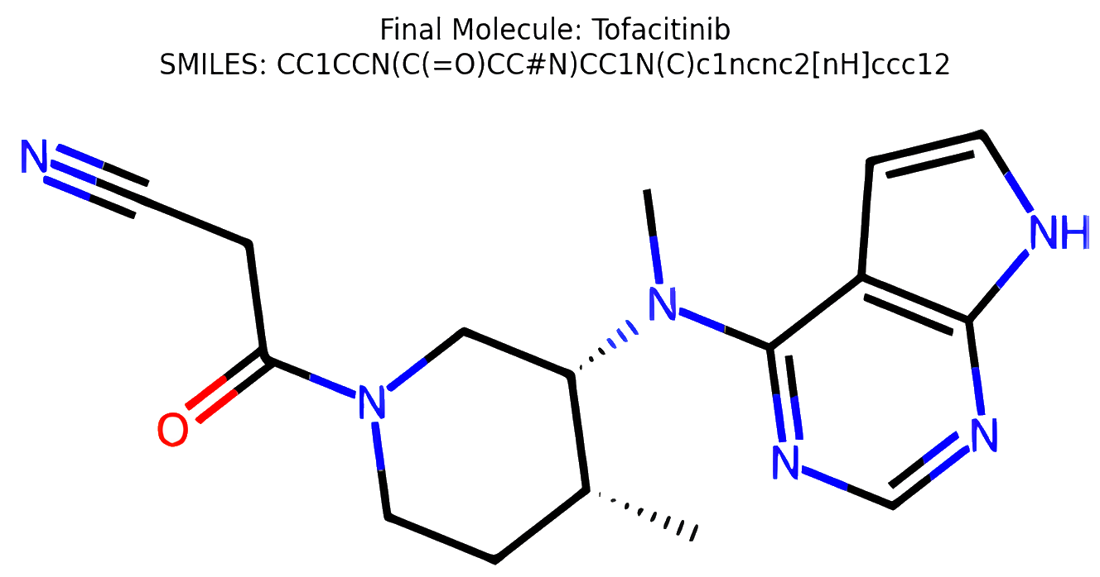
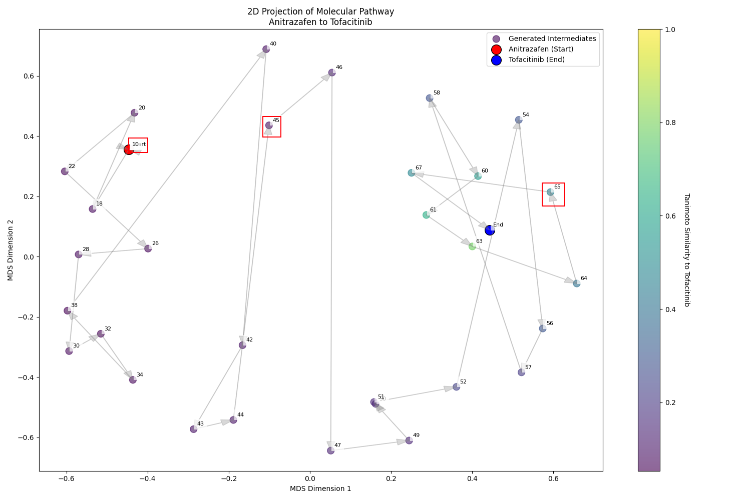
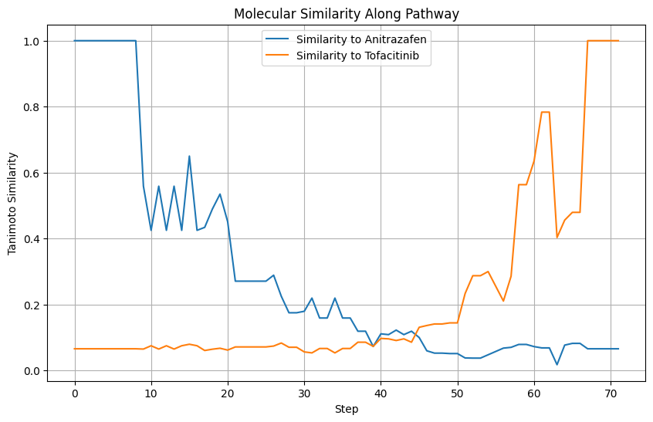
Anitrazafen → Tofacitinib Pathway
Start Molecule
End Molecule
Generated Molecules
Valid SMILES: 71/72, Unique SMILES: 40/71, ChEMBL: 14/71

Slide 20
Conclusions
MolForge is good at reconstructing smiles from ECFP4 vectors. However, it does not a good job at recognizing singular bit flips.
Most of generated SMILES overlap the original SMILE.
ECPF4 from the generated SMILES match in most of the cases with the ECPF4 of the original molecule rather than the flipped ECP4.
This is related in how MolForge was trained.
MolForge is able to generate unique and valid molecules. However,
Most of them are not available in PubChem
Singular bit flipping often results in the original molecule
Generated molecules are repeating the SMILES structure
More bit changes (more 1s in ECFP4) correlate with higher molecular weight and atom count on average

Slide 21
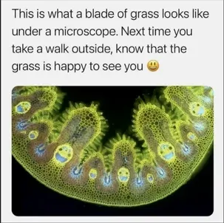
Thanks for listening! :)
Final Presentation
Nils Dunlop, Francisco Erazo, Qi Chen

