Slide 1
Assignment 1 Aerodynamic rotor design for Class IIIB

Slide 2
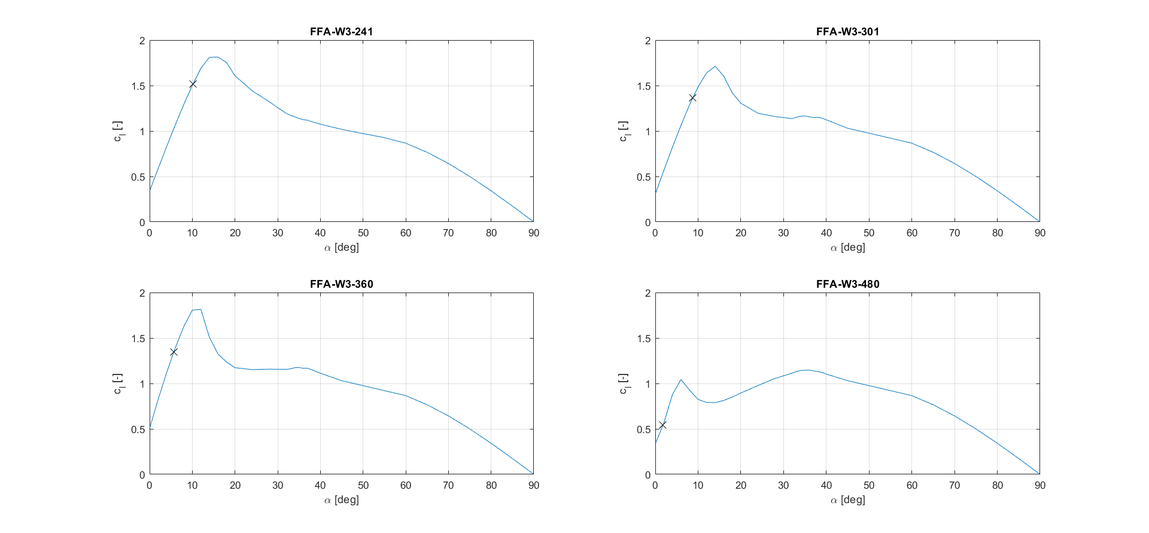
Part 1: Aerofoil polars (cl vs. AoA)

Slide 3
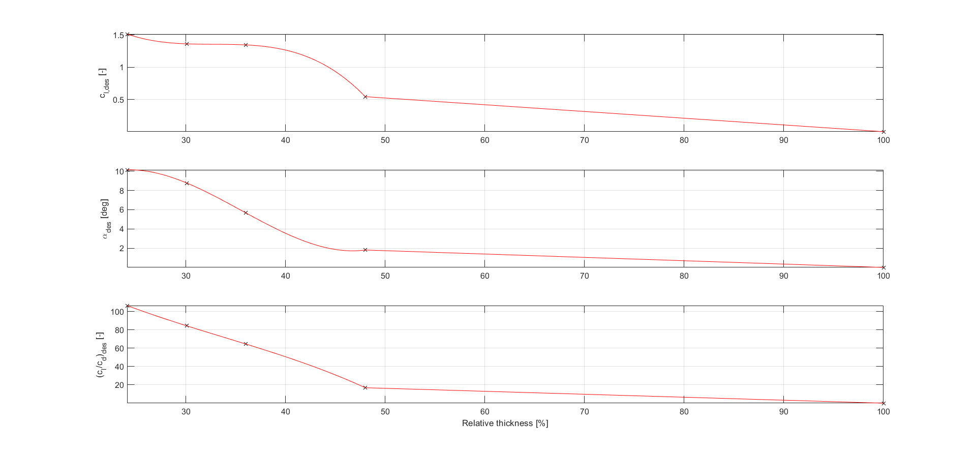
Part 1: Design polynomials

Slide 4
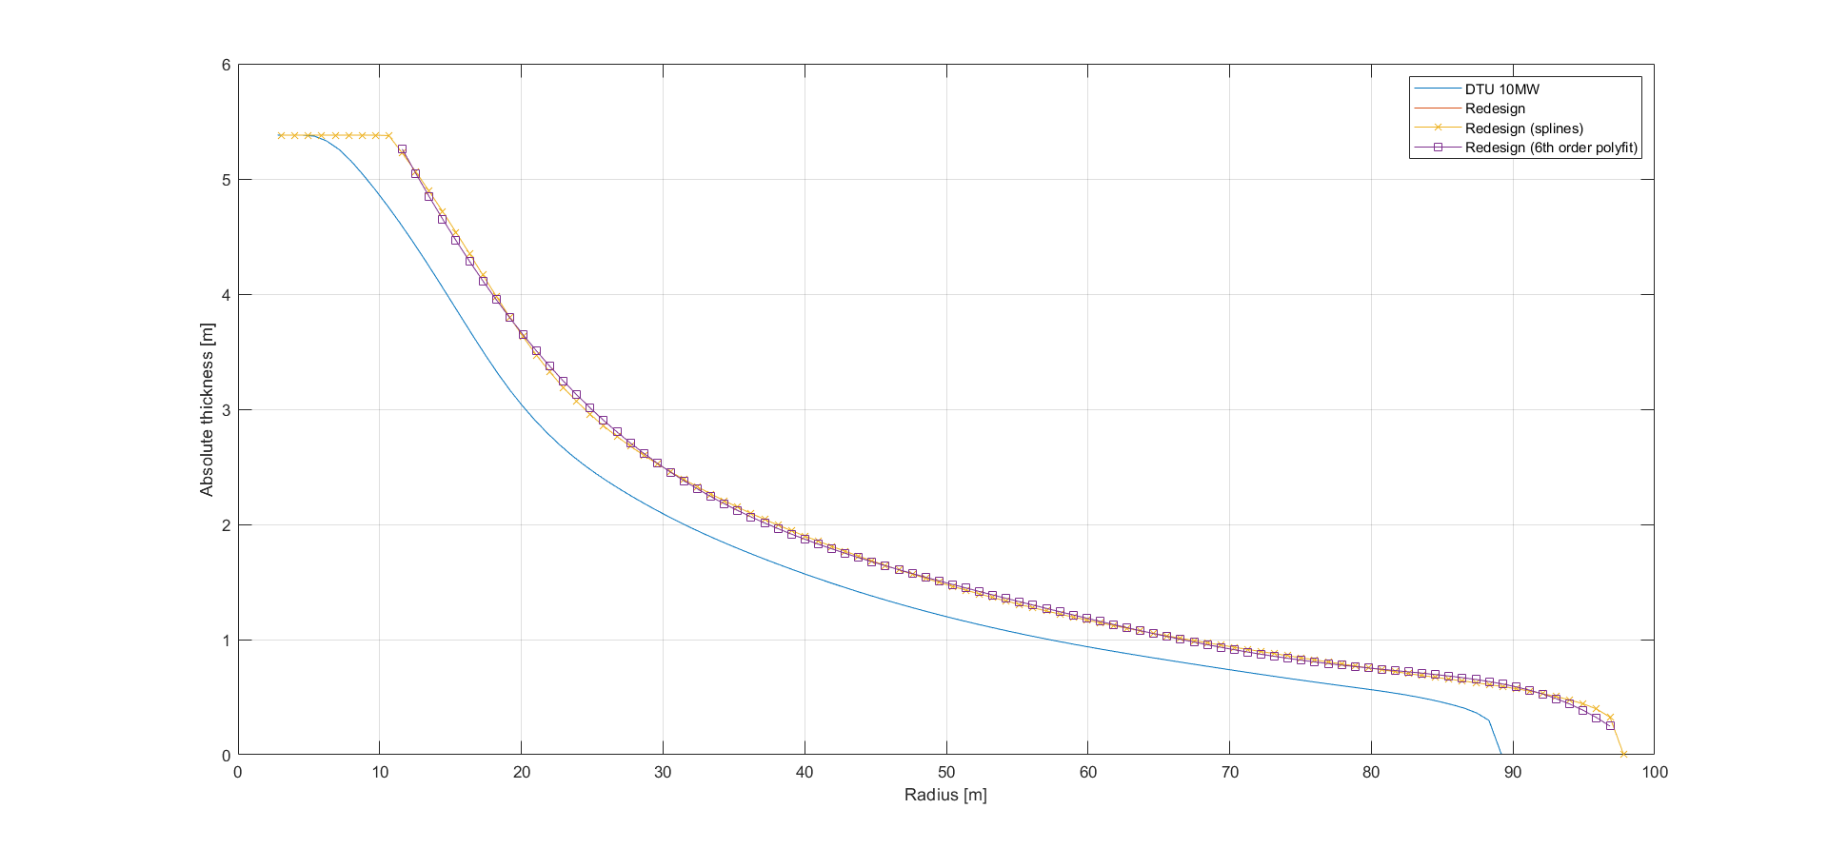
Part 1: Absolute thickness distribution

Slide 5
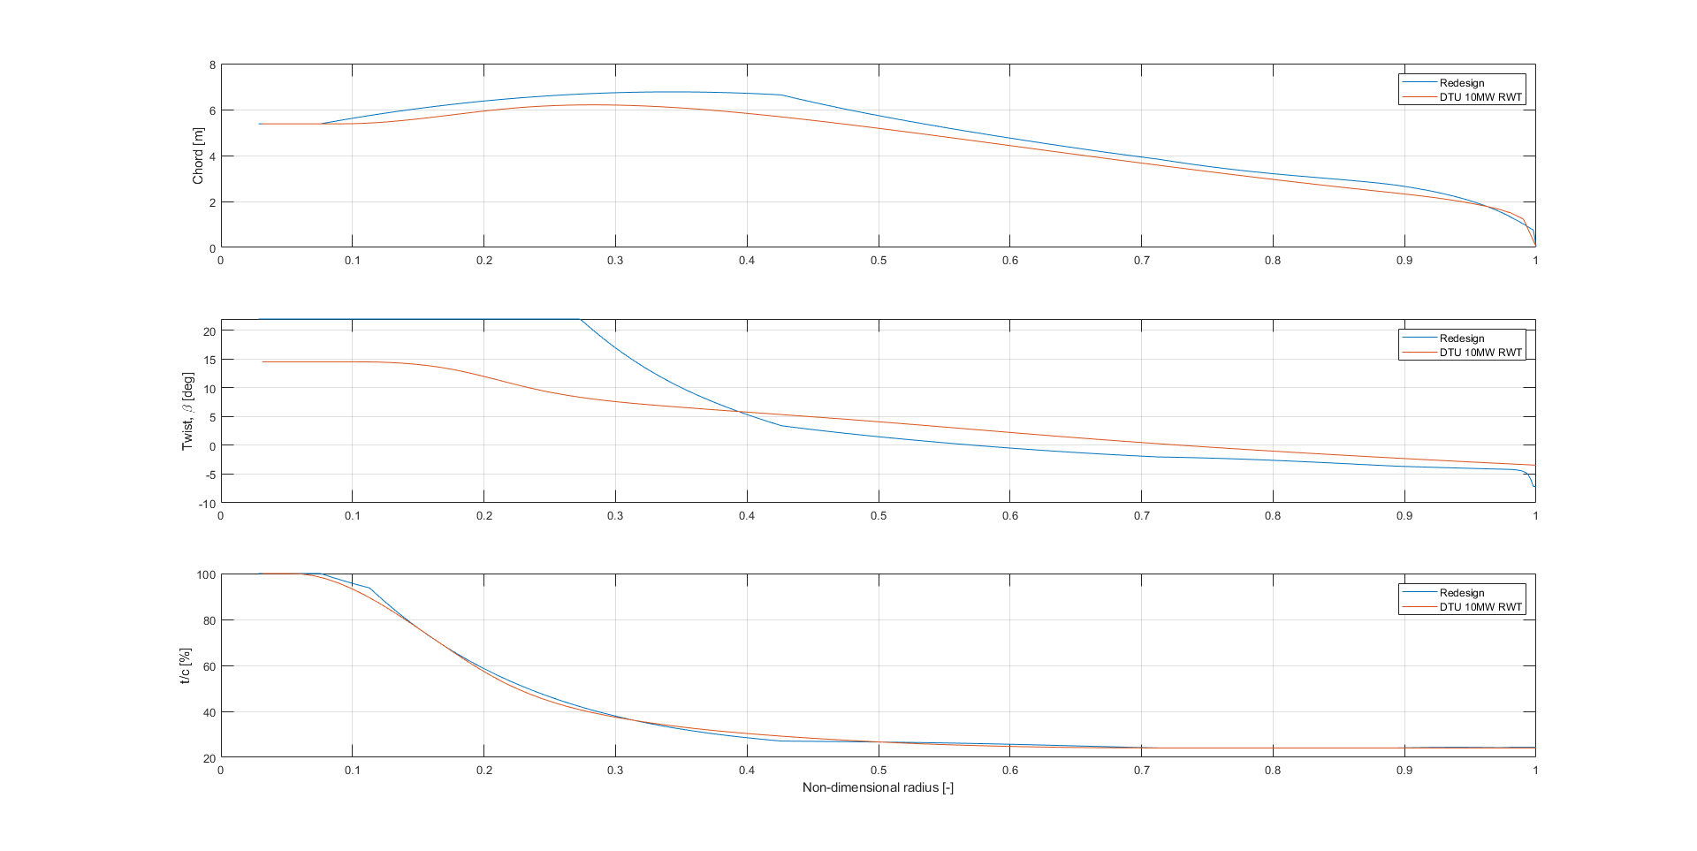
Part 1: Final geometry

Slide 6
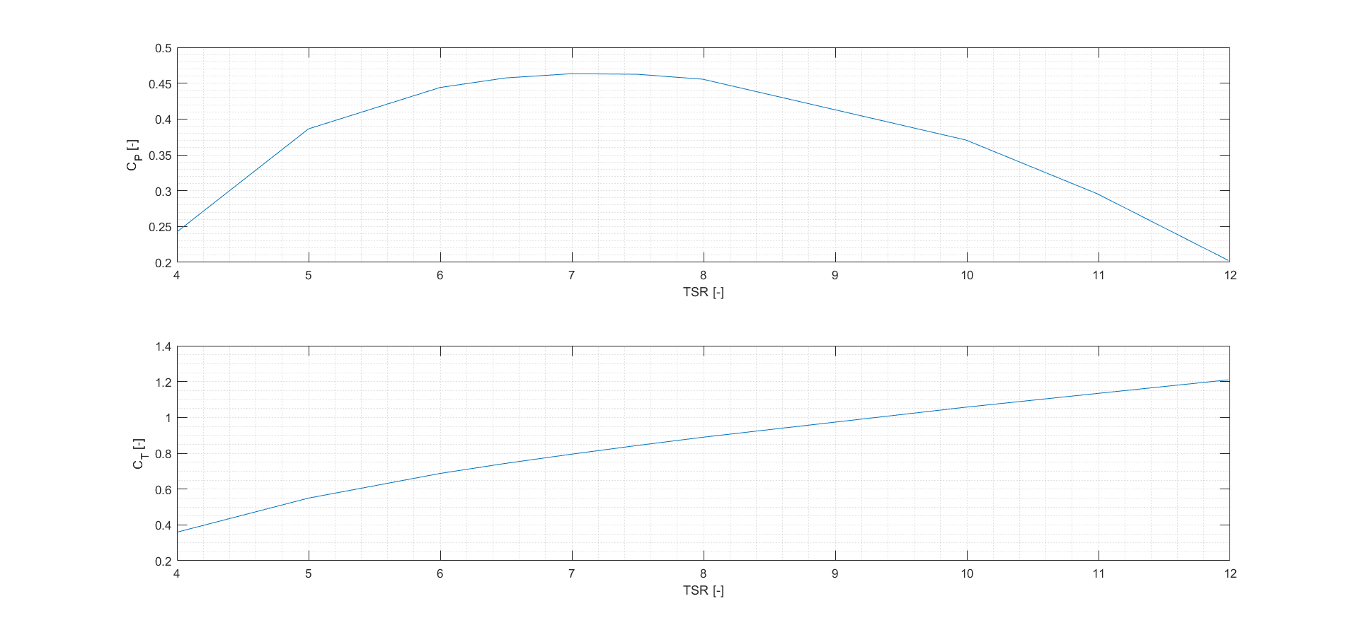
Part 2: CP and CT vs. TSR

Slide 7
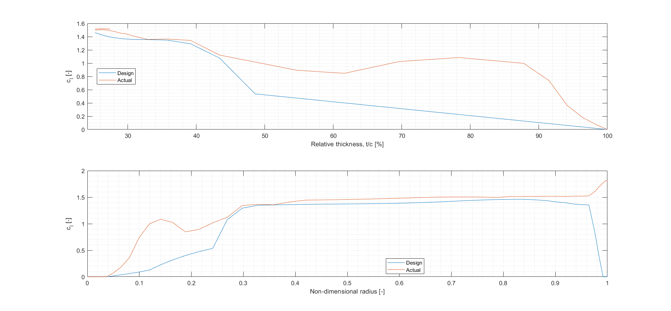
Part 2: Actual and design lift coefficients

Slide 8
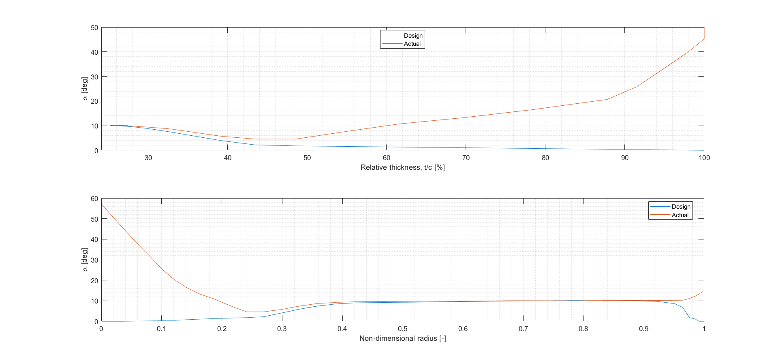
Part 2: Actual and design angle of attack

Slide 9
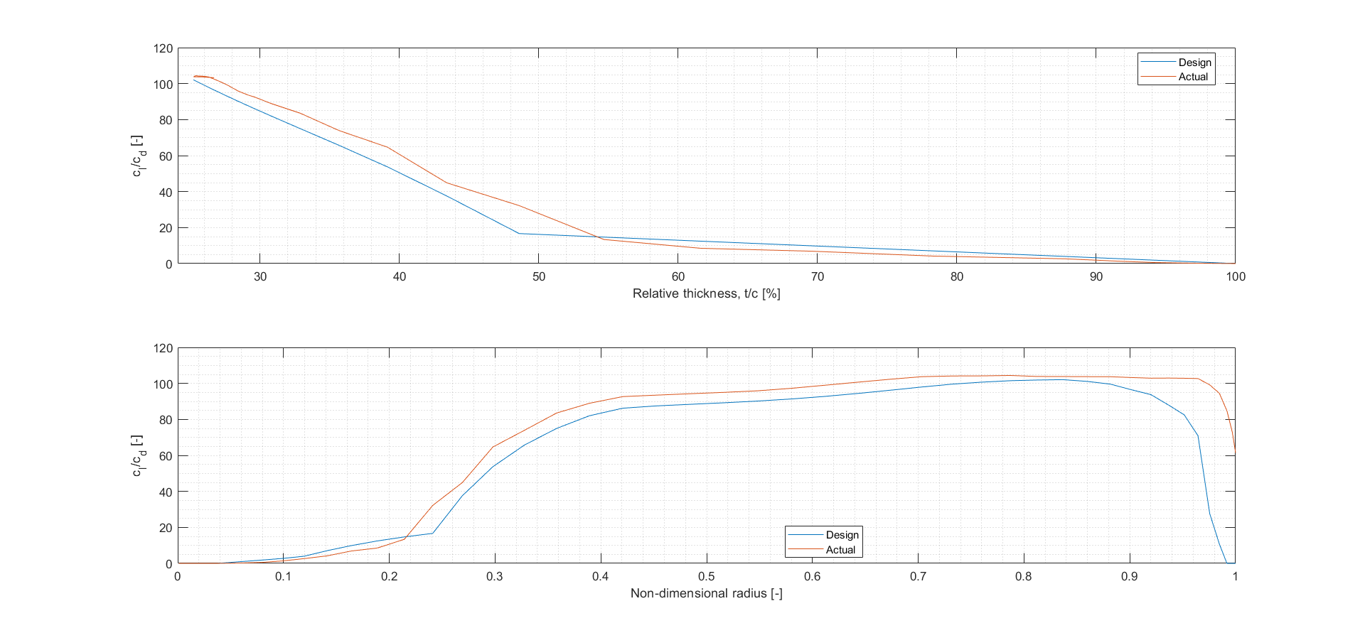
Part 2: Actual and design lift-drag ratio

Slide 10
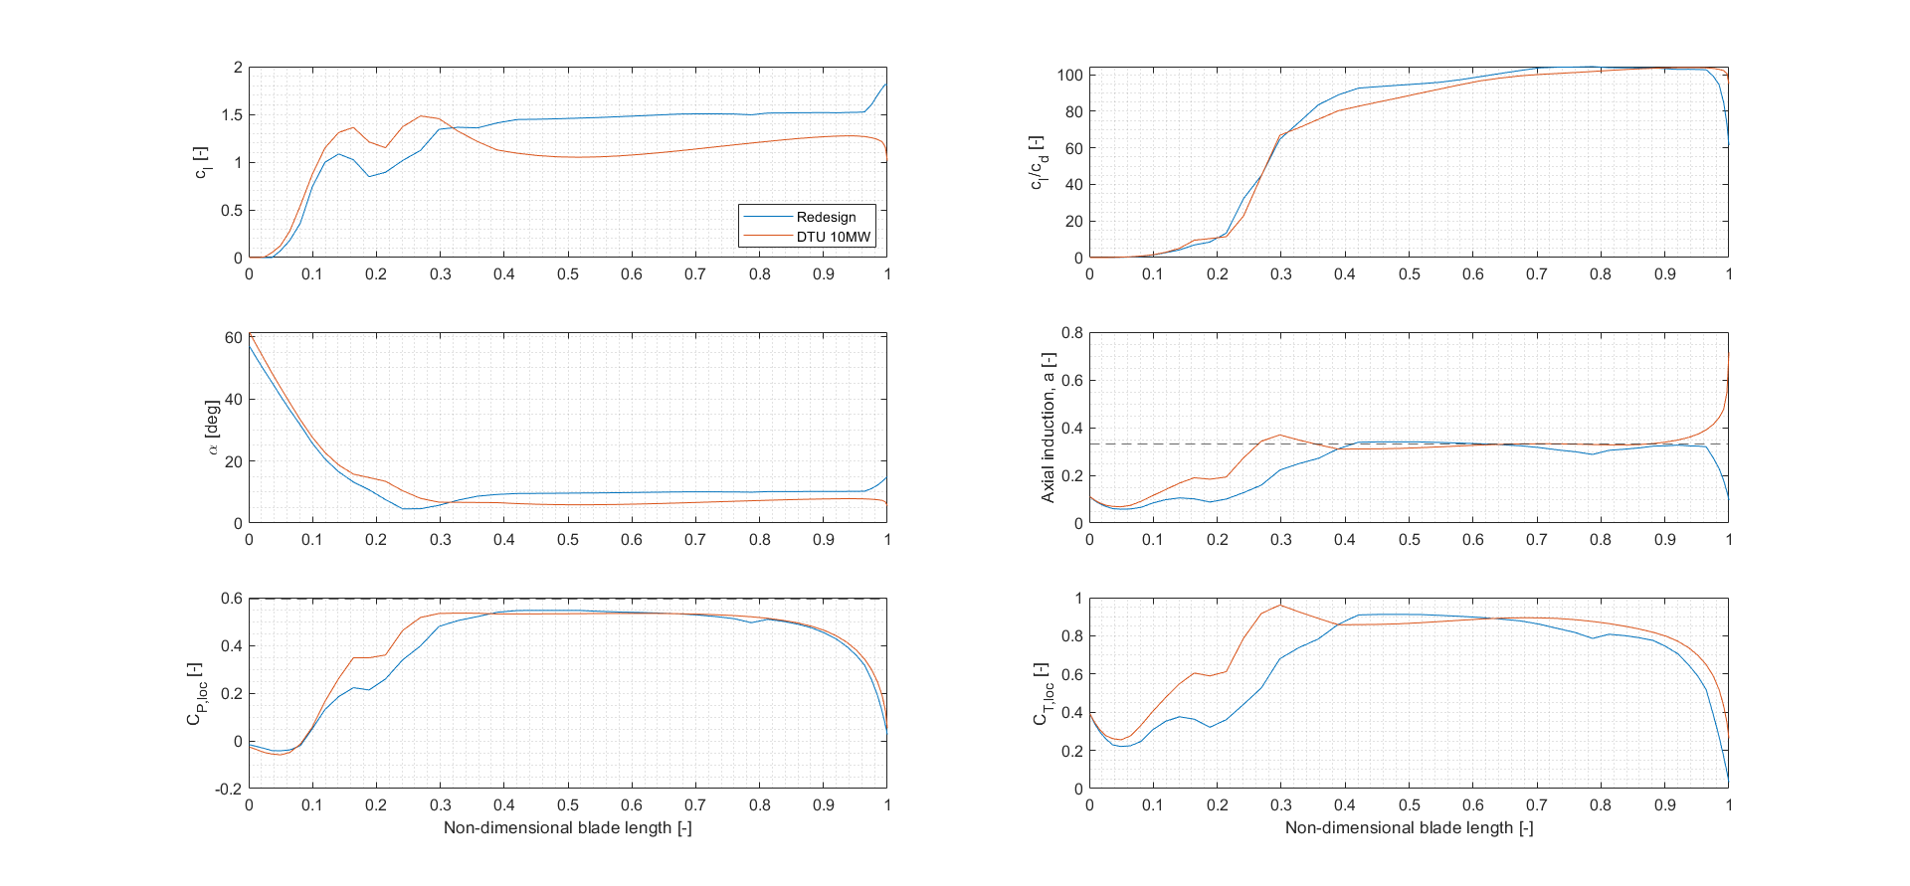
Part 2: Spanwise values

Slide 11
Appendix

Slide 12
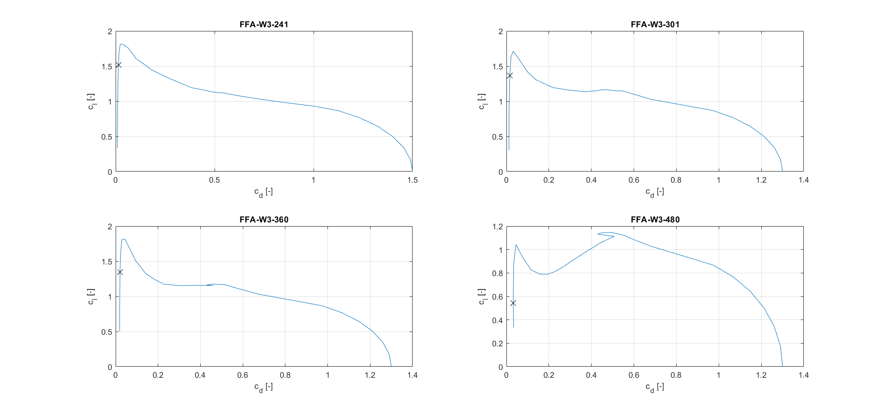
Part 1: Aerofoil polars (cl vs. cd)

Slide 13
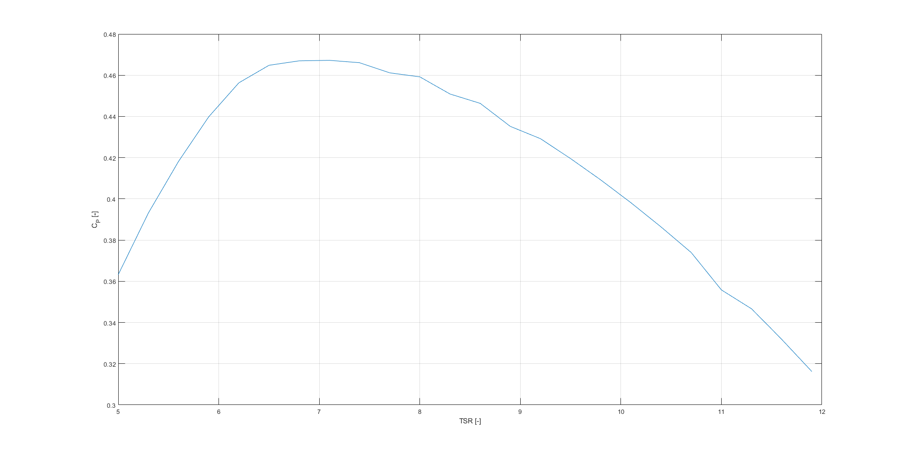
Part 1: CP vs. TSR

Slide 14
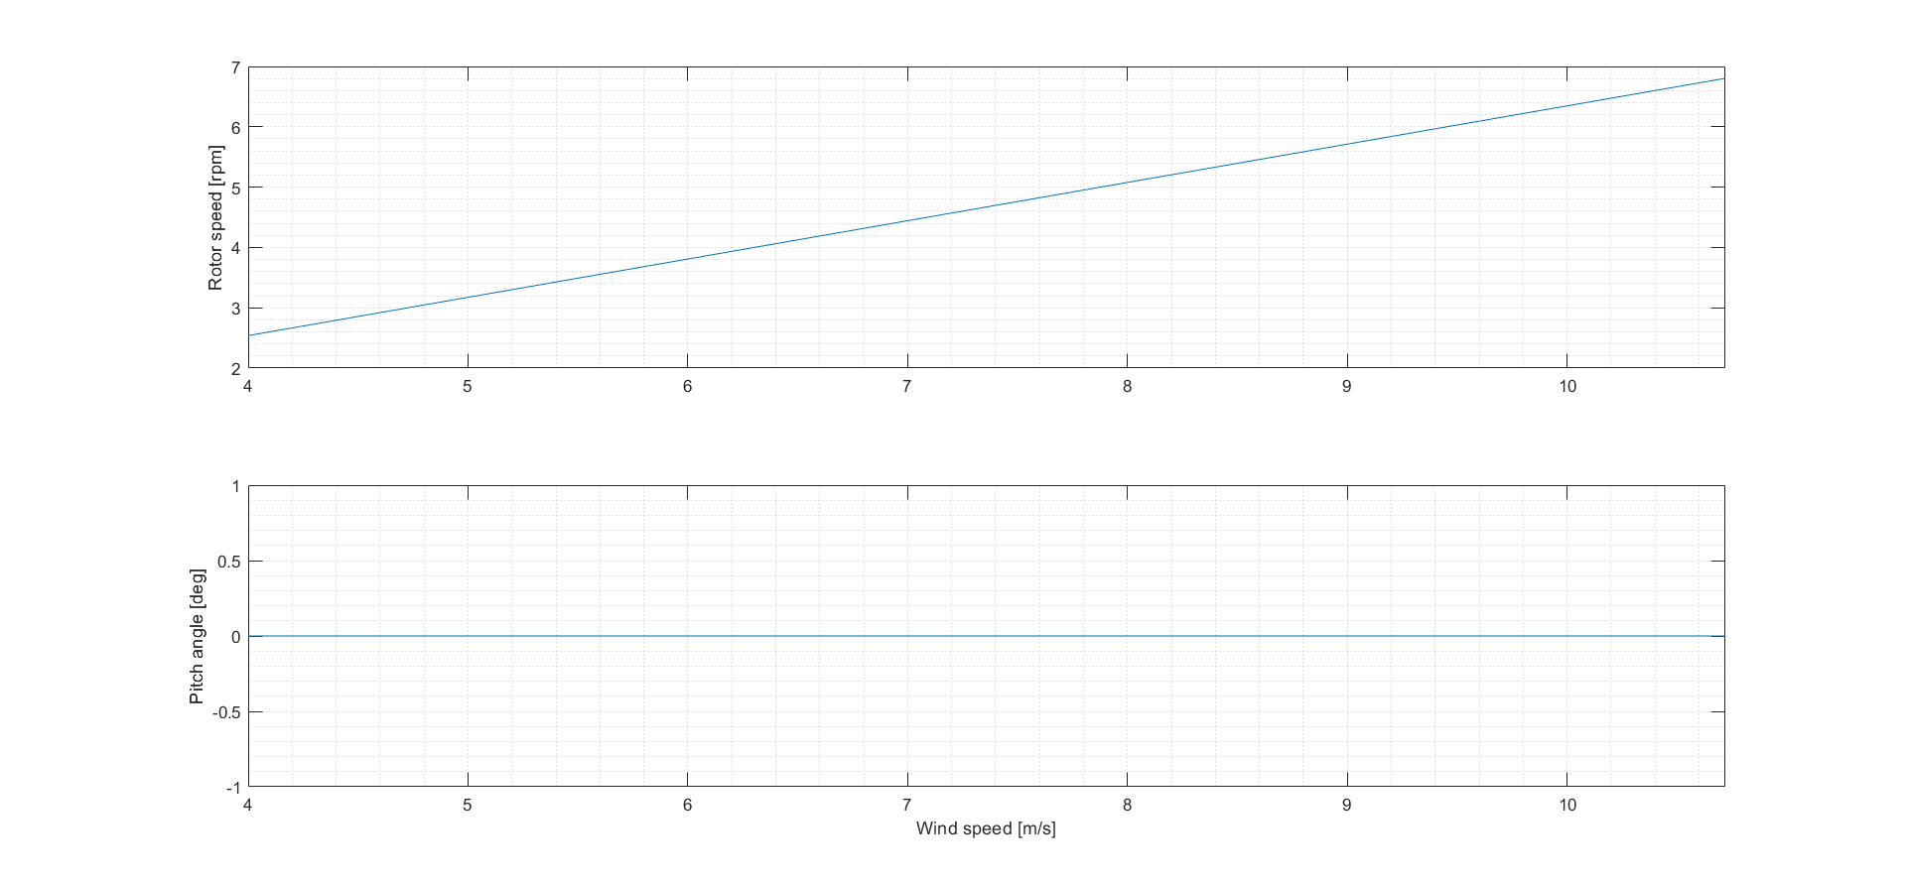
Part 2: Rotor speed and pitch vs. wind speed

Slide 15
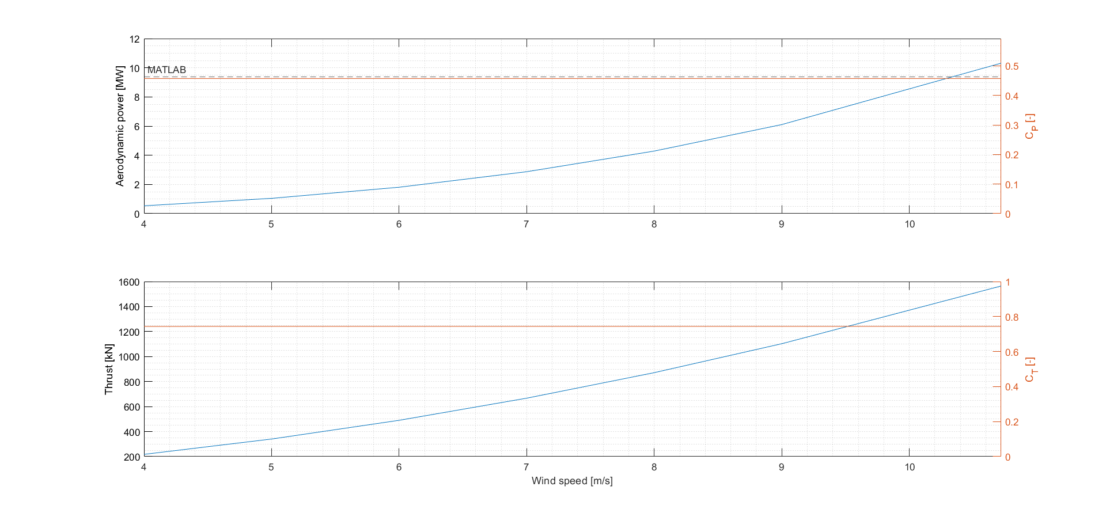
Part 2: Power, CP, thrust, and CT vs. wind speed

Slide 16
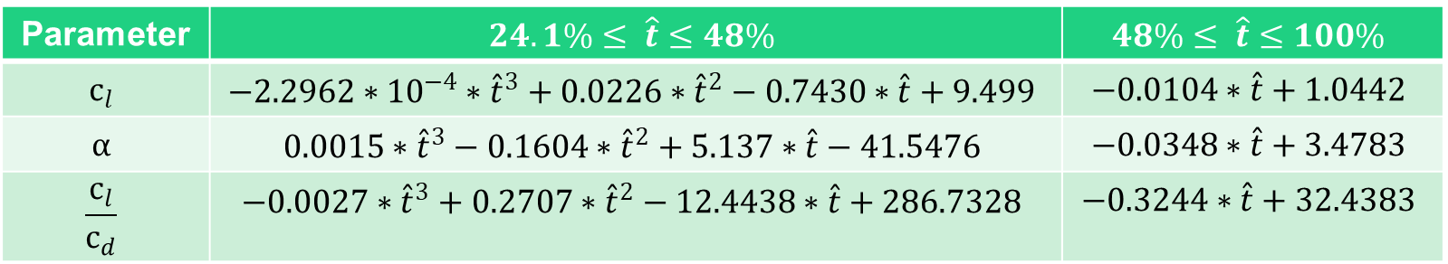
Part 1: Design polynomials
Parameter | $$24.1\%≤ \hat{t}≤48\%$$ | $$48\%≤ \hat{t}≤100\%$$
$$c_{l}$$ | $$−2.2962∗{10}^{−4}∗{\hat{t}}^{3}+0.0226∗{\hat{t}}^{2}−0.7430∗\hat{t}+9.499$$ | $$−0.0104∗\hat{t}+1.0442$$
$$α$$ | $$0.0015∗{\hat{t}}^{3}−0.1604∗{\hat{t}}^{2}+5.137∗\hat{t}−41.5476$$ | $$−0.0348∗\hat{t}+3.4783$$
$$\frac{c_{l}}{c_{d}}$$ | $$−0.0027∗{\hat{t}}^{3}+0.2707∗{\hat{t}}^{2}−12.4438∗\hat{t}+286.7328$$ | $$−0.3244∗\hat{t}+32.4383$$

Slide 17
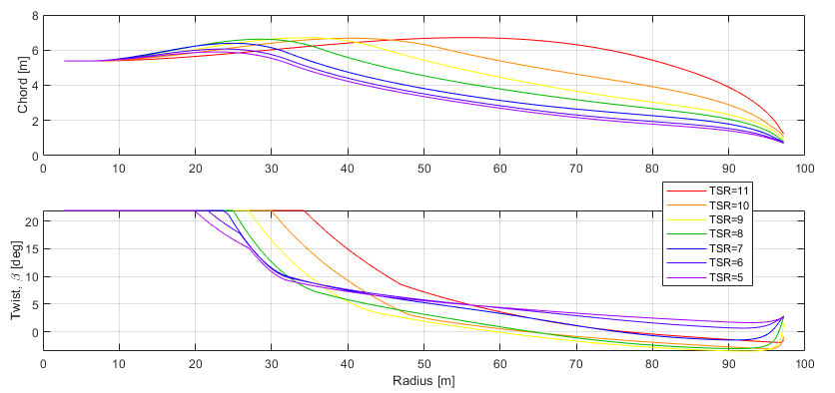
Chord and twist distributions for various TSRs

Slide 18
Group 7 work distribution.
Stef: Worked on producing a geometry with his own MATLAB script, found out about problems before the rest and allowed us to anticipate things as a group. Wrote inputs for HAWC2 first and then helped Nick with the second version.
Nils: Worked on a second version of the geometry with the others, writing a MATLAB script. Wrote a post-processing script to evaluate the results from HAWC2.
Nick: Pair coded and debugged Nils' script. Wrote the second geometry into HAWC2 and produced results for post-processing.
Eduardo: Picked up the pieces. Helped improve the splines for the geometry, wrote a script to make inputs to HAWC easier and was all round very helpful with the trickier bits of code.

