Slide 1
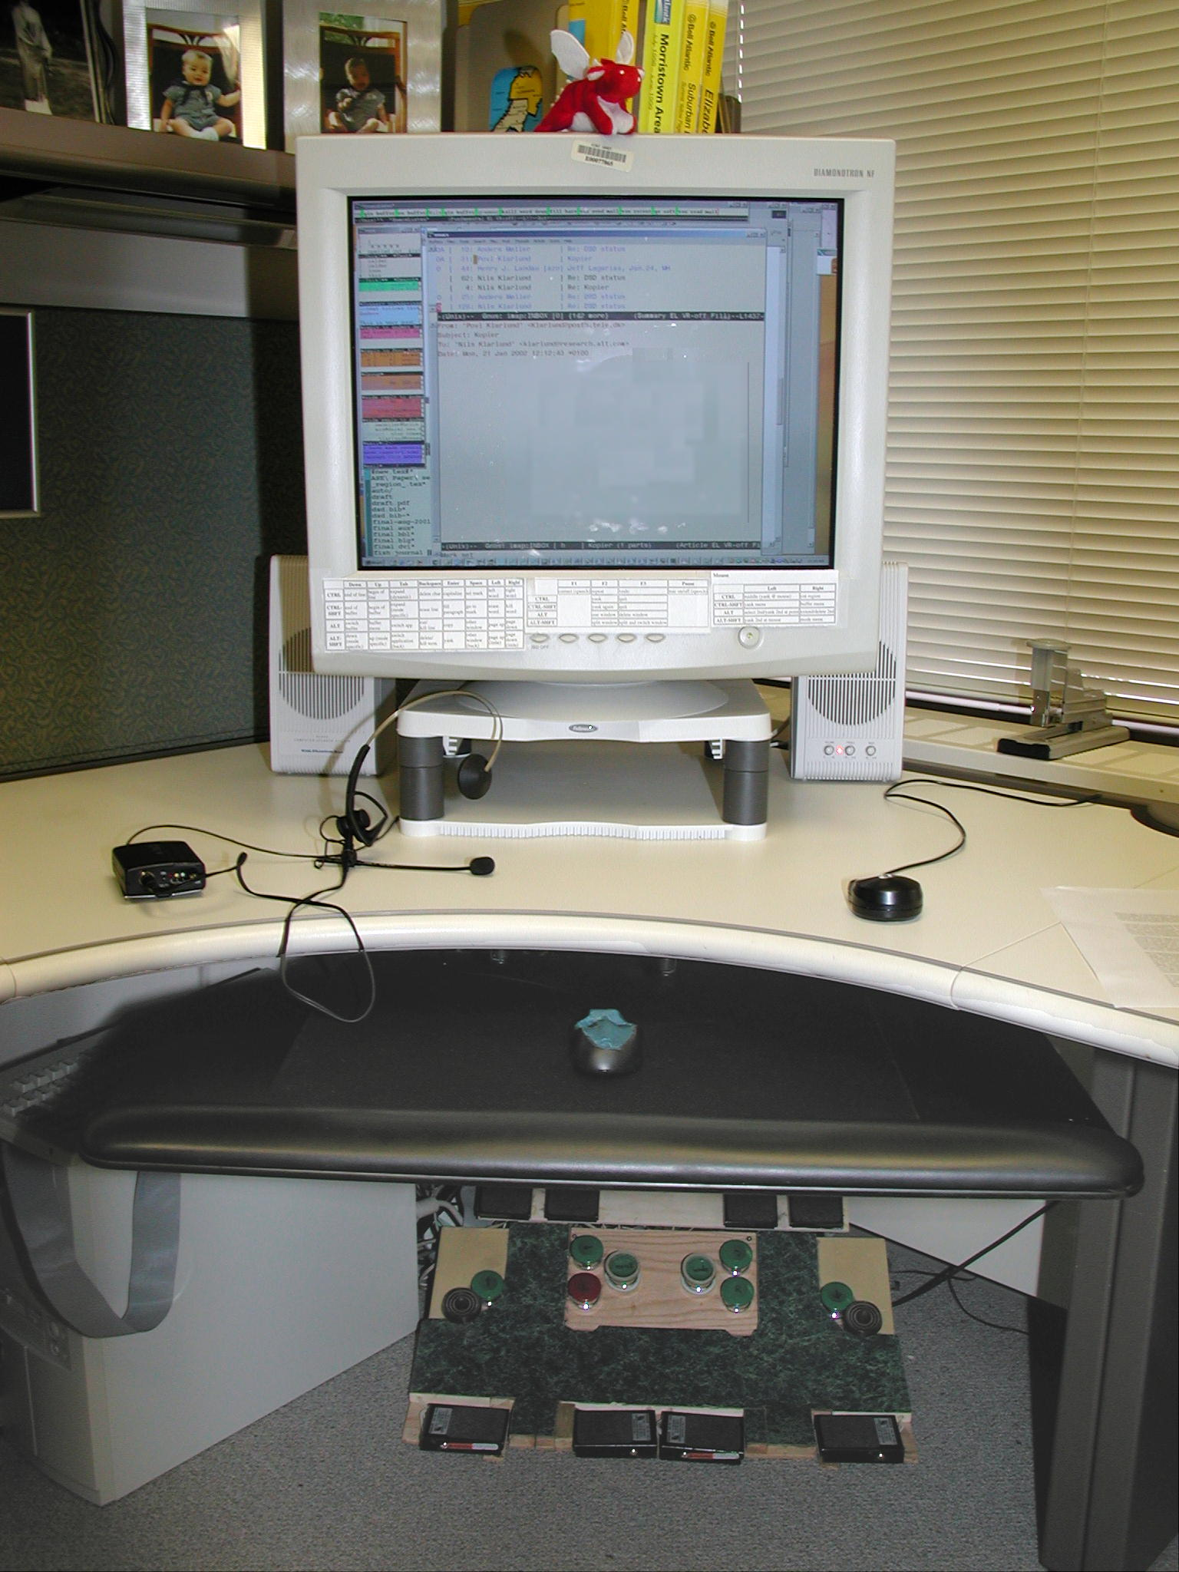
monitor stand
to minimize neck strain
wireless mic
guest mouse
for speech recognition with
no shackling to computer
for those needing a button
buttonless mouse
large, empty rest area
with edges for easy grip
also for occasional mouse work
with one or both hands pushing
fast computer
foot keyboard
with dictation software and
ShortTalk for very effective
editing and control by voice
for repetitive work: arrow keys, undo,
return, spacebar, delete, page
up & down, error correction, mic
on/off, mouse buttons, etc.
Very low impact workspace

