Slide 1
ReaX -- a reactive programming language for multimodal applications
Nils Klarlund, AT&T Labs
With contributions from Anders Møller, Jennifer Beckham, Giuseppe di Fabbrizio

Slide 2
Goals
Introduce reaction trees and ReaX, a reactive scripting language
Argue reaction trees are what has been missing in event driven programming notations
Explain causality in simple operational and explicit terms without nondeterminism, fixed points, intuitionistic logic, …

Slide 3
Motivation: unfinished business in UI
Time seek and undo missing or inconsistent
Why a reactive core language is essential to a user agent or browser
  Especially if speech recognition is involved
How SMIL, a W3C technology for multimedia presentation, represents important progress in controlling the user interface

Slide 4
Opportunities
ReaX work is conceptual
Exploiting trend: XML is turning trees into an important paradigm of abstraction
Exciting thing:
  trees are actually now used by software practitioners
  they open new venues for programming language design

Slide 5
Talk overview
I. Motivation
II. SMIL demo
III. Event woes
IV. Solution: reaction trees
V. Tie things together
Appendix. ReaX overview

Slide 6
Part 1. Motivation spiral
UI issues
→
Central problem about events

Slide 7
My background
For a decade, I’ve been looking for a solution to work on the computer with
  Much less use of arms and hands
  Reason: typing injury
What I have learned:
  Efficiency is the keyword to solve this problem
  Efficiency is the motivation for learning anything new
  Don’t look for alternatives, look for more efficient ways

Slide 8
User interface work driven by entropy rate
Foot keyboard
  Must have sufficiently many keys for repetitive work
Dictation system spoken command interface
  Design ShortTalk, a “perfect language” for commands, maximizing bits/second
  Errors that put system in strange states are offensive
  Any error (by human or by machine) must be immediately correctable
  For a hundred years, typewriter necessitated an education until delete button was invented
  It has all to do with efficiency

Slide 9
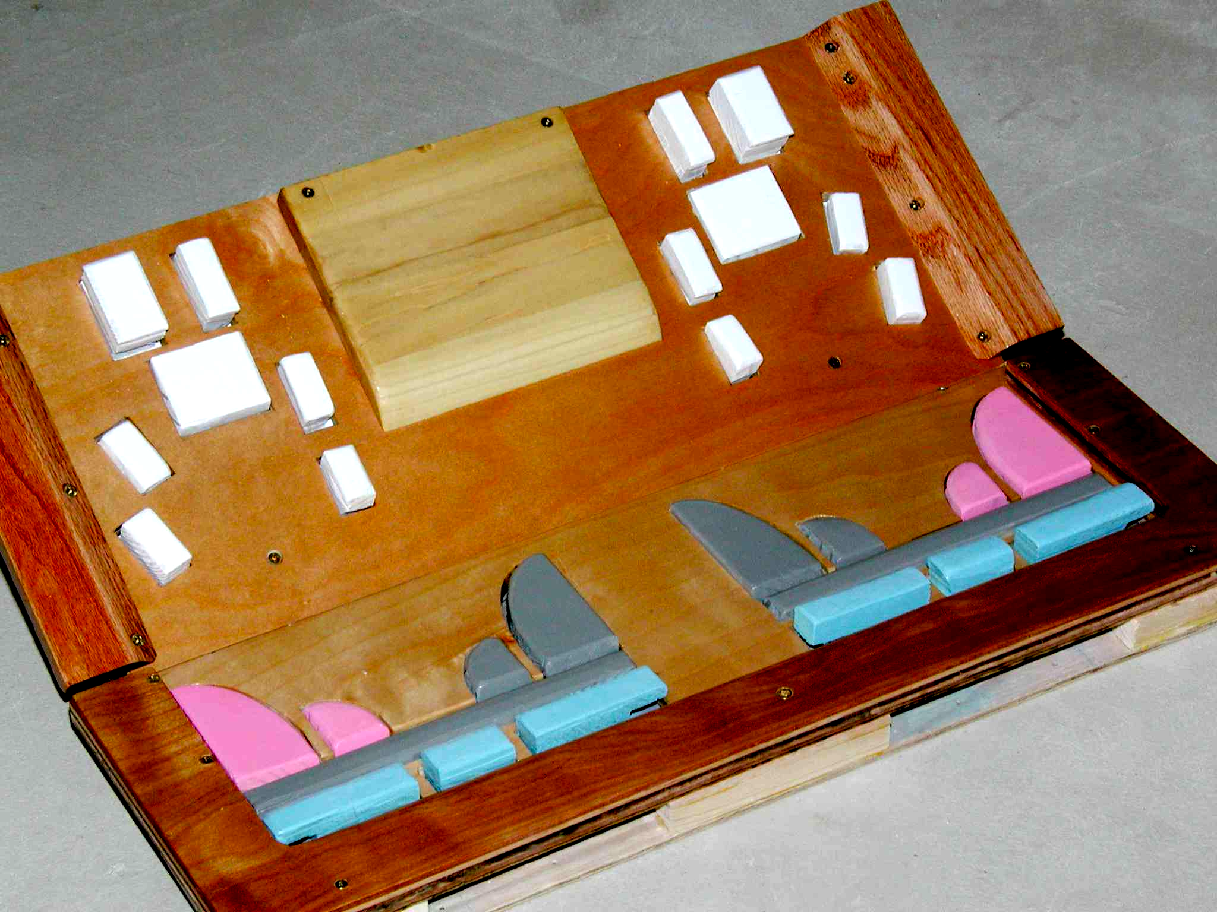
User interfaces take efforts
I spent 8 years on
  Foot keyboard design →
  “Perfect language”, but
    “perfect implementation”
    10,000 lines of Emacs Lisp
This work is currently being monetized

Slide 10
Buzzword Zoo, Browser Section
User agent = browser or PDA or phone or…
Visual: HTML + CSS = not perfect, somewhat standardized in practice
Telephone: VoiceXML, SALT
  Intermediate technologies
Multimedia: SMIL
  Used in RealOne for high-level coordination
  Used in IE for Flash-like presentations

Slide 11
Buzzwords II
Multimedia: Flash by Macromedia
  Virtual monopoly (516 million users)
  Macromedia Flash File Format Specification
    just reading it requires a license
  ActionScript: Ecmascript-based and very involved
The format results in UI problems

Slide 12
Common UI problems
Flash Web site: BBC “Life of Mammals”
  Embedded back button, no forward button
  “Explore another species link” sometimes does not work
  Movie sound and animal sound not mutually exclusive
  Accessibility issues: some common keyboard shortcuts don’t work
ATM: enter a wrong amount---and go through the whole cycle again after waiting for a slip of paper!
IVR systems: say or press something wrong---and end up cornered!
Voicemail: to hear that phone number again, rewind the whole message!
Dictation systems: say something that is misinterpreted and end up in a strange state!

Slide 13
Undo claim
The lack of undo is a most fundamental and most easily solved problem in speech and gesture recognition interface
The undo button would be the most frequently used of them all and should be sized accordingly
One success: the “back button” on browsers

Slide 14
Undo and seek are horribly implemented in general
Even as check-pointing and recovery techniques known for years
The problem:
  In practice, it’s hard to do
But a programming language that incorporates classic knowledge about recovery can alleviate almost all the complexity
We will show that the principal obstacle is a classic issue: understanding events and synchronization

Slide 15
Part II. SMIL demo
Elegance
Semantic gremlins

Slide 16
SMIL demo
SMIL (Synchronous Multimedia Language)
  Declarative and very convincing approach to managing the sequential and parallel activities of UI
  Does for the temporal dimension what HMTL does for the two dimensions of layout
Link to AVI

Slide 17
The SMIL declaration
<SMIL:seq repeatCount="indefinite">
<button class="time" end="c.click" id="c">
Click to launch!
</button>
<SMIL:par end="clip.click" id="example">
<span class="time">Launching!</span>
<SMIL:video src="spaceshuttle.avi" id="clip">
<SMIL:animate begin="10s"
dur="5" to="true"
attributeName="mute"/>
</SMIL:video>
<SMIL:seq begin="rewind.click" dur="0"
onend="rewind(example);"/>
</SMIL:par>
</SMIL:seq>

Slide 18
Time seek and undo are hard
Because how
  events, which take place over time, and
  synchronization, which is instantaneous,
  are related is not well-understood
Once we have a model that tie these concepts together
  solving undo and seek semantics become rather simple
Main goal for rest of talk: understand events and synchronization

Slide 19
Part III. Event woes
Emacs
Statecharts
Sync arcs

Slide 20
Event woes I: Emacs
An event (mouse click, key press) is an abstraction unit
Namely, in keyboard macros
Events are queued in unread-command-events
A macro is a sequence of events
A macro can be assigned to a key
Thus, macros are definable in terms of macros

Slide 21
Renegade thinking
Does execute-kbd-macro add events to front or to back of queue?
  Neither works in case of macro of macros!
Analogy: consider a programming language where yet-to-be-executed procedures are kept in a queue. One procedure at a time, from the front of the queue, is picked for execution
  Is this a good idea?
For ShortTalk prototype written in Emacs Lisp
  Event model creates serious headaches

Slide 22
Event woes II: Statecharts
Events are propositions
Not consumed, but generated in a reaction
On {e} as stimulus, least fixed point is {e,f}
Now on {e}, we get {e,f,g}
*→f
g→f
f→g

Slide 23
Mystery programs 1 and 2
Do this first
Try others, then check
MP1
{I: * → f |
J: g → f |
K: f → g }
MP2
{I: ¬g → f |
J: g → f |
K: f → g }
Then, this
Try this first
I
J
K
I
J
K
g→f
f→g
¬g→f
g→f
f→g
*→f

Slide 24
Event Woes III: SMIL
In SMIL, you can say “time containers I and J are to start at the same time”
“time container” = “interval”
  We use “thread”
  Example: two videos to be started together
  <video src=’head’ id=’I’ begin=’J.begin’/>
…...
  <video src=’side’ id=’I’ begin=’I.begin’/>
Time arc from I to J and from J to I synchronizing start of video

Slide 25
Binding world of synchronization to programmatic world of events
Declarative notion inadequate in general
Programmatic way to begin an element; that is, way to go from push events into declarative world
  I.beginElement()forces I to begin
  And by synchrony J begins

Slide 26
More bindings between worlds
Also, SMIL (Microsoft implementation) offers
Programmatic inspection of declarative world
  I.isActive property (is interval I active or does thread I run?)
Cast synchronization instants as events
  onbegin event fired when thread starts

Slide 27
Part IV. Solution: reaction trees
Causality
Principle of no self-causation

Slide 28
Concepts towards an understanding
An event is identified by a name
A target is a block (that’s where event appears)
bE = beginElement
b = begin
event ? = accept/receive/read/handle (pattern)
event @ target ! = emit/fire/raise/signal (statement)
A handler is of form pattern → {statement ;}*
Co-routine model: one handler executed at a time

Slide 29
Modeling bE to b and sync arcs
Accept beginElement, then signal begin at I
I:
bE? → b@I!
b@J? → bE@I!
co-event
When begin is signaled at J, signal beginElement at I
b@I? → bE@J!
bE? → b@J!
J:

Slide 30

Cyclic dependencies lead to cyclic behaviors
bE@I! | Somebody kicks off I
b@I! | I, kick-off: bE? → b@I!
bE@J! | I, sync arc: b? → bE@J!
b@J! | J, kick-off: bE? → b@J!
bE@I! | J, sync arc: b? → bE@I!
Why not allow this? Make it
Principle of no self-causality
Causality chain ends before a second occurrence

Slide 31
Co-events happen when?
I:
Augment I and J with isActive variable
We expect “true” and “true” to be printed
b signaled at I causes
  event b at I (execution)
  co-event bE@I at J (observation)
So, co-event must happen before execution (here)
bE? → b@I!; I.isActive := true;
b@J? → bE@I!
b? → print(J.isActive)
J:
bE? → b@J!; J.isActive := true;
b@I? → bE@J!
b? → print(I.isActive)

Slide 32
Temporal ordering of co-events
Replace “?” with “-” or “+”
- means before, + means after
to specify temporal order of co-events relative to their source event
bE? → b@I!; I.isActive := true;
b@J-? → bE@I!
E? → print(J.isActive)

Slide 33
The reaction tree
The root is an empty node (document node)
It holds the external event or injected event
After an event is handled,
  the signaled events are appended as children in left-to-right order with time
  each child is accompanied by its pre-events, which are siblings inserted in front of it
When an event has executed
  its post-events are inserted after it as siblings, and
  the next node in pre-order traversal is selected for handling

Slide 34
Example of tree growth
bE@I
isActive.I := true
-
Goal: when b@I and b@J are handled, both isActive variables are true
b@I@J
b@I
bE@J
isActive.J := true
-
When event node p is handled, the already handled nodes are the ones before p in document order (preorder)
b@J@I
b@J
b@J
bE@I

Slide 35
When to be able to handle?
A guard of true always enabled?
  Goes against idea of event consumption
So, tie this predicate to an event!
Which one?
  The external event
  Not every event!

Slide 36
Reify reaction tree
Expose reaction tree to program and programmers to account for all causality
Reify reaction tree

Slide 37
Node matching: XSLT/XPath
Convention: a pattern is now that of XSLT
Examples:
  / the root, but never signaled/handled
  e the event named e
  /* any external event
  /click the external event click
  /*//click any mouse click that was synthesized

Slide 38
Use filters
/*[not(//g)]
  an external event, but only if g has not been signaled so far
/*//e[not(ancestor::f) and not(ancestor::g]
  any e, when not external and when not indirectly caused by f or g

Slide 39
Mystery Program Solutions
MP1:
{I: /*@MP1 - → f !MP1|
J: g → f !MP1 |
K: f → g !MP1 }
MP2:
{I: /*[not(//g)]@MP2 + → f |
J: g → f!MP2 |
K: f → g!MP2 }
I
J
K
I
J
K
*/f
g/f
f/g
¬g/f
g/f
f/g

Slide 40
Mystery Program 1
e@MP1
Let us inject e at location MP1
This event is never handled
  There is no handler!
Still f is generated as expected
-
e@MP1@I
f@MP1
MP1:
{I: /*@MP1-? → f !MP1|
J: g → f !MP1 |
K: f → g !MP1 }
g@MP1
f@MP1

Slide 41
Mystery Program 2
e@MP1
+
Let us inject e at location MP2
Post-event generates f
e@MP1@I
MP2:
{I: /*[not(//g)]@MP2+? → f |
J: g → f!MP2 |
K: f → g!MP2 }
f@MP1
g@MP1
f@MP1

Slide 42
Namespace for event values
Events, of course, are not atomic, but are trees
So reaction tree is tree of trees!
Use namespace notation with
  ReaxEvt for top element of an event
  ReaxEvtPre top element of pre-event
  ReaxEvtPost for top element of post-event

Slide 43
Example of namespace use
<ReaxEvt:e loc=’id1’>
<ReaxEvtPre:f at=’id3’ loc=’id4’/>
<name>Anna</name>
<ReaxEvtPre:f>
<ReaxEvt:f loc=’id3’>
<name>Anna</name>
<ReaxEvt:f>
<person gender=’male’>
<name>Bob</name>
  </person>
  <ReaxEvt:e/>

Slide 44
XML for locations as well
Broadcast for event signals
Observe several places for co-events
So, program syntax itself should be XML
Then, we can write
  //* any location
  id(helperProc)//* any location within helperProc
  .. for the block above

Slide 45
Modeling exceptions
try S{… throw e; … throw f; …}
catch {e → Se ; f → Sf }
becomes
init@I!;
I:{init → S{… e!; break; …
… f!; break; …}
e → Se; exit;
f → Sf; exit; }

Slide 46
Program analysis
Good opportunities because
  ReaX is simple (relatively speaking) and deterministic
  Trees are at the foundation
  Analogy to XSLT
For example
  While loop should be annotated with variants to insure termination
  Or, simple analysis will reveal termination of must while loops

Slide 47
Related work
Esterel
UML Statecharts
  As in our approach, one event is presented at a time. If several transitions are enabled, then either they are in different threads or the deepest one takes precedence
  By default all events are broadcast
[Varro 2002] A Formal Semantics of UML Statecharts by Model Transitions
  Uses a hierarchy of queues

Slide 48
Part VI. Tying it together

Slide 49
UI issues and undo & seek
In principle, we can now with confidence explain a SMIL-like language
  With declarative synchronization and temporal features
  Based on one event model comprises
    Reified causality
    Principle of no self-causation
And, we can augment this notation with undo and seek as built-in mechanisms

Slide 50
Time seek and undo
Add to ReaX
  Notion of module
  Checkpoints to identify unit tasks that are to be undone
  Ways of categorizing events as
    Undoable
      With or without specific undo event
      Various roll-back characteristics of modules
    Not undoable
  Notion of real time and module that allow time seek

Slide 51
In conclusion
Causality explained by reaction trees, not queues, that can be exposed in program, debugger, etc
All (?) the engineering advantages of Esterel and Statecharts in an operational framework that explains synchronization, broadcast, and time arcs
XML to the rescue twice
  for pattern matching in reaction trees
  for explaining broadcast, event propagation
Consequently, ReaX can be extended with time seek, undo, and redo
Result: better user interfaces and better modeling languages

Slide 52
End-of-talk, silent conclusion
In programming languages: convince you that there are ripe fruits to be plucked by looking at XML
In industrial practice: convince you that there are pervasive problems that can easily be solved through programming language design
Industrial research needs to take a much more active role in XML area

Slide 53
Appendix. ReaX overview
Syntax
Semantics

Slide 54
ReaX expressions
LocE ::= XPath expression with
  context node = node of innermost block containing expression
EvtE ::= XPath expression with
  context node = current event being handled
E ::= EvtE or XSLT-like tree fragment
In XPath: event()refers to current event

Slide 55
ReaX syntax: I
Stmt::= while EvtE do {Stmts}; |
if EvtE then {Stmts} else {Stmts};| var := E; |
EvtNnm@LocE ! ( < | > ); |
break; |
exit; |
Handlrs |
Decls
Stmts::= Stmt*
Exit handler
Exit handlers block

Slide 56
ReaX syntax: II
Decls ::=
{(var VarNvm (:= E)?;)* Stmts};
Handlrs ::=
{(EvtNme{[EvtE]}? |
  EvtNme@locE {[EvtE]}?{+ | -}?)
  → Stmts)*};

Slide 57
Run-time model
The run status of a thread is none, waiting, or executing
When status is waiting or executing, the thread has a program counter
Between reactions all thread statuses are none or waiting
Co-routine model: at most one thread is executing at a time
If a thread is waiting, then its parent is, too

Slide 58
The reaction
Add(e@l at p):
  Append pre-events of e@l as children of p
  Append e@l
Process(e@l at p):
  If there is a handler e[EvtE] → Stmts at l with thread of l waiting at l and with EvtE evaluating to true, then execute Stmts as a subthread
  For each e@L that is signaled, Add(e@L at p)
  Append post-events as siblings of p
  Process(event at next node) [in pre-order traversal]
Pre-events and post-events are processed similarly
  No additional pre- and post-events added

Slide 59
Statement execution
Simple do the obvious, advancing the PC of the thread, until a handlers block in encountered; then stop
  This is where the thread waits
  A subthread’s run status is (still) none
If break or end of thread is encountered, then stop
  The thread’s run status becomes none (parent thread still waiting)
If exit is encountered
  Make run status none for this thread and all siblings
  Continue execution of parent thread after parent block

Slide 60
Add co-events for e@l
For each
  e @ locE [EvtE]- → Stmts
  at location l_{t} such that
  locE evaluated at l_{t} contains l
  EvtE evaluates to true
  add e @ l @ l_{t} to set of co-events
Order co-events according to document order on l_{t} (or use static priority declarations)

Slide 61
Termination property
If every while loop terminates, then the ReaX semantics guarantee termination of a reaction
  Proof
    König’s Lemma states that a finitely branching tree is infinite only if it has an infinite path
    Termination of while loops imply that the reaction tree is finitely branching
    Principle of no self-causation implies no infinite paths

Slide 62
Exceptions through transformations,…
try S{… throw e; … throw f; …}
catch {e → Se ; f → Sf }
becomes
init@I!;
I:{init → S{… e!; break; …
… f!; break; …}
e → Se; exit;
f → Sf; exit; }

