Slide 1
The ShortTalk editing language --- and its relevance to languages in human computer interfaces
Nils Klarlund
Clairgrove, LLC
www.clairgrove.com

Slide 2
Goals
Provoke reflection on spoken language for operating machinery
Were we deluded by
  HAL and Startrek?
  The idea that speech input would be inherently natural when working on the computer (a la “NaturallySpeaking)”?
Even if yes, there is a fascinating opportunity to make speech recognition viable as a tool with no assumptions about the presence of intelligence outside the brain

Slide 3
Context
Typing injury (> 10 years)
The question “Did humans evolve so that they could operate complex machinery only through their fingers?” becomes of interest
The answer is “no” already by virtue of our feet
  Cars
  Excavators
  Organ
Pedal control has limited bandwidth, so the overriding question is:
  “What about speech?”

Slide 4
Imagine: with your hands tied
Do the following tasks
  Capitalize the next three words
  Move to the beginning of the line and replace two words there with “A new”
  Insert two new lines and backup to the place between the new lines
  Delete what is inside the parenthesis that enclose text where the mouse pointer is and insert “practically speaking”
  Place cursor at last “l” in the preceding word “travelling”
  Split the current window to show the file “newtrace”

Slide 5
The frustration of joint editing
You are editing a paper with a colleague
Your colleague has the mouse and the keyboard
You have an editing intention in mind
What happens:
  “Uh, move this word over here, no, no, one line down, and then insert ‘the’, which you should capitalize, oh no, but not that ‘the’, the next ‘the’…”
  At which point you physically take position of the mouse while you’re both yanking at the keyboard

Slide 6
Natural language doesn’t work
NL has no meaning!
  No communicative context
NL is verbose!
  “Move to the beginning of the line and replace two words there with ‘A new’”
NL is not a tool!
  Since tools allow concise sequencing of atomic actions
NL commands are confusable with NL dictation!
  Current dictation system are most unnatural to use as a result (because pauses must be inserted by user

Slide 7
The natural language fallacy
The belief that natural language is a feasible substitution for tools whose use is characterized by the unconscious sequencing of well-defined atomic operations
The four reasons natural language doesn’t work
  No meaning issue
  Verbosity
  Syntax too complicated
  Mode problem (for dictation systems)

Slide 8
A billion people can’t be wrong!
Keyboards work
Precise, specific concepts (instead of no meaning)
  “copy selection,” “move cursor to beginning of line”,…
Concise symbolization as keys (instead of verbosity)
  Ctrl-C, Home Key,…
Sequences of keys can be arbitrarily composed (instead of complicated syntax)
No confusion as what are commands (instead of mode problem)
  But Shift, Ctrl, Alt keys are slow and results in chaotic naming of concepts

Slide 9
What is a keyboard language
These languages can be written but not read, some “sentences” or “paragraphs” perhaps are
  C-x C-b M-x v i tab w e q RET C-e (Emacs)
  j j j a the RET ESC (vi)
  C-left C-S-left C-x C-right right C-v (Windows)

Slide 10
Time trip to period immediately following WWII
Director of the Office of Scientific Research and Development, Dr. Vannevar Bush
In July of 1945, Bush published a remarkably prescient outline of research directions “As we may think”
A universal language is one that should be understood and spoken by every one
Next, the excerpt. ..

Slide 11
Predicts speech-to-text apparatus, inspired by theVocoder, a Bell Labs invention
“Our present languages are not especially adapted to this sort of mechanization, it is true. It is strange that the inventors of universal languages have not seized upon the idea of producing one which better fitted the technique for transmitting and recording speech.”

Slide 12
In fact…
Speech recognition for natural language works really quite well (especially if user trained)
No need for universal constructed language at least on phonetic grounds (most of us will be relieved!)
Instead, we need specialized languages for controlling the computer itself. Such languages are simple and semi-universal for their domain (each is known by many people).

Slide 13
From 1949: A perfect language
Robert A. Heinlein, a sci-fi author
    Reference thanks to Jeffrey Bilmes
A perfect language is one that mirror the true nature of objects, the precise nature of ideas (Umberto Eco: “The search for a perfect language”)
A perfect language need not to be universal (and vice versa)
Next, the ideas in the novel “Gulf”…

Slide 14
Speedtalk premises
850 words sufficient to express anything that could be expressed by "normal" human vocabularies: Ogden’s Basic English (not sci-fi)
"Blood, toil, tears and sweat" becomes "Blood, hard work, eyewash and body water”
Phoneticians analyzed all human tongues into about 100-odd sounds, represented by the letters of a general phonetic alphabet
Each capable of variation: length, pitch, …

Slide 15
Efficient represenation
“Without much refinement of accepted phonetic practice, it was possible to establish a one-to-one relationship with Basic English so that
  one phonetic symbol was equivalent to an entire word in a “normal” language,
  one word was equal to an entire sentence”
“Speedtalk was not shorthand basic English…other languages made scientific, multi-valued logic almost impossible to achieve; in Speedtalk it was difficult not to be logical.”

Slide 16
On paradoxes
“In the syntax of speech talk the paradox of the Spanish barber could not even be expressed, safe as a self-evident error”
Paradoxes are verbal, they do not exist in the real world.

Slide 17
Speedtalk: key to thinking efficiently
A pool of 215,999 words (60³-1) available for specialized meaning, most of them monosyllabic
“The ability to learn Speedtalk at all is proof of supernormal intelligence” (and your “association speed” is 3x that of normal humans)
“Speedtalk enabled him to manipulate symbols approximately seven times as fast as English symbols could be manipulated”
So, total gain is 7 x 3 = 21!!

Slide 18
What do with such outrageous cognitive theories?
Well, nothing really, but principles of sentence formation apply them to verbalize keyboard languages!
1 billion users of such non-verbalized languages

Slide 19
To get an editing language
Verbalize the symbols of keyboard languages?
  Yes but keyboard languages are much too poor
Instead, start over, make a constructed, perfect language
  Phonemes must carry units of editing meaning
  Syllables are words
  Words are command phrases
That is what ShortTalk is (although not quite as perfect as Speedtalk)

Slide 20
ShortTalk phonetics
ai
  Go forward from cursor as in syllable nairx (next)
  The word nairx-rye means “go to next ‘)’ after the cursor”
  gnaith “go neither”, i.e. “down arrow”
oo
  Go backward from cursor
  noorx-rye means “go to the nearest ‘)’ before the cursor”
  goop “go up”

Slide 21
More phonetics (about syllables)
..ft
  The end of what is found
  “chaiw-aift the most”: chew up (delete forward) one character after the first occurrence of “the most” after the cursor
b..f
  The beginning of what is found
  “chaiw-baif the most”: chew up (delete forward) one character before the first occurrence of “the most” after the cursor

Slide 22
ShortTalk syllables
(which would be words in NT)
ghin, ex,…
  Beginning, end,…
chaiw, choock
  Delete a character (forward direction, backward direction)
hare, tair
  Here (cursor), there (mouse)
ane, twain, traio,.. (strictly speaking traio is not a syllable)
  One, two, three,…
smack, grab,…
  Delete, make a copy at cursor,…
line, senten, inner,…
  Line, sentence, inside of parenthesis or quotes

Slide 23
ShortTalk word
(sentence in NT)
Capitalize the next three words
  caip-traio
Go to the “l” in the preceding word “travelling”
  noorx-lima
Split the current window to show the file “new trace”
  sploot-menu new trace
  Note: this ShortTalk word that has an English sentence fragment as an argument

Slide 24
Sequencing sentences
Move to the beginning of the line and replace two words there with ‘a new’”
  ghin-line, smack-twain, a new
Insert two new lines and backup to the place between the new lines
  loon-twain, gloof
Delete what is inside the parenthesis that enclose text where the mouse pointer is and insert “practically speaking”
  smack-inner-gook, practically speaking

Slide 25
Speaking funny for a reason
ShortTalk constructed so that none of the command words is confusable with a common fragment of English
Without this property, the mode problem would reappear and destroy any hope of fluency
Demo:
  letter.wmv (Windows), letter.rm (Real Networks)

Slide 26
Keyboard level analysis: ShortTalk + pointing v. keyboard + mouse
Estimate time for various actions and sum them to provide indication of how long specific edit tasks take
Combining mouse and keyboard is very expensive due to need to home hands
  ShortTalk + pointing for many tasks several times faster because homing is eliminated and because of much more succinct expression of editing intention
  But analysis does not include cognition effort

Slide 27
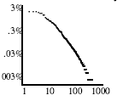
Experimental results
From data collected over a couple of months
  n log n estimate of information rate is about 16 bits/second for ShortTalk commands (assuming four syllables/second speech output)
  About 1000 different commands used

Slide 28
Complementing ShortTalk
Repetitive work is often unfeasible by voice:
  “page down, page down, page up, page down”
Clearly feet are underutilized when sitting at the computer
  State of the art: at most one or two pedals offered for control of say voice recorder or for delete key or mouse button
  Loose pedals, not combined with foot rests, and completely insufficient coverage of repetitive functions

Slide 29
Introducing ShortStep
ShortStep is my 7th or so attempt at producing a foot keyboard that
  Covers virtually all control functions
    Shft-tab, Alt-tab, Alt-Shft-Tab, left, Ctrl-b, Shft-left, PgUp, Ctrl-Alt-s, Ctrl-Esc, Backspace, …
  Doesn’t hurt
  Is fast (foot pedals on an organ are spaced far apart)
  Doesn’t require you to take your socks off

Slide 30
Sales talk: imagine leaning back
Browsing, reading
Process your email
  Next email
  Delete or not
Process your photos
  Some need to be rotated others not
Edit your text
  Just pressing the return key and the backspace key by feet saves time and effort (because they’re a little out of the way)
CAD applications
Programming

Slide 31
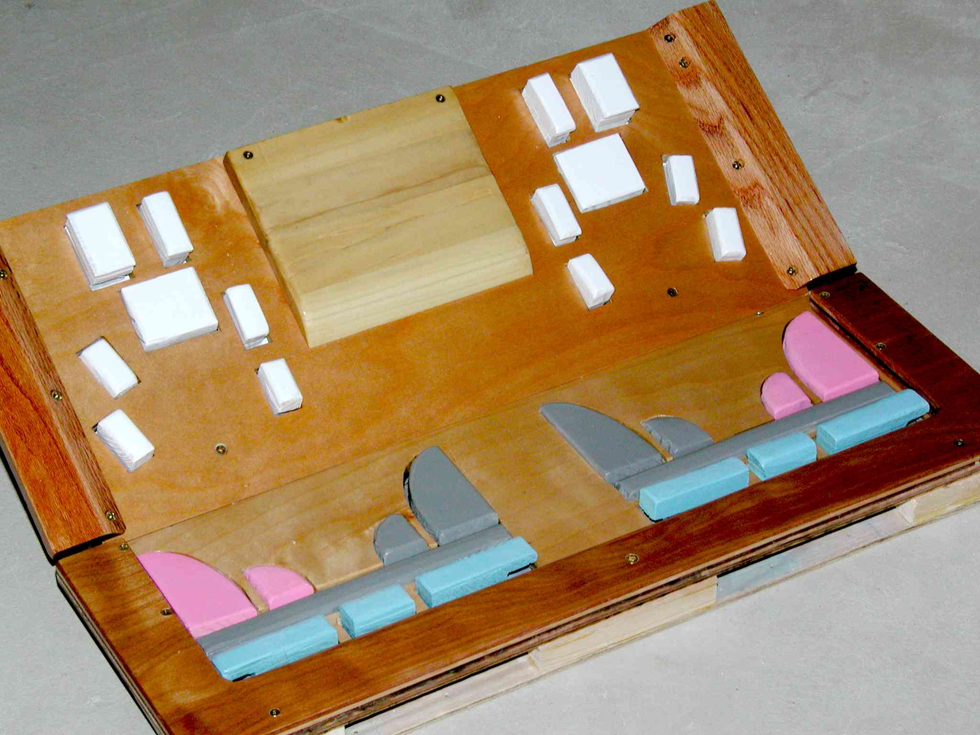
Photo

Slide 32
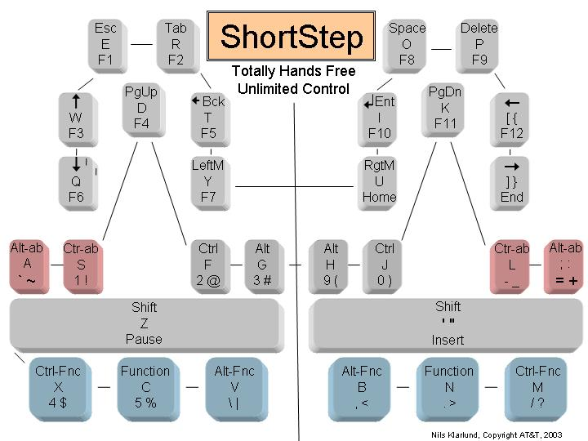
Key layout

Slide 33
Pointing
Pointing (and hence the mouse) cannot be replaced in general
Fortunately, a foot keyboard offers a very significant advantage:
  The mouse buttons can be eliminated
  Why important: think of a graphic pen and the bothersome button on the side
  Similar problem with mouse…

Slide 34
A friendly mouse
  Problem: ever-present tension because fingers must be constantly lifted in order not to press the buttons
  Consequently, the more “ergonomic” the mouse is (in terms of large button and light pressure) the more injurious it may be
  Without buttons the mouse can be made small, which makes it possible for the whole hand to rest on the table, again significantly reducing static tension
  These theories are medically unproven (so far…)

Slide 35
Conclusion I
There is so much to be done for computer users who are disabled, even for those who have just sores and pains
Questions raised about whether natural language is really necessary---at what level of user sophistication or need does natural language offer any advantages?
The USI (Universal Speech Interface research at CMU) is less radical than ShortTalk but also advocates simple keywords for controlling interactive voice response systems

Slide 36
Conclusion II: Some unsolicited user comments on ShortTalk…
Hallelujah & Congratulations!... I have been thinking along these lines for years now
Very exciting video using ShortTalk inside of Emacs...
I would really like to try your ShortTalk product.
I am very impressed with your work...I have to warn you, I'm really really really hoping I can motivate you to find a way so that I can try ShortTalk

Slide 37
Conclusion III
Were we deluded by HAL? Yes and no.
Certainly, in my opinion yes, when it comes to operating text editors. Natural language makes no sense.
The human mind must be trained and efficiency is the very best motivation
Research question: Is there something in the brains or conditioning of humans that makes our hands inherently better suited over voice for editing and similar very complex sequencing of operations?

