Slide 1
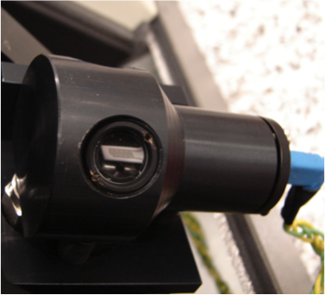
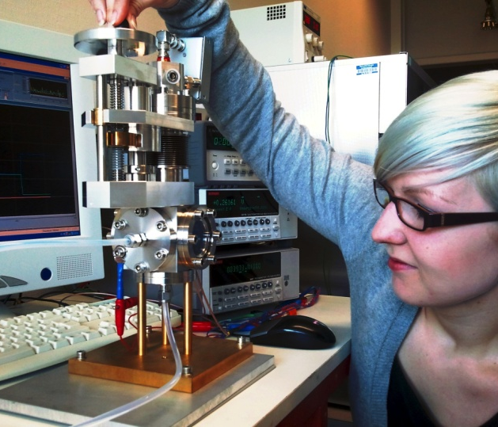
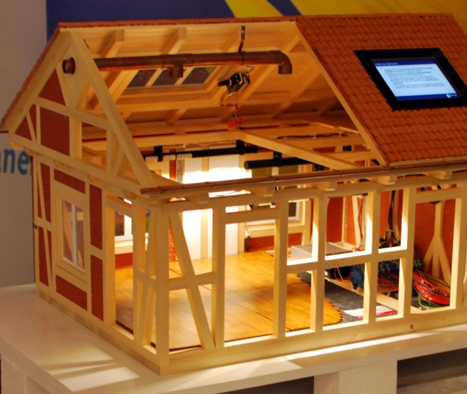
Setting up a data mining machine
Installation of a Python & data mining toolkits
Peter Bonanati

Slide 2
Data mining?
Data mining is the computing process of discovering patterns in large data sets involving methods at the intersection of machine learning, statistics, and database systems.

Slide 3
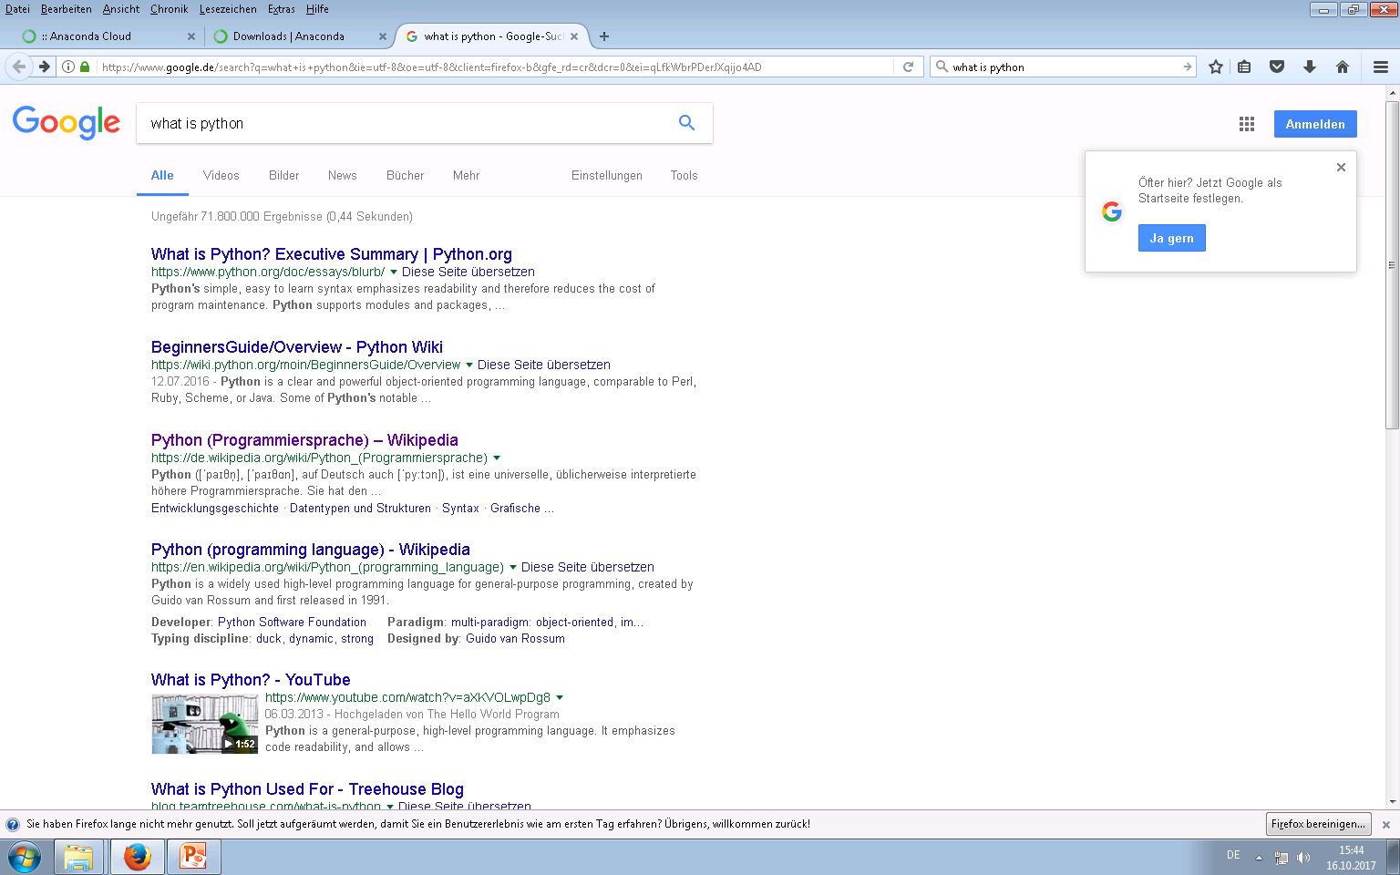
What is Python?

Slide 4
What is Python – and how I see it…
Many things I often do can be done by a computer very well. Python helps me to translate my whishes into computer language.
This task will work nice and is quit simple:
My Whish:
Open the resistance measurement data and draw me the resistance vs. time.
Python Code:
Flow_data = Pd.read_csv(‘Flow.txt’)
Flow_data[‘Resistance’].plot()
This is already data mining.

Slide 5
What is Python – and how I see it…
Other tasks are more complicated will most likely fail:
Whish:
Check if the experiment was running correctly.
Code:
Many things to check and not so simple to implement
!!!!BUT!!!!
Using Python will help me to build smaller tools to get along with most tasks
See the programming rather as a tool to build new tools helping you for your mining.
It will help you to skip (boring) repetitive work and concentrate on what distinguishes you from a computer:
your intelligence

Slide 6
What is Python
Python is a way to express your commands in a language the computer will understand. See it just as a language like French you will need to talk in France to get your glass of wine.
“Python has a design philosophy that emphasizes code readability […], and a syntax that allows programmers to express concepts in fewer lines of code […]]. The language provides constructs intended to enable writing clear programs on both a small and large scale.^{[25]” Wikipedia}

Slide 7
What is Python – What makes it special
I don’t know why but many people are using Python as a language to build many, many tools for lots of use cases.
Additionally most of those tools are shared and anybody can use it.
Such tools are nothing more that a list of precise commands for a PC, telling “him” what to do step by step. Once this step-by-step recipe is ready, it can be easily applied to similar us cases.
Those step-by-step commands can be seen as cookbooks and are generally called Libraries

Slide 8
What is Python
So if Python is just a language, where do I get those ‘step-by-step cookbook’ from?
The most useful ones come in as a set of multiple libraries. Since some of the libraries are depending on each other one has to take care that we have all needed libraries together.
This task is a bit complicated for humans, but a typical task for a computer.
That’s why we use ANACONDA, which checks the decencies and bundles a well working package for us with most of the tools we will ever need.

Slide 9
Let’s start!
Installing Anaconda

Slide 10
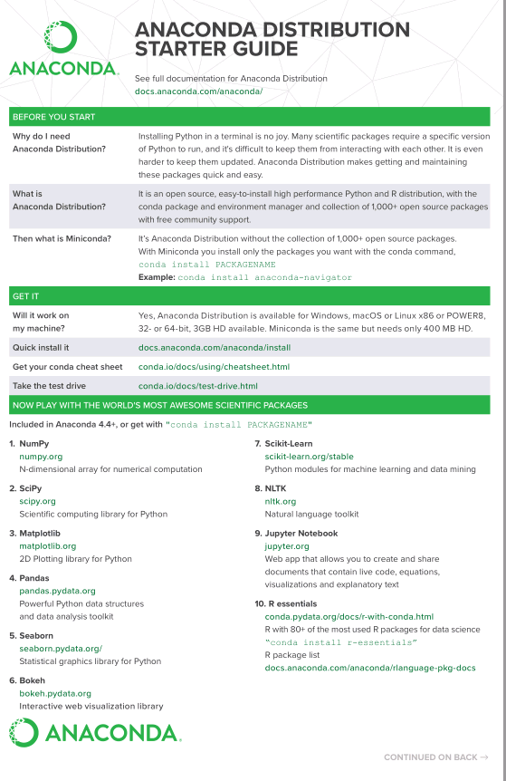
ANACONDA

Slide 11
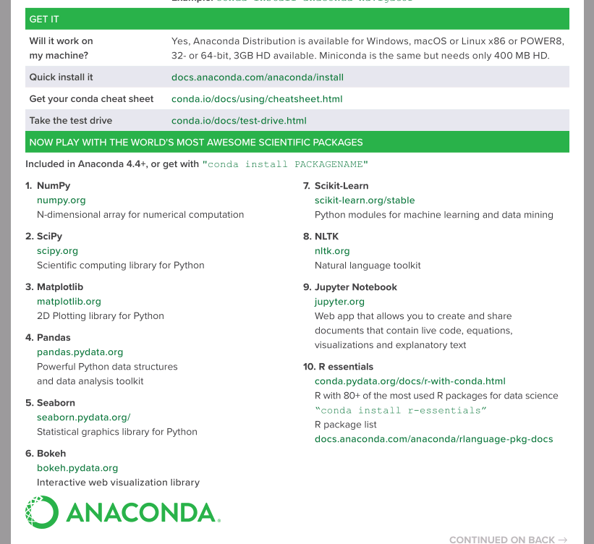

Slide 12
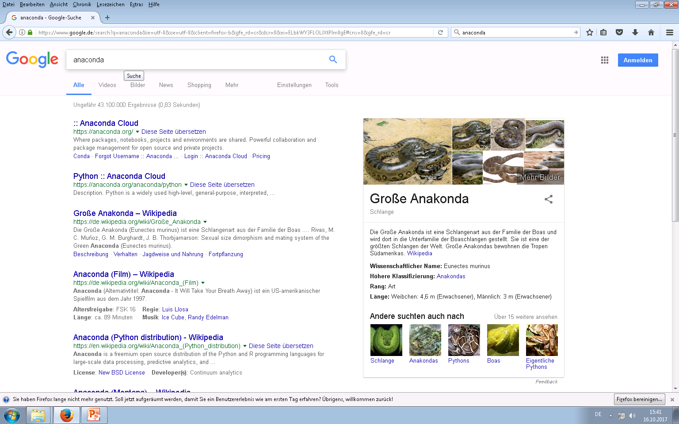

Slide 13
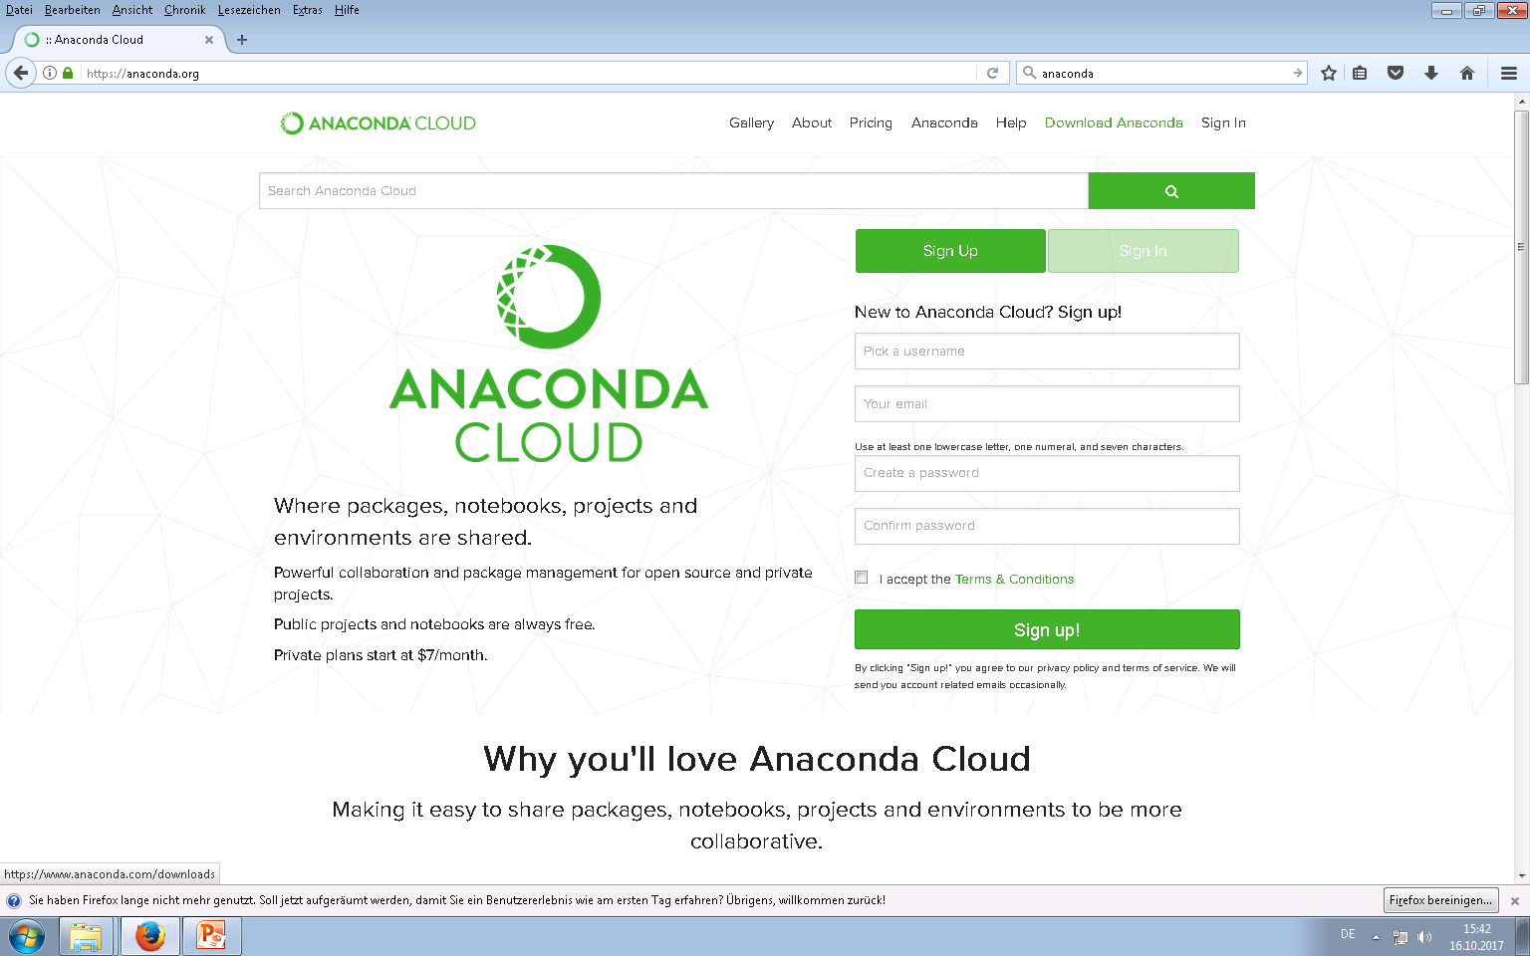

Slide 14
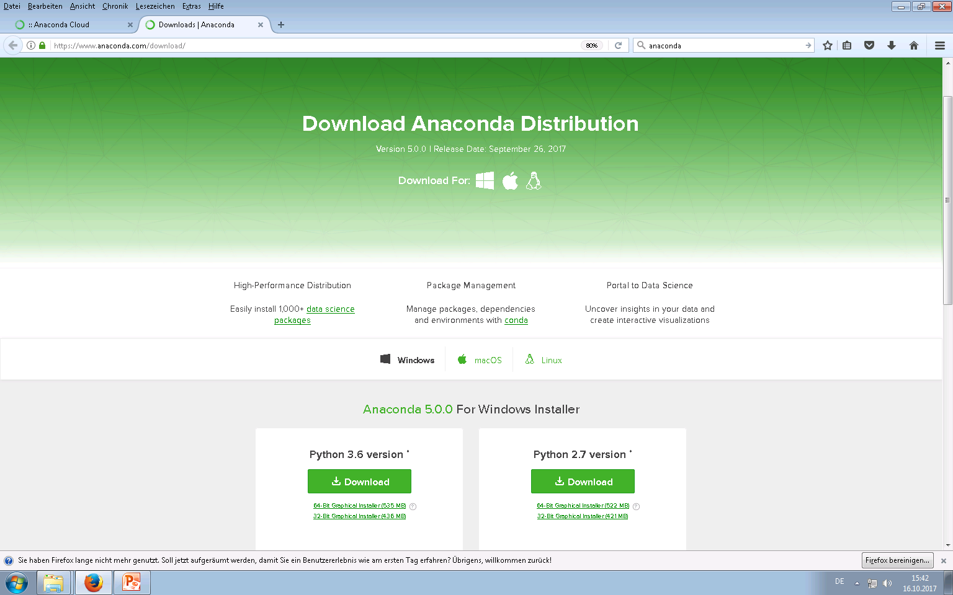

Slide 15
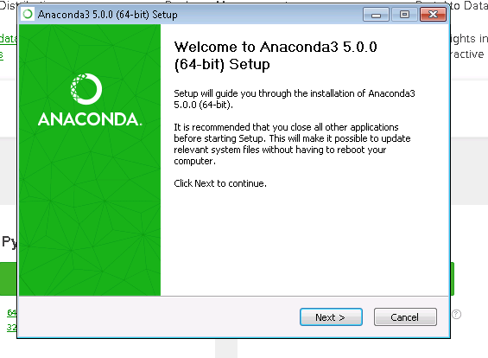
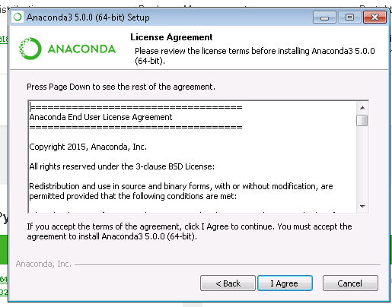
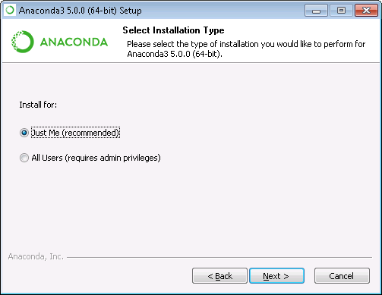

Slide 16
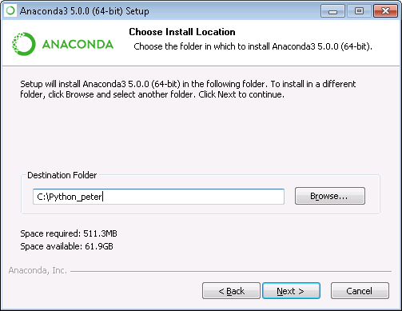
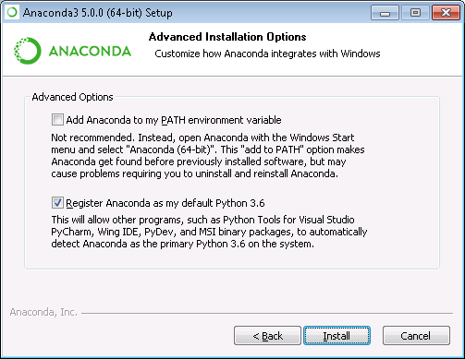
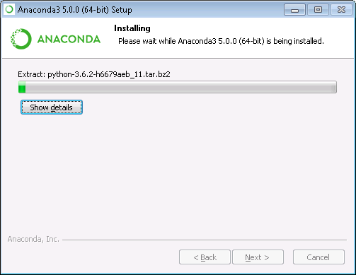
Put a path in here
you can remember

Slide 17

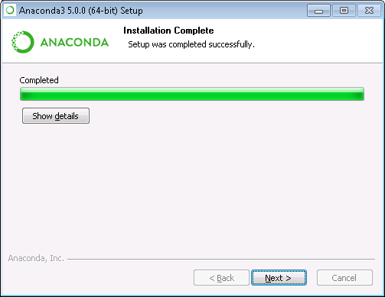
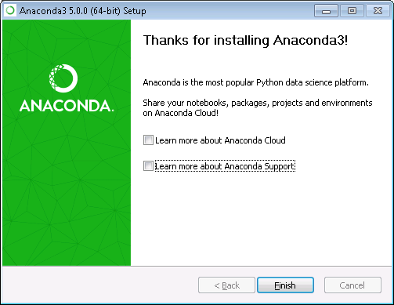

Slide 18
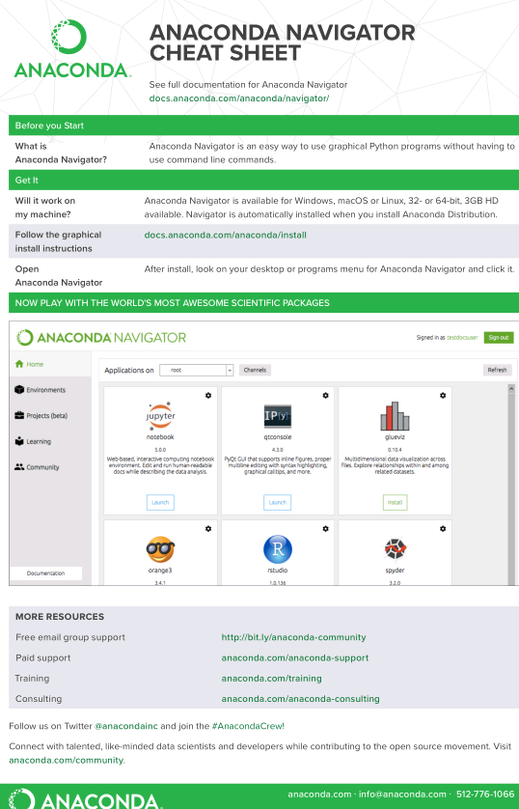

Slide 19
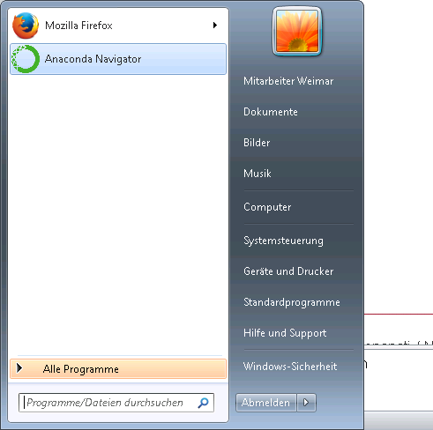

Slide 20
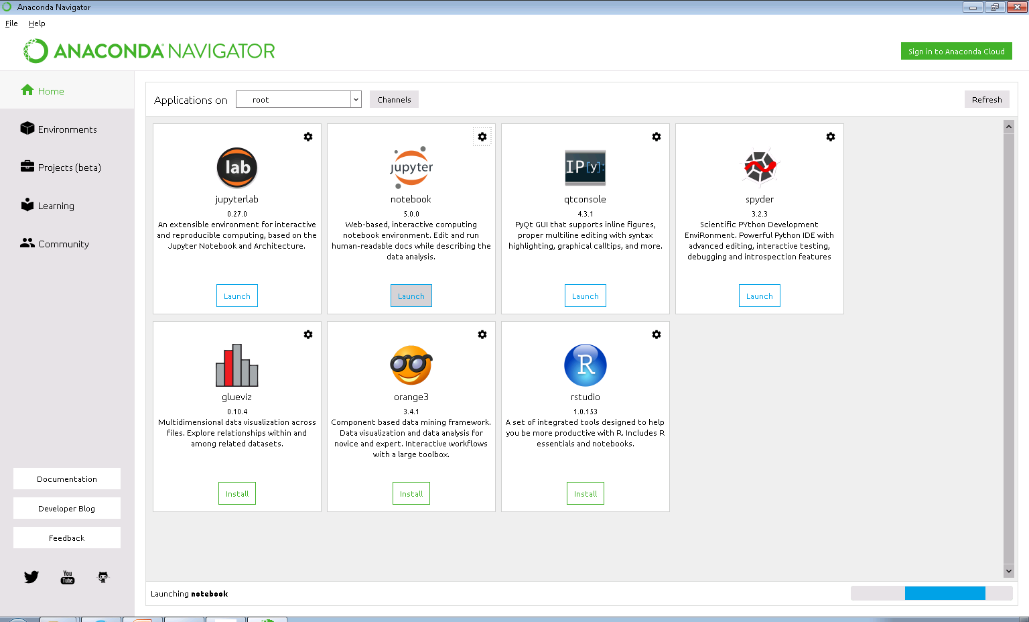

Slide 21
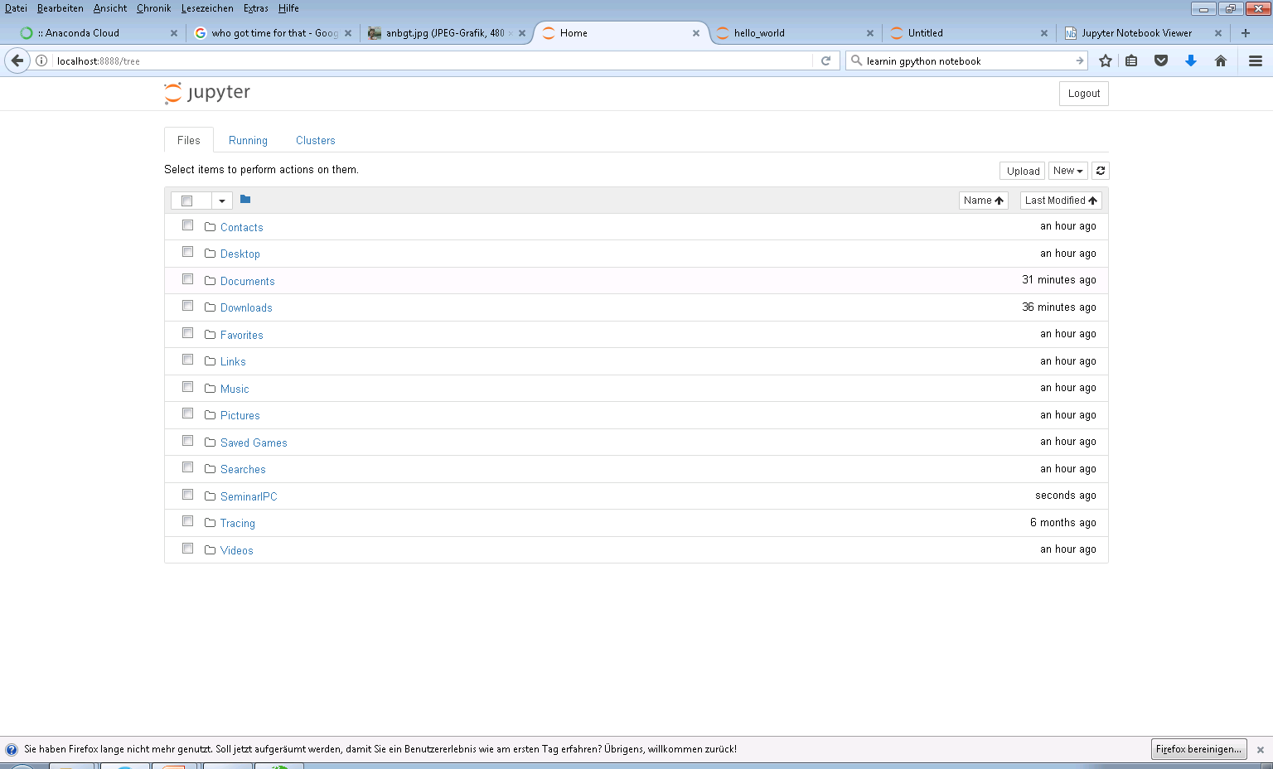
The Browser will show a representation of your “Home-Folder”

Slide 22
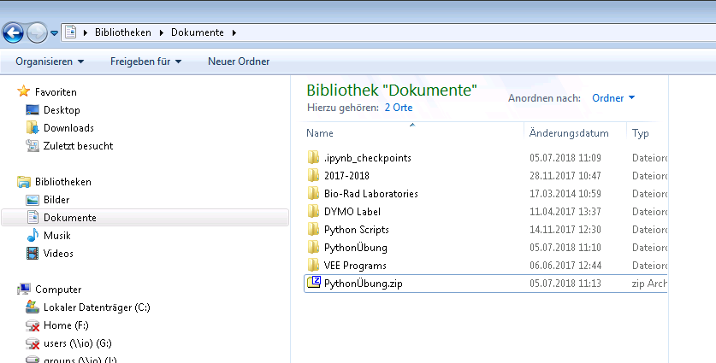
Find and extract the file “PythonÜbungen.zip” in your file browser

Slide 23
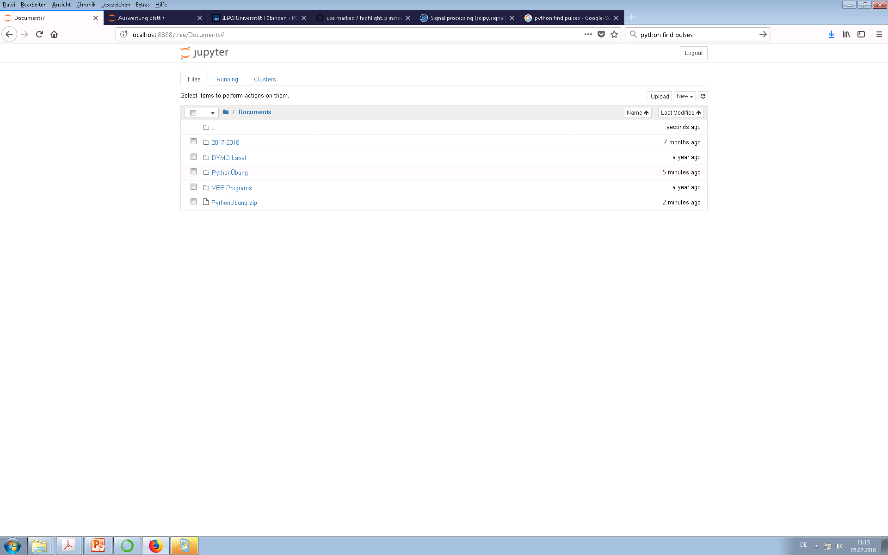
Int the web browser navigate to the extracted files.

Slide 24
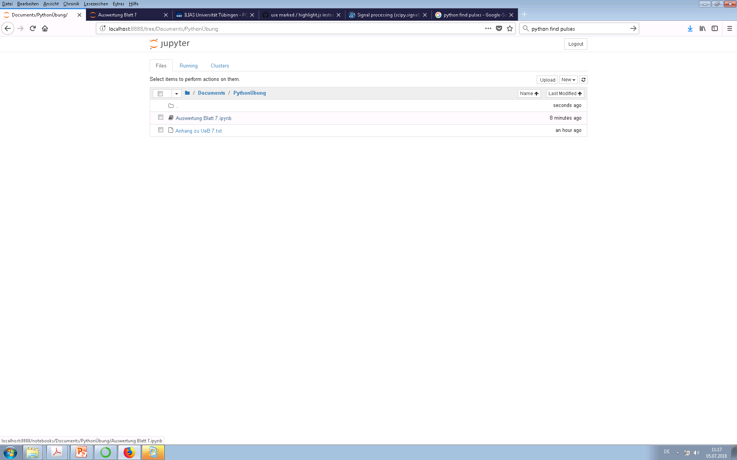
Click on the file with the “ipynb” ending to open it.

Slide 25
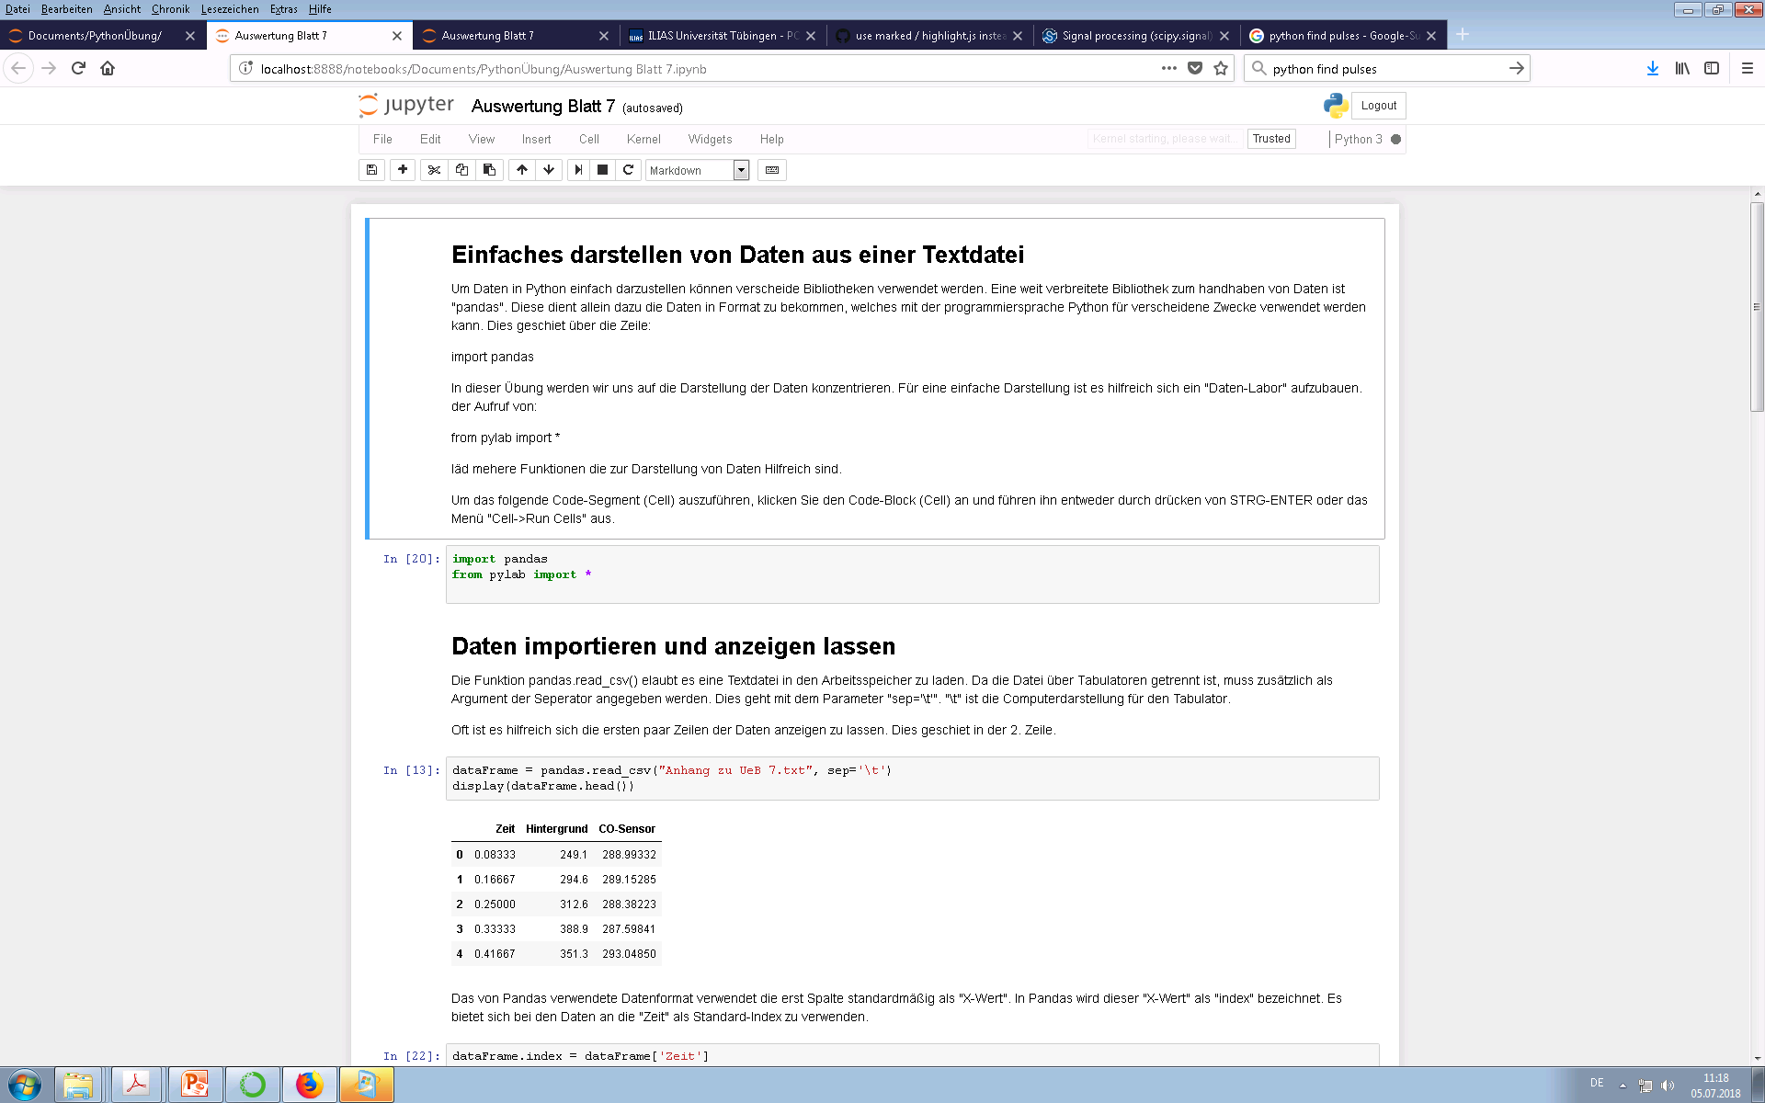
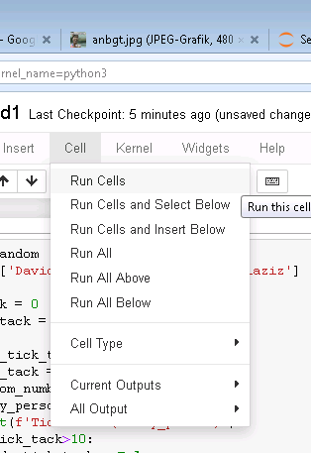
The program/script is structured in different cells. Besides the code you will also find explinations and results in the notebook. You can execute the code by (“Cell->Run Cells”) of by pushing “CTRL-ENTER” on your keyboard. Run some cells and see what is happening.
Empty cell

Slide 26
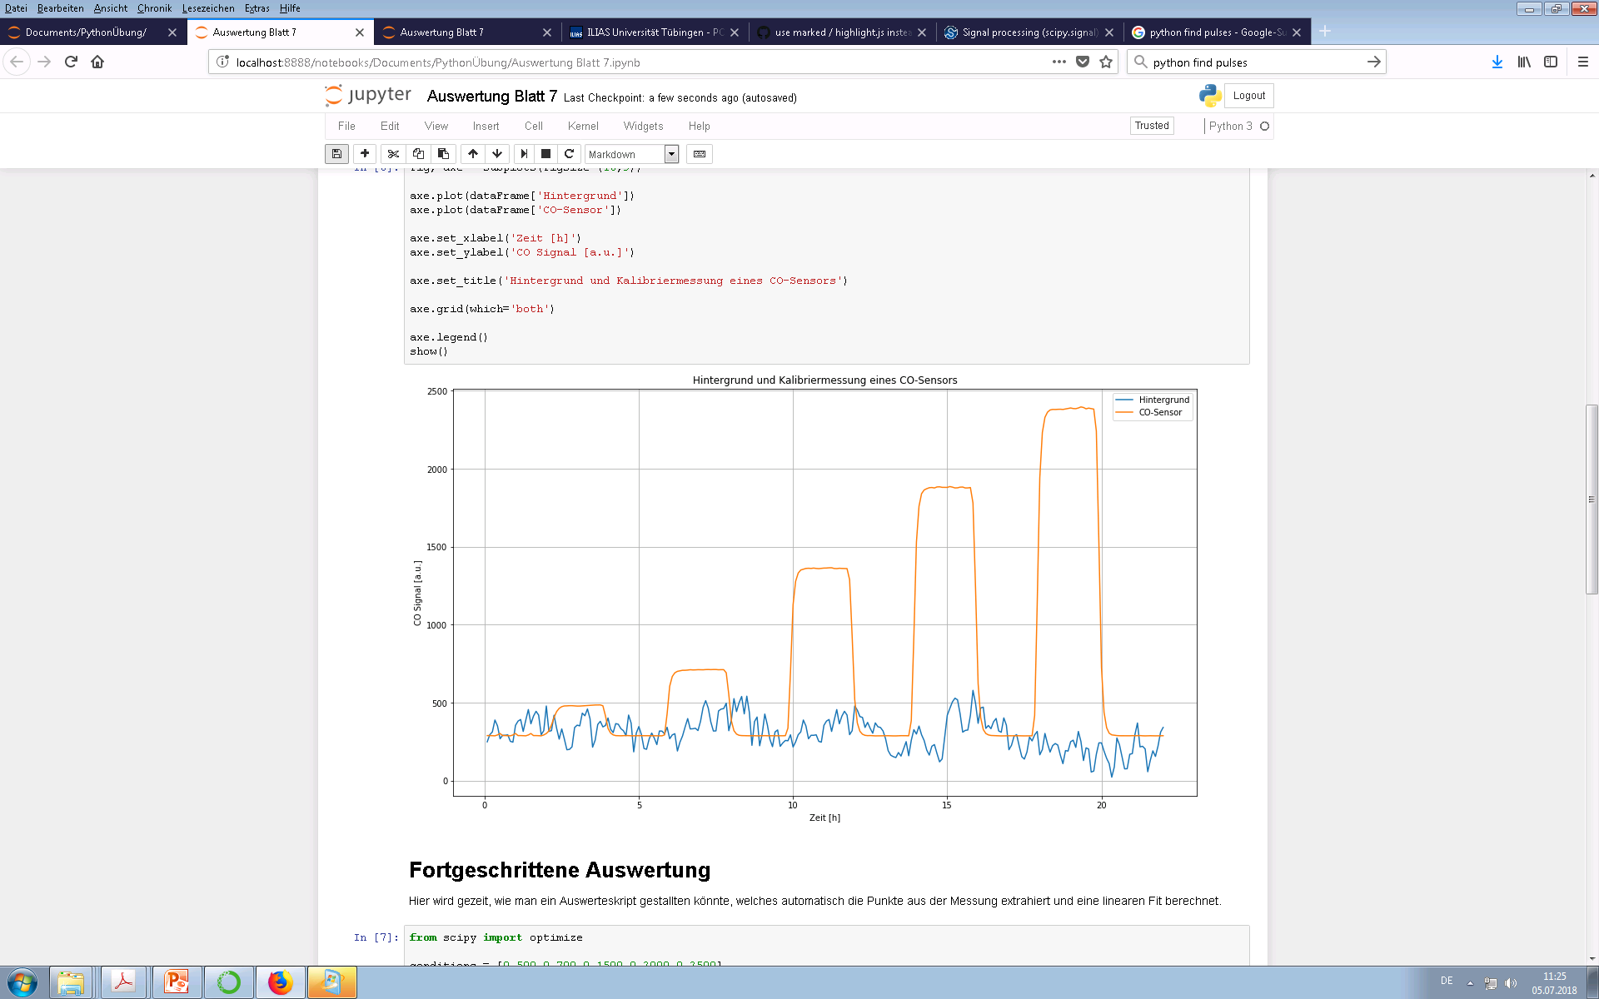
Try to get the following plot on your own. You may also want to play a bit around with the code.
Good look!

Slide 27
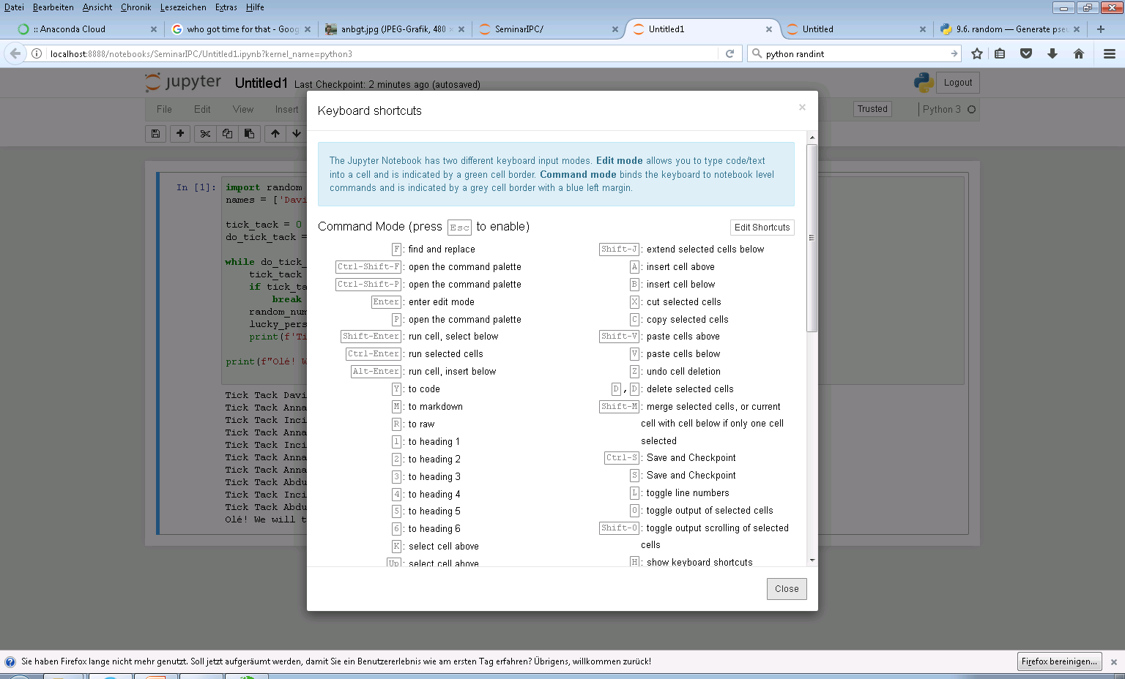
Um Shortcuts nutzen bietet sich die Hilfsfunktion an: Drücke “ESC”, und dann “h”.

Slide 28
Thank you.
Contact:Peter Bonanati
Institute of Physical and Theoretical Chemistry / AG Weimar
Auf der Morgenstelle 15, 72076 Tübingen
Phone: +49 7071 29-77633
Fax: +49 7071 29-5960
Peter.Bonanati@ipc.uni-tuebingen.de

