Slide 1
Factor Based Radex Visualizations in R
Nils Petras
Notes:
My name is… I work on my masters thesis…
Creating an R package

Slide 2
The FBRV Concept
(by Michael Dantlgraber)
Design Choices
(an Expedition in R)
Master Thesis
(Usability)
Notes:
Schublade = Drawer

Slide 3
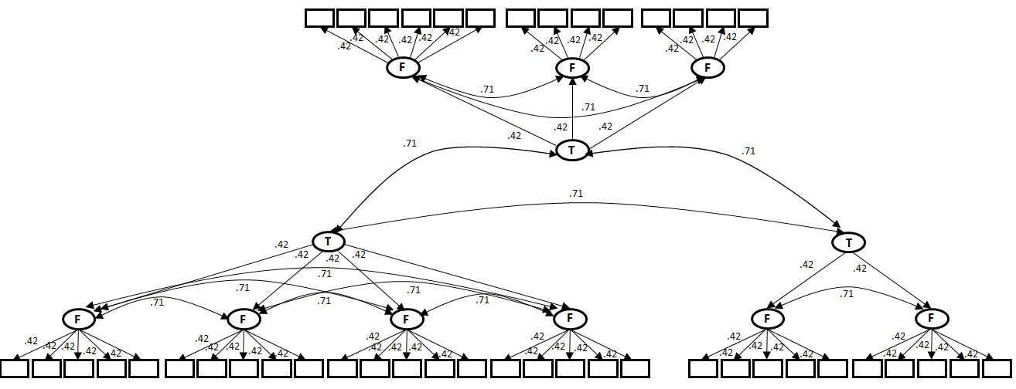
The Problem
Notes:
item sets and their latent factor structures
Relation between item sets of 3 tests

Slide 4
The Problem
No visual representation of factor loadings (=mapping)
Notes:
the values are written without a representation in size, color, shape or other

Slide 5
The Problem
No visual representation of factor loadings (=mapping)
Comparizon between tests difficult
Notes:
Only the number of item sets and latent factors visible, not their statistical relations,
The relation between tests and their item sets are only represented by one correlation number

Slide 6
The Problem
No visual representation of factor loadings (=mapping)
Comparizon between tests difficult
Advantage of using correlated factors invisible
Notes:
Item sets are generally represented better with multiple factors (facets) compared to one factor
This increase in factor loadings is invisible

Slide 7
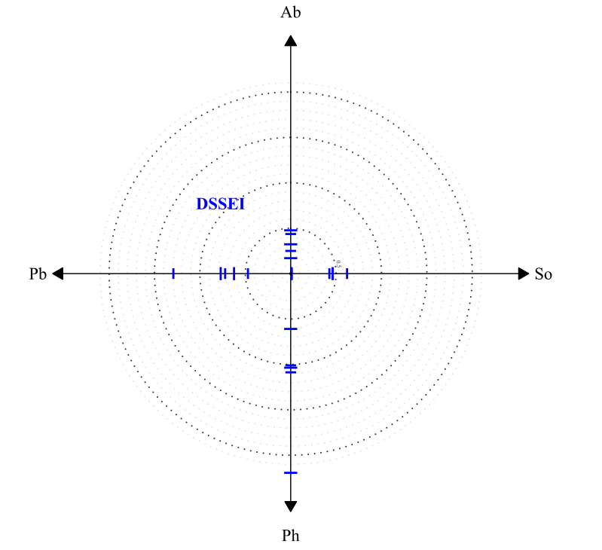
Notes:
Items can be located relative to the facets and the general factor
we can see common deviation from the general factor within a facet
DSSEI Domain Specific Self-Esteem Inventory
Ab Task-Related Abilities
Pb Public Presentation
So Social Competence
Ph Physical Appeal
Physical inhomogeneous

Slide 8
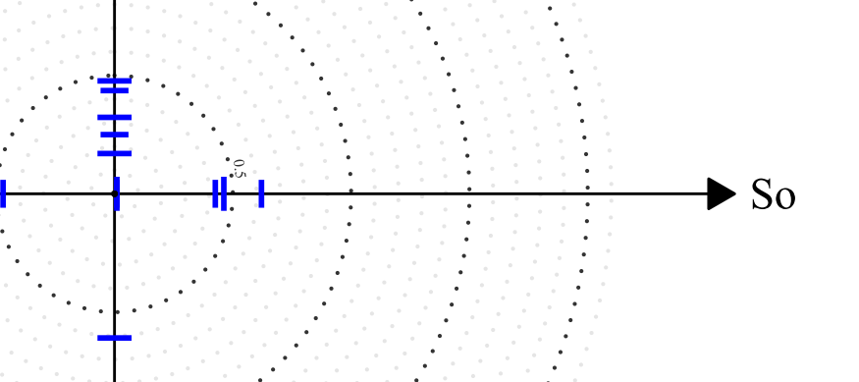
Example:
„DSSEI“ squared factor loading: .2
„DSSEI Social Competence“ squared factor loading: .4
=> Center distance: 1
100% increase in explained variance

Slide 9
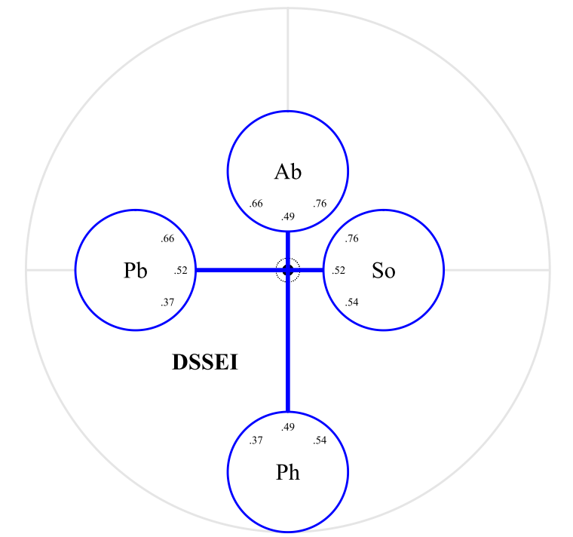
Notes:
The mean center distance for the items of a facet as distance between center and edge of circle
Latent correlations between Facets
DSSEI Domain Specific Self-Esteem Inventory
Ab Task-Related Abilities
Pb Public Presentation
So Social Competence
Ph Physical Appeal

Slide 10
Notes:
DSSEI Domain Specific Self-Esteem Inventory
Ab Task-Related Abilities
Pb Public Presentation
So Social Competence
Ph Physical Appeal

Slide 11
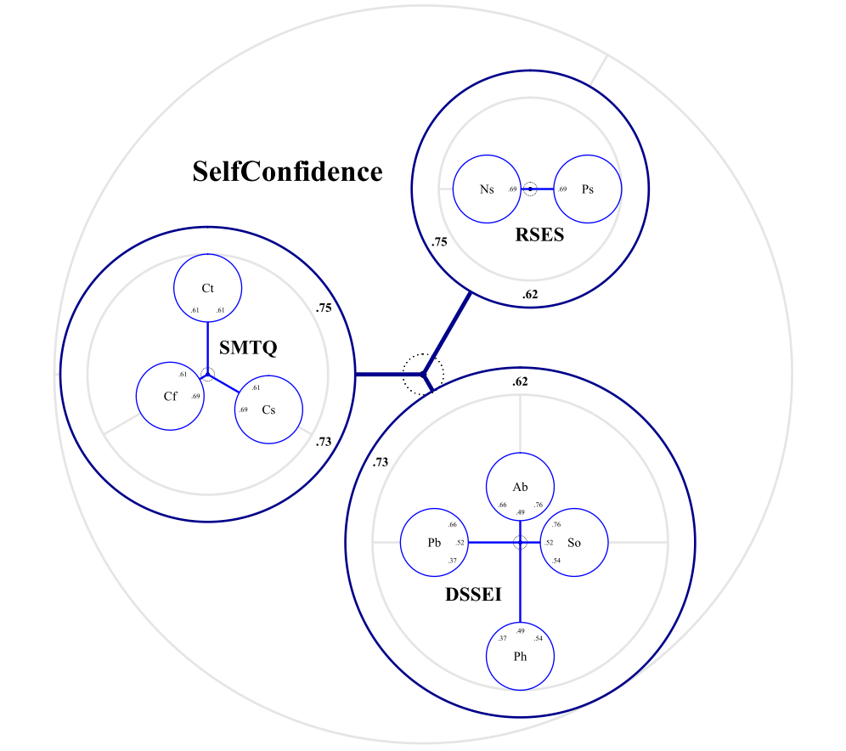
Notes:
Several tests with multiple facets in a higher order factor structure
Lower order structure nested
Created space for latent correlations
SMTQ Sports Mental Toughness Questionnaire
Cf Confidence
Cs Constancy
Ct Control
RSES Rosenberg Self-Esteem Scale
Ns Lack of Negative Self-Esteem
Ps Positive Self-Esteem

Slide 12
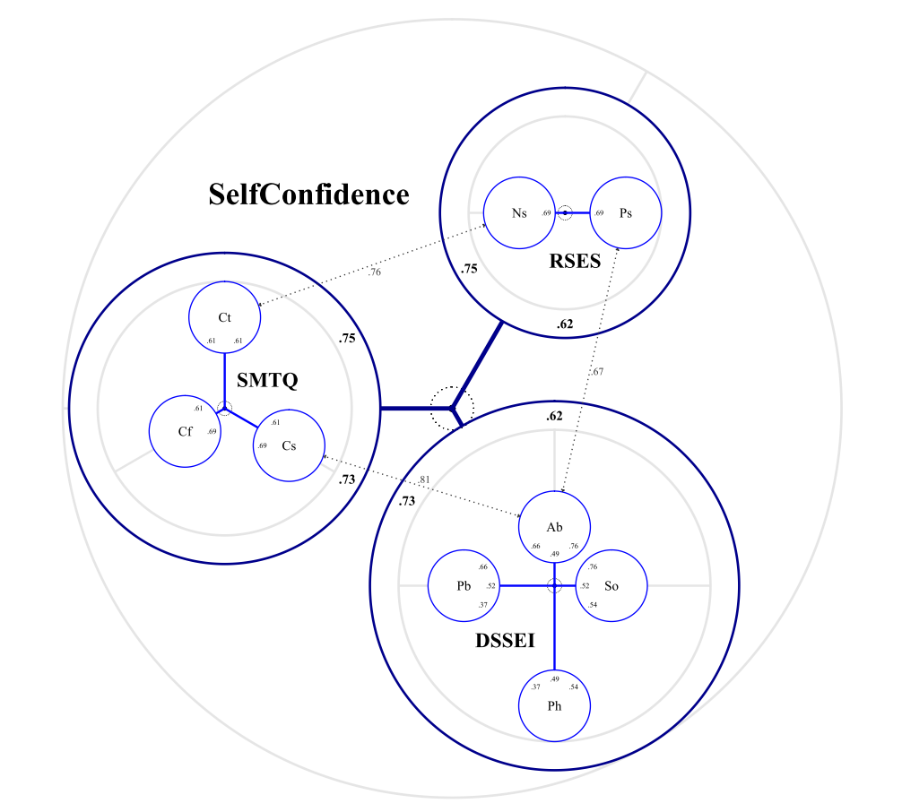
Notes:
Some facets of these tests relate closer to each other than the overall tests
„deviating back towards each other“
Constancy Sports Mental Toughness Questionnaire and Task Related Abilities Domain Specific Self-Esteem Inventory

Slide 13
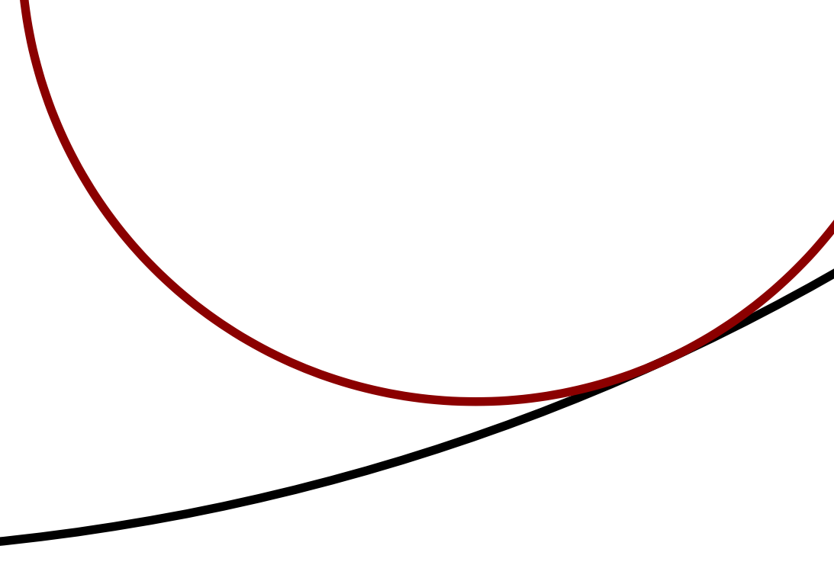
Design Choices
Notes:
Layering
Positioning
Dependency
Smart adaptation
Contrast
In Absprache

Slide 14
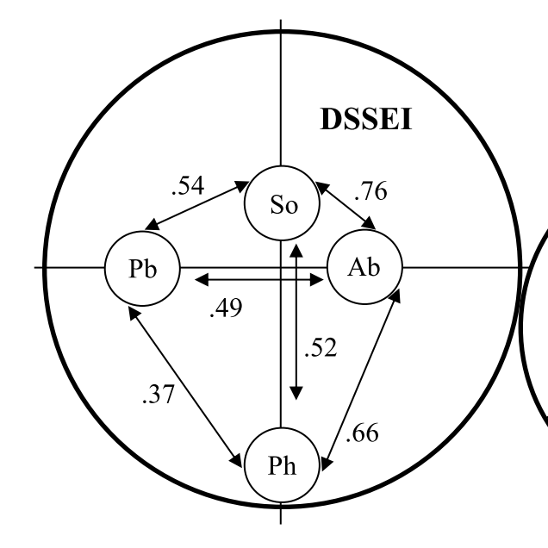
In MS Word
In R
Notes:
arrows -> numbers next to circles -> numbers within circles in direction -> numbers within circles distributed evenly (even polygon assumption)
Contrast
Layering
Positioning
Dependency
Smart adaptation
DSSEI Domain Specific Self-Esteem Inventory
Ab Task-Related Abilities
Pb Public Presentation
So Social Competence
Ph Physical Appeal

Slide 15
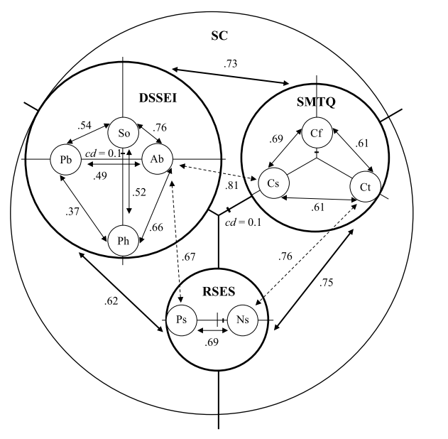
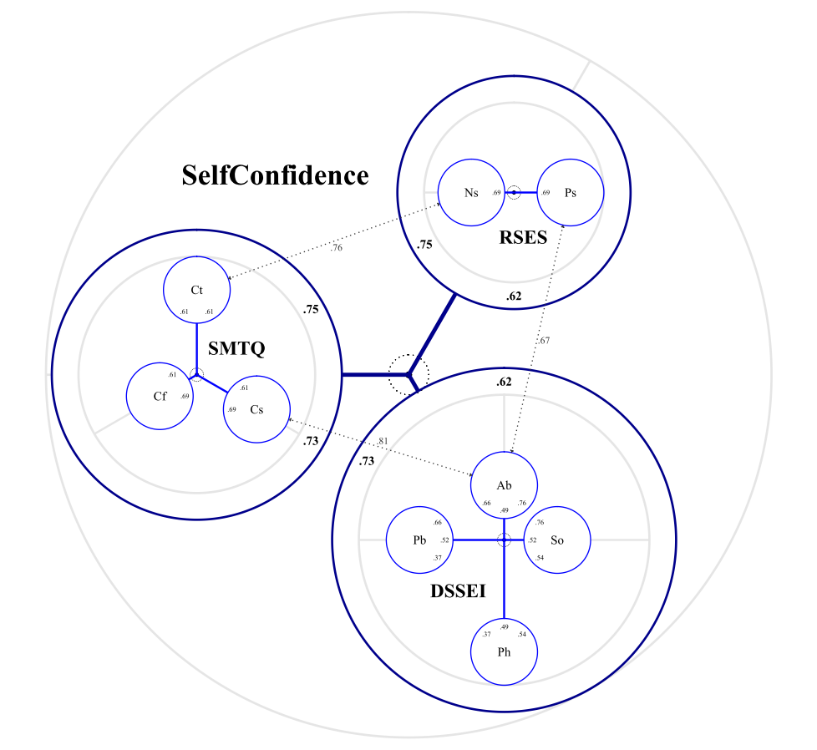
In MS Word
In R
Notes:
Several agreed changes:
Axis Tick as ring
No arrows, correlations in circles instead
Ring to avoid overlap
Extra arrows less prominent (gray)
Overall use of contrast

Slide 17
This part is presented in R Studio
Design Choices

Slide 19
This part is presented in R Studio
Design Choices

Slide 20
Master Thesis
Programming
Instructions (Example)
Usability Test

Slide 21
Usability Test
Imagine you are a user of this package…
…what would make it easy to learn and use it?
Notes:
What would I have to ask my users?

Slide 22
Master Thesis
Programming
Instructions (Example)
Usability Test
Success

Slide 23
Master Thesis
Programming
Instructions (Example)
Usability Test
Success
Thank you, for your attention!

Slide 24
Factor Based Radex Visualizations in R
Nils Petras
Michael Dantlgraber

