Slide 1
Hotel bookings
Goal? Increase profit
How? - Identify customers that are likely to cancel their booking. - Make an intervention that increases the likelihood of them not cancelling
Finding?
After tweaking the interpretation of the models original performance we will be able to construct a story for a reasonable business opportunity and have ourselves a GDMPMLM
GOD DAMN MONEY PRINTING MACHINE LEARNING MODEL

Slide 2
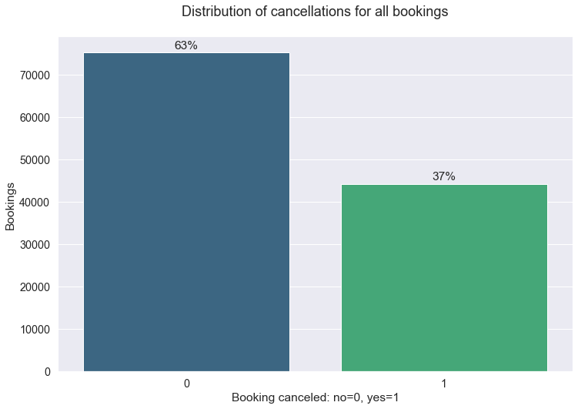
is_canceled
37% cancellations!

Slide 3
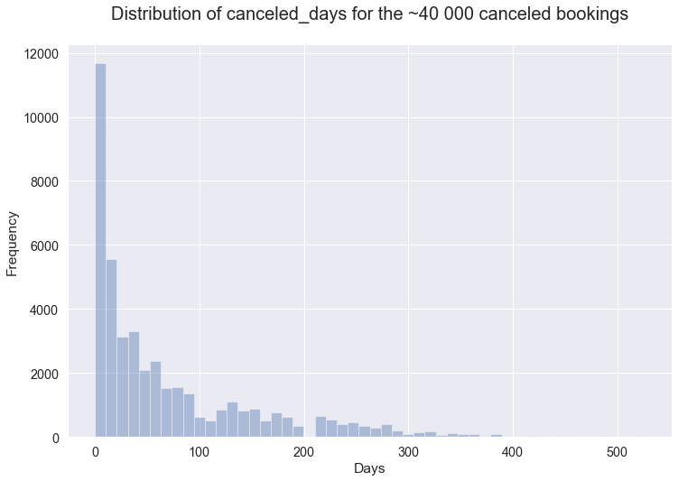
canceled_days
Explanation
If im cancelling my booking 30 days before my arrival date:
canceled_days = 30

Slide 4
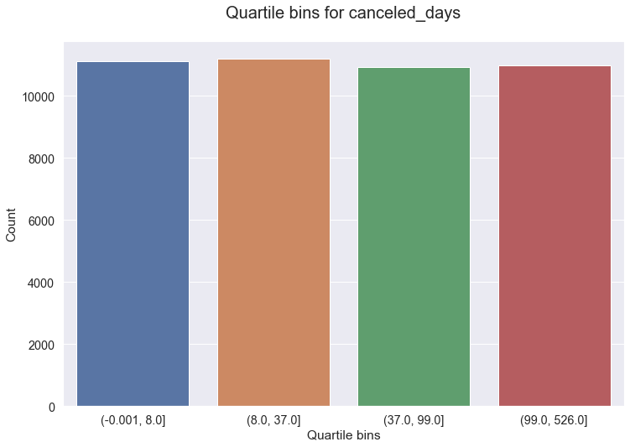
canceled_days
Q1: 0-8 days
Q2: 8-37 days
Q3: 37-99 days
Q4: 99-526 days

Slide 5
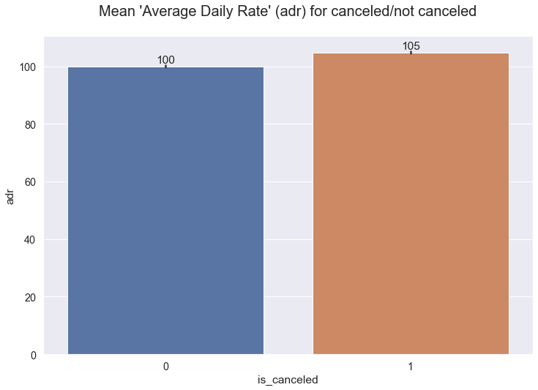
adr
Average daily rate per booking
5% higher for canceled bookings!

Slide 6
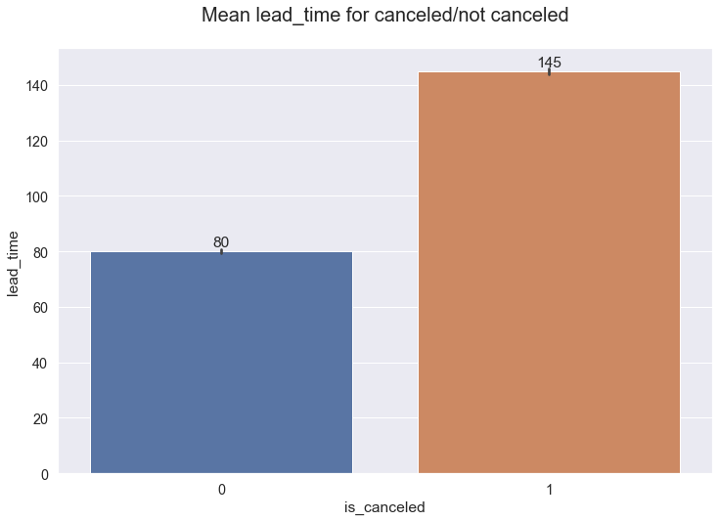
lead_time
No. of days before arrival when the booking occured
Significantly higher for canceled bookings!

Slide 7
MODEL TIME!

Slide 8

RandomForestClassifier() with default settings

Slide 9
RandomForestClassifier()
Model evaluation based on 3 different slices of result-table:
full testdata
canceled days > 31
canceled days > 31 + predict_proba > 0.9

Slide 10
Model performance Slice 1: all testdata
technically not a slice?:(
23878 bookings in test data
8844 canceled (37%)
Precision: 88%
Problem!
Remember canceled_days?
We don’t want to wait 1 year before we can evaluate the model.

Slide 11
canceled_days
Q1: 0-8 days
Q2: 8-37 days
Q3: 37-99 days
Q4: 99-526 days

Slide 12
Model performance Slice 2: canceled_days < 31
23878 bookings in test data
4004 canceled 30 days or less before arrival (17%)
Precision: 70%
Problem: Not good enough!
Calculations for business did not add up

Slide 13
Model performance Slice 3: canceled_days < 31 & predict_proba > 0.9
23878 bookings in test data
1508 predictions made with
predict_proba > 0.9
canceled_days < 31
Precision: 97.7%
Question: Are we able to make money?
Let’s find out!

Slide 14
Assumptions! We need to make some assumptions to be able to calculate possible business opportunities for our model
Intervention - what is the intervention? - what is the success rate for the intervention?
Cost for FP?
Gain for TP?
Cost for model?

Slide 15
Choosing intervention
Let’s look at:
feature_importances_

Slide 16
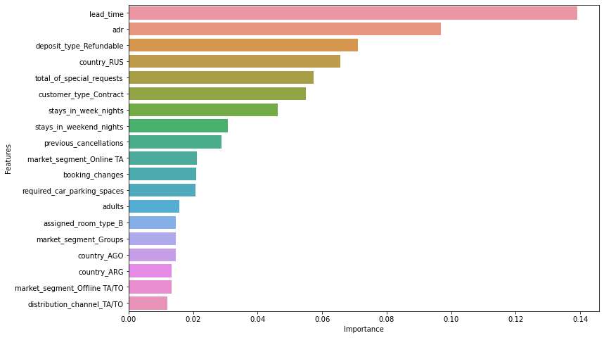
Feature_importances_
Number one: lead_time
Difficult to intervene!
Number two: adr
Possible to intervene!

Slide 17
Intervention
What is our intervention?
Offer a 10% discount for average daily rate (adr)
Success rate?
We are assuming that the intervention is successful 10% of the time.
So…
For every 10 TP we have 1 booking which does not cancel because of intervention. We must also take into account that we are “only” saving 90% of the value of the booking.
For every FP we are losing 10% of the value of the booking

Slide 18
Assumptions! We need to make some assumptions to be able to calculate possible business opportunities for our model
Intervention - what is the intervention? - what is the success rate for the intervention?
Cost for FP?
Gain for TP?
Cost for model?

Slide 19
Calculating FP cost!
Per booking average:
People ~ 1.96
Average stay (no. of days) ~ 3.43
Average Daily Rate ~ 101.8€
Value average booking:
1.96*3.43*101.8 ~ 684€
Every FP will result in a cost / value loss...
684€ * 0.1 ~ 68€ FP cost!

Slide 20
Calculating TP gain!
TP
684 * 0.9 ~ 616€ income (‘value average booking’ with 10% discount)
684 * 0.6 = 410€ variable cost (assuming variable cost per booking is 60% - mainly staff)
Profit when intervention is successful: 616 - 410 = 206€
Assuming 10% success rate for intervention each TP has the average expected value of…
206 * 0.1 ~ 21€ TP gain!

Slide 21
Assumptions made! With assumptions + model perfomance we can calculate expected profit/loss
Intervention - what is the intervention? 10% discount - what is the success rate for the intervention? 10%
Cost for FP? -68€
Gain for TP? 21€
Cost for model? 2000€/month (Nils decides)

Slide 22
Calculating profit/loss
If the model performs equally well on real data, then based on our assumptions: - every decision the model makes is us on average 18 euro in profit.
(0.97*0.1*206) - (0.03*68) ~ 20 - 2 = 18 euro
TP
FP
Precision 97%

Slide 23
Calculating profit/loss
If the model performs equally well on real data, then based on our assumptions: - every decision the model makes is us on average 18 euro in profit.
Fixed cost = 2000€
Break even point = 2000 / 18 ~ 111 decisions
After 111 decisions we have covered the fixed cost for the model. Every decision after =
!!!$$$MONEY PRINTING MACHINE$$$!!!

Slide 24
Will the model be able to make enough predictions in order to be profitable?
Depends on how many actionable predictions we are able to make. This is the product of:
Total no. of bookings
% of total we are making actionable predictions for

Slide 25
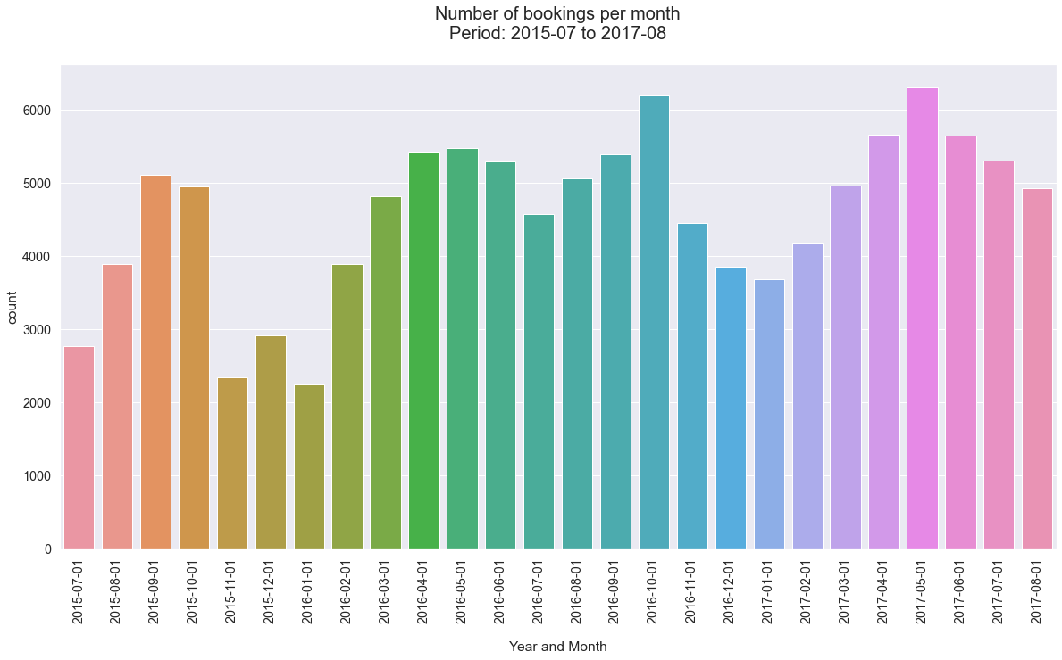
Mean no. of bookings per month:
2015-2017: 4600
2017: 5300
We’ll go with 5000

Slide 26
Will the model be profitable?
mean no. of bookings per month ~ 5 000
Positive predictions made with 0.9 or more “certainty” ~ 6% of total data. Our model will make actionable predictions for 300 (5 000 * 0.06) bookings per month.

Slide 27
Model performance Slice 3: canceled_days < 31 & predict_proba > 0.9
23878 bookings in test data
1508 predictions made with
predict_proba > 0.9
canceled_days < 31
1508/23878 ~ 6 %
So…
We are making actionable predictions for 6 % of total bookings

Slide 28
Will the model be profitable?
mean no. of bookings per month ~ 5 000
Positive predictions made with 0.9 or more “certainty” ~ 6% of total data. Our model will make actionable predictions for 300 (5 000 * 0.06) bookings per month.
Average profit per decision = 18 euro Fixed monthly cost for model = 2000
18*300 - 2000 = 3400€ in monthly profit

Slide 29
THE END

Slide 30
Possible issues
Problem = Model will not perform on real-world data (i.e. “grouped cancellations” could cause bias)
Solution!
Test model for 1 month without taking action
Problem = Intervention won’t succeed
Solution!
Spend lots of effort on trying out different interventions before scaling up the operation
Problem = Only allowing predictions with >= 0.9 “certainty” (may filter out cancellations which won’t respond at all to interventions)
Solution!
No sé

Slide 31
Comments about money printing machine
We 4 sure have a money printing machine if:
Our assumptions hold true (highly unlikely)
We have taken everything into consideration (we have not and we can not do)
However, it could go either way in a real world setting.
So...
“... we remain confident, yet humble” - Ötzi

Slide 32
THE END

