Slide 1
JUKEBOX
NAME: NILUFA KHAN
GUIDED BY-MR. VAIBHAV DIWAN
& MRS. CHARUL BAPNA

Slide 2
TABLE OF CONTENTS
REQUIREMENT ANALYSIS
DESIGN
SQL QUERIES
CLASS DIAGRAM
OUTPUT

Slide 3
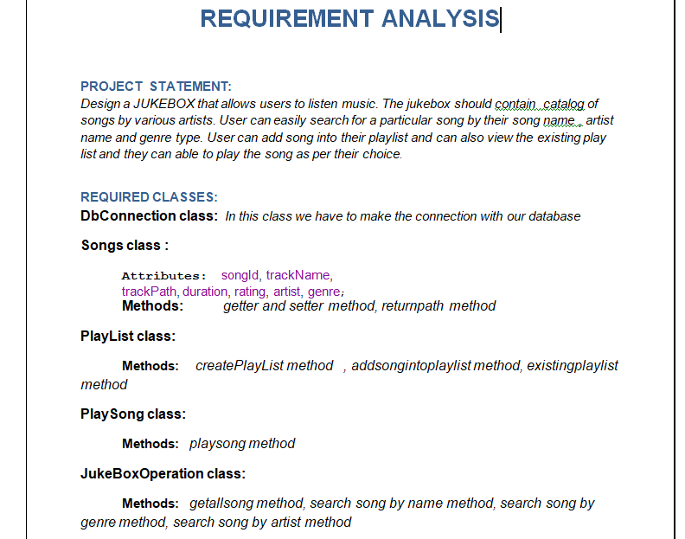
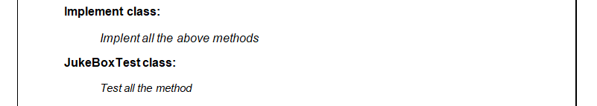

Slide 4
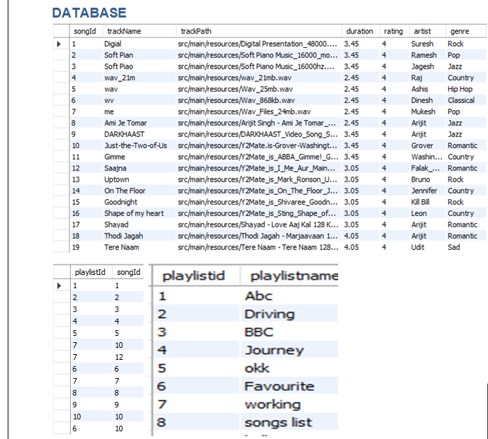
DESIGN

Slide 5
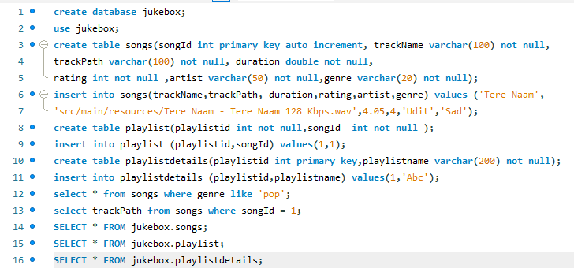
SQL QUERIES

Slide 6
CLASS DIAGRAM
PLAYLIST CLASS
createPlayList ()
addsongintoplaylist ()
Existingplaylist()
PLAY SONG CLASS
playsong()
SONGS CLASS
returnpath()
DB CONNECTION CLASS
JUKEBOX OPERATION CLASS
getallsong ()
search song by name()
search song by genre ()
search song by artist ()
IMPLEMENTATION CLASS
JUKEBOX TEST CLASS

Slide 7
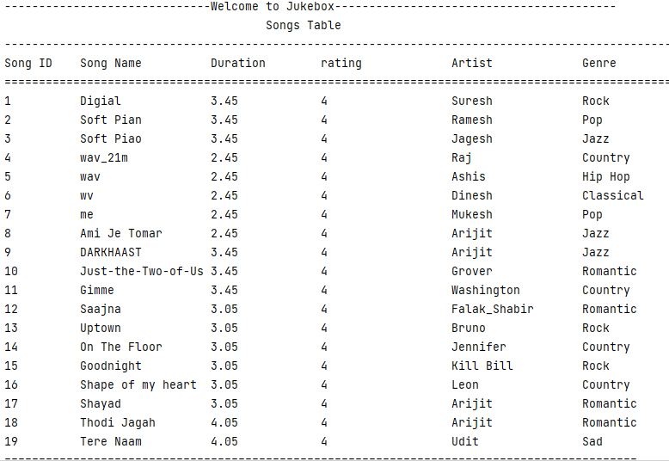
OUTPUT

Slide 8
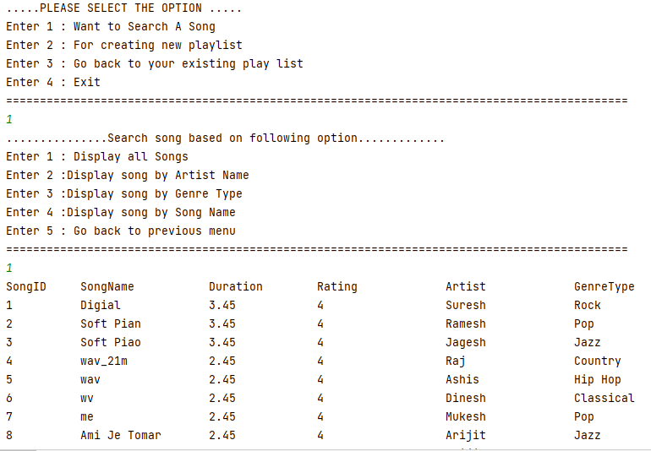

Slide 9
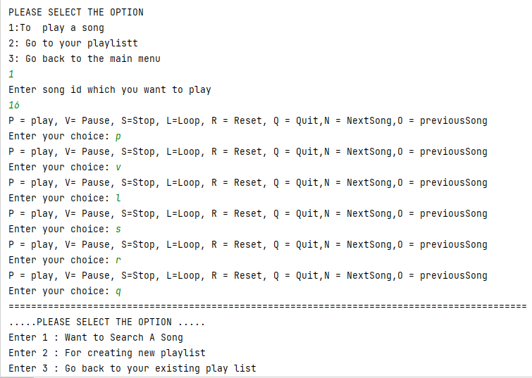

Slide 10
THANK YOU

