Slide 1
Students Performance in Exams
Nilufa Yeasmin
Date: 18-04-2019

Slide 2
Outline
Description of the Problem
Data Source
Preprocessing On Data
Technologies Used
Visualizations
Conclusion
Lessons Learned

Slide 3
Description of the Problem
Students performance in exam generally represent their skills on different subjects.
There could be various influence factors that have an impact on their exam performance.
The dataset I have worked with consists of students exam score in different subjects along with their gender, ethnicity, parent’s education and the type of lunch they used to take.

Slide 4
Description of the Problem
Based on the given factors, I have visualized the score by different category, such as by subjects, genders etc.
Identified some correlation among the scores.
In addition, I have identified some influencing factor that has impact on the students score.

Slide 5
Research Questions
RQ1: How to visualize the dataset observations in different categories and students’ scores in exam?
RQ2: Is there any correlation among the scores students achieved in exam for different subjects?
RQ3: What are the visible and influencing factors for the students’ score in exam?

Slide 6
Data Source
I have used the open source dataset from Exam Scores site to get the students’ scores in exam.
Data source URL: http://roycekimmons.com/tools/generated_data/exams
This data set consists of the marks secured by the 1000 students in 3 different subjects, Math, Reading and Writing.
In addition, it consists of some influencing factors such as gender, race, parents education, lunch type, and if the student took test preparation courses.

Slide 7
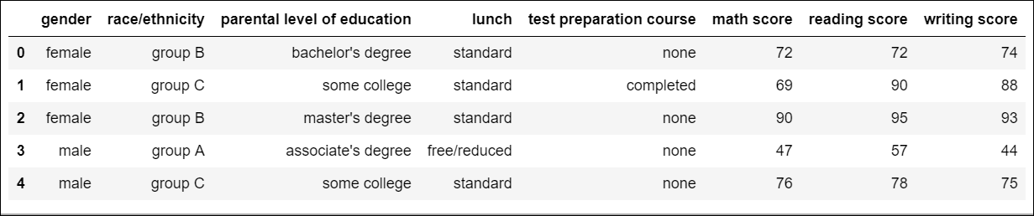
Preprocessing On Data
There is no missing value in the given dataset. Below is a glimpse of few data from the dataset:
Fig 1: Glimpse of dataset

Slide 8
Technologies used
Python Anaconda Notebook (python version 3.5). Specifically, I have used python pandas, numpy, seaborn and matplotlib libraries.

Slide 9
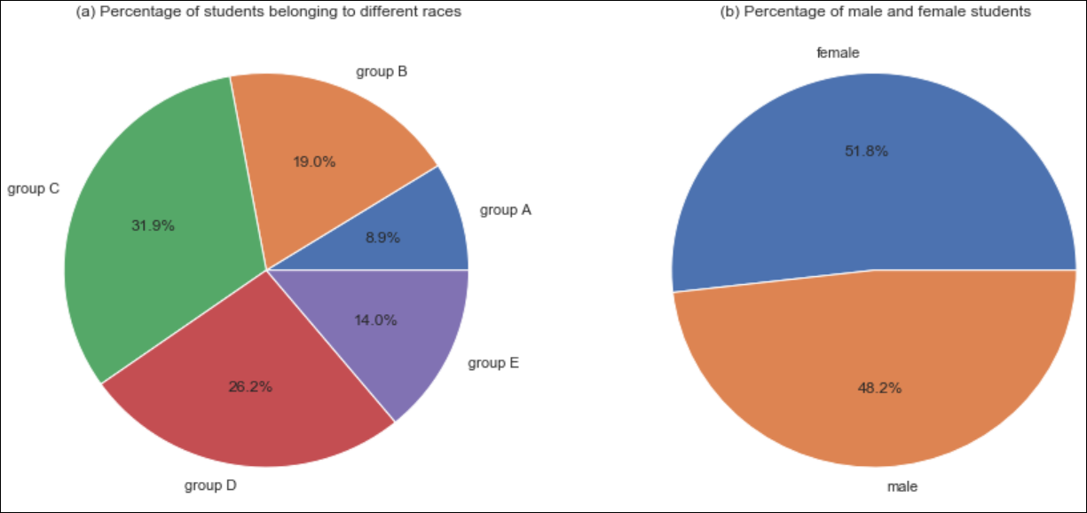

Data Analysis and Visualization
RQ1: Visualize Dataset (dataset observations in different categories from high level)
It is seen from the Fig 2(a) that the majority of the students belong to ethnic group C and group D, respectively 31.9% and 26.2%. We also see in Fig 2(b) the number of female students are slightly higher compared to male students.
Fig 2: Data observations

Slide 10
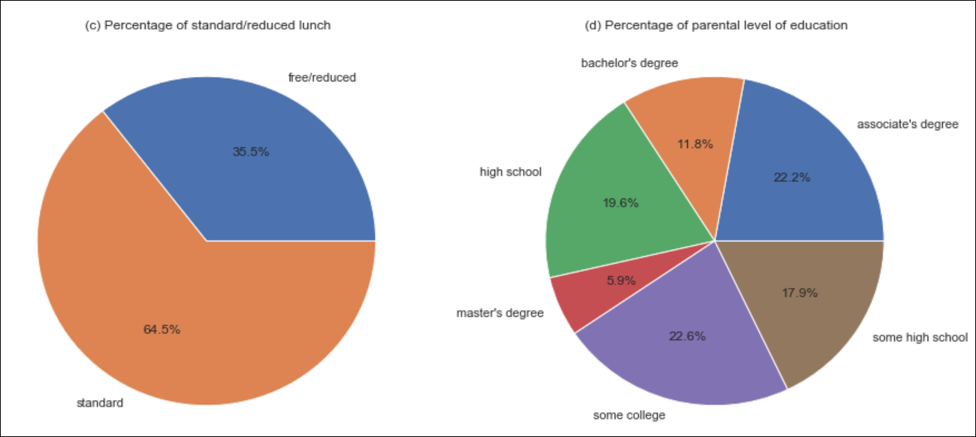
Among all the students, majority of the students take standard lunch than the reduced lunch as in Fig 2(c).
Fig 2(d) shows the parents education level, and as seen only 6% of the parents have Masters’ degree, whereas approximately 45% of parents have associate/college degree combined.

Slide 11
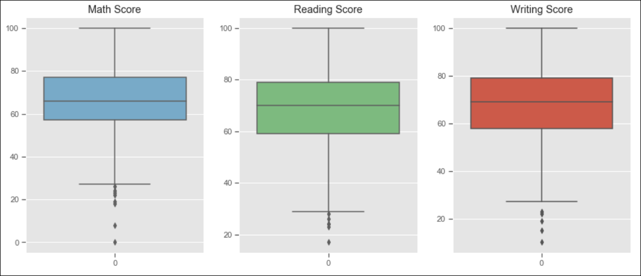
Distribution of students’ scores in Math, Reading and Writing in boxplots.
It shows a similar distribution of scores in all three subjects with some minimal differences.
For example, the Q1 for Reading score is lower than the others, but majority of the students scored between 60 and 80 for all three subject.
Fig 3: Score distribution in boxplots for Math, Reading & Writing

Slide 12
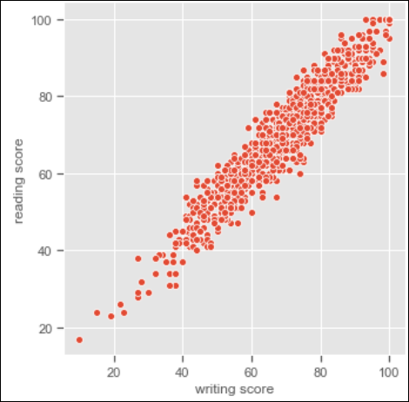
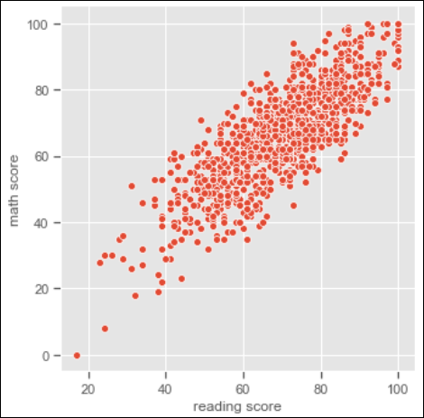
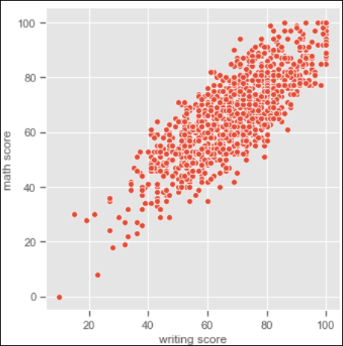
RQ2: Finding Correlation in scores
Reading & Math, and Writing & Math shows a linear correlation, however, these are less linear compared to the Reading & Writing scores, as indicated by the Pearson’s Correlation Co-efficient shown in Fig 4 (b) (c).

Slide 13
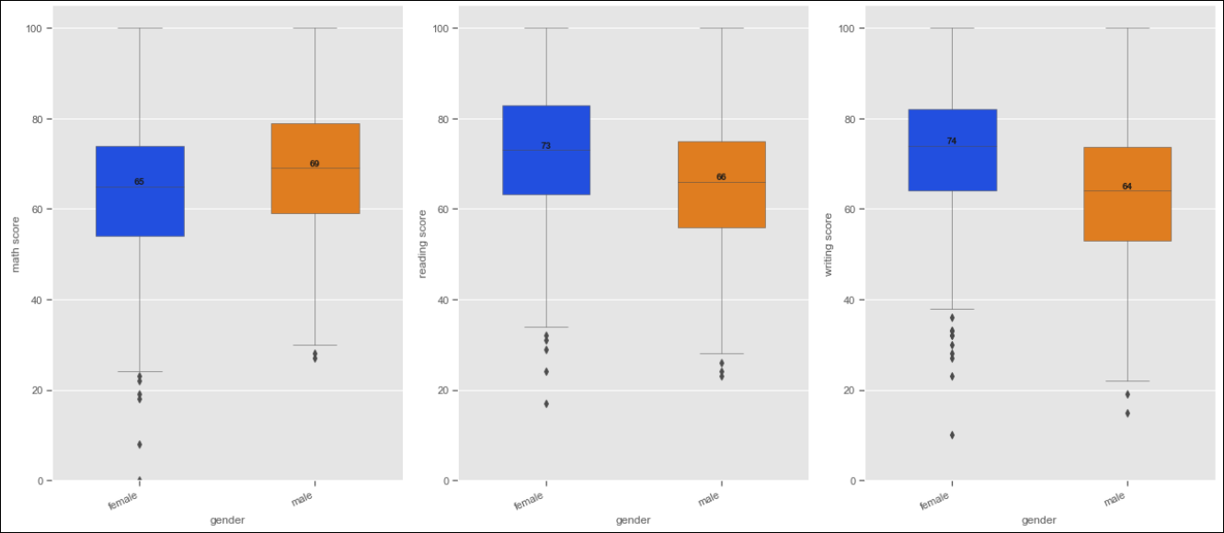
Score distribution based on gender
As we see, on average, females get higher score than males in Reading and Writing, considering the median value and Q2/Q3 quartile in the boxplot.
Math, males tend to get better score than female.

Slide 14
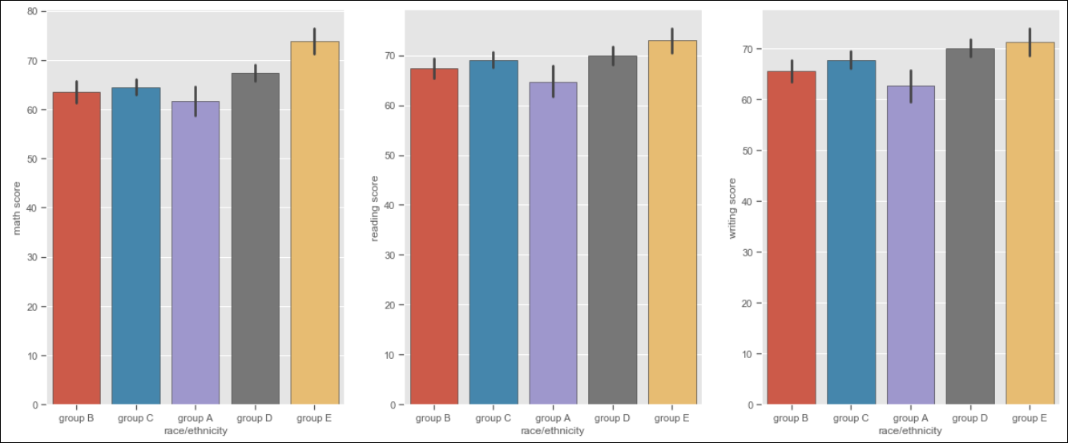
Score in Math, Reading and Writing based on race/ethnicity
We can students from group E scores better in all three subjects than the other groups.

Slide 15
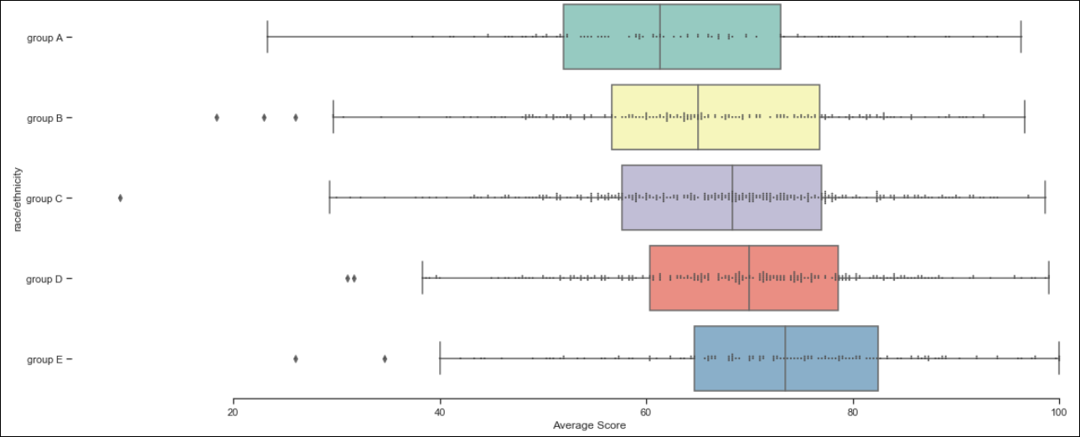
Average scores of students based on race/ethnicity
In general, score shows some kind of relationship with the students race/ethnicity, where certain ethnicity group are performing better than other groups.

Slide 16
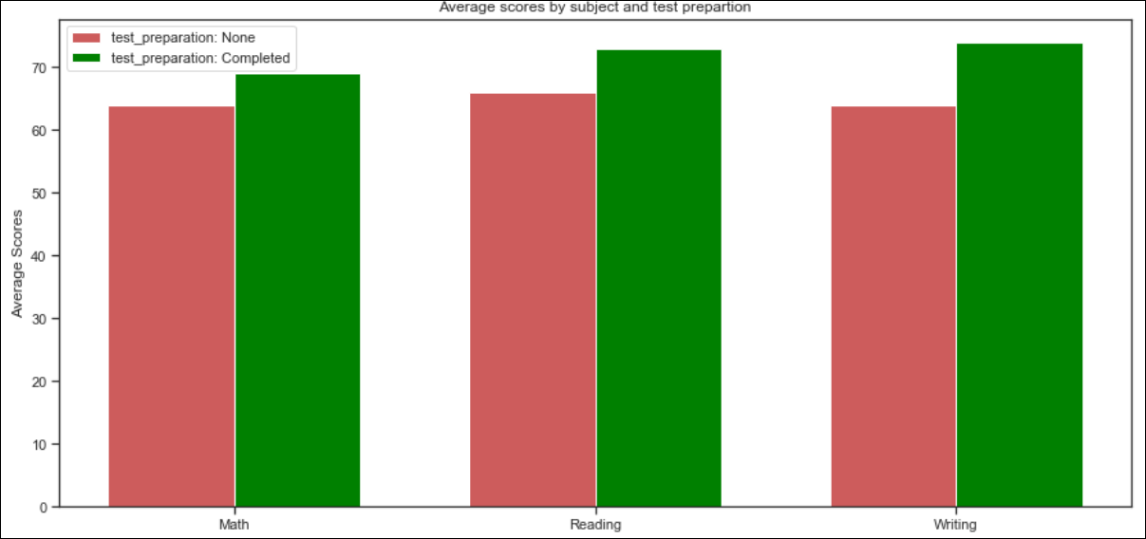
Average scores in Math, Reading and Writing based on test preparation
We can clearly observer that, the students who completed the test preparation, get higher score in all the subjects, and this difference is higher in Writing

Slide 17
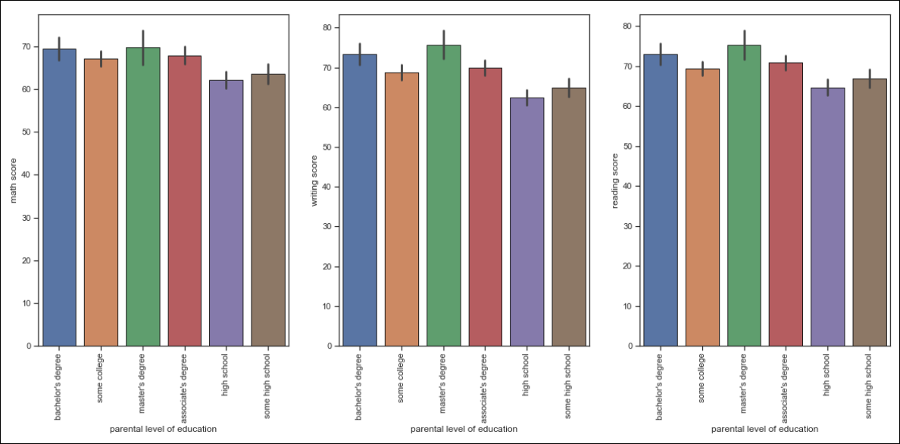
Scores in Math, Reading and Writing based on parents level of education
We can consider from here that the parents who went to university are most likely better able to help their children in their studies.

Slide 18
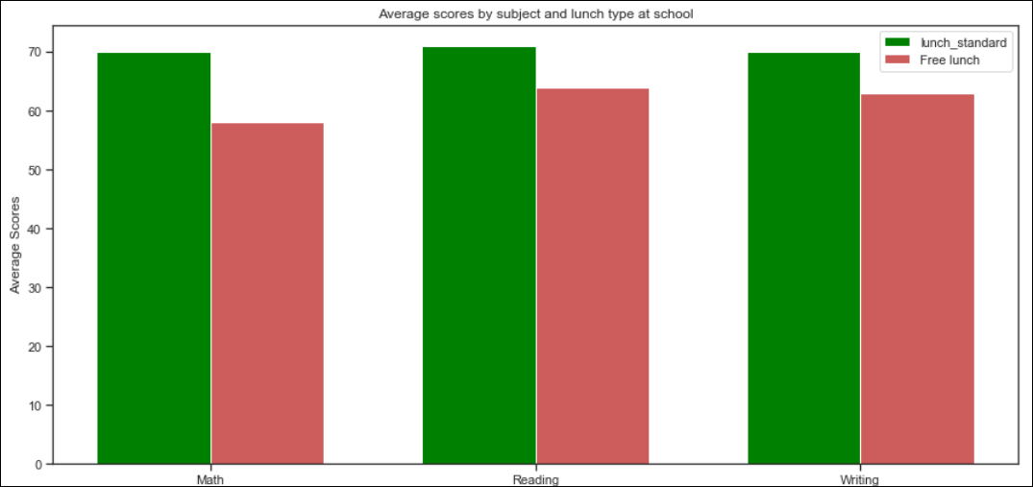
Scores in Math, Reading and Writing based on lunch
The students taking the standard lunch tend to be getting higher scores in exam.

Slide 19
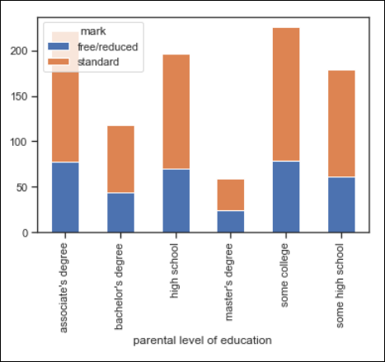
Student’s type of lunch based on parent’s education level
So we can conclude here, although the students score are related to their parents education level and the type of lunch, however, lunch and parents education are not related in terms of the score.

Slide 20
Conclusion & Lessons Learned
In this project, I visualized students score in exam in different categories and identified correlation and influencing factors affect the score on the given dataset.
We have seen Reading and Writing scores are linearly correlated compared to Reading vs.
Math and Writing vs. Math.
We have also seen students score is dependent on the gender and race/ethnicity.

Slide 21
Parents’ level of education and the type of lunch students get at school are major influencing factors in terms of achieving higher score in exam.
Lastly, formulate a question then try to answer it using visualization

Slide 22
Thanks for listening

