Slide 1
DBWT
Laragon Setup with Composer, PostgreSQL, NPM, Apache, Redis, Laravel
Nilusche Liyanaarachchi (INF)
19.03.2022

Slide 2
Table of Contents
Disclaimer P.3
Laragon Installation P.4
PHP-Version upgrade to Version ^8.0 P.6
Setup first Laravel Project P.10
PostgreSQL Setup P.12
NPM Setup P.21
Redis Setup P.22

Slide 3
Disclaimer
There are many different ways to setup Laravel on a machine
Laragon offers a wide variety of development tools that can be also installed separately but is intended to ease the development process
You do not have to use every part of Laragon if you already use a separate installation of a particular module

Slide 4
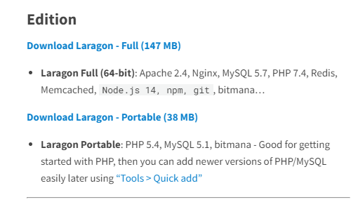
Laragon
Installation
You can download the „Full-Version“ of Laragon with the link below:
https://laragon.org/download/

Slide 5
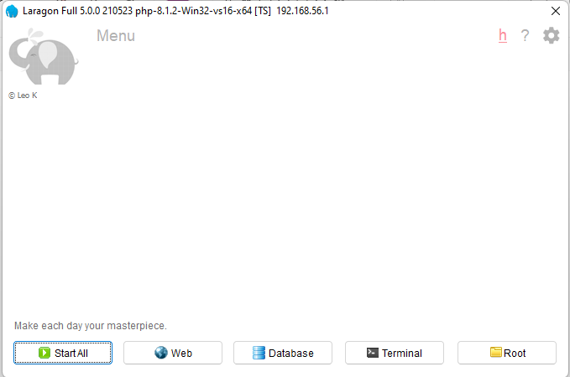
Laragon
Installation
Once installed, here is a quick preview of the Home-Panel:
Access settings
(like ports etc.)
Access the running Apache
Server on the web
Access the
root folder of
all your projects
Start all Development-Servers
Manage database
services/installations
Access console

Slide 6
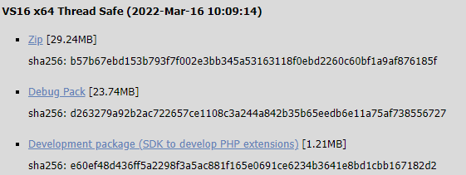
PHP Upgrade
Preparing for Laravel 9
Per default, Laragon comes with a PHP installation of version 7.4
Since the release of Laravel 9 we require at least a version of 8.0
If you already have the newest version installed, you can skip this part
https://windows.php.net/download
Generally, you should
Download a Thread Safe
Version

Slide 7
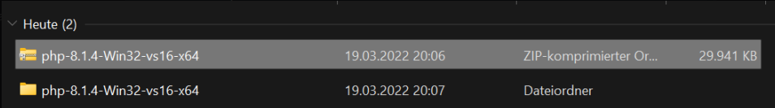
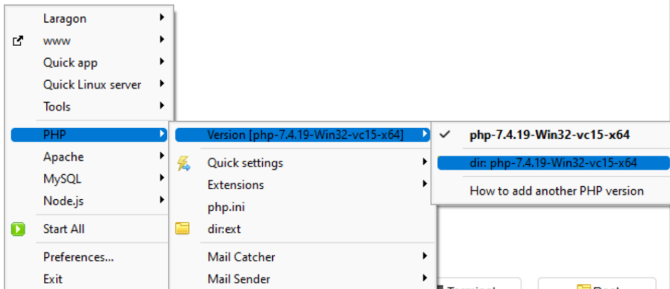
PHP Upgrade
Preparing for Laravel 9
Once downloaded you can extract the zip to a location of your preference
Right click at the home panel to access your current PHP-Folder

Slide 8
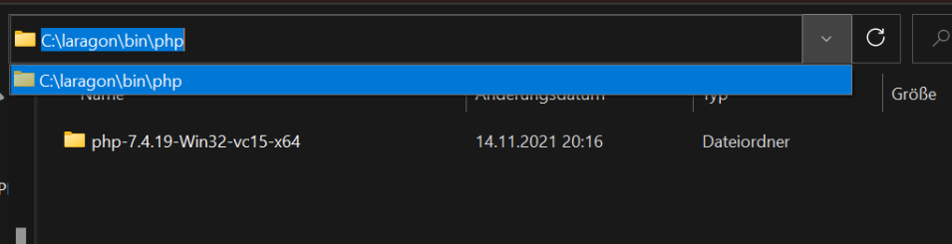
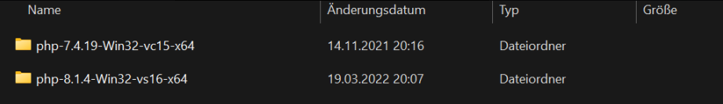
PHP Upgrade
Preparing for Laravel 9
In your „Laragon\bin\php“ directory you can paste the newly downloaded version of PHP

Slide 9
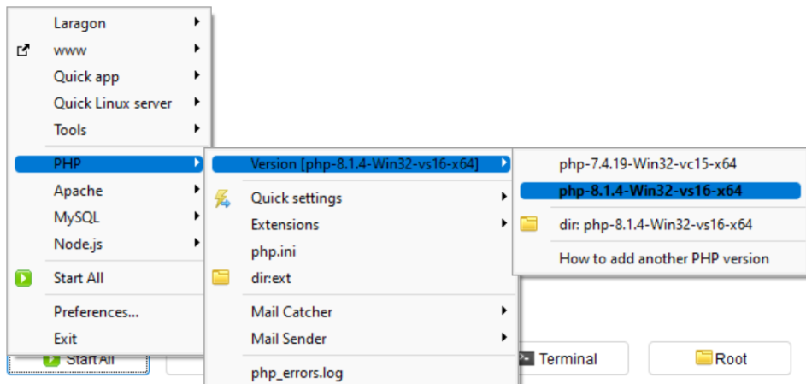
PHP Upgrade
Preparing for Laravel 9
Now all we need to do is to select the new version at the home panel (right click again)

Slide 10
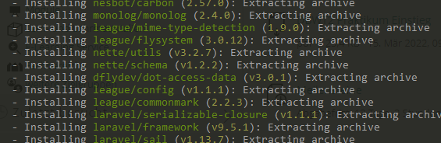
Laravel Setup
Setup your first Laravel Project
To create our first project open the console and type in following line to install a project called „HelloLaravel“ (You can use another name)
The option „prefer-dist“ tries to download and unzip archives of the dependencies using GitHub or another API when available
This might take a while …

Slide 11

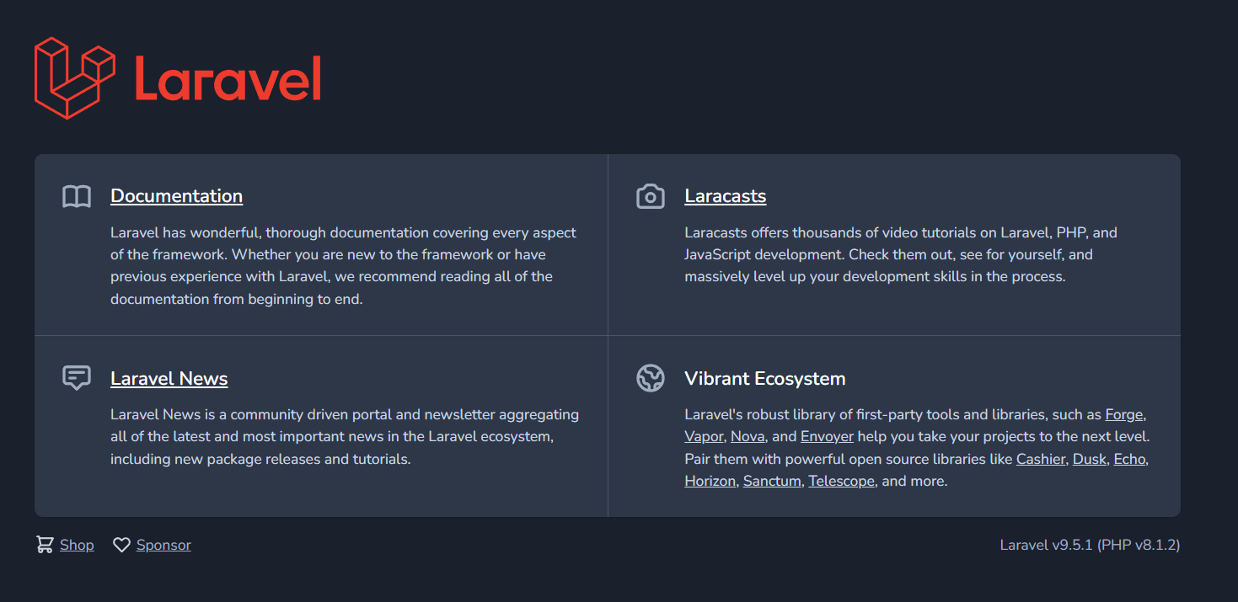
Laravel Setup
Setup your first Laravel Project
Change the directory to the new project and start the Development-Server
Access the Server in your browser with http://127.0.0.1:8000
and your good to go
You can also stop the
Server with
Ctrl+C

Slide 12
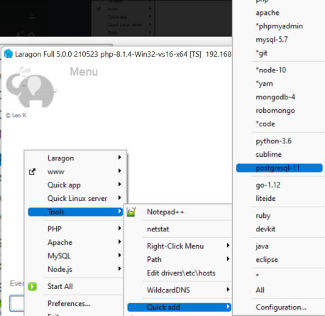
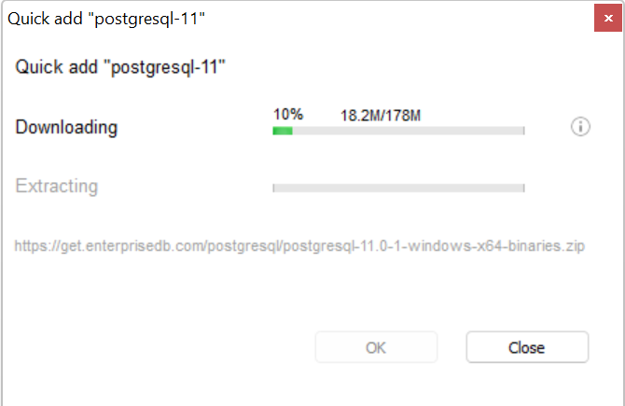
PostgreSQL
Setup a Database-Connection
If you choose to use another DBMS like PostgreSQL you can easily set it up with Laragon as well (Tools->Quick add ->postgresql-11)

Slide 13
PostgreSQL
Setup a Database-Connection
With the options „Start All“ the PostgreSQL Server will be started as well
We can use Pgadmin to manage our PostgreSQL databases:
https://www.pgadmin.org/download/pgadmin-4-windows/
Next we will create a server on pgadmin so that it can recognize the running instance of PostgreSQL

Slide 14
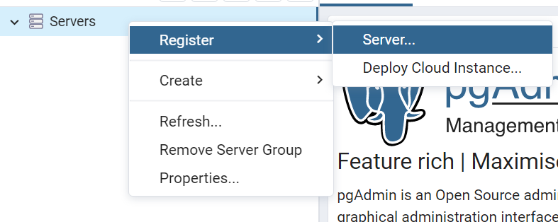
PostgreSQL
Setup a Pgadmin
Right click on „Servers“ to register a new Server
Here you give your server a name and under „Connection“ the hostname/address „localhost“
(the port should be 5432 per default)

Slide 15
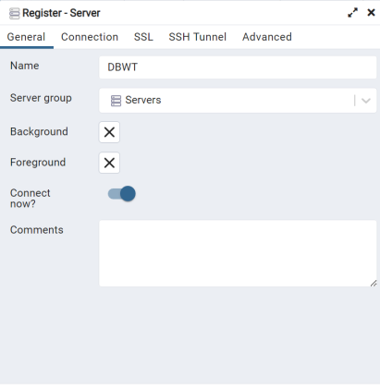
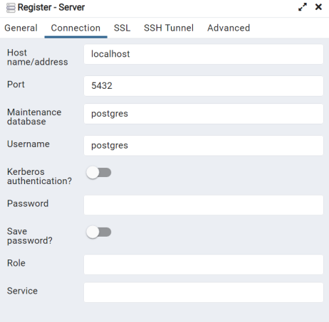
PostgreSQL
Setup a Pgadmin

Slide 16
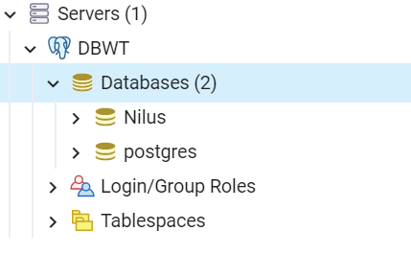

PostgreSQL
Setup a Pgadmin
Now you can create a database for the laravel project
I have called my database „hellolaravel“

Slide 17
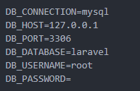
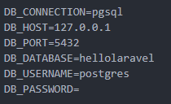
PostgreSQL
Connecting with the application
In the .env file of your project you can now setup the database connection
(if you use VSCode you can open the File Directory in VSCode directly by typing „code .“ in the console)
In the .env file we will change the settings from mysql to pgsql
Databasename
Username

Slide 18
PostgreSQL
Connecting with the application
To test our database connection we can simply run migrations
Since I will not create any migrations-files i will use a laravel authentication package called „jetstream“ which comes with a user-migration
To install jetstream run:
Now lets migrate our user table:

Slide 19
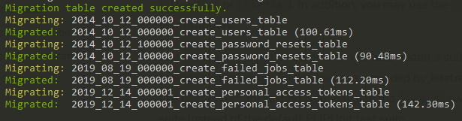
PostgreSQL
Connecting with the application
If the database connection is properly setup the migrations should run flawlessly without error
Check pgadmin for a „users_table“

Slide 20
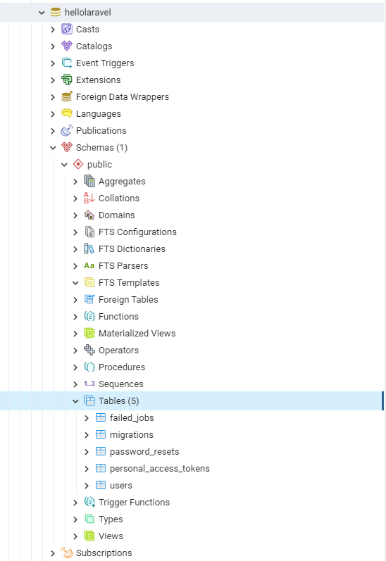
PostgreSQL
Connecting with the application
The table “user” has been successfully
migrated and the application connected
to the database

Slide 21
NPM
Installing precompiled webpackages
Node Package Manager manages JavaScript-packages using Node.js
Laragon also comes with a version of node preinstalled
Just run „npm install“ in the console to setup the package.json file with npm
To find out more about compiling assets in laravel with npm have a look at the Laravel-Documentation:
https://laravel.com/docs/9.x/mix

Slide 22
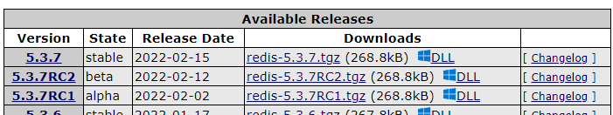
Redis
Enabling Redis in Laragon
If you right-click the Home Panel and check
php->extensions, you will not find redis because it does not come up with Laragon by default, so you have to add it manually.
Go to https://pecl.php.net/package/redis
and find your current PHP version and the lateset stable available
Click the Windows icon DLL to get the available distribution for your PHP version

Slide 23
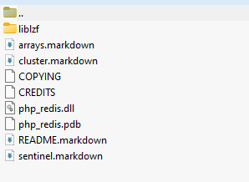

Redis
Enabling Redis in Laragon
After the download, you should find the
„php_redis.dll“ file
Copy or move the file to
„D:\laragon\bin\php\php-8.1.2-Win32-vs16-x64\ext “
(replace with you own path)
and add the line
„extension=php_redis.dll to the
„D:\laragon\bin\php\php-8.1.2-Win32-vs16-x64\php.ini“ php.ini file
You should see that the Redis extension is available now

Slide 24
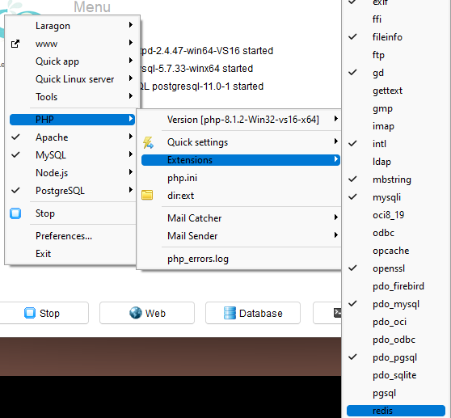
Redis
Enabling Redis in Laragon

Slide 25
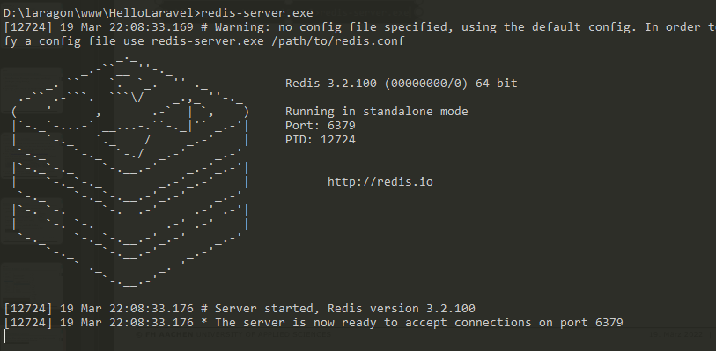
Redis
Starting Redis in Laragon
To run the Redis server, you can use the console to execute the redis-server.exe
You can also stop it using Ctrl+C

Slide 26
FH Aachen
Fachbereich Elektrotechnik und Informationstechnik
Nilusche Liyanaarachchi (INF) https://github.com/Nilusche www.fh-aachen.de

