Slide 1
Types Of Software Piracy
Aanjishnu Bhattacharyya class: XI sec: A roll: 20

Slide 2
Contents
What is piracy
Shoplifting
Hard disk Loading
Renting
OEM unbundling
Counterfeiting
Online piracy
Terms of Condition violation
Conclusion
Reference
Acknowledgement

Slide 3
What is Piracy
The term ‘piracy’ generally refers to the act of stealing or forcefully taking away an object from its rightful owner. From the mid 1990’s this word has transformed itself from aggressive to a more virtual form. Software piracy refers to the act of using software that is does not follow the copyright laws of the land or is in the clear violation of the user terms of condition. Software piracy causes a lot to damage to the large corporations like Microsoft and Google because most of their profit is derived from commercial software. Software piracy can be broadly be classified into physical and virtual both of which are similarly damaging. But sometimes piracy helps to preserve digital art like games to stand the test of time.

Slide 4
Shoplifting
Shoplifting referred to act of stealing from a open establishment like a shop. In software piracy Shoplifting can be defined as stealing a CD or DVD of a certain kind of software. It can also refer to the act of copying and distributing these unlicensed copies. This is the most common type of software piracy, the reasons are apparent: the copies are hard to track and the people doing are even harder to track. One of the most commons security measure against shoplifting is DRMs, OEMs and digital licensing. The digital arts shops also install CCTV as a security measure.

Slide 5

Shoplifting in action

Slide 6
Hardware Loading
Hard disk loading is a type of commercial software piracy in which someone buys a legal version of the software and then reproduces, copies or installs it onto computer hard disks. The person then sells the product. This is very common in developing countries because cyber security is not the top priority of the government. This type of piracy is very hard to stop just because there is not way to track down the pirated copy of the software. The FSF foundation has completely nullified this type of piracy because it is ok to copy their software and their only source of income is donations.

Slide 7
Renting
Renting of software refers to buying a single software license and then sharing it with different people thus breaking the terms of service. This type of piracy can be prevented with an monthly subscription system or a token system.

Slide 8
OEM unbundling
Original equipment manufacturer unbundling (OEM unbundling) involves dissembling the major components of the bundled software that usually accompanies OEM hardware. Software can be sold in conjunction with hardware. When it is, a notification to the consumer or retailer is present (a user license), explaining that the software is only to be used with the packaged hardware. Of course, the software may be installed on other machines, but this is a form of software piracy. An example of this would be scripts that activate windows without actually ever connecting to windows servers.

Slide 9
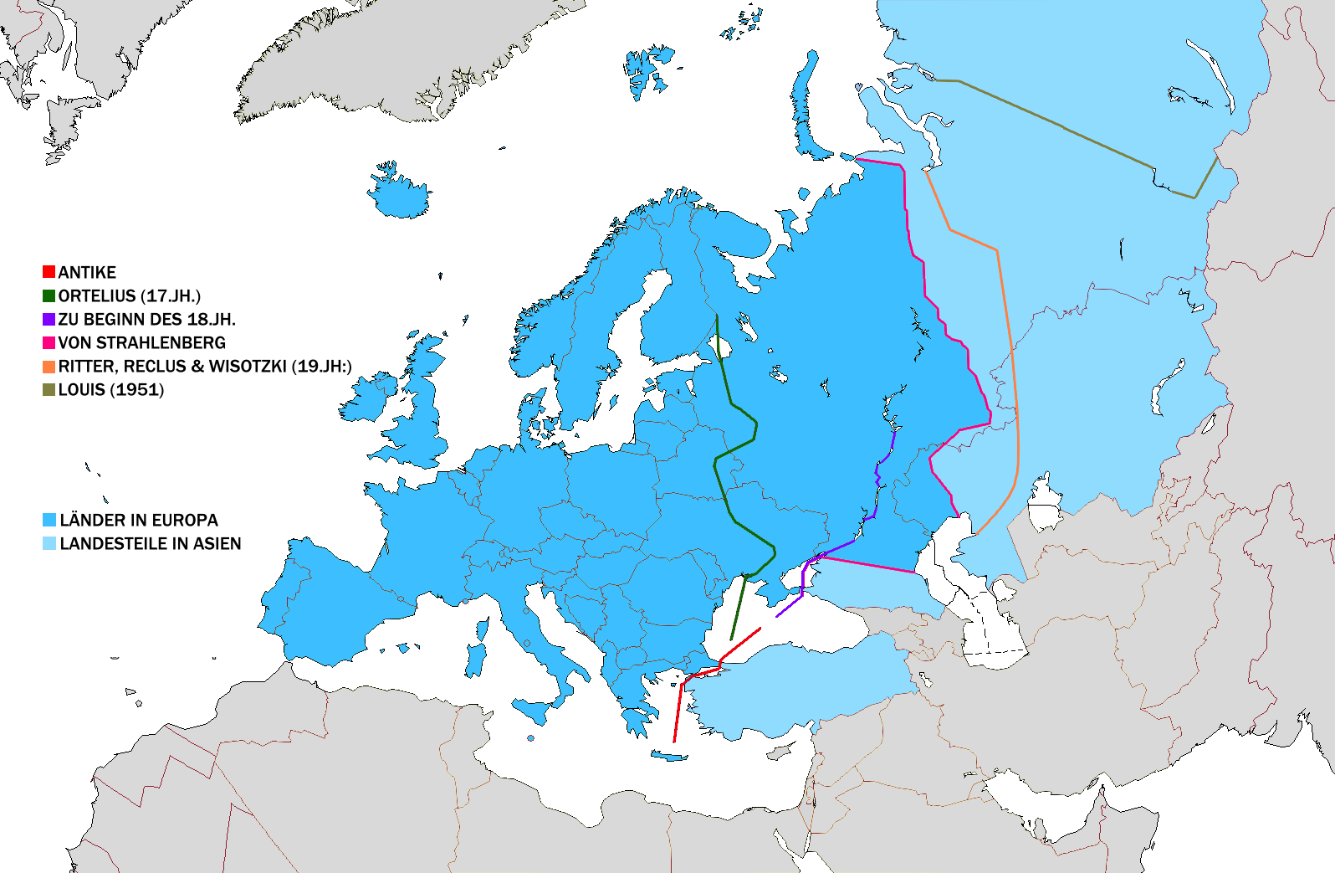
The places where OEM unbundling takes place

Slide 10
Online Piracy
Online piracy is the practice of downloading and distributing copyrighted content digitally without permission, such as music or software. The principle behind piracy has predated the creation of the Internet, but its online popularity arose alongside the internet. Despite its explicit illegality in many developed countries, online piracy is still widely practiced, due to both the ease with which it can be done and the often defensible ethics behind it.

Slide 11
Terms of Condition Violation
Terms of service (also known as terms of use and terms and conditions, commonly abbreviated as TOS or ToS, ToU or T&C) are the legal agreements between a service provider and a person who wants to use that service. The person must agree to abide by the terms of service in order to use the offered service. Terms of service can also be merely a disclaimer, especially regarding the use of websites. Vague language and lengthy sentences used in the terms of use have brought concerns on customer privacy and raised public awareness in many ways. Terms of service violation can be illegal or it may also be unethical. Awareness is the only way to prevent this kind of piracy

Slide 12

Free Software Foundation

Slide 13
Conclusion
Piracy is a very illegal and should not be practiced. But it is sometimes a necessary evil. It is the only way to preserve old digital arts. There are many more types of software piracy and all of them are very unethical.

Slide 14
Reference
Wikipedia https://wikipedia.org
Computer Science with Java - Sumit Aurora

Slide 15
Acknowledgement
I would like to thank my teachers and Parents to help me with this project. I would also like to thank myself for working really hard to complete this project. This was made in google docs in a raspberry pi 4.

