Slide 1

Active Deep Learning framework with Data programming

Slide 2

Agenda
Project Plan
Results
Methodology
Future Work

Slide 3
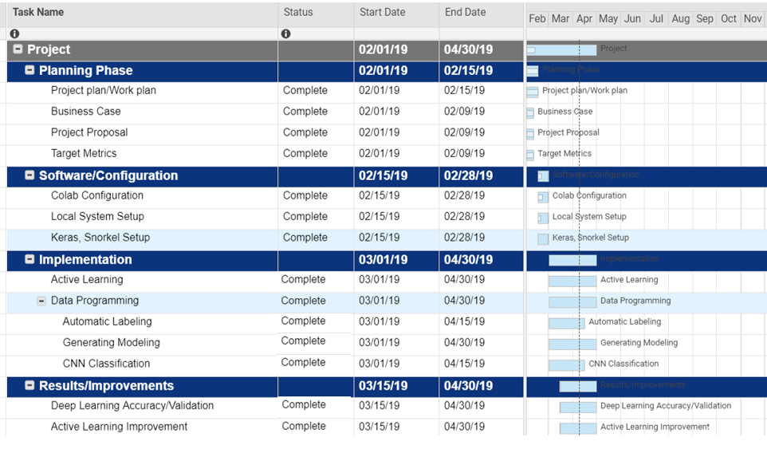
Gantt Diagram

Slide 4
The Context
Deep Learning requires large labeled training sets to obtain high-quality results
The Problem
how can one make it easier for users to build training sets?
The Proposed Solution
DATA PROGRAMMING IN ACTIVE LEARNING METHODOLOGY

Slide 5
Results
 | Train loss | Train acc | Val loss | Val acc
CNN Train - 1481 samples, Validation - 635 samples Epoch = 10 | 0.2067 | 0.9494 | 0.2742 | 0.9291
CNN with DataProgramming Experiment-1 Train on 1918 samples, validate on 823 samples with epoch =10 | 0.3337 | 0.8634 | 0.7264 | 0.7181
CNN with DataProgramming Experiment-2 Train - 1918 samples, Validation - 823 samples Epoch =10 | 0.3587 | 0.8655 | 0.4430 | 0.7485

Slide 6
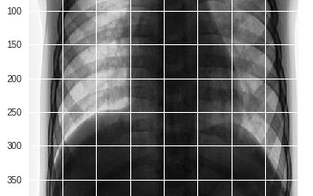
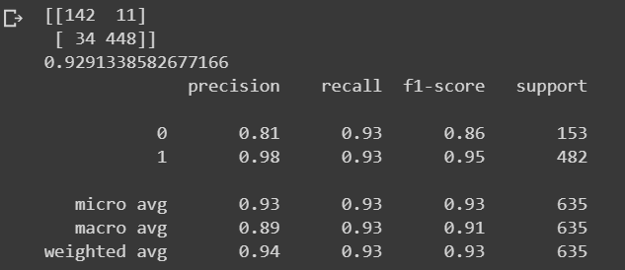
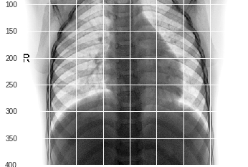
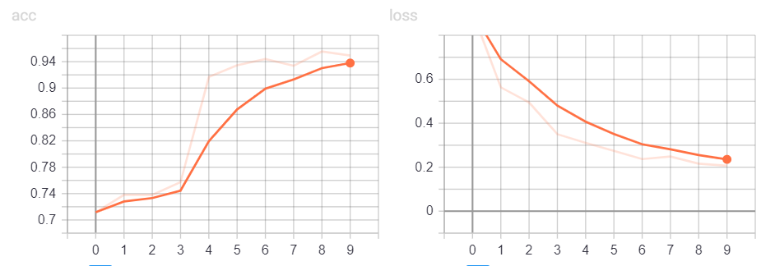
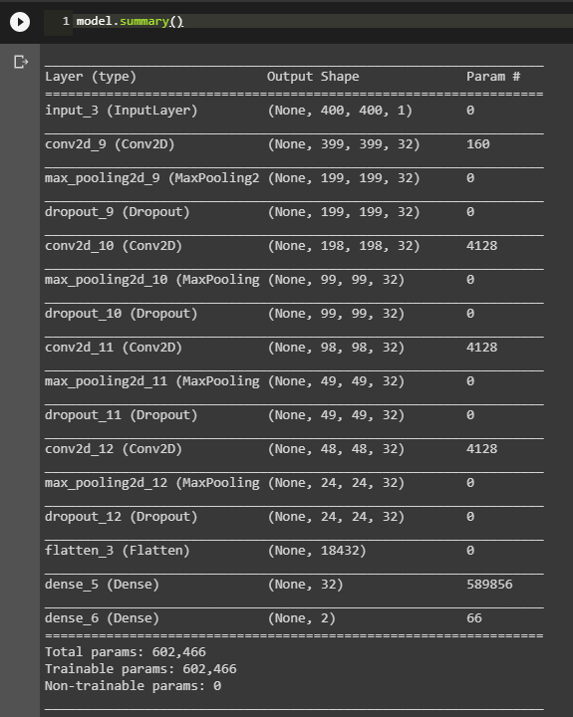
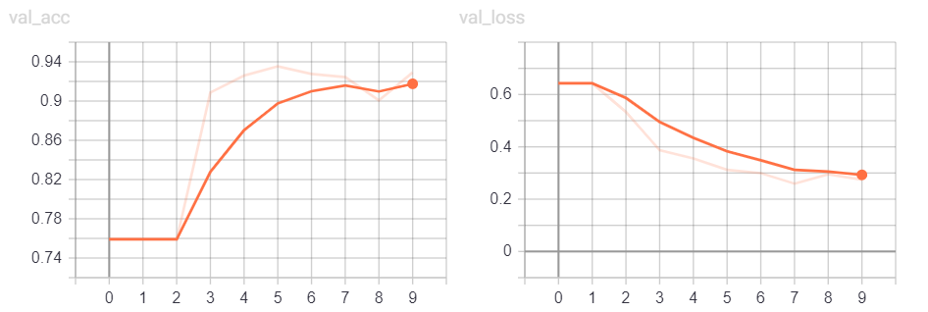
CNN Classification
Business Problem : Classify x-ray images for Pneumonia/Normal
Input images : ~ 2116 Labelled and ~625 Unlabelled
Data Source : Kaggle Datasets
Validation Accuracy : ~93%
Environment : Google Colab ,
Keras ,
python 3.7
TensorBoard Views

Slide 7
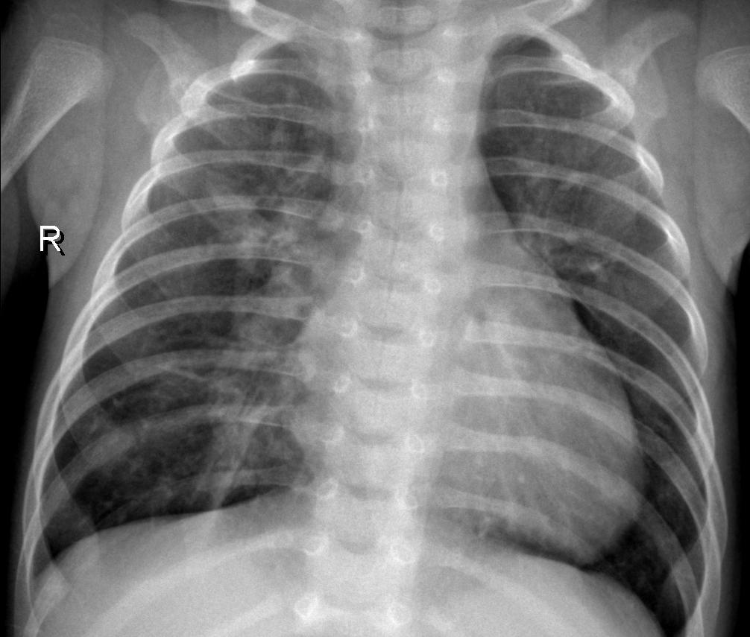
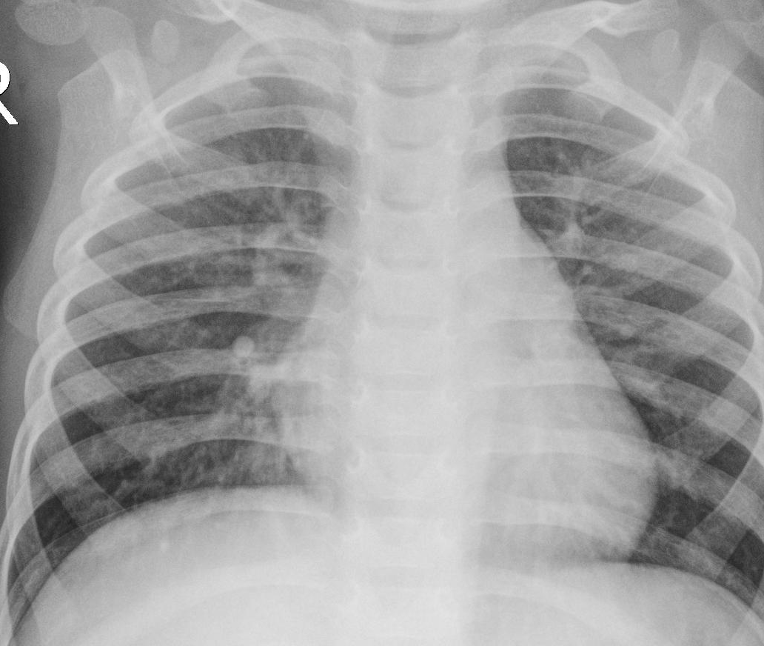
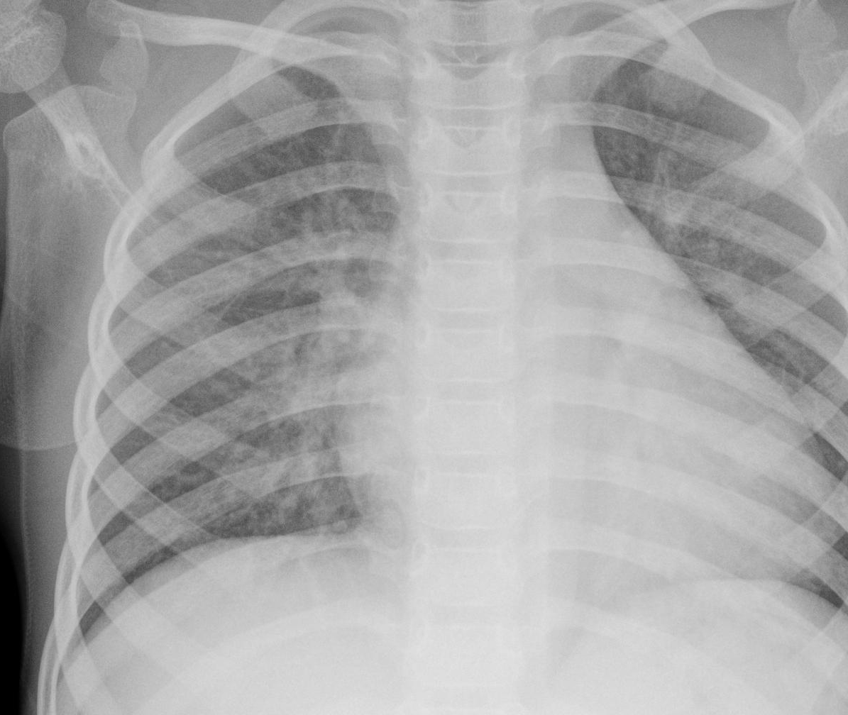
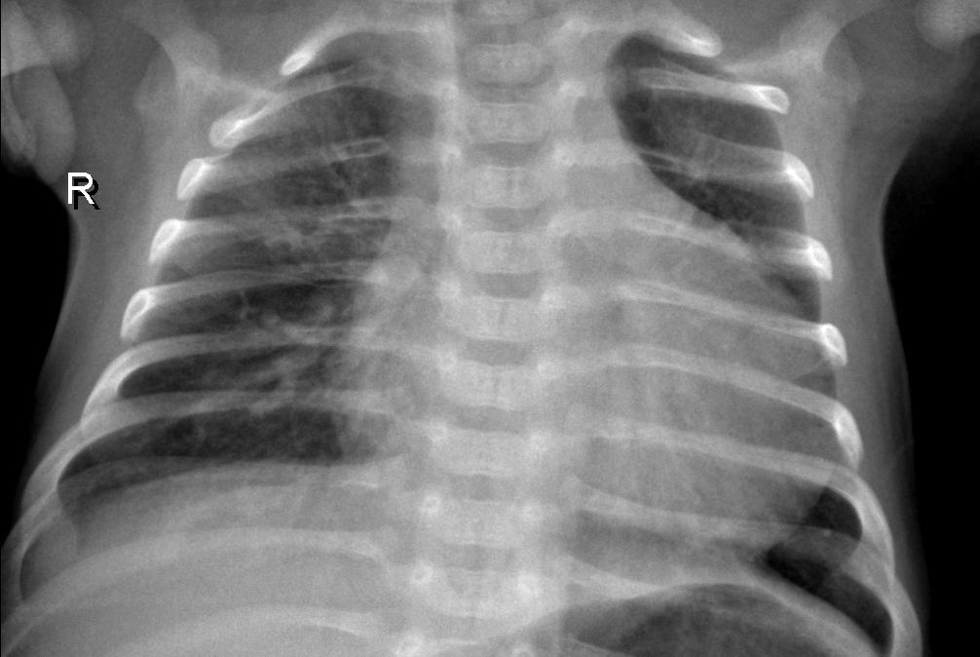
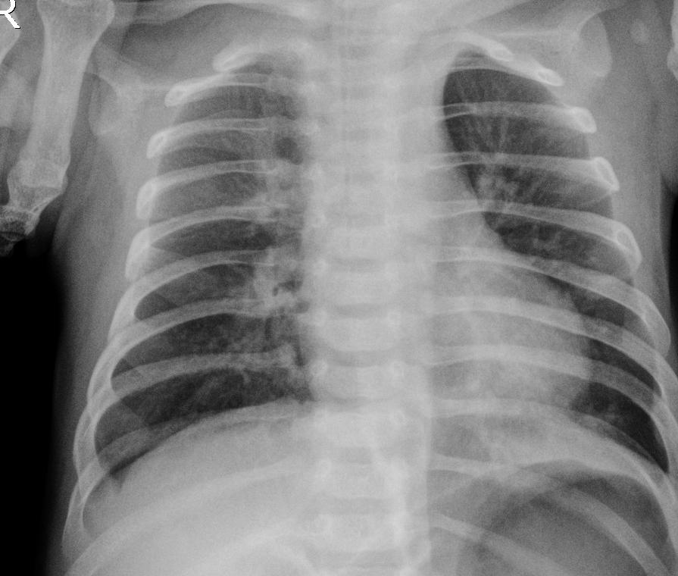
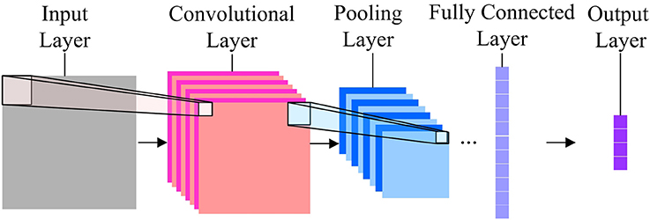
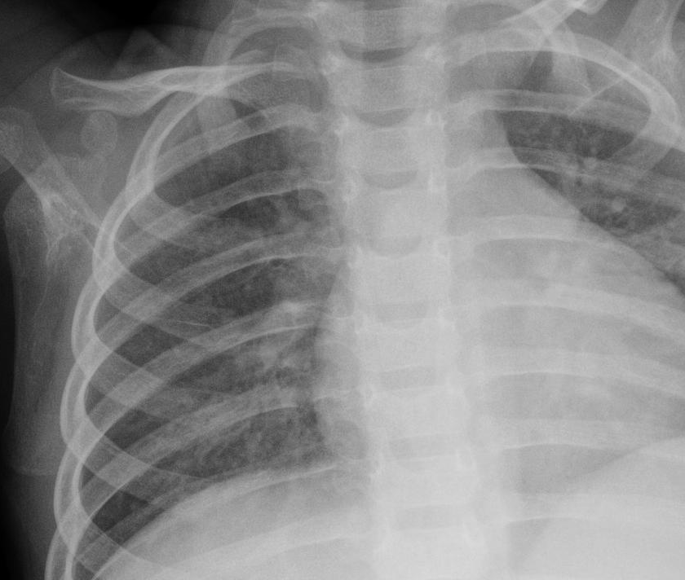
Active Learning Methodology:
Classified images with High prediction confidence
Convolutional Neural Network Model
Classified images with low prediction confidence
Unlabelled Dataset
Model Updating
Labelled Dataset
Human Labelling

Slide 8
Active Learning Methodology:
Classified images with High prediction confidence
Convolutional Neural Network Model
Classified images with low prediction confidence
Unlabelled Dataset
Model Updating
Labelled Dataset
Human Labelling
Data Programming

Slide 9
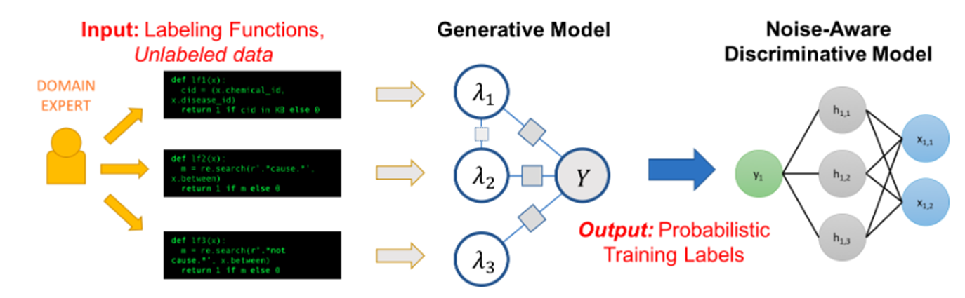
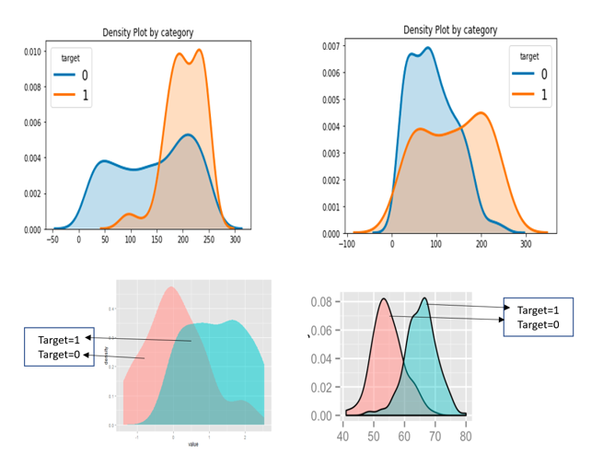
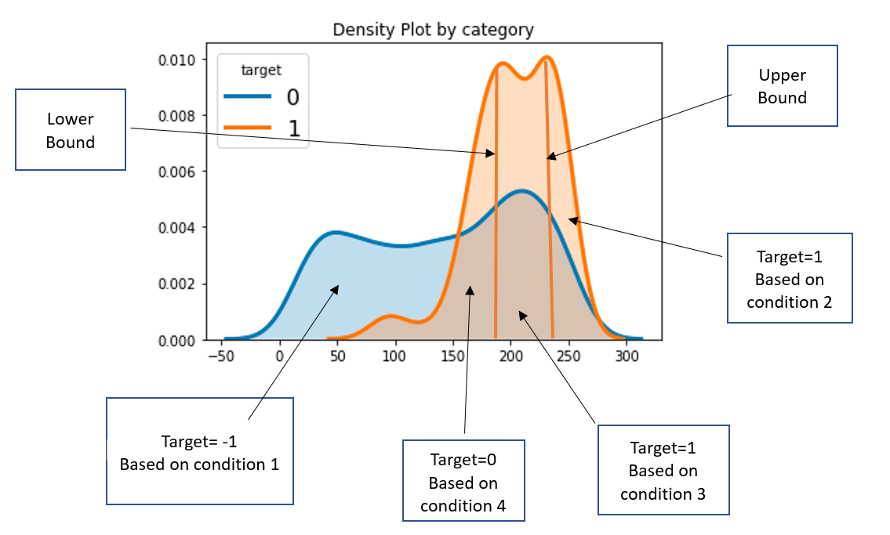
Data programming

Slide 10
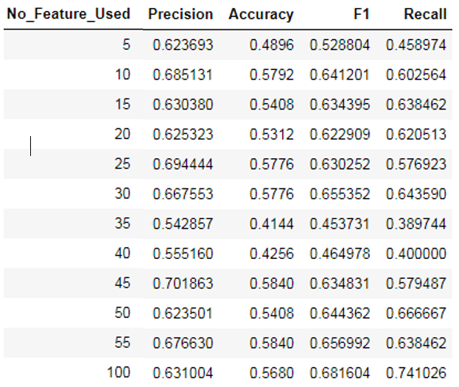
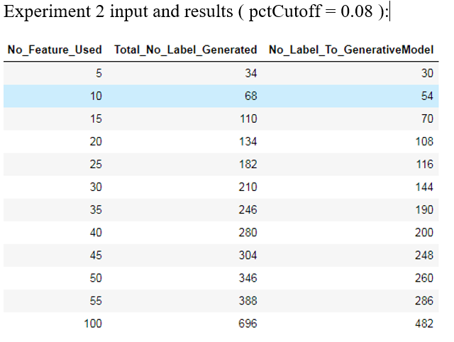
Data programming Results

Slide 11


Large image
Future Work
CNN Model Tuning
Active learning loop Improvement
Data Programming Validation
The code used in this project can be accessed publicly at https://github.com/NimJ/IITH_Project

Slide 12
References:
[1] M. Anthimopoulos, S. Christodoulidis, L. Ebner, A. Christe and S. Mougiakakou, "Lung Pattern Classification for Interstitial Lung Diseases Using a Deep Convolutional Neural Network," in IEEE Transactions on Medical Imaging, vol. 35, no. 5, pp. 1207-1216, May 2016.
[2] CheXNet: Radiologist-Level Pneumonia Detection on Chest X-Rays with Deep Learning https://arxiv.org/abs/1711.05225v3 .
[3] Alexander Ratner, Christopher De Sa, Sen Wu, Daniel Selsam, Christopher Ré . Data Programming Creating Large Training Sets Quickly. https://arxiv.org/pdf/1605.07723.pdf
[4] Alexander Ratner Stephen H. Bach Henry EhrenbergJason Fries Sen Wu Christopher R ́e . Snorkel: Rapid Training Data Creationwith Weak Supervision. https://arxiv.org/pdf/1711.10160.pdf
[5] https://hazyresearch.github.io/snorkel/blog/snorkel_programming_training_data.htm
[6] https://hazyresearch.github.io/snorkel/
[7] http://sujitpal.blogspot.com/2018/02/using-snorkel-probabilistic-labels-for.html
[8] https://www.frontiersin.org/articles/10.3389/fpsyg.2017.01745/full

Slide 13

Thank You
Sudhir Kumar Kedarnath Rai
cs17emds11030@iith.ac.in
Nimesh Jha
cs17emds11014@iith.ac.in
Santosh Kumar Siripuram
cs17emds11025@iith.ac.in

