Slide 1

Encrypting the penguin
“Hands-on theoretical workshop”
Designed by Martin Ukrop
mukrop@mail.muni.cz
Masaryk University, Czech Republic

Slide 2

Need for encryption...

Slide 3
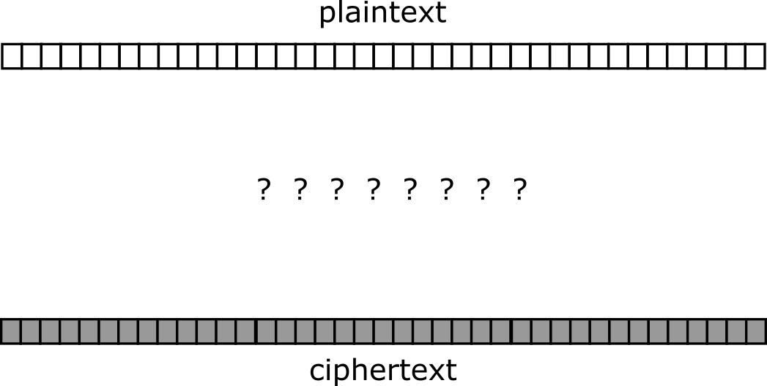
Need for encryption (in the abstract)

Slide 4
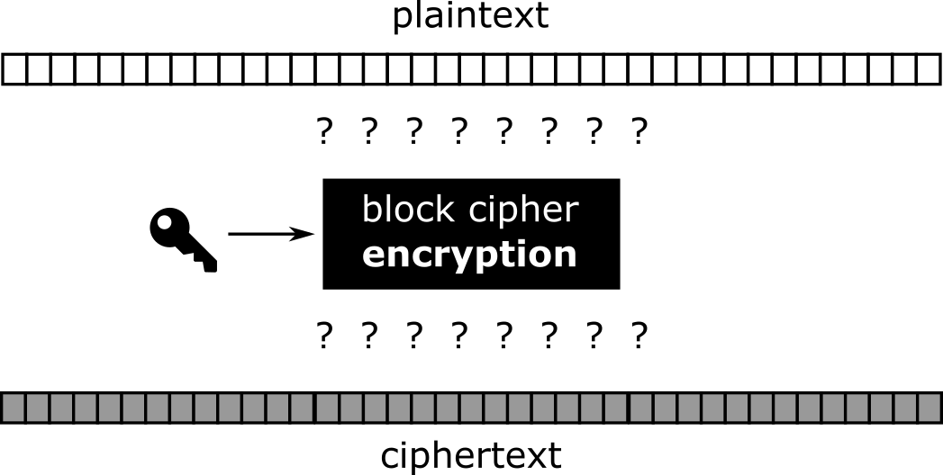
Block cipher to help!

Slide 5
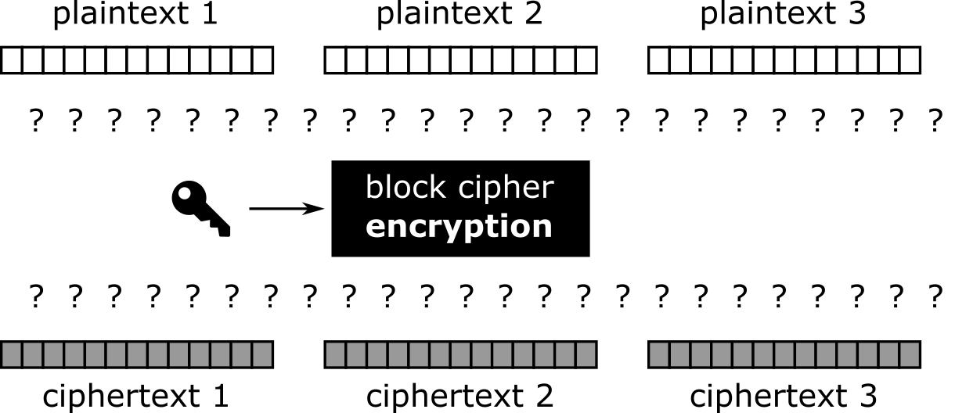
Cutting plaintext in small, workable pieces

Slide 6
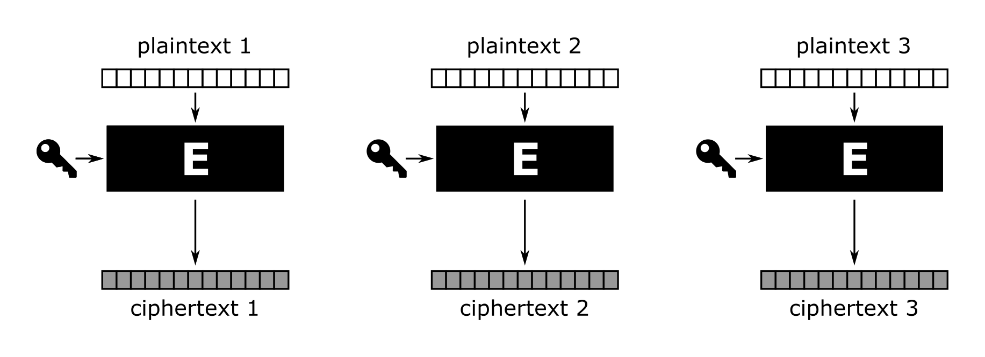
Electronic code book (ECB)

Slide 7
Encrypting TUX
(plaintext)

Slide 8

Encrypting TUX
(ECB ciphertext)

Slide 9

We can do much better!

Slide 10
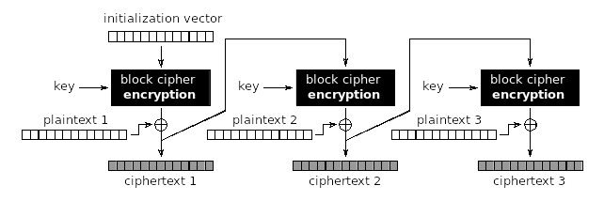
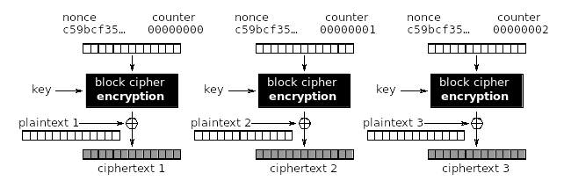

We can do much better!

Slide 11
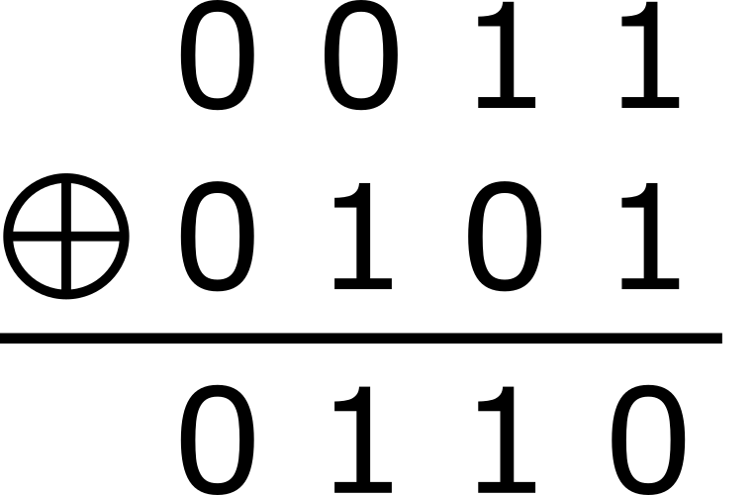
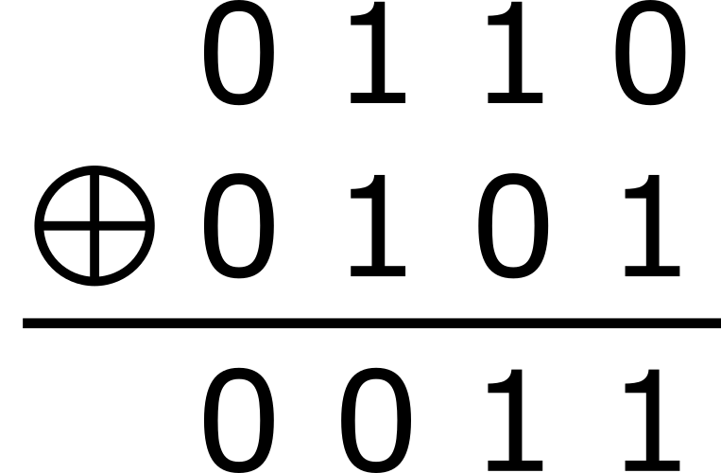
Features of XOR (eXclusive OR)
1. Binary exclusive operation for simple “encryption”
2. XORing with the same string “decrypts” the original

