Slide 1
</>
OXIDESLOC
WEB UI WALKTHROUGH
IEEE 1045 · 60 LANGUAGES
The Application Guide
Measure, compare, and share code metrics — whether you wrote the code or just need the numbers.
App running
http://127.0.0.1:4317
Notes:
OxideSLOC is a fast, self-contained local code analysis tool. This guide covers the web UI: what every menu button does and how to run a scan whether you write the code or just need the numbers. The app is already running at 127.0.0.1:4317.

Slide 2
ORIENTATION
What OxideSLOC Does
A self-contained, offline code-analysis tool that runs entirely on your machine. Point it at a folder, get the metrics — no cloud, no setup, no account.
01
02
03
04
Counts SLOC
Estimates Effort
Tracks Tests
Shares Results
Physical lines to the IEEE 1045-1992 standard, across 60 languages.
COCOMO cost & schedule, approximate complexity, and DRYness every run.
Test-to-code density and coverage import from LCOV, Cobertura, JaCoCo & more.
HTML, PDF, CSV and Excel reports — plus trends and side-by-side compares.
Notes:
Orient the audience. It's a local, offline tool. Open it in a browser at port 4317. The four pillars: count physical SLOC to the IEEE standard, surface deeper metrics like COCOMO cost and complexity, track tests and coverage, and export everything as reports.

Slide 3
THE NAVIGATION BAR
The Top Menu
</>
OxideSLOC
Home
View Reports ▾
Compare Scans
Test Metrics
Git Browser ▾
● Local
⚙
☾
Home
View Reports
Compare Scans
Test Metrics
Git Browser
Your launch pad — start a scan, reach every feature.
Browse saved scans, open reports, see Trend Reports.
Diff two runs — added, removed, changed lines.
Test density and imported coverage data.
Scan any branch, tag, or commit — no checkout.
Right side — ● Local/Server toggle · ⚙ Settings · ☾ Light / dark theme
Notes:
The top bar is the same on every page. Five navigation buttons on the left, three utility controls on the right. Home is your launch pad; View Reports holds history and trends; Compare Scans diffs two runs; Test Metrics is the coverage view; Git Browser scans any branch or commit. On the right: the Local/Server toggle, Settings, and the light/dark theme switch.

Slide 4
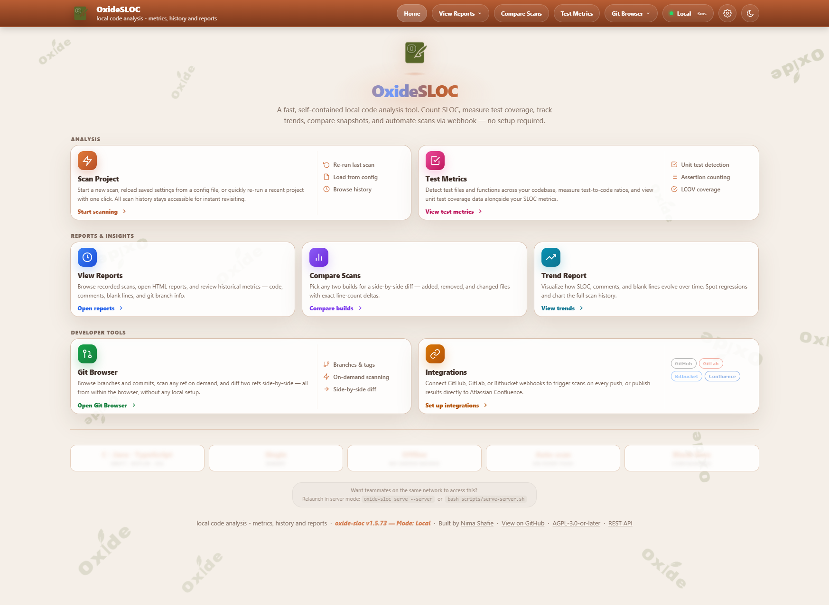
YOUR LAUNCH PAD
The Home Hub
Every feature is one click away, grouped into three lanes.
Start a scan · jump to Test Metrics
ANALYSIS
View Reports · Compare · Trend Report
REPORTS
Git Browser · Integrations (webhooks)
DEV TOOLS
Tip › The Scan Project card also offers Re-run last , Load from config, and Browse history.
127.0.0.1:4317 — Home
Notes:
The Home page groups every launch card into three lanes. Analysis is where you start a scan or jump to test metrics. Reports & Insights holds View Reports, Compare Scans, and Trend Report. Developer Tools has the Git Browser and webhook Integrations. The Scan Project card also offers re-run last scan, load from config, and browse history.

Slide 5
01
SECTION 01
Running a Scan
The guided flow, the one-click Quick Scan, and the two ways people get there.
Notes:
Section one: running a scan. We'll cover the guided four-step flow, the one-click Quick Scan, and the two ways people approach it depending on whether they own the code.

Slide 6
FROM HOME › START SCANNING
The Guided Scan Flow
›
›
›
1
2
3
4
Select Project
Counting Rules
Outputs
Review & Run
Point at the folder you want to measure.
IEEE 1045 policies — defaults are fine to leave.
Pick formats: HTML, PDF, CSV, Excel.
Confirm the summary and launch the scan.
QUICK SCAN ⚡
In a hurry? Quick Scan submits straight from step 1 with every default applied — one click, full report.
Notes:
From the Home page, click Start scanning. The guided flow has four steps: pick the project folder, confirm counting rules, choose outputs, then review and run. Quick Scan submits straight from step one with every default applied — the fastest path for anyone who just wants the numbers.

Slide 7
SAME TOOL, TWO MINDSETS
Two Ways In
PATH A
engineers, tech leads
PATH B
POs, scrum masters, managers
The Developer
The Business User
“SLOC metrics for code I wrote.”
“Metrics for someone else’s code.”
1
Home › Start scanning, select your repo folder.
1
Point at the folder you were handed — or open Git Browser.
2
Tune counting rules & languages for IEEE precision.
2
Pick any branch/commit — no local build or setup.
3
Read SLOC, complexity, COCOMO & Git Hotspots.
3
Hit Quick Scan — defaults give the full picture.
4
Export plain output to wire into CI later.
4
Read the summary, export a PDF to circulate.
Both paths land on the same report — the difference is only how much you tune on the way in.
Notes:
Same tool, two mindsets. A developer scans their own repo on disk to get SLOC for their work; they may tune counting rules and export plain output for CI. A business user is scanning someone else's code and may not have it built locally. They point at the folder they were handed, or use the Git Browser to pull any branch with no local setup, run Quick Scan, read the summary, and export a PDF to circulate. Both end up reading the exact same report.

Slide 8
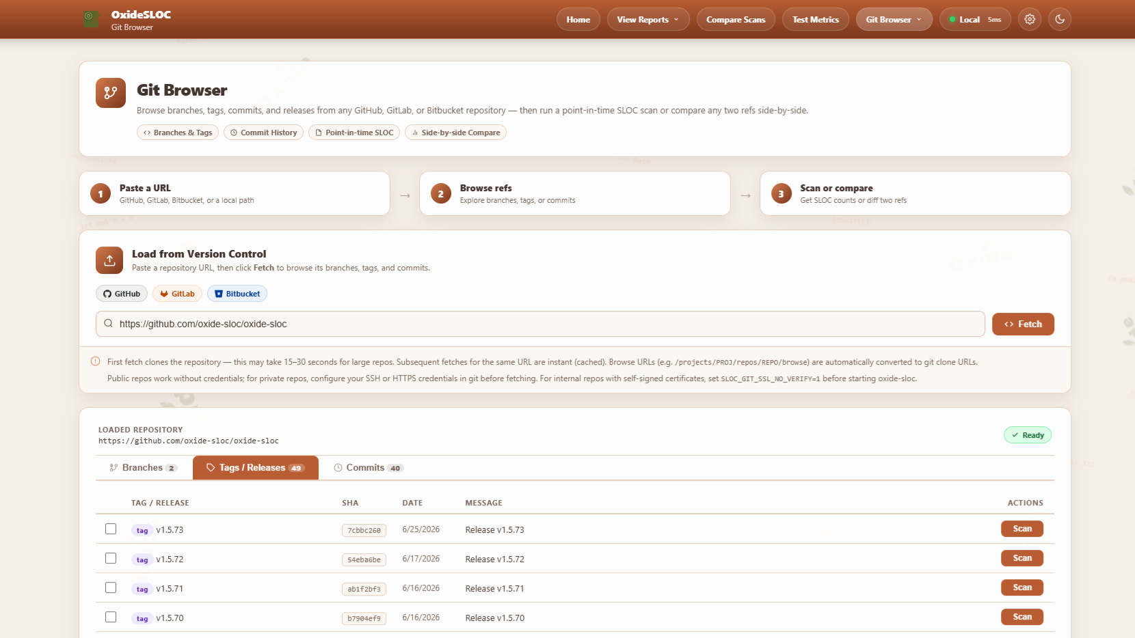
GIT BROWSER
Scan Without a Checkout
The business-user path — measure code you don’t host locally.
●
Paste a URL
GitHub, GitLab or Bitbucket — fetch branches, tags & releases.
●
Point-in-Time Scan
Run any ref on demand — no local clone or build.
●
Side-by-Side Compare
Diff two refs directly in the browser.
Note › First fetch clones the repo (15–30s); later fetches are cached and instant.
127.0.0.1:4317 — Git Browser
Notes:
Git Browser is how you scan code you don't have built locally — the business-user path. Paste any GitHub, GitLab, or Bitbucket URL and it fetches the branches, tags, and releases. Pick any ref and run a point-in-time scan on demand, or diff two refs side by side. No clone, no build, no local setup. The first fetch clones the repo; after that it's cached and instant.

Slide 9
02
SECTION 02
Reading & Sharing Results
Reports, test coverage, comparisons, trends, and export.
Notes:
Section two: once a scan finishes, what do you do with it? Read the report, check test coverage, compare against a baseline, watch the trend, and export to share.

Slide 10
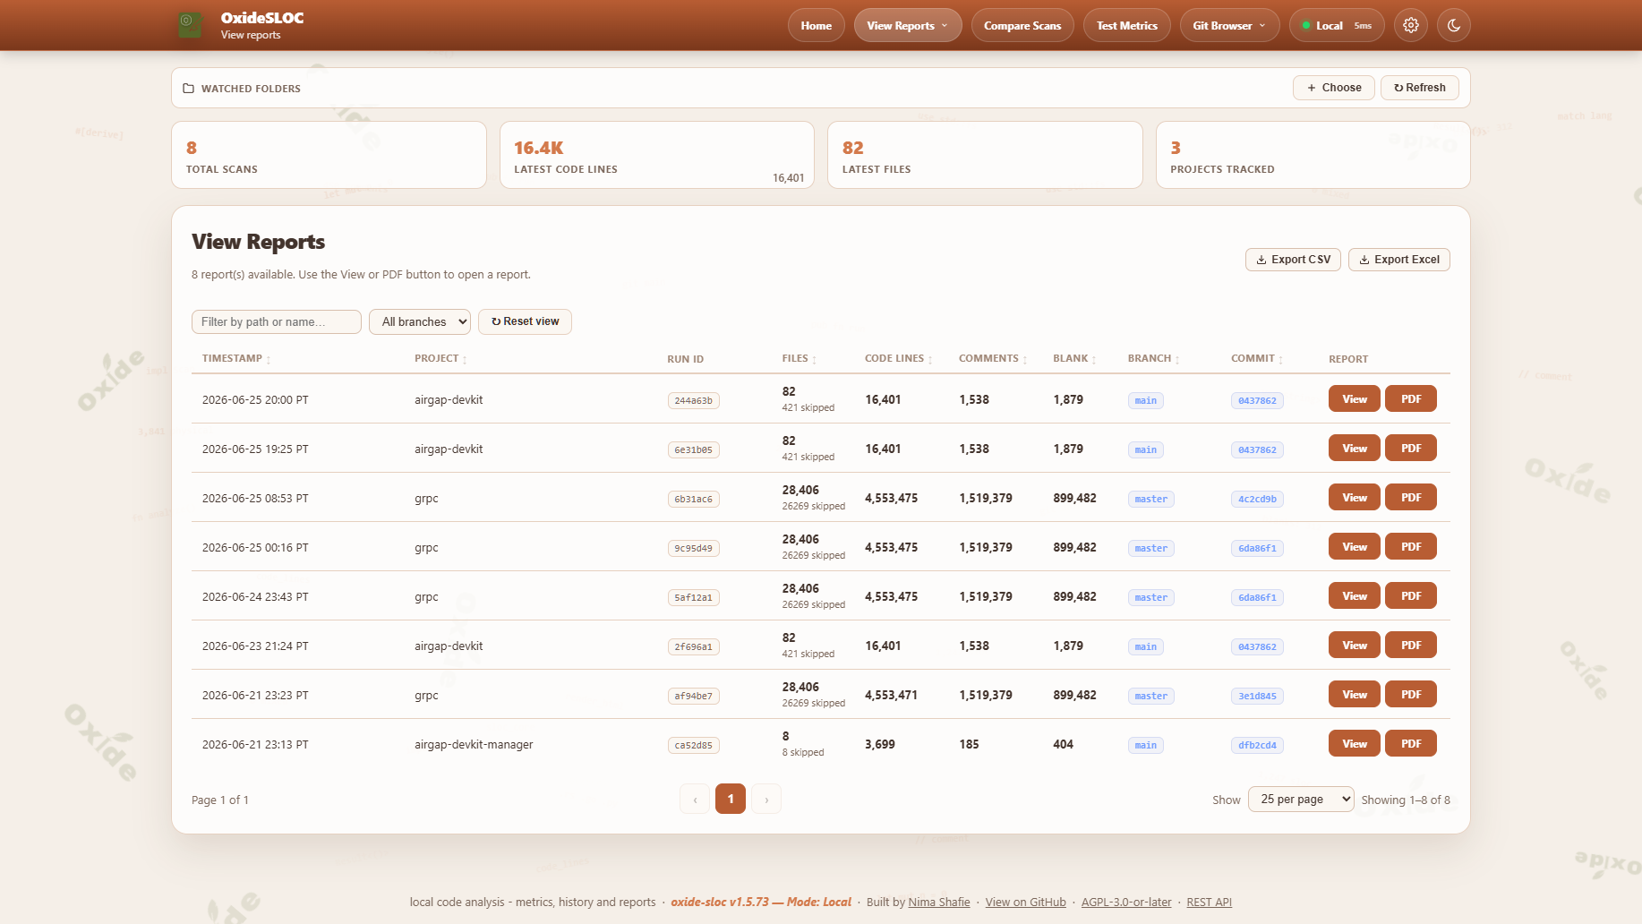
VIEW REPORTS
Every Scan, One Click Away
Browse your full scan history — open any run as HTML or PDF.
●
Saved History
Every run, newest first, across all tracked projects.
●
Key Columns
Code, comment & blank lines, plus branch and commit.
●
Open or Export
One-click View / PDF per row, or export the list to CSV / Excel.
127.0.0.1:4317 — View Reports
Notes:
View Reports lists every saved scan with code, comment and blank lines, plus branch and commit. Open any one as HTML or PDF, or export the whole list to CSV or Excel. It's your scan history in one place.

Slide 11
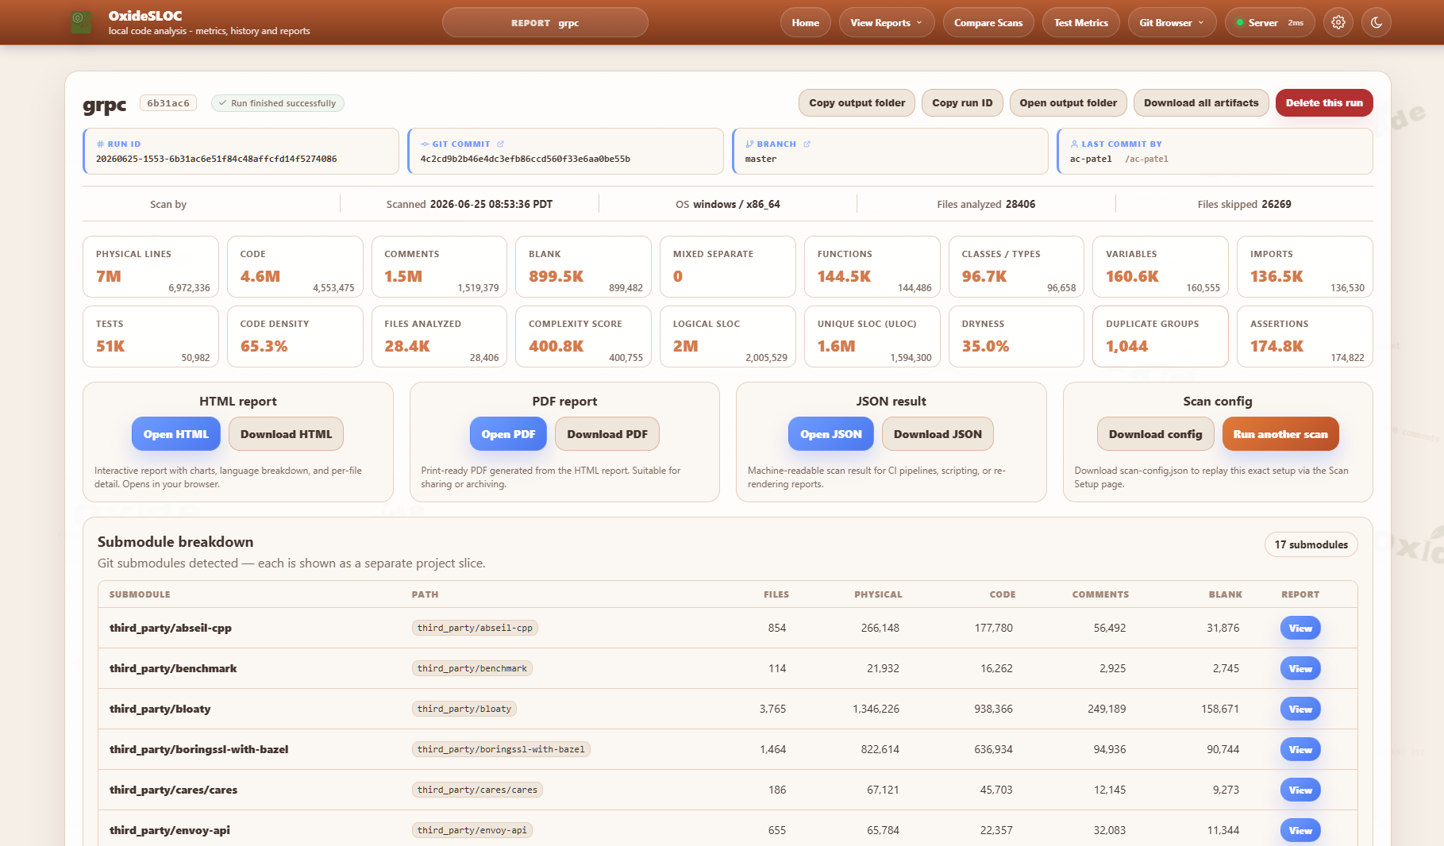
INSIDE A REPORT
The Metrics That Matter
One run, every angle — from raw counts to cost estimates.
●
Headline Counts
Code, comments, blanks, functions, classes & imports.
●
Effort & Quality
COCOMO estimate, complexity score, code density, DRYness.
●
Code Style Analysis
Per-language guide adherence and 80-col compliance.
●
Grab the Artifacts
Open or download HTML, PDF or JSON — or re-run the scan.
127.0.0.1:4317 — Report
Notes:
Open any run and this is the report page. Up top, headline counts: physical lines, code, comments, blanks, functions, classes, variables, imports — plus tests, code density, complexity, and DRYness. One click opens or downloads the HTML, PDF, or JSON, or re-runs the exact scan. This is the same report both personas read.

Slide 12
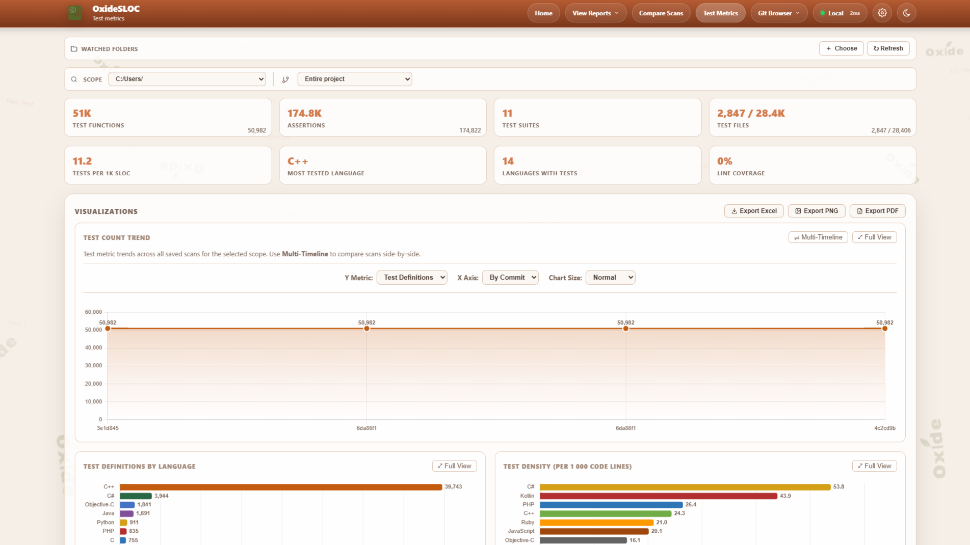
TEST METRICS
Tests & Coverage
How much of the codebase is tested — without running the suite.
●
Test Detection
Test functions & suites found across 60 languages.
●
Test-to-Code Density
Tests per 1K SLOC, plus your most-tested language.
●
Coverage Import
Feed LCOV, Cobertura, JaCoCo, coverage.py or Istanbul.
127.0.0.1:4317 — Test Metrics
Notes:
The Test Metrics page detects test functions lexically across 60 languages and shows test-to-code density, most-tested language, and how many languages have tests. Drop in a coverage file — LCOV, Cobertura XML, JaCoCo, coverage.py JSON, or Istanbul — and it adds line coverage per language. Great for spotting under-tested areas without running the suite.

Slide 13
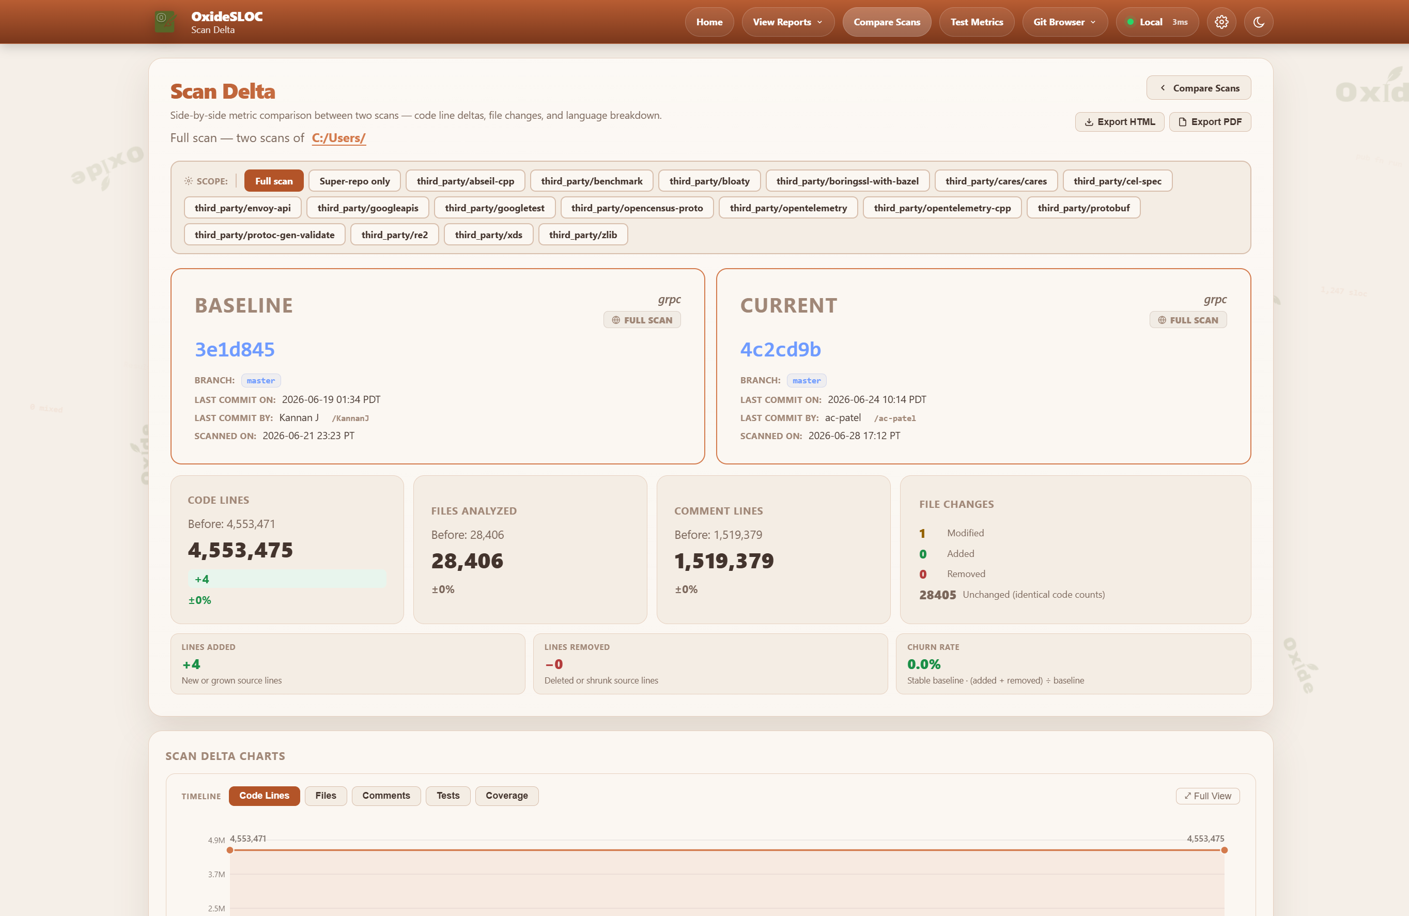
COMPARE SCANS
Comparing Two Scans
Baseline vs current — exactly what changed, and by how much.
●
Line & File Deltas
Added, removed, modified — with percentages.
●
Churn Rate
Development velocity between the two snapshots.
●
Per-Language Delta
See which languages grew or shrank at a glance.
Useful for: sprint-over-sprint change, or what a vendor delivered.
127.0.0.1:4317 — Scan Delta
Notes:
Compare Scans diffs a baseline against a current run. Pick two scans and it shows code-line, file, and comment deltas, churn rate, and a per-language breakdown of what grew or shrank. Use it for sprint-over-sprint change, or to see exactly what a vendor delivered between two drops.

Slide 14
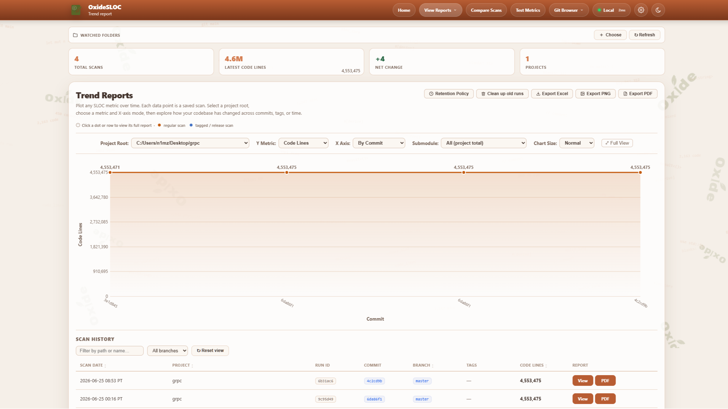
TREND REPORTS
Trends Over Time
Plot any metric across every saved scan — by time or by commit.
●
Pick Your Metric
Code lines, comments, blanks — per project root.
●
Spot Regressions
See a refactor land, or a sudden jump, instantly.
●
Drill In
Click any point to open its full underlying report.
127.0.0.1:4317 — Trend Reports
Notes:
Trend Reports plot any SLOC metric over time from your saved scans. Choose the project root, the Y metric, and whether the X axis is by time or by commit. It's how you spot regressions, watch a refactor land, or show steady growth to stakeholders. Each point links back to its full report.

Slide 15
EXPORT & SHARE
Exporting & Sharing
Turn any scan into something you can hand off — a document, a spreadsheet, or a live badge.
.html
.pdf
.csv
.xlsx
HTML Report
PDF
CSV
Excel
Full interactive report with charts.
Print-ready — ideal to email or attach.
Raw rows for your own analysis.
Four-sheet workbook, ready to pivot.
FOR ENGINEERS
FOR BUSINESS USERS
Live SVG badge & JSON metrics API for dashboards and CI gates.
Grab the PDF — attach it to a status update or stakeholder review.
Notes:
Every scan exports four ways: a styled HTML report, a print-ready PDF, raw CSV, and a four-sheet Excel workbook. Engineers can also expose a live SVG badge or the JSON metrics API for dashboards and CI gates. Business users typically just grab the PDF to attach to an email or a status doc.

Slide 16
RECAP
Quick Reference
OPEN
Browse to 127.0.0.1:4317 — the app is already serving.
NAV
Home, View Reports, Compare Scans, Test Metrics, Git Browser.
SCAN
Start scanning for the guided flow, or Quick Scan for defaults.
DEV
Tune counting rules, read hotspots, export plain output for CI.
BIZ
Point or use Git Browser → Quick Scan → export a PDF to share.
SHARE
Export HTML / PDF / CSV / Excel, or watch the trend over time.
</>
OxideSLOC — local code analysis, no setup required.
Notes:
Recap. Open the app at port 4317. Use the five menu buttons to navigate. To scan: Home, Start scanning or Quick Scan. Developers tune and export for CI; business users point or use Git Browser, Quick Scan, and export a PDF. Everything else — reports, tests, compare, trends — reads from the scans you've already run.

