Slide 1
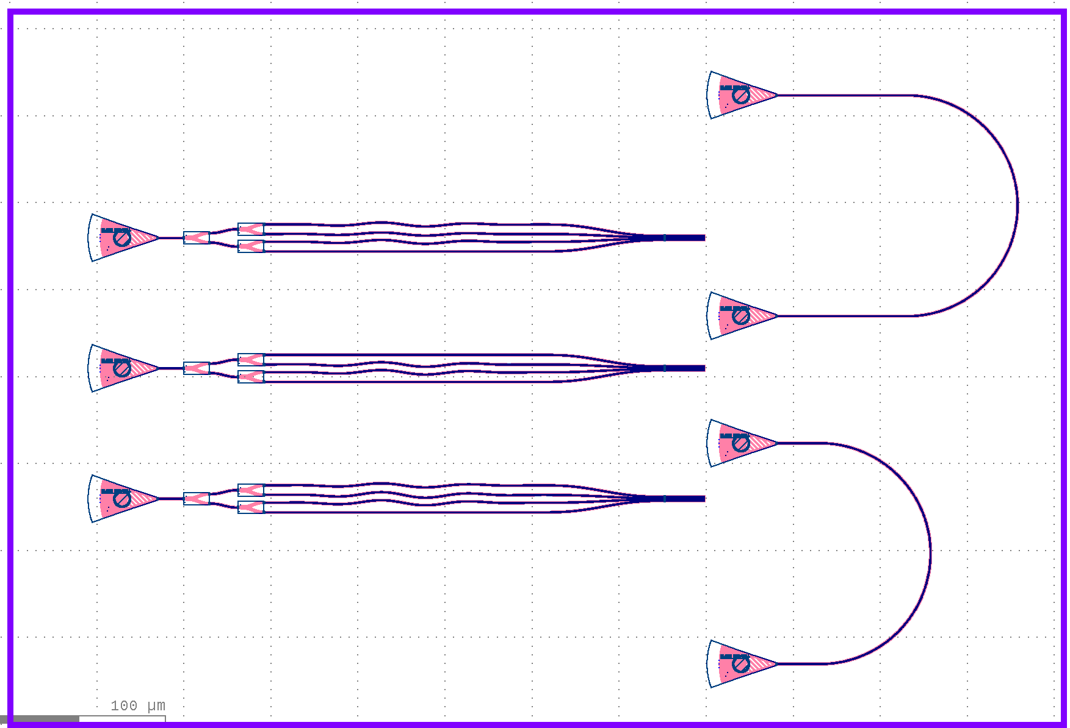
Silicon Photonic Optical Phase Array (OPA) Test Chip
LiDAR-oriented passive steering | 3 passive OPA variants + 2 grating-coupler loopback references | Engineering design and verification brief
CHIP AT A GLANCE
FLOORPLAN
605 × 410 µm
OPA +20 deg. Lateral
TECHNOLOGY
SiEPIC EBeam PDK
OPA 0 deg. Lateral
OPA ARCHITECTURE
loopback references
Three independent 1×4 networks, with 4 emitters
OPA -20 deg. Lateral
PASSIVE PHASE STATES
−20° / 0° / +20°
TEST STRUCTURES
2 matched U-shaped loopbacks
✓
DRC + functional checks: 0 Error
Final merged GDSII floorplan • actual KLayout view
1 / 2

Slide 2
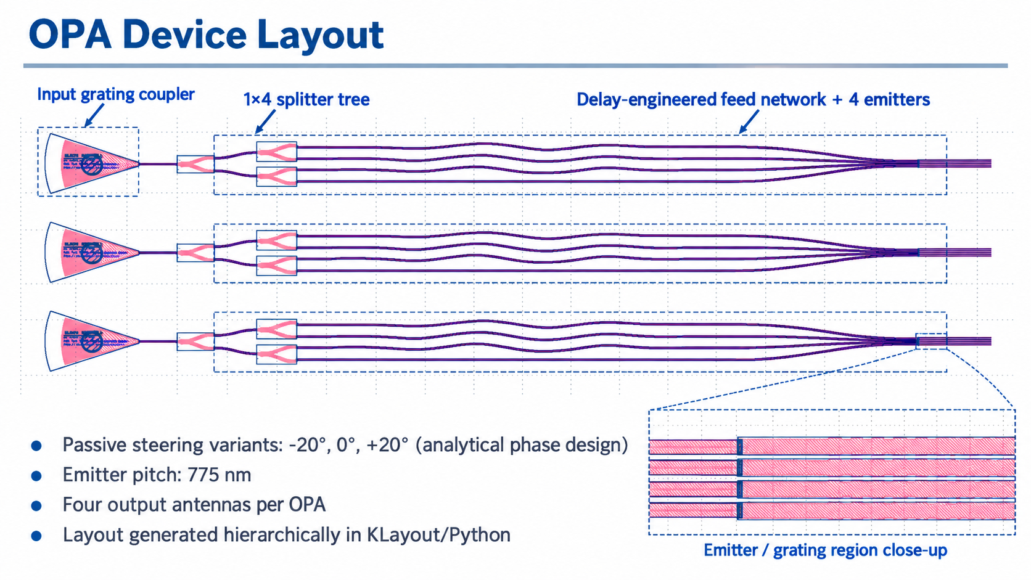
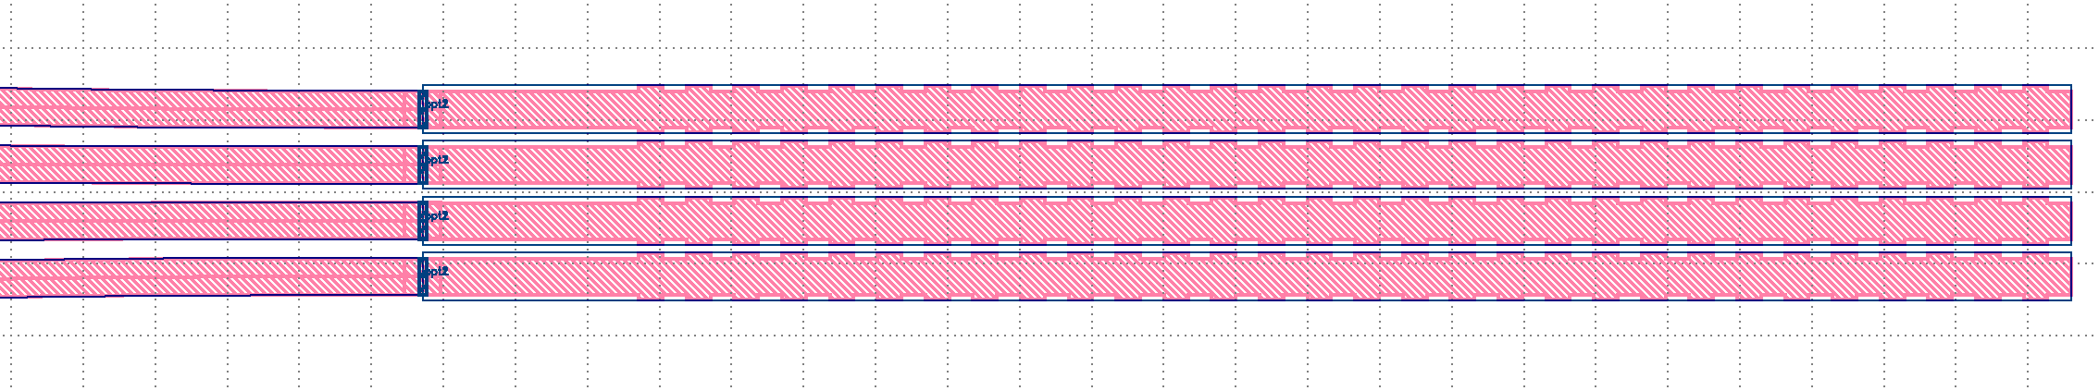
OPA Device Layout
Input grating coupler
1 x 4 Splitter
Delayed-Engineering feed network + 4 emitters
30 sidewall-corrugation periods; 663 nm trial period; 50% duty cycle
2 / 2

