Slide 1
Graph Embeddings and GNN-Based
Community Detection
in Social and Computer Networks
Nima Kamali Lassem · Nicola Mambelli
February 2026 · CentraleSupélec / Paris-Saclay

Slide 2
Knowledge Graph Fundamentals
Core Concepts
Triple Representation: (h, r, t)
Nodes (Entities)
Represent real-world objects: users, hosts, devices. Each node can have attributes (features).
Edges (Relationships)
Connections between nodes. Can be directed (client→server) or undirected (friendship). Can carry types and weights.
Triples (h, r, t)
The fundamental unit of a knowledge graph: (head, relation, tail). E.g., (User₁, friend, User₂) or (Host₅, port80, Host₁₂).
Community Structure
Groups of densely connected nodes. Reflects functional roles, social groups, or organizational structure.
User₁
(head)
User₂
(tail)
friend
▶
Undirected (symmetric)
Host₅
(head)
Host₁₂
(tail)
port80
▶
Directed (asymmetric)

Slide 3
Two Contrasting Datasets
LastFM Asia Social Network
Cisco g21 Network Traffic
7,624 nodes
(music users from 18 Asian countries)
27,806 undirected edges
(friendships — 1 relation type, 100% symmetric)
Rich node features
(7,842 binary artist preferences → 128-dim SVD)
Density: 0.096% · Sparse
Ground truth: 18 country labels
Class imbalance: 98:1 ratio (largest vs smallest)
52 nodes
(network hosts with functional roles)
Directed edges, 2,157 relation types
(port/protocol combos — 94.2% asymmetric)
No native node features
(engineered from port usage patterns)
Density: 96% raw → 51% filtered
Ground truth: 23 functional groups
(verified by actual host function)
Description: Social network of Last.fm users from 18 Asian countries, with friendships as edges and music listening preferences as node attributes.
Description: Network of 52 hosts representing communication traffic between devices, where edges capture port/protocol interactions reflecting functional roles.

Slide 4
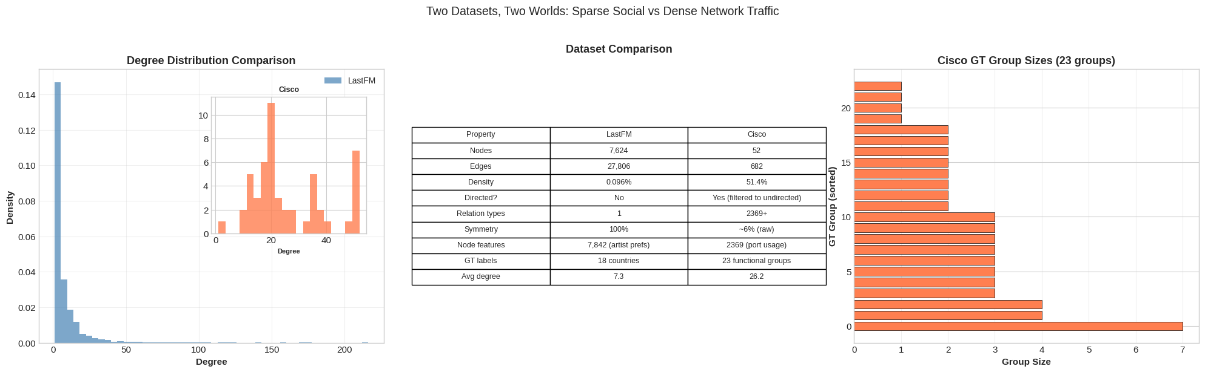
Dataset Characterization: Properties That Determine Model Choice
Why this matters: Symmetry, density, and relation count directly predict which models will succeed or fail.

Slide 5
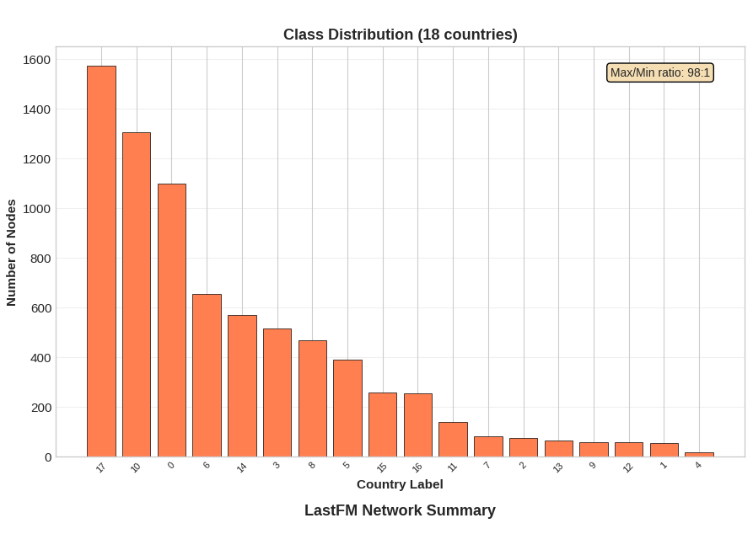
Dataset Characterization: Properties That Determine Model Choice
Why this matters: Symmetry, density, and relation count directly predict which models will succeed or fail.

Slide 6
Summary of Previous Work
Part 1: Classical Community Detection · Part 2 (early): Spectral Clustering & Node2Vec
Brief recap — these methods set the baseline for the main results

Slide 7
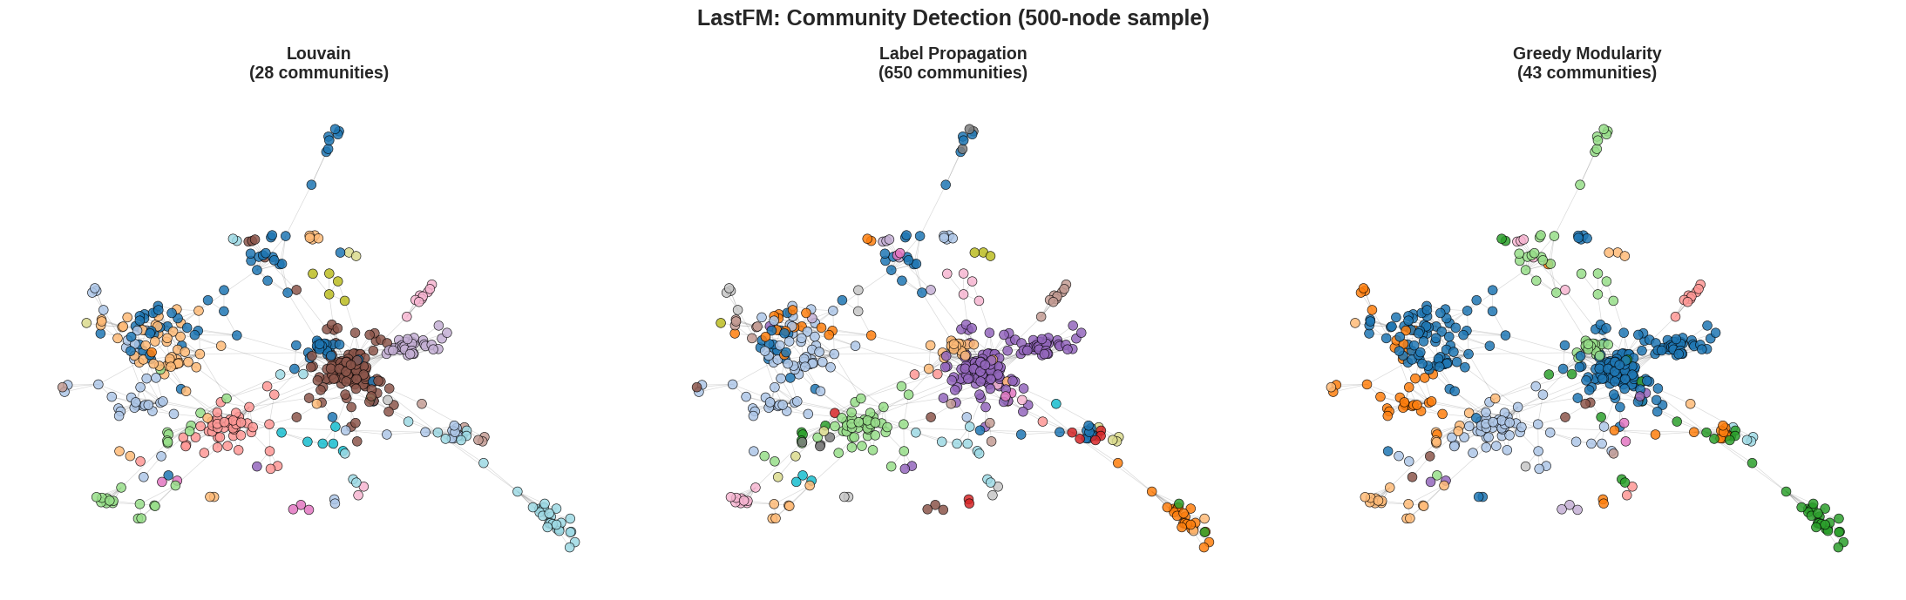
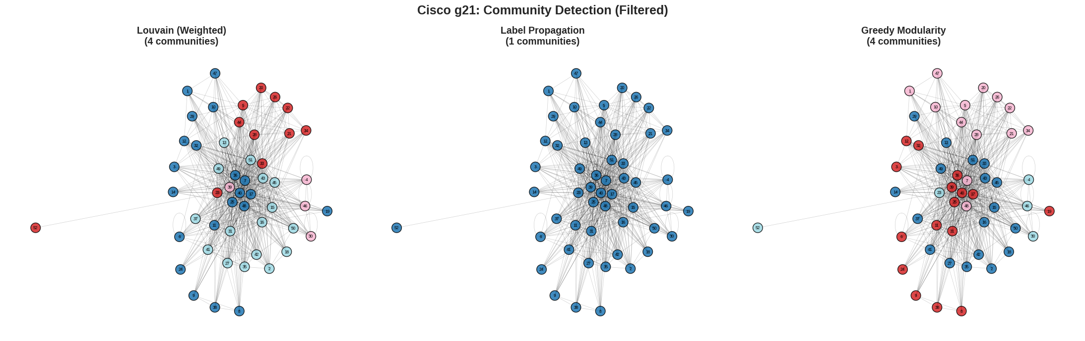
Part 1: Classical Community Detection — Baselines
LastFM (Undirected, No Ground Truth)
Cisco g21 (Directed, With Ground Truth)
Algorithm | Modularity | Conductance | Communities
Louvain ✓ | 0.815 | 0.135 | 27
Label Propagation | 0.752 | 0.435 | 650
Greedy Modularity | 0.796 | 0.163 | 43
Algorithm | Jaccard | NMI | Communities
Louvain | 0.531 | 0.165 | 2
Girvan-Newman | 0.322 | 0.296 | 9
Label Propagation | 0.077 | 0.000 | 1
Key insight: Louvain is our strongest baseline. Dense networks (Cisco) cause Label Propagation and Infomap to collapse into a single community.

Slide 8
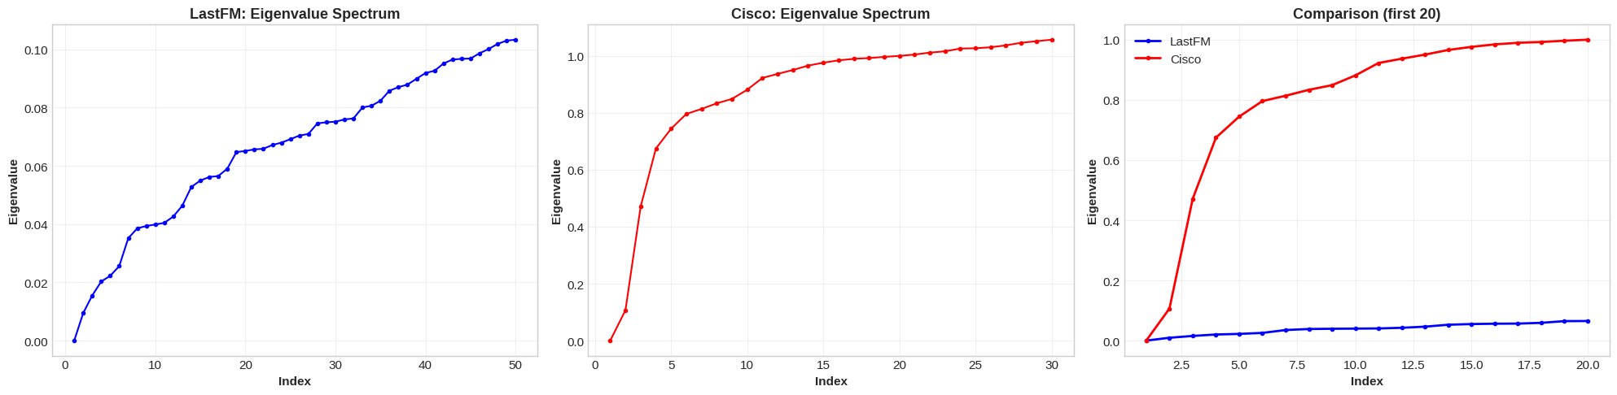
Spectral Clustering: Eigenvalues of the Graph Laplacian
Pipeline
Results
Adjacency Matrix A
Dataset | k | Mod. | NMI | ARI
LastFM | 18 | 0.799 | 0.659 | 0.671
Cisco | 23 | 0.205 | 0.863 | 0.496
▼
Normalized Laplacian L_sym
Cisco achieves NMI=0.863 despite low modularity — functional groups aren't dense subgraphs.
▼
k smallest eigenvectors
▼
K-Means on eigenvectors
▼
Community Assignments
L_sym = D^(-1/2) L D^(-1/2)
Eigengap heuristic selects k

Slide 9
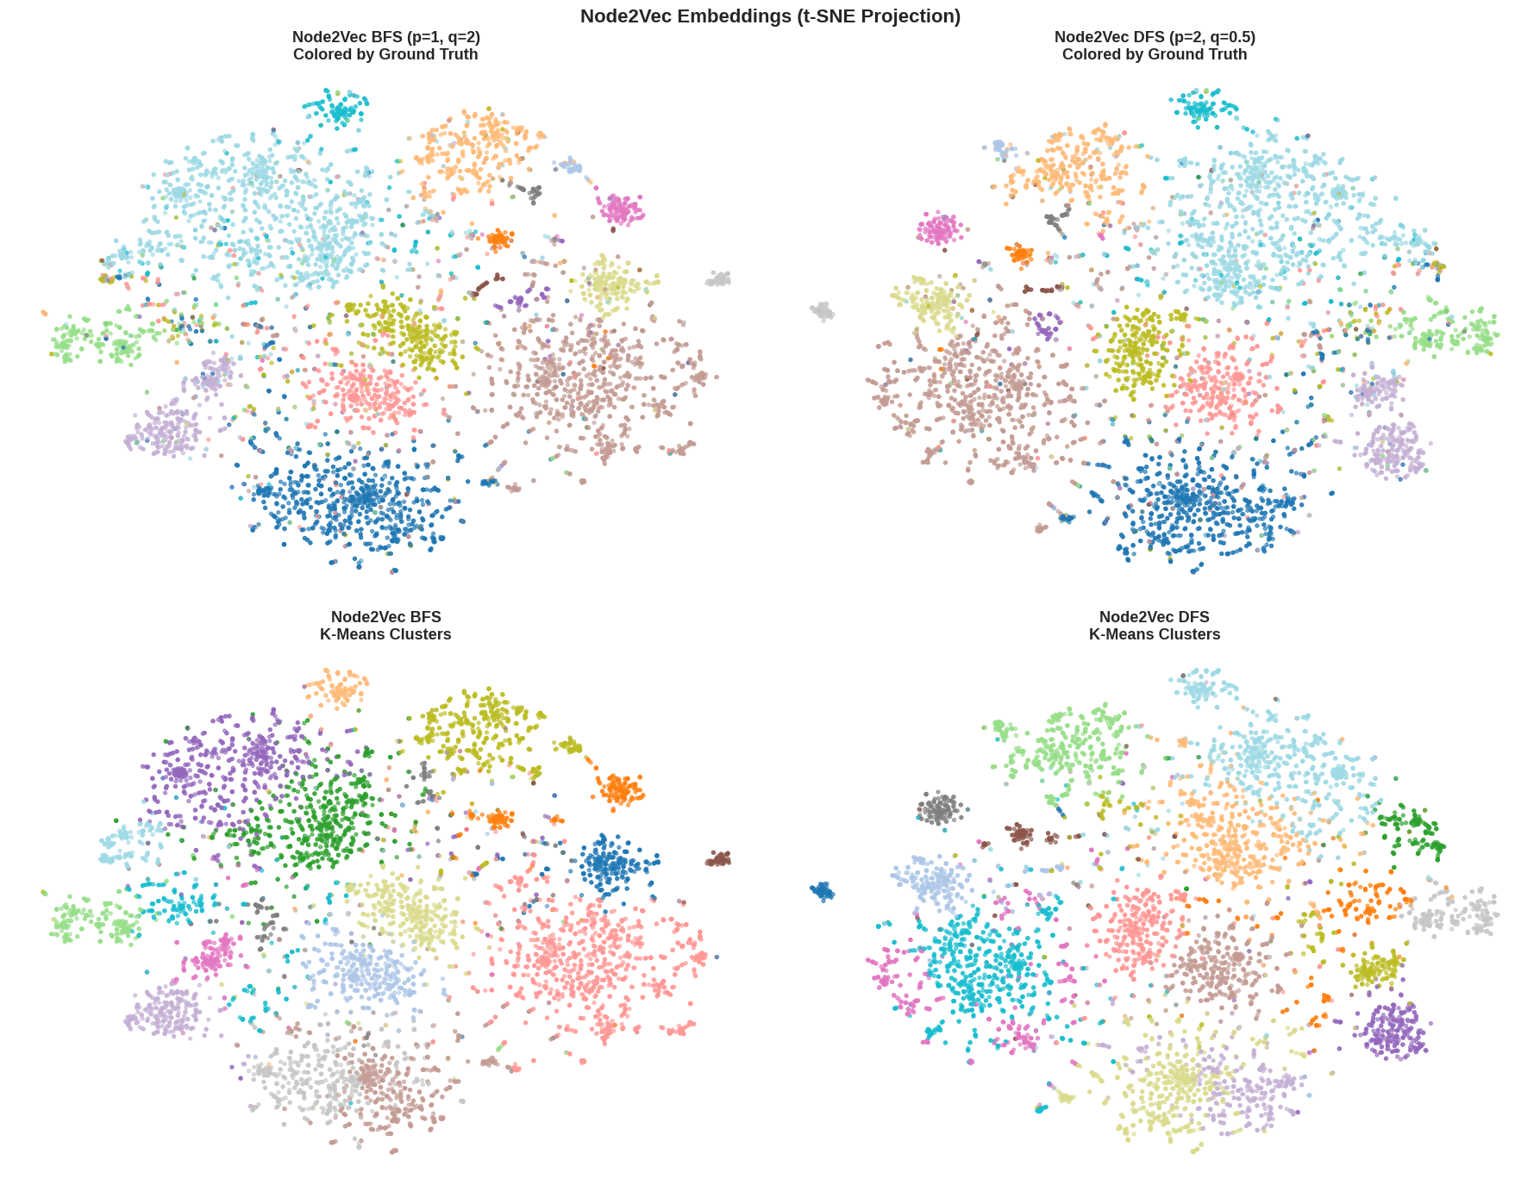
Node2Vec: Biased Random Walks → Shallow Embeddings
Pipeline
LastFM Results
Graph G
Config | Mod. | NMI | ARI
BFS (p=1, q=2) | 0.778 | 0.623 | 0.533
DFS (p=2, q=0.5) | 0.804 | 0.635 | 0.561
▼
Biased Random Walks
p, q control BFS vs DFS
DFS > BFS: global structure captures more community signal. Neither beats Louvain on modularity or spectral on NMI. Cisco: poor (too dense for random walks).
▼
Word2Vec (Skip-gram)
▼
Node Embeddings
+ K-Means → Communities
BFS (p=1, q=2): local structure
DFS (p=2, q=0.5): global homophily
num_walk LastFM: 10 (Original Paper)
num_walk Cisco: 20 (more sparse) (low for W2V)
t‑SNE stands for t‑distributed Stochastic Neighbor Embedding, a nonlinear dimensionality reduction method mainly used for visualization, not for downstream modeling.

Slide 10
Main Contributions
GCN · Link Prediction · Knowledge Graph Embeddings · Transfer Learning
The core of our work: deep learning and knowledge graph embedding methods

Slide 11
GCN for Node Classification: Theory & Pipeline
Why GCN?
Node Classification Pipeline(LastFM)
Only method that uses both graph structure AND node features
Message passing: each node aggregates neighbor information
H' = Â · H · W
where Â = D̃^(-1/2) Ã D̃^(-1/2) (normalized adjacency)
Architecture: 2 GCN layers (128→64→18 classes)
Trained with cross-entropy on 70% labeled nodes
Node Features (128-dim SVD)
▼
Normalized Adjacency Â
▼
GCN Layer 1: 128 → 64 + ReLU
▼
GCN Layer 2: 64 → 18 classes
What makes GCN different from previous methods?
▼
Softmax → Cross-Entropy Loss
Method | Structure | Features | Learned
Spectral | ✓ | ✗ | ✗
Node2Vec | ✓ | ✗ | ✓
GCN | ✓ | ✓ | ✓
▼
Country Prediction (18 labels)

Slide 12
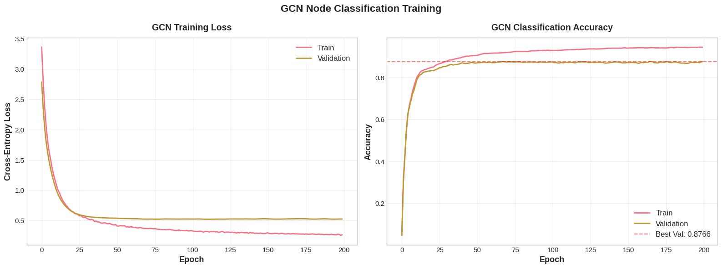
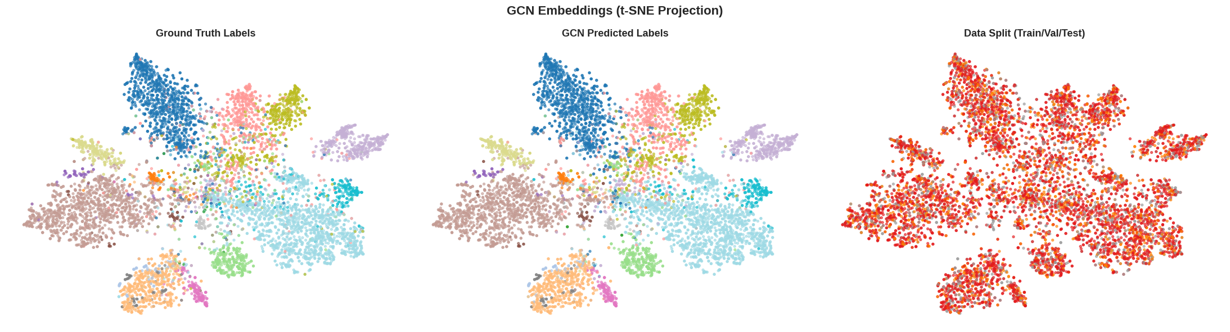
GCN Results: Training & Embeddings
LastFM Test Accuracy: 89.4%
Cisco Test Accuracy: 20.0%
Cisco: Port-based features
Binary vector of port usage patterns — web servers on 80/443, DNS on 53, etc.
Only 52 nodes → higher variance, smaller hidden dim (32 vs 64)
20% accuracy with high variance reflects extreme difficulty: 23 classes, ~2 nodes/class

Slide 13
Link Prediction with GNN: Pipeline (LastFM)
Original Graph
7,624 nodes, 27,806 edges
Edge Split
85% train / 5% val / 10% test
Negative Sampling
1:1 pos/neg ratio
Balanced
Train Set
▶
▶
▶
SVD Features
(128-dim per node)
GCN Encoder
2-layer: 128→64→embed
Dot-Product Decoder
score = σ(z_u · z_v)
BCE Loss
Edge / No-edge
▶
▶
▶
Two Evaluation Paradigms:
Binary Edge Classification
AUC, Average Precision
"Does an edge exist between u and v?"
Binary yes/no → GCN trained for this (BCE)
AUC = 0.944 (Area Under the ROC Curve) ·
AP(Average Precision) = 0.948
Entity Ranking (head + tail)
MR, MRR, Hits@K
"Rank the correct target among ALL 7,624 nodes"
GCN NOT trained for this → much worse performance
Hits@10 = 12.82% · MRR = 0.058

Slide 14
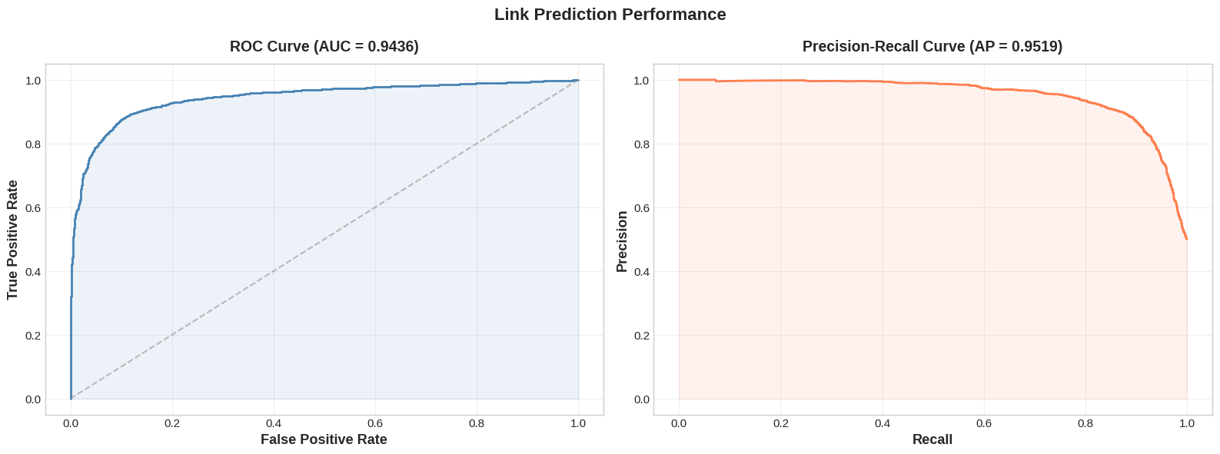
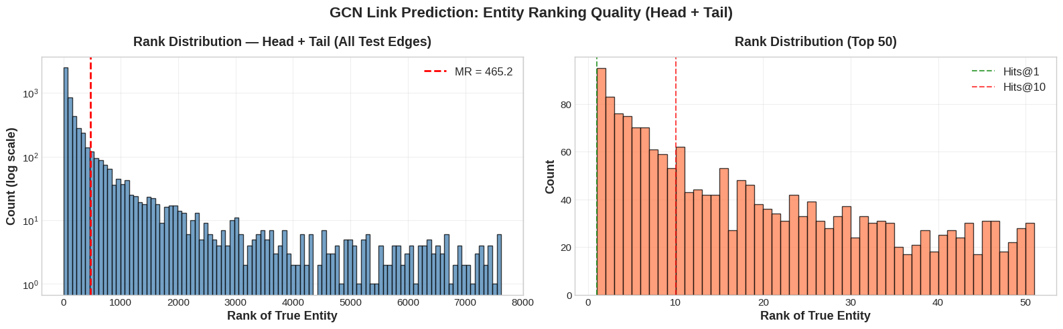
Key Insight: Why Loss Functions Determine What Embeddings Learn
Binary Cross-Entropy (GCN) vs Margin-Based Ranking (KGE models)
BCE asks: "Is this pair an edge?" — just needs scores above/below 0.5. Easy: most random pairs are clearly not edges.
Ranking loss asks: "Can you rank the correct target ABOVE all other candidates?" — requires fine-grained score differences among plausible neighbors.
Result: GCN achieves AUC = 0.944 (great at discrimination) but only Hits@10 = 12.82% (poor at ranking).
TransE/RotatE trained with ranking loss → directly optimized for the harder ranking task.

Slide 15
Knowledge Graph Embedding Models
TransE · RotatE · DistMult — Dedicated link prediction models with ranking-based loss

Slide 16
TransE: Translational Embeddings
Scoring Function
Impact on Our Datasets
f(h, t) = ||h + r − t||₂
Relation r acts as a translation from head to tail.
Low score = triple is likely true.
Loss: MarginRankingLoss (γ=1.0)
Push correct triples' scores below corrupted triples by at least margin γ. All negatives weighted equally.
LastFM: Expect FAILURE
• 100% symmetric edges → r ≈ 0
• 77% nodes have multiple friends → 1-to-N collapse
• Single relation type → zero relational capacity
• High clustering → cascading embedding collapse
Cisco: Expect SUCCESS
• 94% asymmetric → no symmetry problem
• 2,157 relation types → full multi-relational power
• Simple geometry generalizes with sparse data (~2.3 triples/relation)
Known Limitations (from lecture)
Symmetry: Forces r → 0, collapsing h and t to same point
1-to-N: Forces all tails to collapse (t₁ = t₂)
N-to-N: Same collapse in both directions
✓ Composition, ✓ Antisymmetry
Python library: PyKEEN

Slide 17
RotatE: Rotational Embeddings in Complex Space
Scoring Function
NSSA Loss: Self-Adversarial
t = h ∘ r, |rᵢ| = 1 (unit complex numbers)
f(h, t) = ||h ∘ r − t||
Each rᵢ = e^(iθᵢ) — a rotation angle in complex plane.
Relations as rotations, not translations.
Loss: NSSALoss (self-adversarial, γ=6.0, α=1.0)
Weights harder negatives more → focuses training on most informative examples.
Standard negative sampling treats all corrupted triples equally — but some negatives are easy (clearly wrong) and some are hard (plausible).
NSSA uses the model's own scores to weight negatives: harder negatives get higher weight.
Why RotatE + NSSA?
RotatE's rich complex-space embeddings quickly learn easy negatives. NSSA keeps training challenging by focusing on the negatives the model is most confused about.
Why TransE + MarginRanking?
TransE is simpler — uniform negative sampling gives stable, predictable gradients. Its limited capacity benefits from diverse negatives.
Capabilities (solves TransE's limitations)
✓ Symmetry: Rotation by π (rᵢ = −1), applying twice returns to start
✓ 1-to-N: Different complex embeddings map correctly under same rotation
✓ Composition: r₃ = r₁ ∘ r₂ (rotation composition)
✓ Inversion: r₂ = r̄₁ (conjugate = inverse rotation)
Python library: PyKEEN

Slide 18
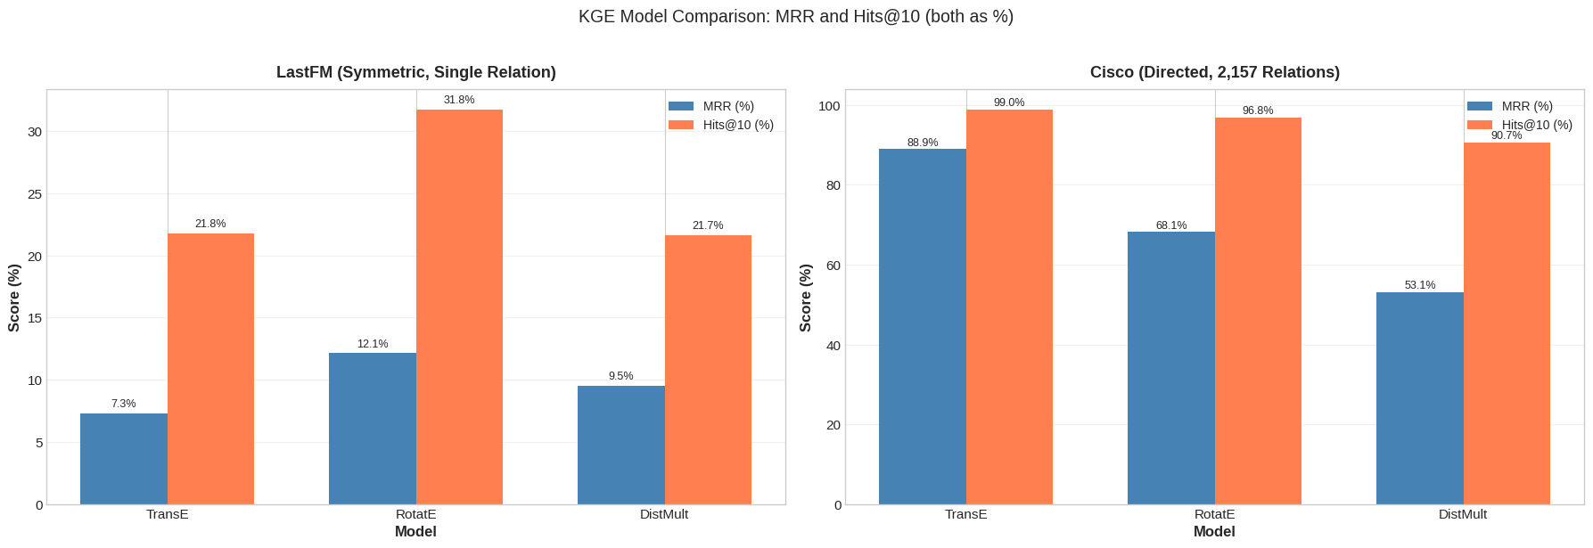
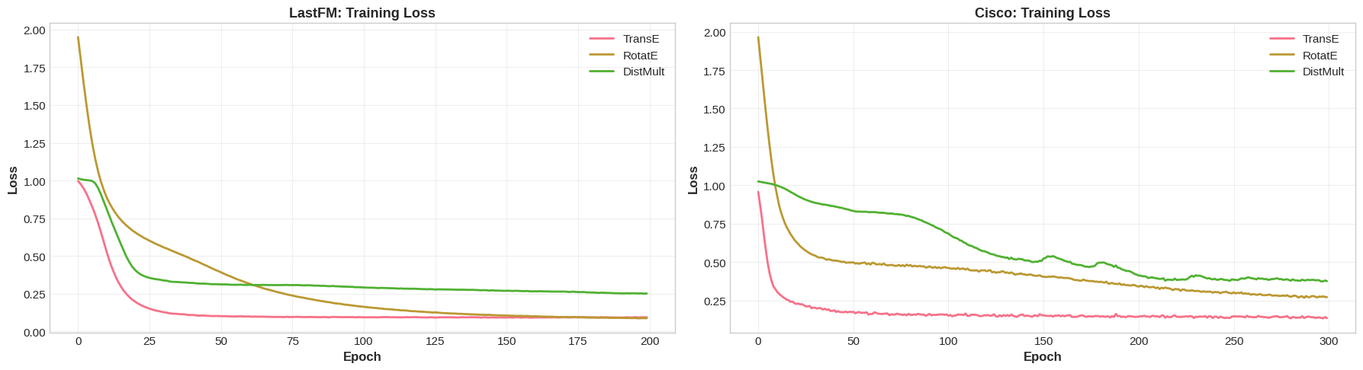
DistMult & Three-Model Comparison
DistMult: Bilinear Model
Model Architecture Comparison
f(h,t) = h^T diag(r) t = Σᵢ hᵢ · rᵢ · tᵢ
Inherently symmetric: f(h,r,t) = f(t,r,h) always
Natural fit for symmetric graphs (LastFM)
Fatal flaw for directed graphs (Cisco)
Model | Scoring | Symmetry | Params/rel
TransE | ||h+r−t|| | Anti-sym | d
RotatE | ||h∘r−t|| | Both | 2d
DistMult | h^T diag(r) t | Always sym | d
One model breaks on symmetry (TransE), one handles everything (RotatE), one assumes symmetry (DistMult)

Slide 19
Link Prediction Results: LastFM (Symmetric, 1 Relation)
Metric | GCN (h+t) | TransE | RotatE | DistMult
MR | 449 | 323 | 323 | 402
MRR | 0.058 | 0.073 | 0.121 | 0.095
Hits@1 | 1.74% | 0.00% | 2.33% | 3.40%
Hits@10 | 12.82% | 21.77% | 31.77% | 21.66%
RotatE wins on LastFM — exactly as theory predicts:
TransE Hits@1 = 0%: Symmetric edges force r ≈ 0 → all nodes equidistant → can NEVER rank correct target first. Compounds with single-relation bottleneck and cascading embedding collapse.
RotatE MRR 66% higher than TransE: Models symmetry as rotation by π without collapse. Cross-dimensional expressiveness matters at scale (7,624 entities).
DistMult (MRR=0.095): Built-in symmetry avoids TransE's collapse but lacks RotatE's cross-dimensional power. Hits@1=3.40% is actually highest — precise top-1 predictions but poor recall.

Slide 20
Link Prediction Results: Cisco (Directed, 2,157 Relations)
Metric | TransE | RotatE | DistMult
MRR | 0.848 | 0.682 | 0.482
Hits@1 | 74.5% | 48.3% | 22.6%
Hits@10 | 98.2% | 96.2% | 90.7%
TransE dominates Cisco — opposite ranking from LastFM:
No symmetry problem: 94.2% asymmetric edges → TransE's main weakness is irrelevant.
Parameter efficiency: TransE has 138K vs RotatE's 276K relation params. With only ~2.3 examples per relation, RotatE overfits.
DistMult's fundamental flaw: Cannot distinguish (h,r,t) from (t,r,h) on 94% asymmetric edges. Scores contradictory triples identically → training signal diluted.
Simple geometry suffices: 52 entities = small ranking space. Straight-line translations are enough; RotatE's rotational complexity is wasted.

Slide 21
The Key Lesson: Dataset Properties Determine the Winner
Dataset Property | Favors TransE | Favors RotatE | Favors DistMult
Symmetric edges | ✗ No | ✓ Yes | ✓ Yes
Asymmetric/directed | ✓ Yes | — Neutral | ✗ No
Many relations, sparse data | ✓ Simpler | ✗ Overfits | ✗ No
Single relation, dense data | ✗ No | ✓ Yes | ✓ Yes
Small entity space | ✓ Yes | ✗ No | ✗ No
Large entity space | — Neutral | ✓ Yes | — Neutral
LastFM → RotatE wins
Symmetric, single relation, large
Cisco → TransE wins
Directed, 2157 relations, sparse, small
This is exactly what the lecture's summary table predicts in theory. Our experiments on two real datasets confirm it in practice.

Slide 22
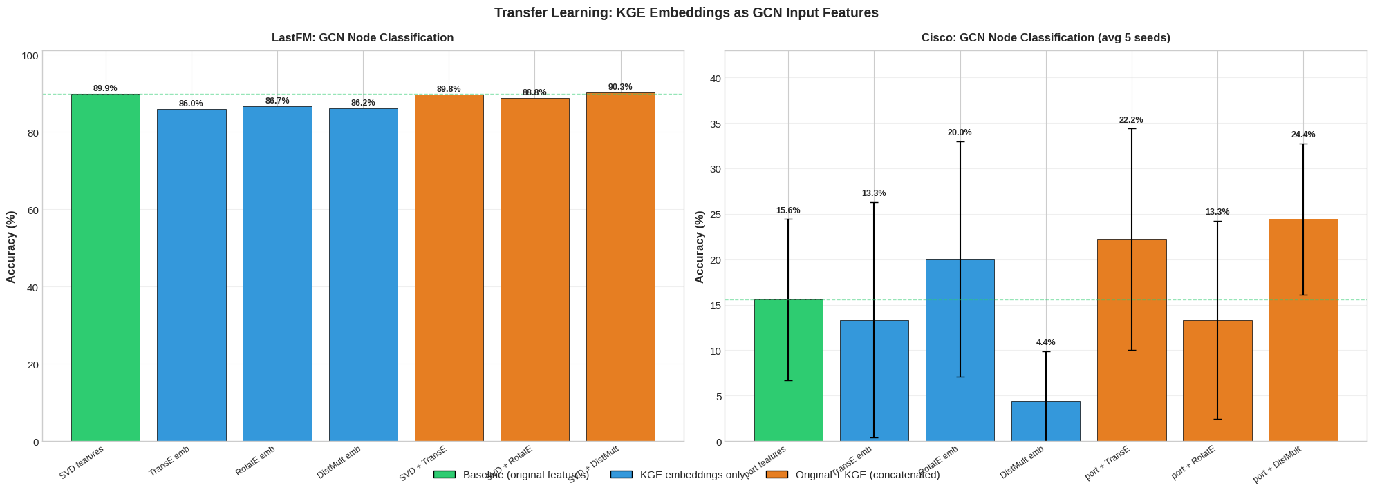
Transfer Learning: KGE → GCN
Step 1: Train KGE
TransE/RotatE/DistMult
for entity ranking
Why transfer learning works here:
1. KGE training is unsupervised — only needs graph edges, not labels
2. KGE captures relational structure (who connects to whom via which relation)
3. GCN adds neighborhood aggregation + non-linear transformation on top
4. Concatenation combines content features (SVD/port) with structural features (KGE)
KGE encodes local relational patterns → GCN adds global neighborhood context.
This combination is more informative than either alone.
▼
Step 2: Extract
Entity Embeddings
(128/256-dim vectors)
▼
Option A:
KGE only
Option B:
Original + KGE
(concatenate)
Step 3: GCN with
KGE input features
▼
Node Classification
+ Community Detection

Slide 23
Transfer Learning Results: Classification & Community Detection
LastFM Node Classification
Cisco (avg over 5 seeds)
Variant | Test Acc
GCN (SVD) | 89.4%
GCN (TransE) | 85.9%
GCN (RotatE) | 86.8%
GCN (DistMult) | 86.0%
GCN (SVD+TransE) | 89.9%
GCN (SVD+RotatE) | 89.1%
GCN (SVD+DistMult) | 90.0%
Variant | Test Acc
GCN (port) | 20.0% ± 17.8%
GCN (TransE) | 8.9% ± 13.0%
GCN (RotatE) | 20.0% ± 20.4%
GCN (DistMult) | 11.1% ± 7.0%
GCN (port+TransE) | 37.8% ± 11.3%
GCN (port+RotatE) | 22.2% ± 14.1%
GCN (port+DistMult) | 11.1% ± 9.9%
Key Findings:
KGE-only features (85.9–86.8%): Graph structure alone carries substantial class-relevant signal — close to SVD baseline.
SVD+DistMult (90.0%) best on LastFM: DistMult's symmetric embeddings complement content features. Modest gain since SVD already captures social homophily.
Port+TransE (37.8%) best on Cisco: Nearly doubles port-only baseline. TransE's strong relational embeddings (MRR=0.848) transfer well.
Community Detection: GCN(SVD+RotatE) achieves best NMI (0.680) across ALL methods.

Slide 24
Comprehensive Comparison: All Methods on LastFM
Method | Type | Mod. | NMI | ARI | AMI
Louvain (Part 1) | Classical | 0.815 | 0.622 | 0.535 | 0.611
Spectral (k=18) | Spectral | 0.799 | 0.659 | 0.671 | 0.656
Node2Vec DFS | Shallow Emb. | 0.804 | 0.635 | 0.541 | 0.624
GCN (Node Classif.) | GNN | 0.449 | 0.589 | 0.366 | 0.588
GCN (Link Pred.) | GNN | 0.674 | 0.477 | 0.256 | 0.486
GCN (SVD+RotatE) | GNN+KGE | 0.713 | 0.680 | 0.595 | 0.677
Louvain leads on modularity (0.815). GCN(SVD+RotatE) achieves the highest NMI (0.680) — surpassing spectral clustering (0.659) and all other methods. Transfer learning from KGE captures community structure best.

Slide 25
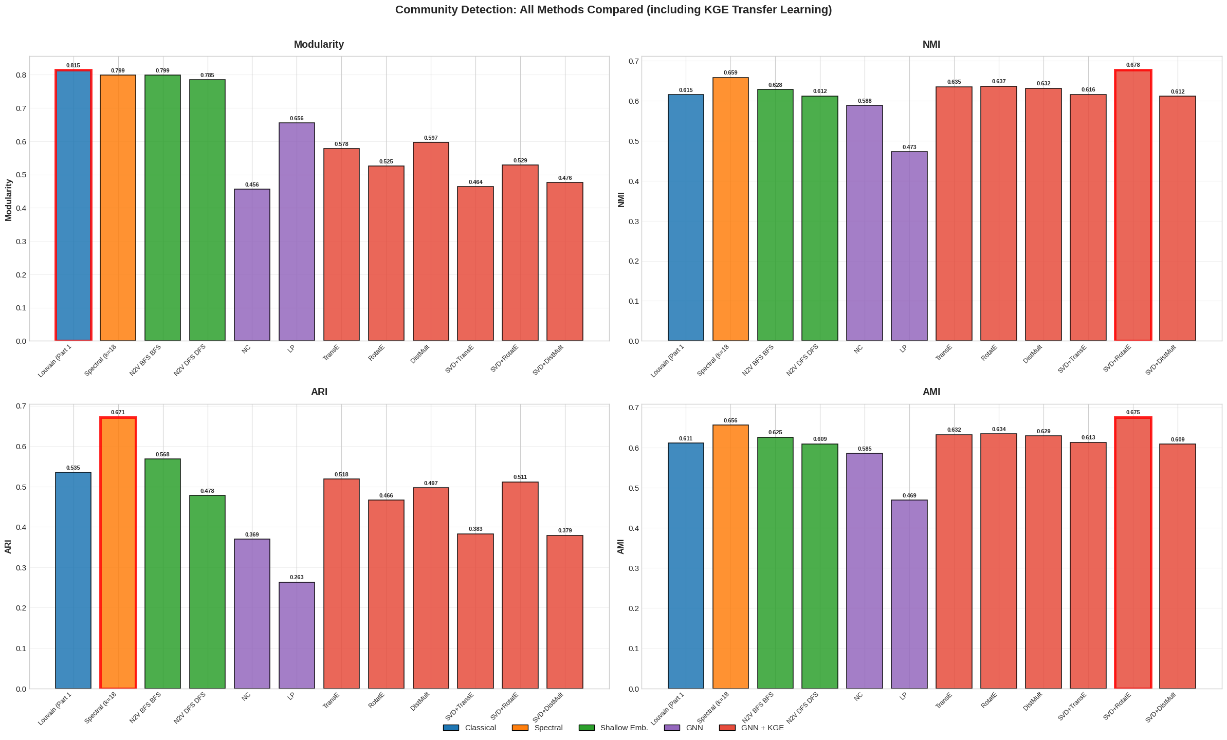
Comprehensive Comparison: All Methods on LastFM

Slide 26
Key Findings
1
Modularity ≠ ground truth alignment
2
AUC ≠ ranking quality
Louvain wins modularity but spectral better recovers true communities (NMI 0.659 vs 0.622). On Cisco, spectral achieves NMI=0.863 with low modularity.
GCN gets AUC=0.944 but Hits@10=12.82%. Ranking metrics (MRR, Hits@K) reveal true link prediction quality.
3
Simpler can be better
4
No universal winner
For community detection, Louvain beats most complex methods. For Cisco link prediction, TransE (MRR=0.848) beats RotatE (0.682).
RotatE wins on symmetric data (LastFM), TransE wins on directed/sparse (Cisco), DistMult collapses on asymmetric data.
5
Loss function shapes embeddings
6
KGE embeddings transfer to GCN
Margin-based ranking loss → good at entity ranking. BCE → good at binary classification. The loss matters as much as architecture.
Concatenation improves both datasets. GCN(SVD+RotatE) achieves best community NMI (0.680) across all methods.

Slide 27
Method Selection Guide: Matching Models to Data Properties
Method | Best For | Weakness
Louvain | Maximizing modularity, dense subgraphs | Doesn't align well with ground truth labels
Spectral | Recovering ground truth (NMI=0.659) | Requires choosing k, no learned embeddings
Node2Vec | General-purpose embeddings (Mod=0.804) | Slightly worse than Louvain at communities
GCN | Classification (89.4%), binary LP (AUC=0.944) | Poor at ranking (Hits@10=12.82%)
GCN+KGE | Community detection (NMI=0.680), combined | Requires KGE pre-training step
TransE | Directed, multi-relational, sparse (MRR=0.848) | Cannot handle symmetry
RotatE | Symmetric/mixed graphs (MRR=0.121) | Overfits with sparse per-relation data
DistMult | Symmetric bilinear patterns (MRR=0.095) | Cannot model directionality at all
Cross-dataset validation is essential. Testing on only one dataset would produce misleading conclusions about model rankings.

Slide 28
Conclusions
1
GCN(SVD+RotatE) achieves best community NMI (0.680)
Surpasses spectral clustering (0.659) and Louvain (0.622) by combining content + structural features through transfer learning from KGE.
2
KGE models with ranking loss outperform GCN for link prediction
RotatE Hits@10=31.8% vs GCN 12.82% — the loss function determines what embeddings optimize for.
3
Dataset properties determine model rankings
RotatE wins on symmetric LastFM, TransE wins on directed Cisco, DistMult collapses on asymmetric data. No universal winner.
4
Transfer learning from KGE to GCN is effective
Unsupervised KGE embeddings provide complementary structural signal. Concatenation improves both classification and community detection.

Slide 29
Thank You
Questions?
github.com/NimakamaliLassem/Massive-Graph
References
TransE: Bordes et al. (2013) NeurIPS · RotatE: Sun et al. (2019) ICLR · DistMult: Yang et al. (2015) ICLR
GCN: Kipf & Welling (2017) ICLR · Node2Vec: Grover & Leskovec (2016) KDD · Spectral: Von Luxburg (2007)
LastFM Dataset: Rozemberczki & Sarkar (2020) CIKM · PyKEEN: Ali et al. (2021) JMLR
Louvain: Blondel et al. (2008) · Word2Vec: Mikolov et al. (2013) NeurIPS

Slide 30
Appendix

Slide 31
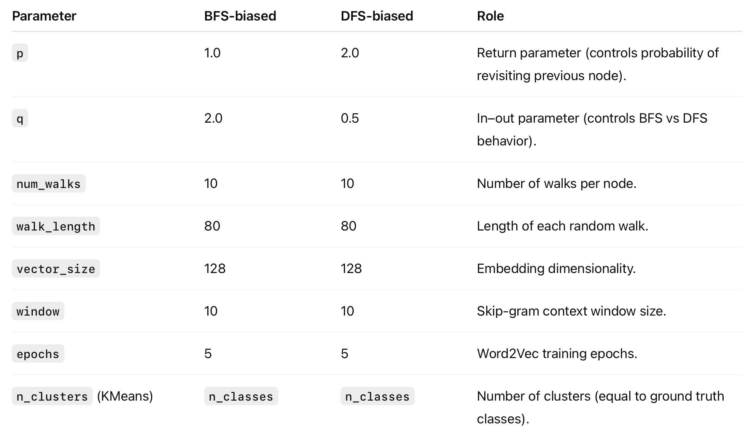
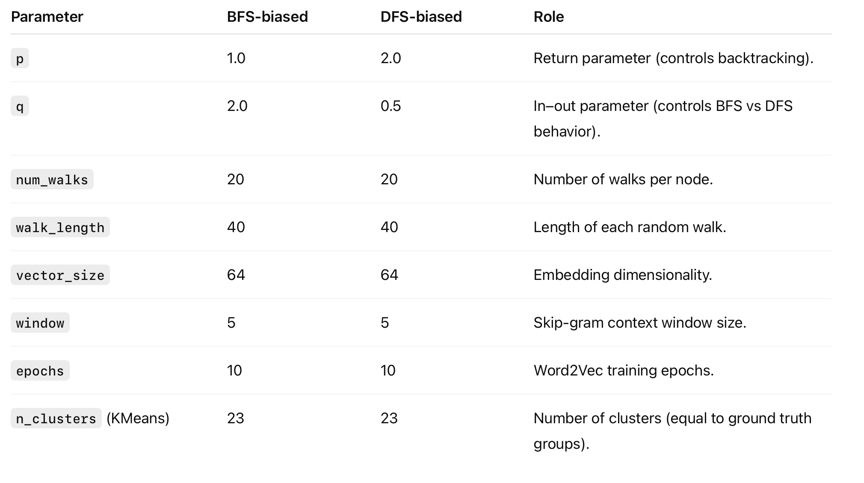
Node2Vec - Parameters
LastFM
Cisco

Slide 32
GCN - Cisco pipeline configuration
Node Classification Pipeline
Node Features (128-dim SVD)
▼
Normalized Adjacency Â
▼
GCN Layer 1: 64→ 32 + ReLU
▼
GCN Layer 2: 32 → 23classes
▼
Softmax → Cross-Entropy Loss
▼
Country Prediction (18 labels)

Slide 33
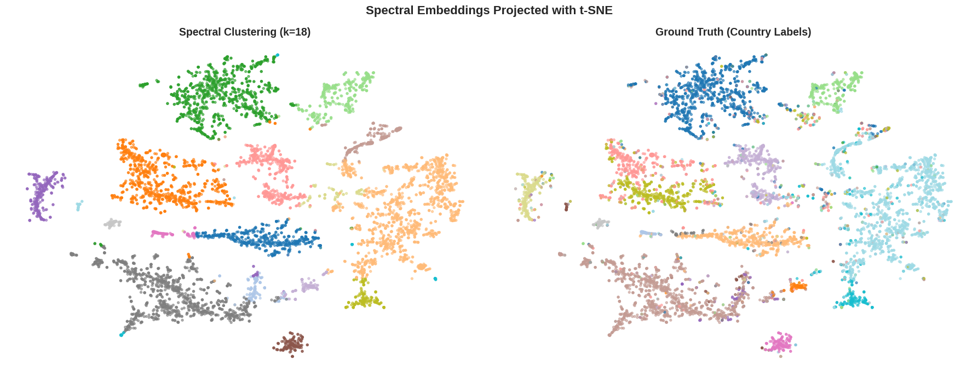

Slide 34
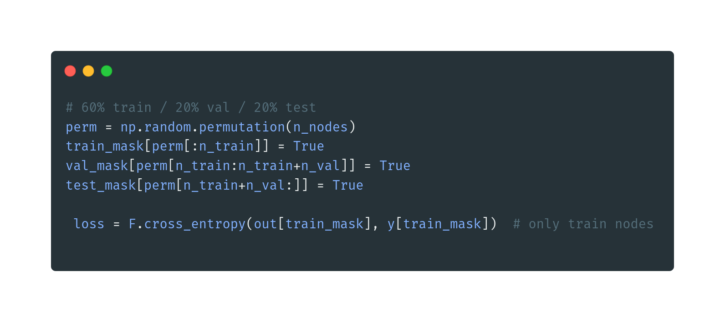

Slide 35
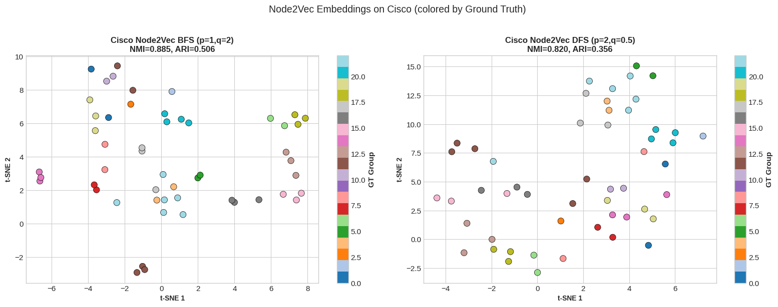
Node2Vec: Biased Random Walks → Shallow Embeddings
Pipeline
Cisco Results
Graph G
Config | Mod. | NMI | ARI
BFS (p=1, q=2) | 0.0415 | 0.8851 | 0.5056
DFS (p=2, q=0.5) | 0.1828 | 0.8196 | 0.4236
▼
Biased Random Walks
p, q control BFS vs DFS
DFS > BFS: global structure captures more community signal. Neither beats Louvain on modularity or spectral on NMI. Cisco: poor (too dense for random walks).
▼
Word2Vec (Skip-gram)
▼
Node Embeddings
+ K-Means → Communities
BFS (p=1, q=2): local structure
DFS (p=2, q=0.5): global homophily
t‑SNE stands for t‑distributed Stochastic Neighbor Embedding, a nonlinear dimensionality reduction method mainly used for visualization, not for downstream modeling.

Slide 36
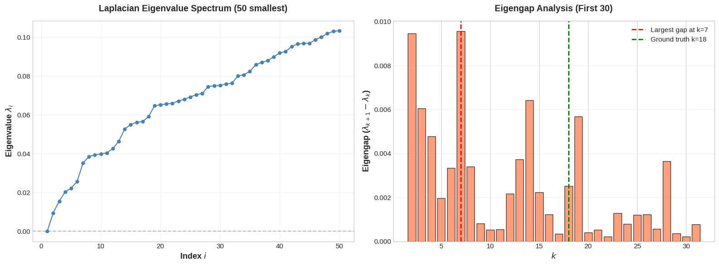
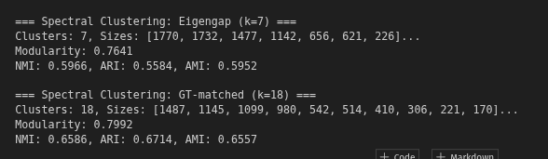
LastFM

Slide 37
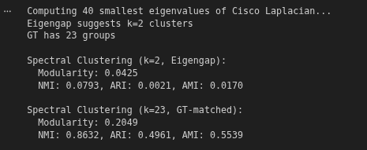
Cisco

