Slide 1
AWS – S3- Simple Storage Service
VishwanaTH m s
VISHWACLOUDLAB.com

Slide 2
Agenda
Amazon S3 Concepts & Fundamentals
Versioning & Cross-Region replication
Encryption and Security Features
Time-Limited Access to Objects
Namespaces
Access Controls
Storage Classes
LifeCycle Rules
Website Hosting
Audit Logs

Slide 3

AWS – S3 Simple Storage service

Slide 4
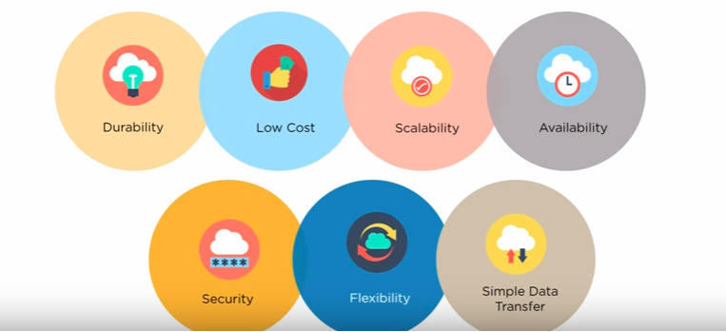
Benefits of S3

Slide 5
Use Cases
Content Storage & Distribution
Big Data Analytics
Static Website hosting
Cloud-native Application Data
Disaster recovery
Backup & Archiving
Accessed via API’s

Slide 6
Concepts of S3
Bucket
It is like a Containers
Bucket name has to be UNIQUE across all the regions of AWS and all accounts.
Eg:- Like your Gmail ID
By Default max of 100 Buckets can be create per Account.
Each Object has an limitation of 5TB.
Objects
Entities Stored in S3
Consist of Data and Metadata
Metadata is a set of name-value pairs that describe the object
Object is uniquely identified within a bucket by a Key and a Version ID.
Files and Folders can be uploaded and downloaded Directly from the Web links.
There is no Dedicated instance created for storing the data.
Buckets are created on Region Level.

Slide 7
Storage Classes: Comparing Durability and Availability
Storage Class | Durability (designed for) | Availability (designed for) | Other Considerations
STANDARD | 99.999999999% | 99.99% | None
STANDARD_IA | 99.999999999% | 99.9% | There is a retrieval fee for STANDARD_IA objects. This class is most suitable for infrequently accessed data.
ONEZONE_IA | 99.999999999% | 99.5% | Not resilient to the loss of the Availability Zone.
GLACIER | 99.999999999% | 99.99% (after you restore objects) | GLACIER objects are not available for real-time access. You must first restore archived objects before you can access them
RRS | 99.99% | 99.99% | None

Slide 8
Storage Class Pricing
Storage Class | Pricing
S3 Standard Storage | $0.023 Per GB
S3 Standard Storage – IA | $0.0125 Per GB
S3 – One – Zone - IA | $0.01 Per GB

Slide 9
Options in S3
Can Enable Versioning
Encryptions – AWS or KMS
Read/Write access to the Bucket
Read/Write access to the Files
Server Logging

Slide 10
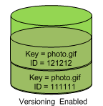
Versioning & Cross-Region replication
Versioning is a means of keeping multiple variants of an object in the same bucket.
Versioning is enabled on the bucket level.
Amazon S3 automatically generates a unique version ID for the object being stored.

Slide 11
AWS – S3 – Web Hosting

Slide 12
2 Types of Hosting is available
Client based Hosting
Server based Hosting

Slide 13
Client based Hosting
Web Server
The website page gets downloaded to the Laptop
Then the page is proceed and shown on the screen.
Typical example
Html pages
Videos
Audios
Means, the data is only stored in the central webserver
Processing of that data happens on the machine that is accessing it
Laptop
Website

Slide 14
Server based Hosting
Web Server
The script file is processed on the server itself
Only the output is sent to the machine that is accessing it.
Typical example
Java based
.net
Python
php
Laptop
WEB Page

Slide 15
S3- Web Hosting
You can host a static website on Amazon Simple Storage Service (Amazon S3)
They might also contain client-side scripts such HTML, Node.js.
Amazon S3 does not support server-side scripting such as such as PHP, JSP, or ASP.NET.

Slide 16
AWS – S3 – Replication

Slide 17
S3 – Replication – Use Case
To Maintain Audit compliance
As a DR/BCP Plan, customer might need data to be replicated in different location.
To Give users a local access within that country for a faster access.

Slide 18
S3- Replication
It is a copy of the existing S3 Bucket
Replication of S3 bucket CAN be done in the same Region or Diff region.
Either complete Bucket can be replicated or based on some “Prefix” values data can be replicated.
Replication can be done to a Different Account S3 Bucket as well.
Create a Bucket Policy on the destination Bucket to allow the source aws account to copy the data.
Replication is a backup of the Source Bucket.
If the file is deleted on the Source bucket , it would NOT be deleted on the destination bucket automatically.
Replication is effective to the files uploaded after Enabling the Replication feature

Slide 19
S3 – Replication - Pricing
Cross-Region Replication Pricing
You pay the Amazon S3 charges for
Storage
Requests
Inter-region data transfer for the replicated copy of data in addition to the storage charges for the primary copy.
Pricing for the replicated copy of storage is based on the destination region, while pricing for requests and inter-region data transfer are based on the source region.

Slide 20

AWS – Glacier

Slide 21
S3 - Lifecycle
3 Types of LifeCycle of S3 Bucket
The Data in S3 Can be moved to “Standard –IA”
The Data in S3 Can be moved to “Once-Zone – IA”
The Data in S3 Can be Archived(moved and OFFline data) to “Glacier”
To transition the data to “Standard-IA” and “one-Zone-IA”, the data has to be min of “30” days old.
To Archive the data to Glacier, the data can be min of “1” day old
We can apply the rules either on “Current Version” or “Previous Version’s” of the files.
Once the data is set to expire, we cannot RETRIVE the data after it is deleted.

Slide 22
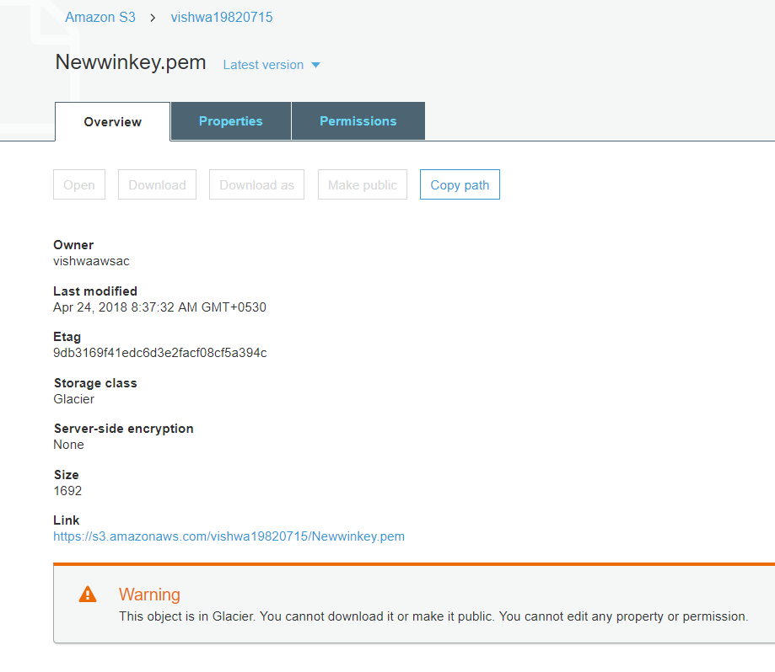
S3 – LifeCycle – Glacier – Output

Slide 23
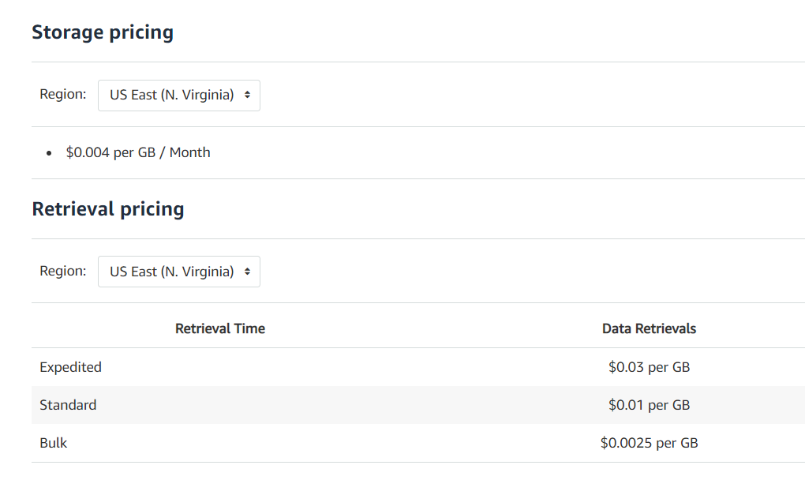
Glacier - Pricing

Slide 24
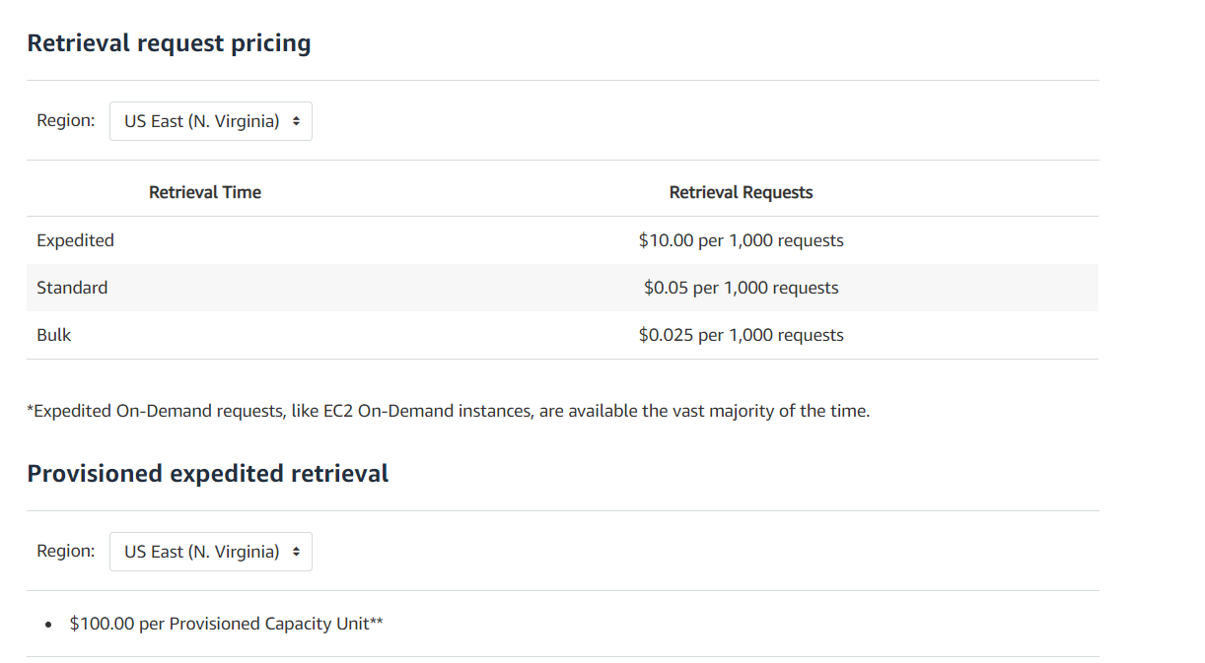

Slide 25
180 days
365*5 days
Data in Standard class
Data in Glacier class
Data to Expire

Slide 26


