Slide 1







Analyzing stack overflow developer survey
Nimanthi Yaseema
September 02, 2023

Slide 2



OUTLINE
Executive Summary
Introduction
Methodology
Results
Visualization – Charts
Dashboard
Discussion
Findings & Implications
Conclusion
Appendix

Slide 3

EXECUTIVE SUMMARY
In this project, we analyze data to help identify future skill requirements in the IT field.
We have two data sets based on technologies and demographics. Using the technology data, we analyze to identify present and future trends of technology. From demographics data, we identify technology insights based on gender, age, locations and education levels.
We visualize our results using IBM Cognos Dashboard Embedded platform and created three different dashboard tabs, i.e., current data technologies, future data technologies and demographics of respondents.

Slide 4

INTRODUCTION
To Visualize the data ,dashboards were created to emphasis on the present and future trends of data technologies.
Through creating dashboards using IBM Cognos Dashboard, we would be able to visualize our data based on top 10 present and future data technology trends based on respondent gender, formal education ,age and countries. To Visualize the data ,dashboards were created to emphasis on the present and future trends of data technologies.
Through creating dashboards using IBM Cognos Dashboard, we would be able to visualize our data based on top 10 present and future data technology trends based on respondent gender, formal education ,age and countries.

Slide 5

METHODOLOGY
Using Webscraping
Exploring Data
We collected data using APIs and Webscraping methods. After data wrangling process, we analyze the data and determine distribution, outliers and correlation.
A modified subset of Stack Overflow data consisting of two data sets based on the demographics and data technologies were used to visualize the present and future data trends based on their demographics.
• IBM Cognos Analytics was used to create different dashboards.

Slide 6
RESULTS
The data was collected from stack overflow blog under Open Database License .
• It consisted of two data sets :
• Survey data technology normalized consisted of approximately 75K respondents querying them about the present and future data technologies interest . Then using visualization tools such as bar, columns graphs along with tree maps and hierarchy trees were used to analysis the top trending present and future technologies trends.
• Survey data demographics was more clustered data set a which involved around 11K respondents answering about various demographics questions such as country , age, education level, ethnicity, gender etc. The results of these finding were visualized in form of bar ,line charts along with maps.

Slide 7
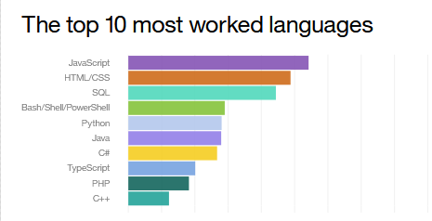
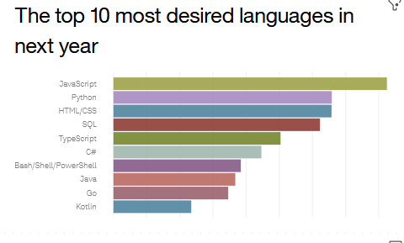
PROGRAMMING LANGUAGE TRENDS
Current Year
Next Year
<Bar chart of top 10 programming languages for the current year goes here.>
< Bar chart of top 10 programming languages for the next year goes here.>

Slide 8
PROGRAMMING LANGUAGE TRENDS - FINDINGS & IMPLICATIONS
Findings
JavaScript and HTML were the languages that were preferred and will continue to dominate in future too.
They were further followed by SQL, Bash, and Python for current trends, but they may not be the next go to languages in future.
Implications
The job market would see a higher influx of JavaScript and HTML engineer.
This may decrease the present high demand of such developer and we may see a saturation point in coming years.

Slide 9
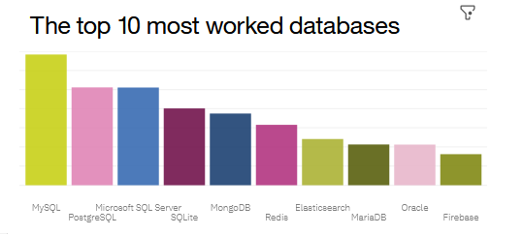
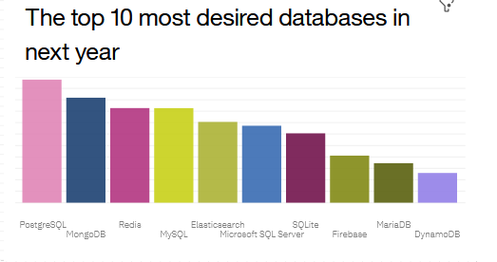
DATABASE TRENDS
Current Year
Next Year
< Bar chart of top 10 databases for the current year goes here >
< Bar chart of top 10 databases for the next year goes here.>

Slide 10
DATABASE TRENDS - FINDINGS & IMPLICATIONS
Findings
My SQL dominates the Database platform preferred by developers but in next few years we may see a steep decline in its preferences.
MongoDB would be the database platform which would be most preferred Database platform to be preferred in future.
Implications
We may see more organization preferring to work with MongoDB and PostgreSQL, as the popularity of them may increase in coming years.
MySQL may reach a saturation point and wouldn’t be sufficient to give you an edge over others in term of skills

Slide 11

DASHBOARD
https://dataplatform.cloud.ibm.com/dashboards/a2988373-42c5-44b9-973b-8e6a81012f81/view/0023c1046e8a109f63cfc4e407902e5378662459b0bb8a57d3827b490d692297a8681a99c87c4b0bde400165a5ba100ccf

Slide 12
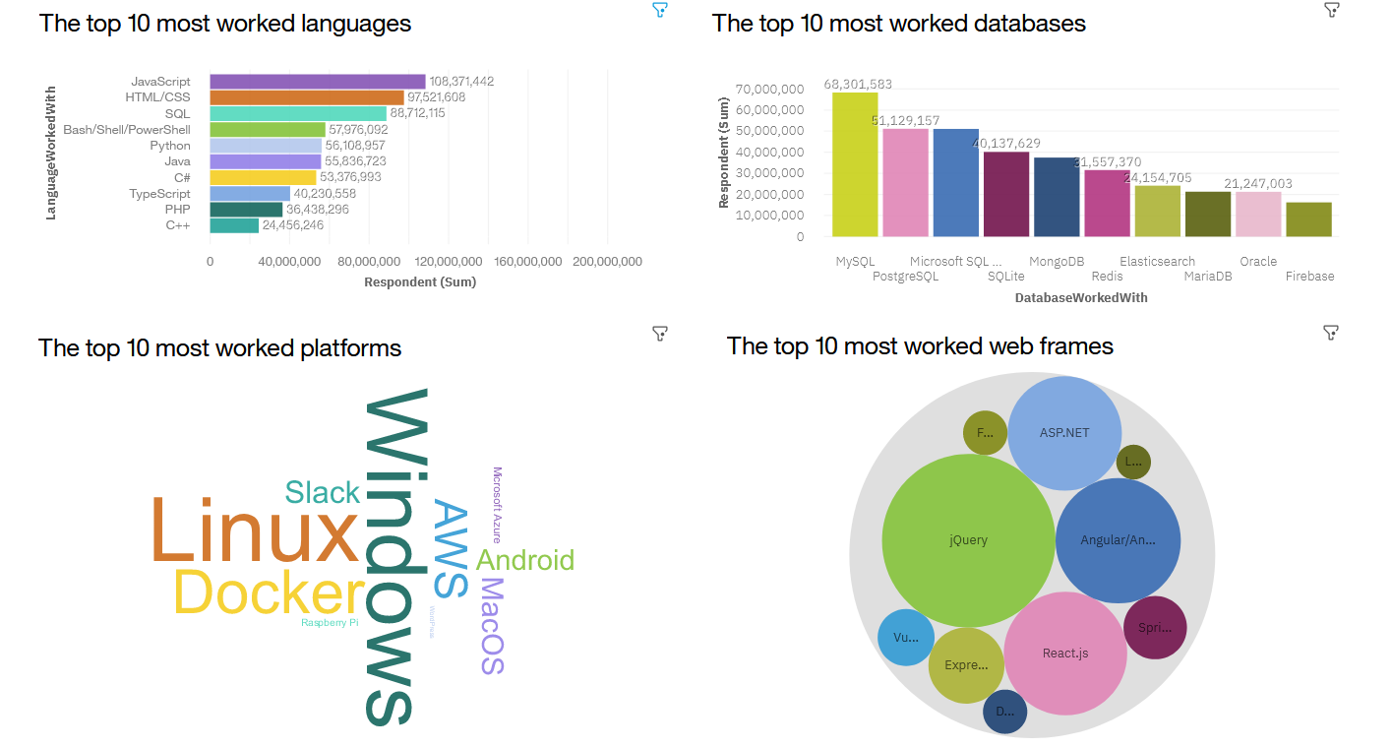
DASHBOARD TAB 1
Screenshot of dashboard tab 1 goes here

Slide 13
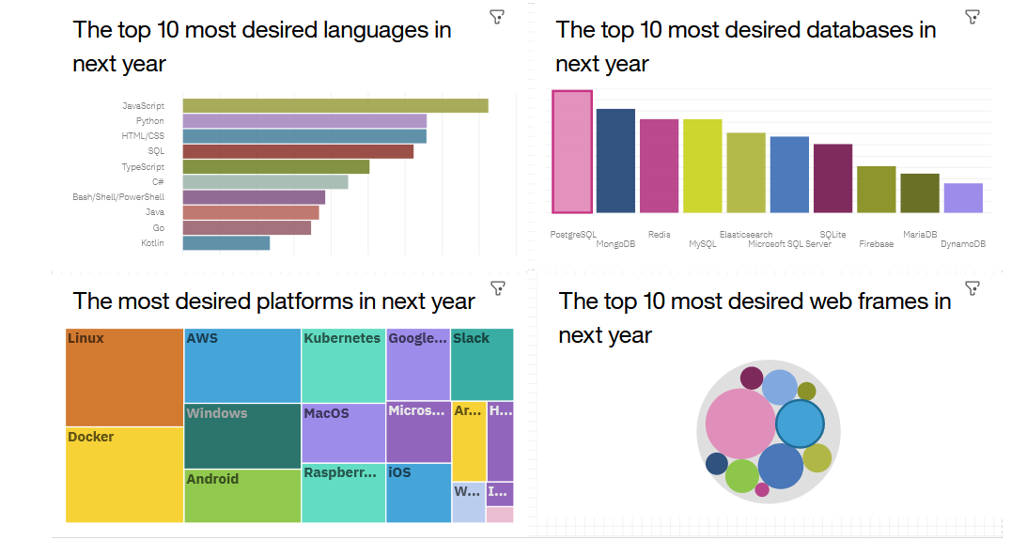
DASHBOARD TAB 2
Screenshot of dashboard tab 2 goes here

Slide 14
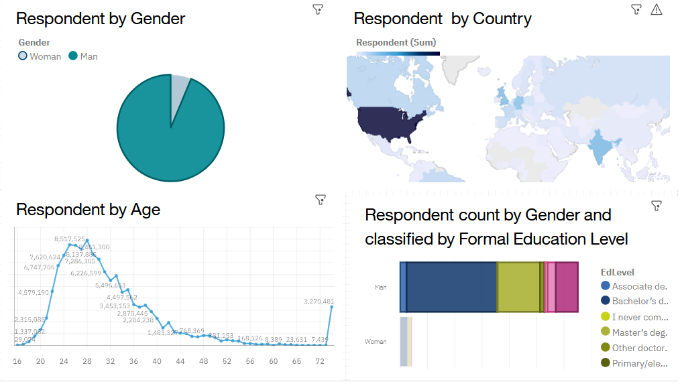
DASHBOARD TAB 3
Screenshot of dashboard tab 3 goes here

Slide 15
DISCUSSION
Languages: Will SQL and Python tend to loose it dominance in upcoming years? Will other languages such as Go, C# would be the new emerging languages of future?

Slide 16
OVERALL FINDINGS & IMPLICATIONS
Findings
The database technologies surveys results are dominated by male population, majority of them being USA respondents.
• Bachelor's and Master’s students highly prefer doing specialization in data technology.
Implications
The database technologies surveys results are dominated by male population, majority of them being USA respondents.
• Bachelor's and Master’s students highly prefer doing specialization in data technology.

Slide 17

CONCLUSION
We wanted to analyze the dataset for the preferred current and future trends in data technology while also considering the demographics of the respondent.
• From the data visualization it is clearly visible that the data technologies trends are preferred by population b/w 21 to 36 years
• It has a wider acceptance among male as compared to women.
• Among the languages , HTML and JavaScript will remain the most preferred languages to be worked with.
• Among the Database, we may see the popularity of SQL decreasing and which may be replaced by MongoDB and PostgreSQL

Slide 18

APPENDIX
Resources used: Database taken from: Stack overflow blog under ODbl: Open Database License. IBM Cognos dashboard were used for creating Dashboards

Slide 19
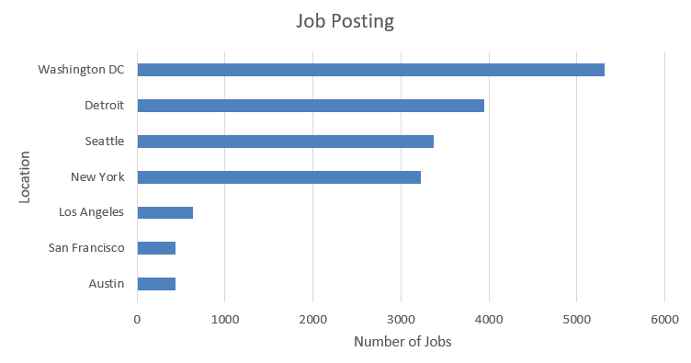
JOB POSTINGS
In Module 1 you have collected the job posting data using Job API in a file named “job-postings.xlsx”. Present that data using a bar chart here. Order the bar chart in the descending order of the number of job postings.

Slide 20
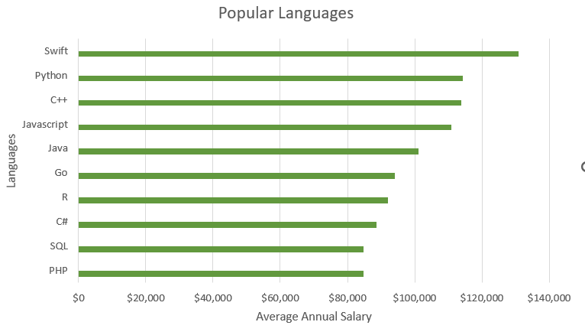
POPULAR LANGUAGES
In Module 1 you have collected the job postings data using web scraping in a file named “popular-languages.csv”. Present that data using a bar chart here. Order the bar chart in the descending order of salary.

