Slide 1
CSE 437 — Machine Learning Project
Predicting Malignant vs. Benign
Breast Tumors from Cell Nuclei Features
Group 10
Naim Mahmud Peyas 22301646
Waess Karnee 23301454
Samin Safwan 23301388

Slide 2
Project Workflow
From raw diagnostic measurements to a trained classifier
Raw Data
Cleaning
EDA & t-tests
Standardize
PCA
Model
Training
Evaluation
569 samples,
30 nuclei features
Drop id / empty col,
encode diagnosis
Distributions,
correlation, significance
Z-score scaling
of all features
10 components
explain 95% variance
Logistic Regression,
Decision Tree & RF
Compare accuracy for
all 3 models; deeper
metrics for the best
Data preparation → cleaning, EDA and statistical testing confirm which features separate the classes.
Modeling → standardized features are compressed with PCA, then classified with three models — Logistic Regression, Decision Tree, and Random Forest — compared on a held-out test set.
Dataset: Breast Cancer Wisconsin (Diagnostic) — 357 benign, 212 malignant samples, 30 real-valued nuclei features (radius, texture, perimeter, area, smoothness, etc.), each measured as mean, standard error, and "worst" value.

Slide 3
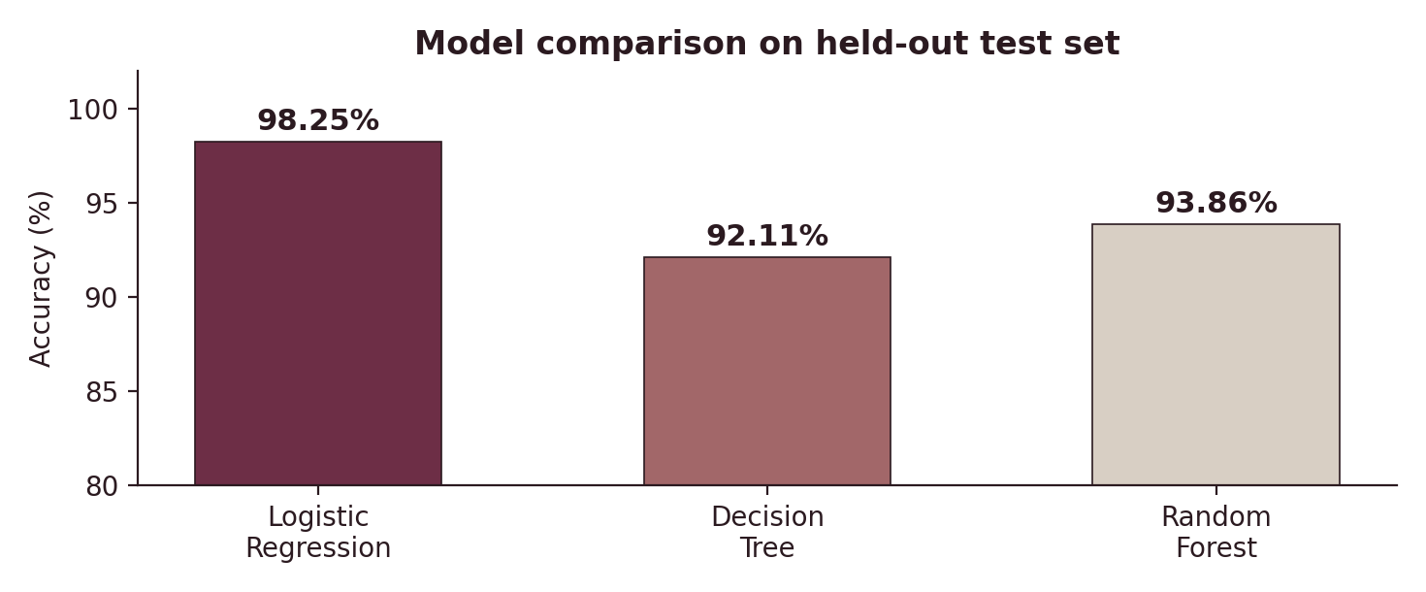
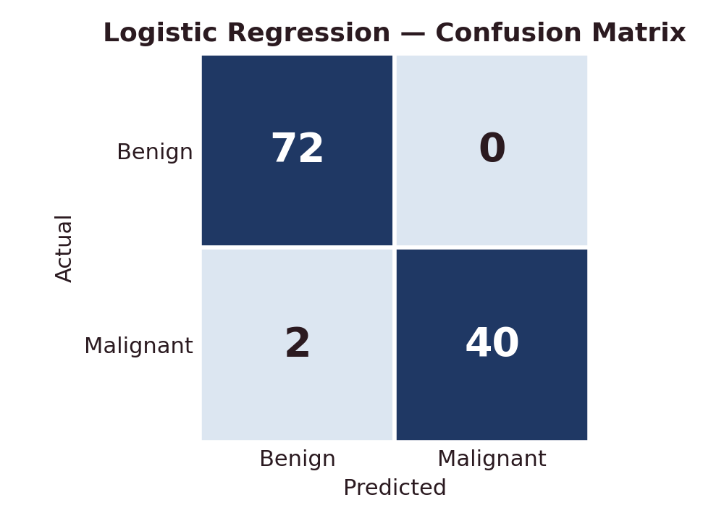
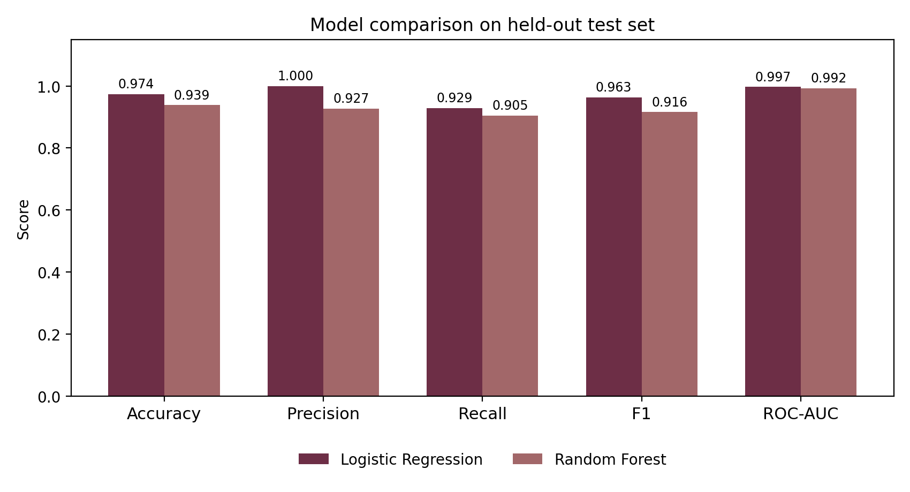
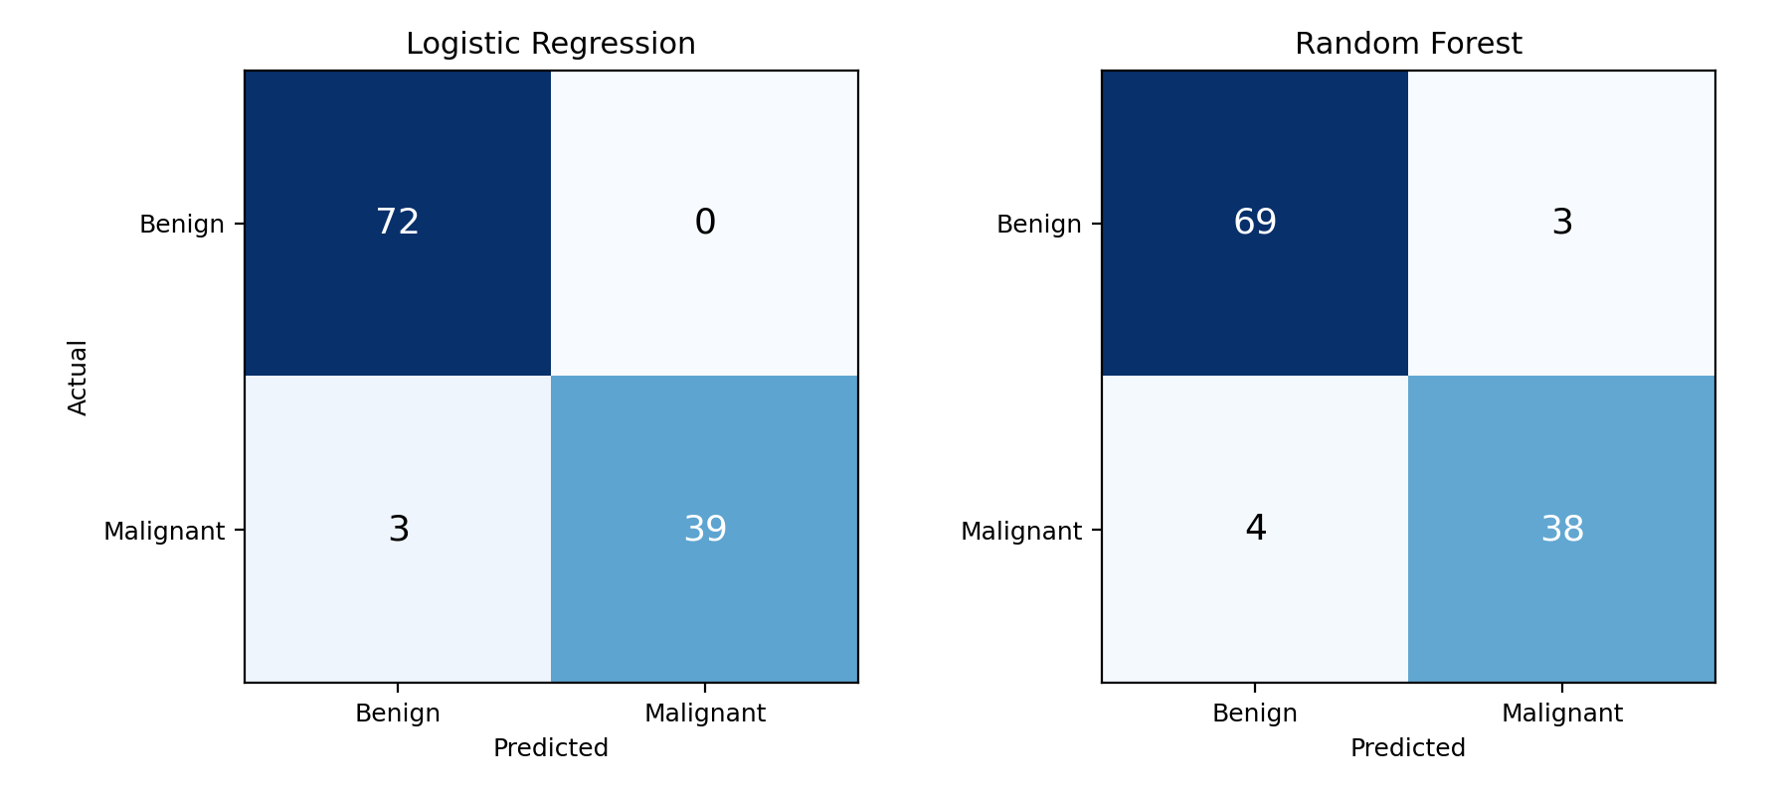
Results
Three models compared on PCA-reduced features, evaluated on a 20% held-out test set
Metric
Log. Reg.
Decision Tree
Accuracy
98.25%
92.11%
Precision
1.00
—
Recall
0.95
—
F1-score
0.98
—
Random Forest (Acc.)
93.86%
—
Logistic Regression achieves the highest accuracy among all three models (98.25%), with perfect malignant precision (1.00) and strong recall (0.95). Detailed precision/recall/F1 were computed only for the top model.

