Slide 1

Laptop Assembly Optimization
In GECCO 23’ Lisbon
Rachit Kumar
rachit.kumar@
pennmedicine.upenn.edu
Andrew Ciezak
andy@impv.au
Nimay Kumar
nimay.kumar@
pennmedicine.upenn.edu

Slide 2
Overview
Problem Definition and Instances
Modeling Approach 1: Local Search
Modeling Approach 2: Constructive Search
Additional Considerations
Future Steps
Conclusions and Final Thoughts

Slide 3

Problem Definition
Single assembly line
Sequential build process
Different part quantities in different laptops
Spread parts uniformly over construction

Slide 4
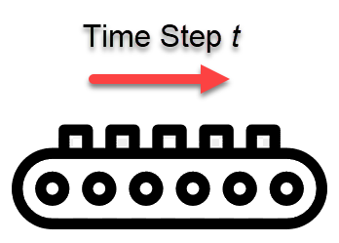
Problem Definition
P part types; M laptop models
Quantity d_{m} of each model m to be built
One laptop built during each time step t in T timesteps
Black-box Combinatorial Problem
Question:
In which order should the various units of the different models be assembled in order to achieve a smooth flow of parts to the cell?

Slide 5
Problem Definition
Objective
Determine uniform rate for parts at each timestep
Aim to minimize deviation from uniform rate at each timestep for each part
Error is accumulated at each timestep

Slide 6
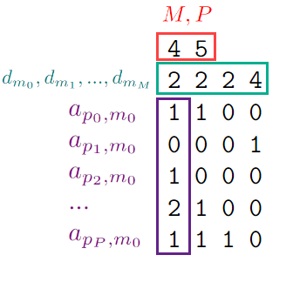



Problem Instance
is the number of laptop types
is the number of different parts
is the P x M matrix specifying
the number of each part in each model

Slide 7
Modelling Approaches
Approach 1: Constructive Search
Approach 2: Local Search

Slide 8



Solution Representation
Consisting of a vector such that
Values are not unique, rather repeated number of times

Slide 9
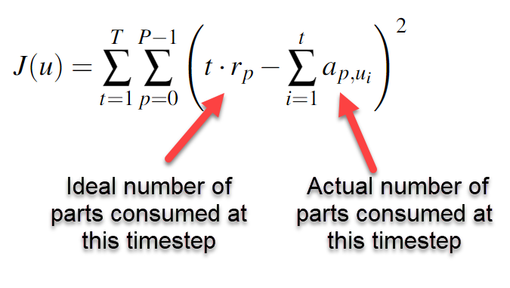

Objective Function

Slide 10
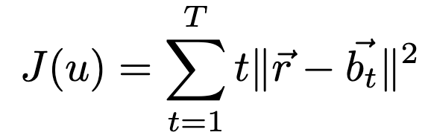
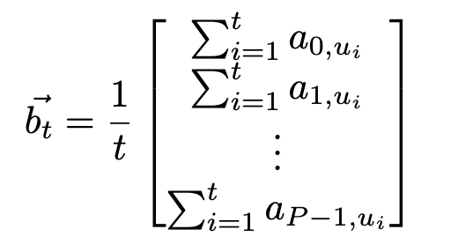
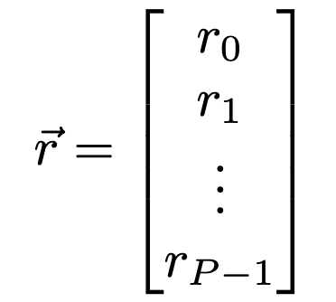
Vectorized Objective Function

Slide 11
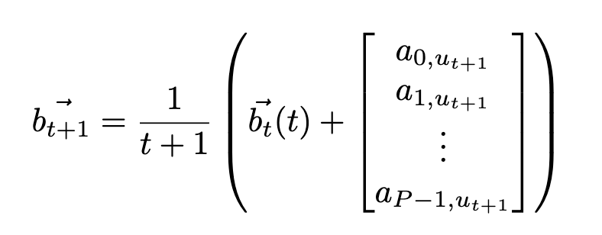
Vectorized Objective Function
Can compute future values by considering time point components
Has future implications for both constructive & local searches

Slide 12
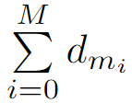
Approach 1: Constructive Search
Choices: each model in the set of unbuilt models
Heuristic (greedy): add model index that minimizes error at next step
Feasible solution: sequence of indices of length
Where all requested models are built
Summary: build a model (from remaining laptops) that brings us closest to the target rates for each part to add to solution

Slide 13
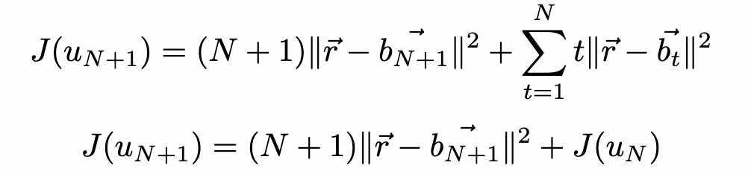
Approach 1: Calculating Objective
Recall: objective is a summation over timesteps
Adding a model to the sequence does not change prior timesteps
Computation of objective:
Take objective to prior timestep and add value computed at new timepoint
N is the length of infeasible solution u_{N}

Slide 14




Approach 2: Local Search
Idea: given feasible solution sequence , swap some to reduce objective
Observation: swapping does not change the objective value for
Need only compute objective for

Slide 15
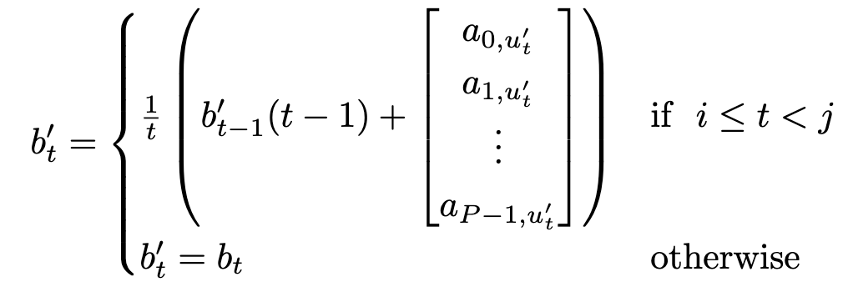
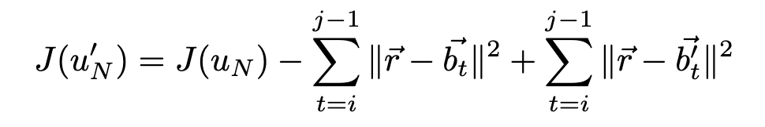
Approach 2: Calculating Objective
Cumulative part numbers only change for
Store component of objective at each timepoint (memoization)
Computation of objective:
Recompute relevant time points and then sum over components
u' is sequence after swapping
Elements can be stored from prior computations
Notes:
Nimay starts presenting here`

Slide 16


Additional Considerations
Local search
Possible consideration 1: swap only adjacent pairs
Possible consideration 2: reduce set of moves to those that improve objective
Constructive search: identify part that diverges most from expected
-
"Mutations" will often create infeasible solutions
Sequence needs to account for number of requested models

Slide 17
Future Steps
Possible heuristics for choosing good swaps
Identify "timepoints of greatest divergence"
Removal of components from a sequence to be considered
Removal from end trivial (same approach as adding)
Removal from within sequence less trivial
Code implementation that takes advantage of both approaches

Slide 18
Conclusion and Final Thoughts
Did not have bandwidth to implement code, but...
Using a combination of local and constructive approaches would be ideal
Can model this problem as a temporal graph
Nodes = models
Path = sequence
Edge weights (temporal) = "cost" based on rate divergence

