Slide 1
Healthcare Information Assistant
developed by
CHETAN CHAUDHARY
NITESH SRIVASTAVA
Students of IIT PATNA
A tool that assists users in understanding medical information. The interface could allow users to input symptoms, and the system could provide information on potential health issues, treatment options, and preventive measures in an easy-to-understand format.

Slide 2
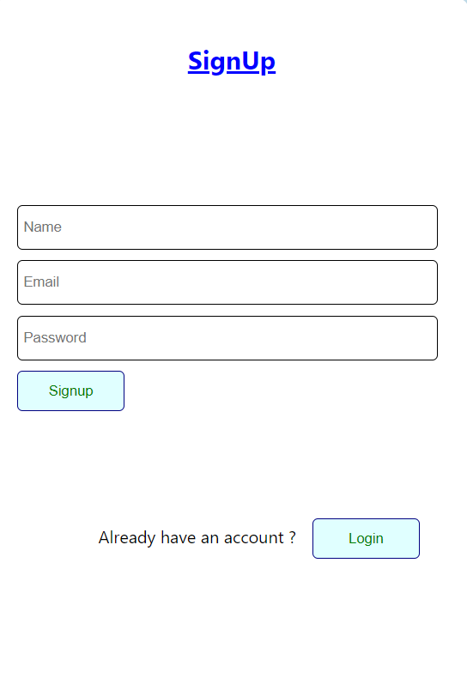
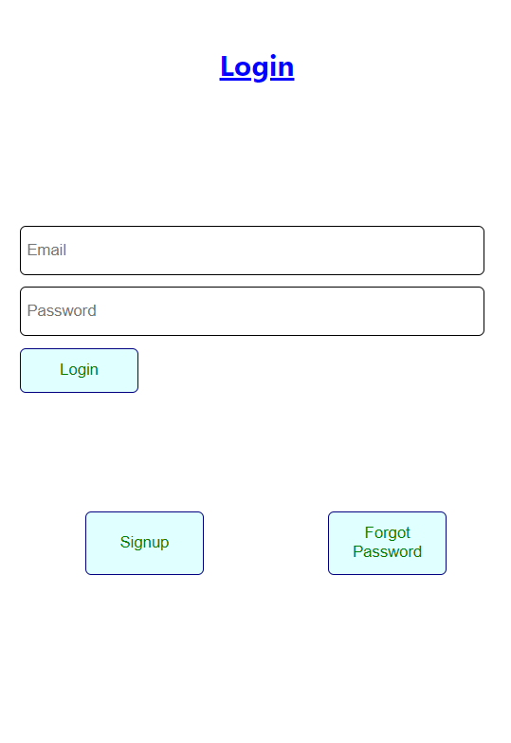
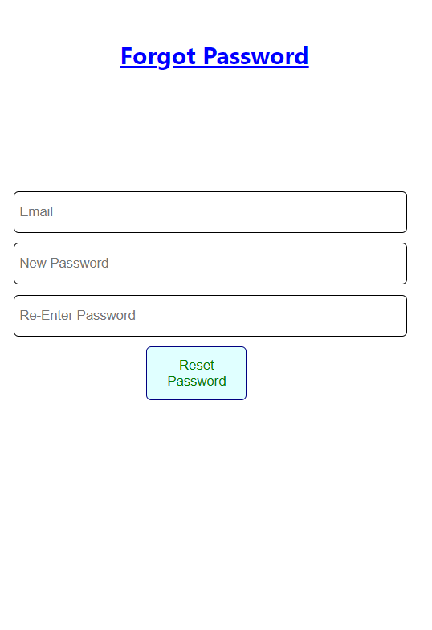
We have made signup page with confirming the email through a verification link. And then user login after successfully verified and also added the reset password availability.
Technologies Used – ReactJS , NodeJS , MongoDB, ExpressJS

Slide 3
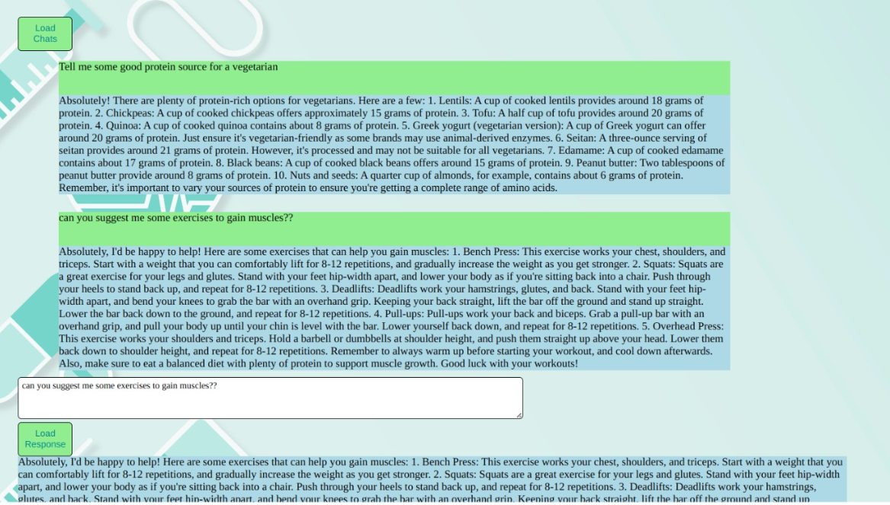
Healthcare Assistant Application using the Mixtral 8x7b Model:
Here you load your previous chats , delete chats and saved chats and load new response using model api.
You can successfully login and logout.

