Slide 1

Capturing Africa’s GovTech Wave Together
eGov <> Africom <> Orbit Partnership Discussion

Slide 2



Regional Demand is growing across countries
GovTech is the Fastest-Growing Vertical in Africa
Every major East African country has an active national digitization mandate: Ethiopia's Digital Ethiopia 2030, Kenya's Digital Economy Blueprint, Rwanda's Smart Rwanda, Uganda's Digital Vision — the demand is regional and simultaneous
The African Union's DPI commitments are aligning national digitisation agendas across the continent
Capital Inflow into the vertical
World Bank, EU, Gates Foundation, GIZ, UNDP are active funders across East Africa — the capital is already flowing into GovTech
DPI Adoption is increasing
Governments across the region are benchmarking India's DPI stack - the language they're hearing from donors and advisors is DPI-native

Slide 3
Systems Integrators, with existing government relationships can ride this wave with the right offering
What’s Available Today
What governments need
Custom Builds
Rapid Deployment
12–18 month timelines, no guarantee of delivery, data silos across departments as each agency builds its own
Go-live in days, not months. Ability to share data across systems.
Foreign black-box SaaS
Control over System and Data
High Cost, Sovereignty concerns, data residency issues, not DPI and funder alignedl
Locally hosted, full control over data, path to own infrastructure.

Slide 4
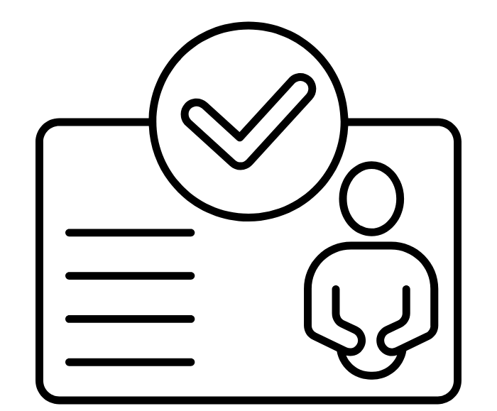

Introducing eGov SaaS Products
DIGIT License and Permit Management
DIGIT Complaints Management
First use case in <4 days
Aligned to the DPI narrative
Aligned to Sovereignty needs
Kickstart a government’s DPI journey with either Complaints Management or License and Permits on the SaaS instance with a highly configurable product
Built on the same open-source DPI used across 300M+ citizens in India and multiple LMIC governments
Governments can have full control over their data and system - Migrate out of SaaS at any point and add additional use cases on DIGIT

Slide 5
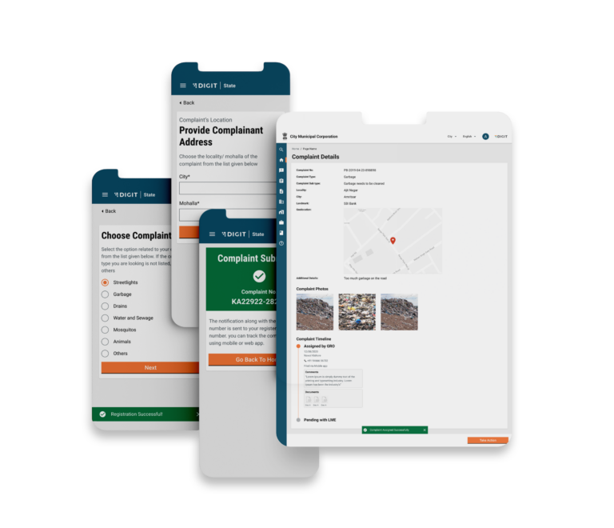
Product Offering 1
Complaints Management
Public Grievance Redressal
Incident Management
Case Management
Call Centre and IVRS Management
Emergency and Disaster Response
And more….
Improve Citizen Trust
Increase Employee Efficiency
Enhance Governance
- File issues anytime, anywhere
- Get proactively notified on status
- Accessible by all
- Clarity on the tasks and issues to be prioritised
- Digital system to provide proof of work
- Access to Real time data
- Easy view into recurring problem areas

Slide 6
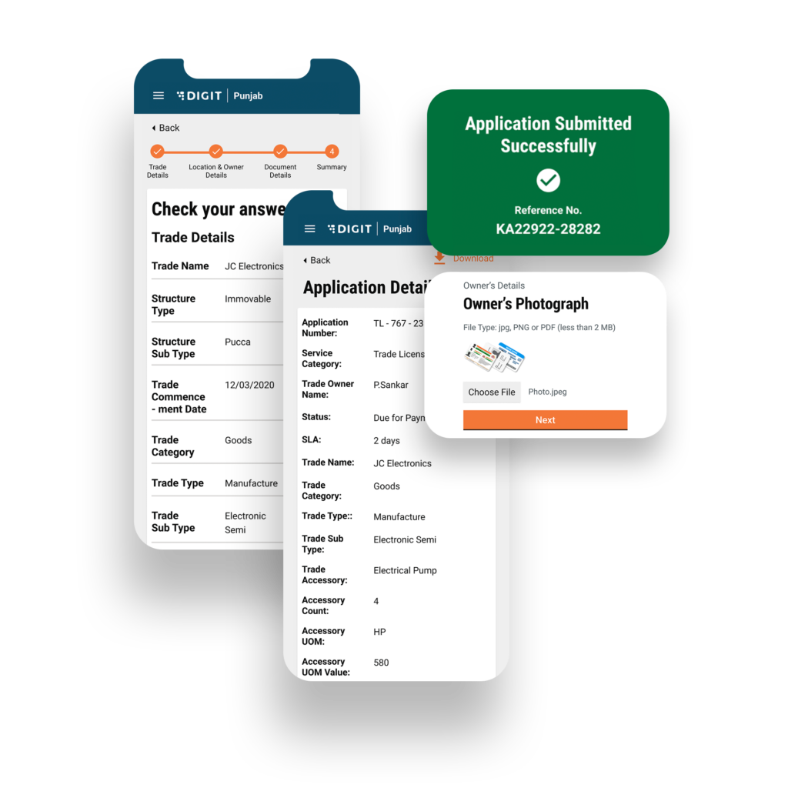
Product Offering 2
License and Permits
Business License
Building Permits
Fire Safety (NOC)
And more….
Road Digging Permits
Birth and Death Certificates
Zoning Permits
Improve Efficiency
Increase Revenue
Improve Trust in Certificates
- Keep a chain of custody from application to issuance
-Automated of common process steps such as fee calculation, issuance of certificates etc
- Improve ease of applications and processing, reducing non compliance
- Track revenwals and non payments
- Powered by Verifiable Credentials, allowing the ecosystem to verify authenticity

Slide 7






Revenue streams you unlock as a hosting partner
SaaS licensing margin
Recurring subscription revenue per government client/department onboarded
Support & maintenance
Ongoing managed services contract per instance
Infrastructure migration Governments s
cale and want to move to their own infra, you deliver and charge for the migration
Plugins & extensions Standardized extensions built once, reused and charged across multiple SaaS instances
Configuration services
Each new ministry onboarding requires setup; this is a billable engagement
Training
Government staff training per deployment

Slide 8
Policy window is open
Digital Ethiopia 2030 calls for digitizing priority public services. Licensing/Complaints management are both high impact and visibility use cases
Why Ethiopia is the Right Starting Point
Institutional momentum
The Ethiopian Digital Economy Council (EDC) is actively steering digital initiatives. 800 services are already digitized via the Mesob One Stop Service pilot — there is appetite and precedent.
Funding is available
World Bank, EU, GIZ, Gates Foundation, UNDP are all active in Ethiopia and funding similar projects in other countries.
Ethiopia isn't the whole story - it's the best first chapter.
Scale of the market alone
134M people, 12 regions, 2 administrative cities, hundreds of departments
eGov and DIGIT is already in Ethiopia
Active engagement with Ministry of Health, Ministry of Finance, Ministry of Trade and Regional Integration, Ethiopian AI Institute (MoU signed), and DIAL

Slide 9
Why DIGIT wins the conversation with a Ministry
Proven at Scale
DPI - Aligned
Managed by an incountry partner
Powers services for 300M+ citizens. Not experimental — it's a proven global standard benchmarking India's DPI model.
Built on open standards and interoperable blocks. Matches the language of donors like World Bank, GIZ, and AU.
Africom/Orbit Hosting the SaaS instance = sovereignty concerns addresed

Slide 10
The Platform Expand Path
One ministry in one country is the entry point. The ceiling is the entire region
Within Country
Across Regions
Start: One Type of License/Permit or Complaints Management
Expand: Additional Type of License/Permits
Further Expand: Migrate to government Infra, use DIGIT to build more use cases
Set up SaaS for one country
Use the same instance and playbooks in other countries
Incremental revenue, near zero product cost

Slide 11
How the partnership works
eGov brings the product, Africom brings the access
Africom/Orbit
eGov
Hosts and manages the SaaS instance
Manages government Client relationships and procurement
Provides L1 support
Delivers configuration and training locally
Owns and maintains product roadmap
Provides L2/L3 technical support
Provides support through partner sales cycles
Connects to global SI network

Slide 12
The Ask

