Slide 1
C
By - Siddhant

Slide 2
Before C
B language(1969):Added ++ ,-- and few more operators
NB Language (1971): Added types
C(1972):Added structs,logical operators , preprocessors and few more things.Renamed NB to create C

Slide 3
After C
First C Standard (1989) by ANSI : C89
C Standard (1995) by ANSI : C95
C Standard (1999) by ANSI : C99
C Standard (2011) : C11
C Standard (2017): C17
Future C Standard C (2023): C23

Slide 4
C89 Got 32 reserved keyword
C99 added five more
_Bool , _Complex , _Imaginary, inline ,restrict
C11 added seven more

Slide 5
Variables
Variable : Memory allocated
Identifier: Name of the memory
Literal : Constant value on Memory

Slide 6
Datatype
Primitive Type:
char,signed char, unsigned char : 1byte
short, signed short, unsigned short : 2 byte
signed short int, unsigned short int : 2 byte
int , unsigned int, signed int : 4 bytes
long,signed long, signed long int,unsigned long, unsigned long int : 4 bytes
long long, signed long long, unsigned long long, long long int, signed long long int, unsigned long long int : 8 bytes
float : 4 bytes
double : 8 bytes
long double : 12 bytes
void

Slide 7
Derived Data types
Array
Reference
Pointer
User Defined Data types:
Structure
Union
Enum

Slide 8
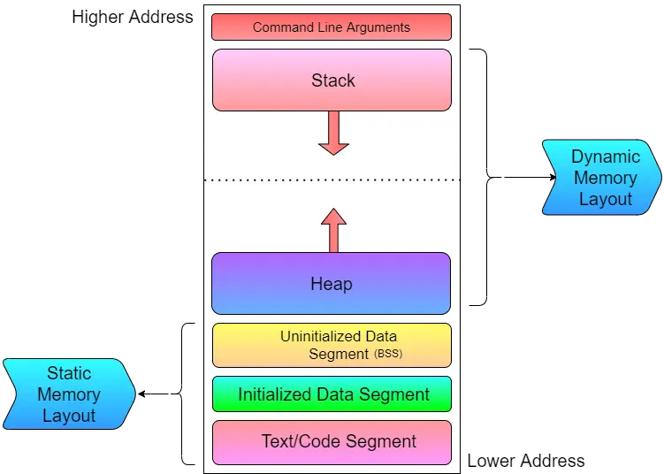
Process
Run-time of a program
Process memory layout

Slide 9
Text Segment : The text section of the program contains the executable instructions of the program. The program instruction counter is a pointer into the text section. Constants, such as the string constants of a printf() statement are also stored in the text section of memory.
Data Segment : The data section of memory if for global and static data that is initialized when declared. Since, the initial value of initialized variables is known in advance, all global or static variables are saved together in the executable file and the data block is loaded into memory directly from the executable file just like the text section.
BSS Segment : The bss section, like the data section, is for storing global and static variables. The difference being that the bss section stores variables that were not initialized to a specific value when declared. Bss data is initialized to zero when the program starts.
Heap : For Dynamic memory allocation,a continuous part of virtual address space where the allocation and de-allocation of memory can be performed in real-time.
Stack: The stack stores various pointer values which are needed for the execution of the program and also is the default storage location for variables which are local to a function, i.e., declared within the body of the function. The stack data is created when program begins a function and is destroyed when that function exits.

Slide 10
Stack
Last in first out
Every function call stored on stack
Local variable of that function also resides inside that function frame on stack
The lifetime of local variable is the lifetime of function frame
Top function frame is always being executed
Address of the top frame is stored in Stack pointer

Slide 11
Heap
Dynamic Memory allocation
malloc
calloc
realloc
free

Slide 12
File Handling
Mode
r
w
a
rb,wb,ab
r+,a+,w+
Rb+,ab+,wb+

Slide 13
Fopen
fscanf,fgets,fread
fprintf,fputs,fwrite
Fseek,rewind
fclose

Slide 14
Macros
Predefined Macros
__DATE__
__FILE__
__LINE__
__STDC__
__TIME__

Slide 15
Define with
#define MACRO_NAME VALUE

Slide 16
Storage Classes in C
auto
extern
register
static

Slide 17
Compiler Steps
Pre-processing (-E)
Removing Comments
Expand Macros
Expand Included files
Compile
Generates assembly language
Assembly
Convert to machine code
Linking
Merge All object code

Slide 18
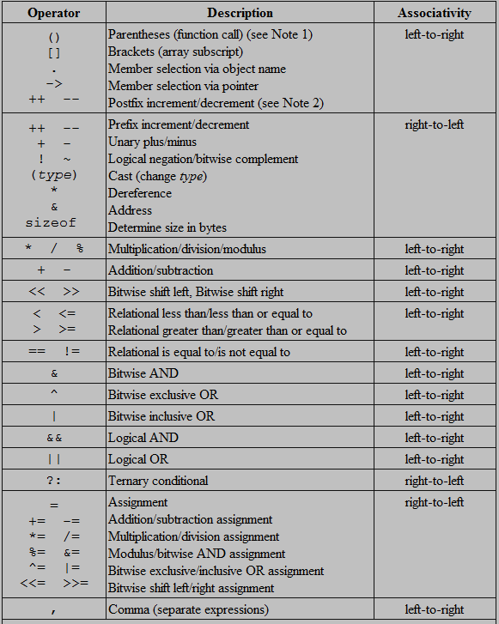
Operator Precedence

