Slide 1
Data science for dynamical system
Finding Unknown Ordinary Differential Equation (ODE)
using
Sparse Identification of Nonlinear Dynamics (SINDy)
Under the guidance of:
Prof. Dr. Sebastian Peitz
By:
Nimesh Bhavsar - 280721
Simran Arora - 281719
Shyam Gupta - 259392

Slide 2
Problem Statement
We are given a dataset of 200 noisy trajectories from an unknown 2D Ordinary Differential Equation (ODE)
The objective is to train a model to learn the underlying physics and predict system behavior.
The scope of this modeling is to forecast 100 steps within condition x0 between [-2,2]^2

Slide 3
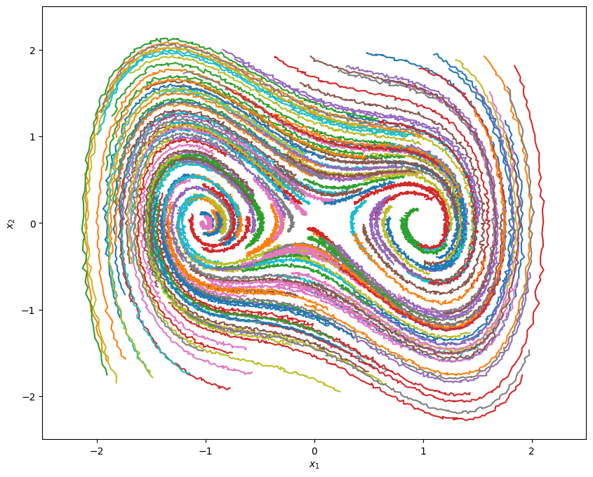
Exploratory Data Visualization
We have X_ode ∈ ℝ ^{m x N x n}
where,
m= 200 trajectory
N = 201 Step Count,
n = 2 state dimension i.e. 2D plane

Slide 4
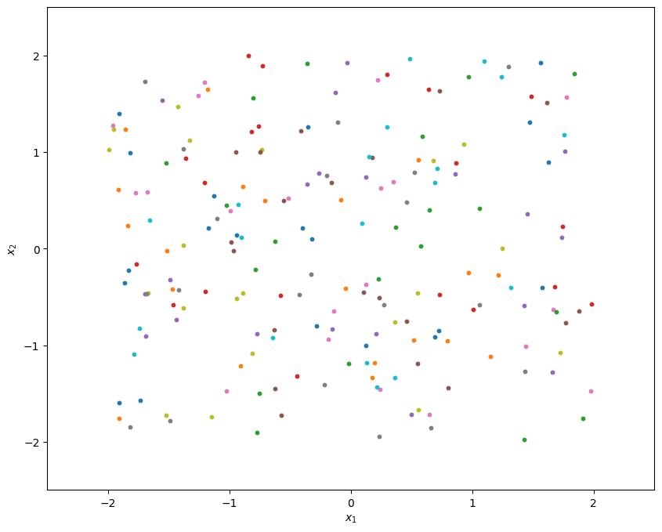
Exploratory Data Visualization
Position of Points at consecutive time stamps:
@ N=1

Slide 5
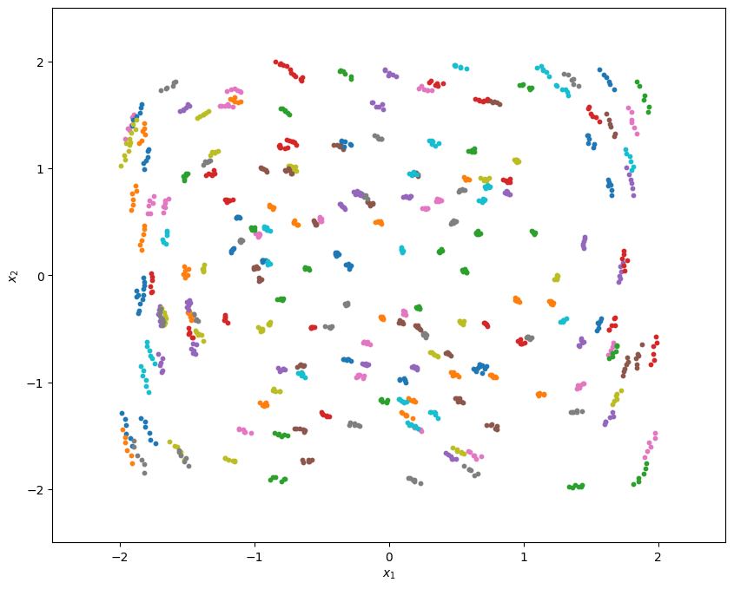
Exploratory Data Visualization
Position of Points at consecutive time stamps:
@ N=5

Slide 6
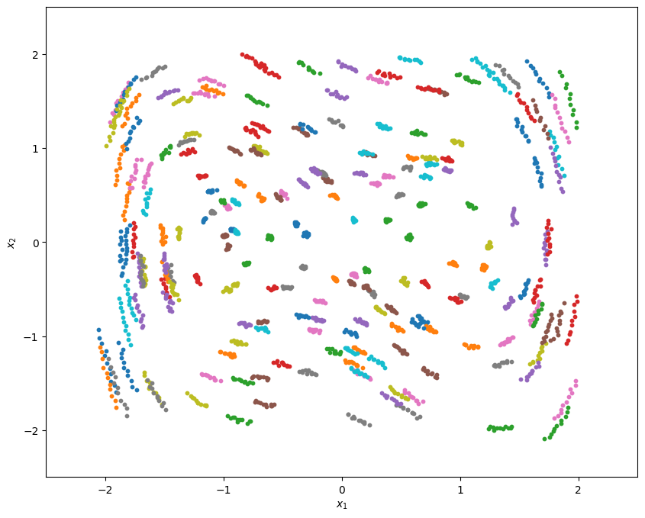
Exploratory Data Visualization
Position of Points at consecutive time stamps:
@ N=10

Slide 7
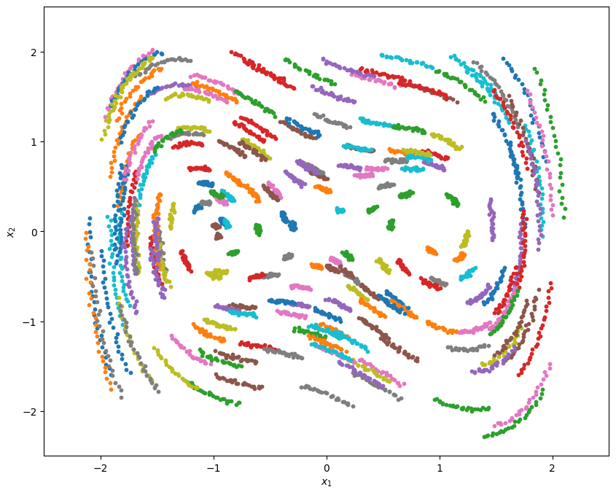
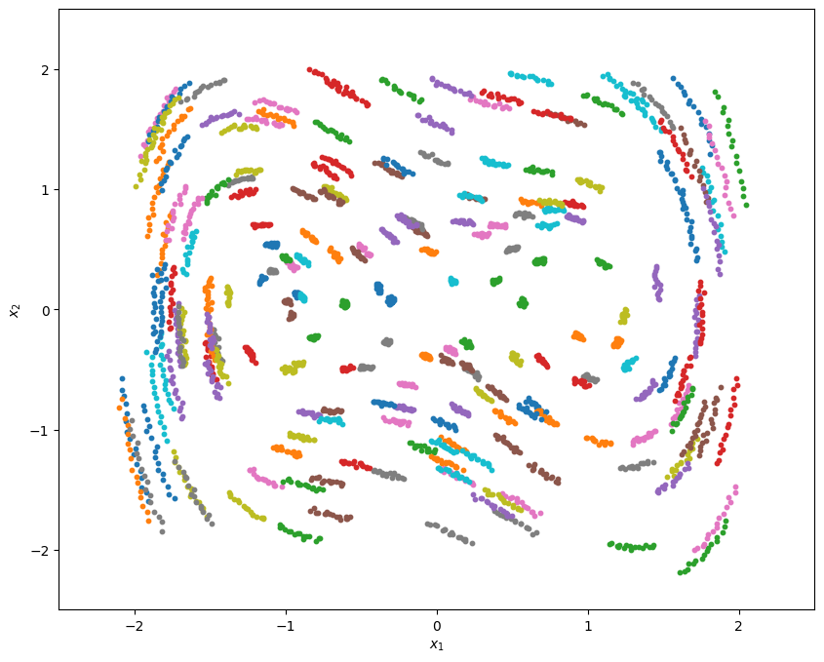
Exploratory Data Visualization
Position of Points at consecutive time stamps:
@ N=25

Slide 8
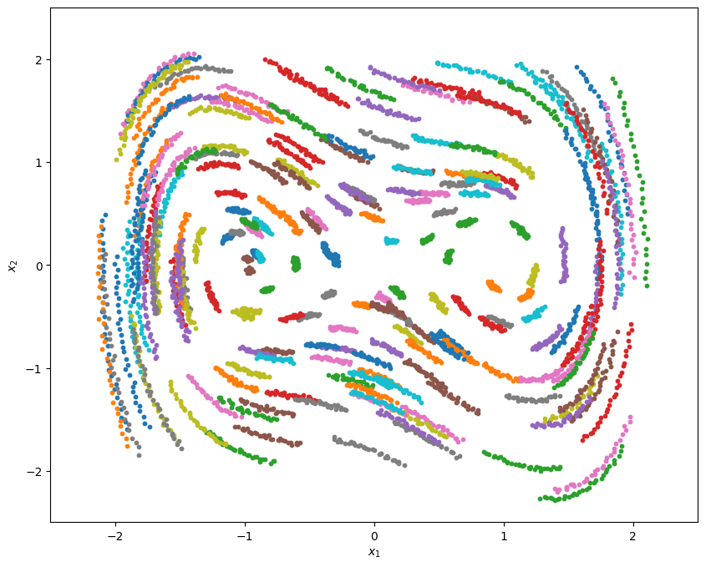
Exploratory Data Visualization
Position of Points at consecutive time stamps:
@ N=65

Slide 9
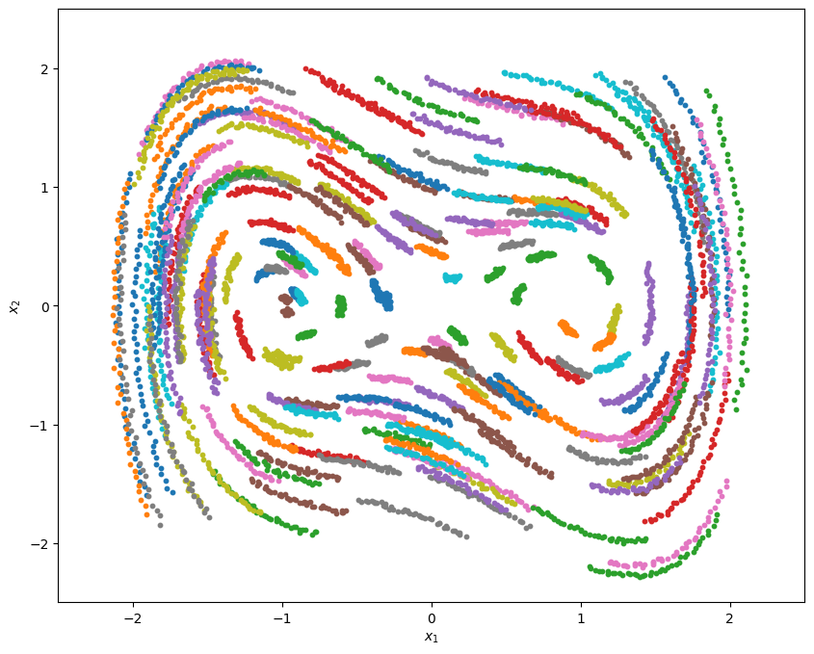
Exploratory Data Visualization
Position of Points at consecutive time stamps:
@ N=100

Slide 10
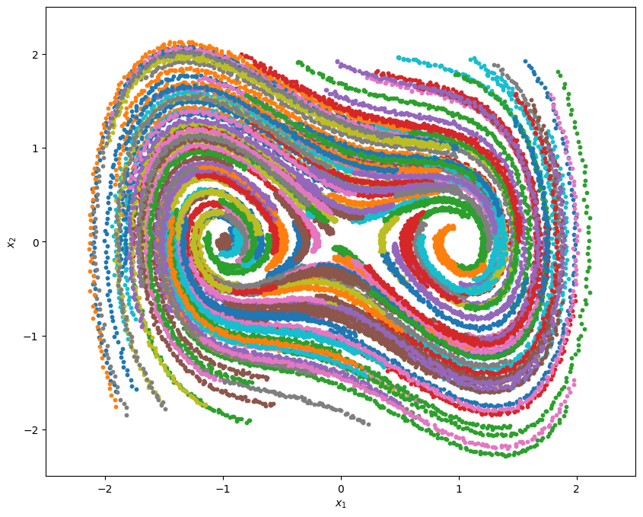
Exploratory Data Visualization
Position of Points at consecutive time stamps:
@ N=200

Slide 11
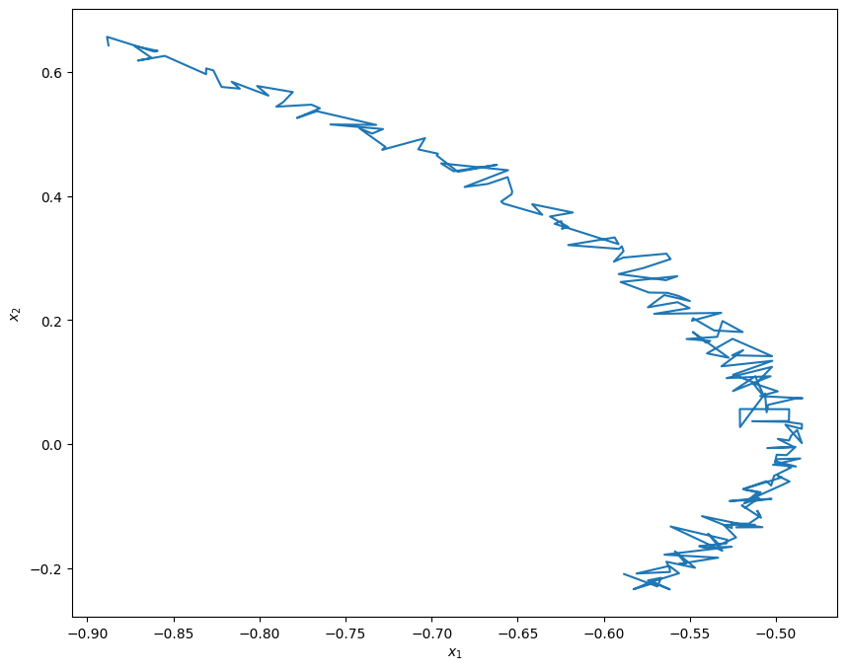
Exploratory Data Visualization
Position of Points at consecutive time stamps:
What do we see?
The trajectory is observed to be smooth and has a continuous pattern.
The pattern is observed to have a clear non-linear dynamical behavior.
Each point is travelling in inward spiral motion towards stable Equilibrium
The structure across all trajectories is consistent.
It is evident that there is Gaussian noise present in individual paths.

Slide 12
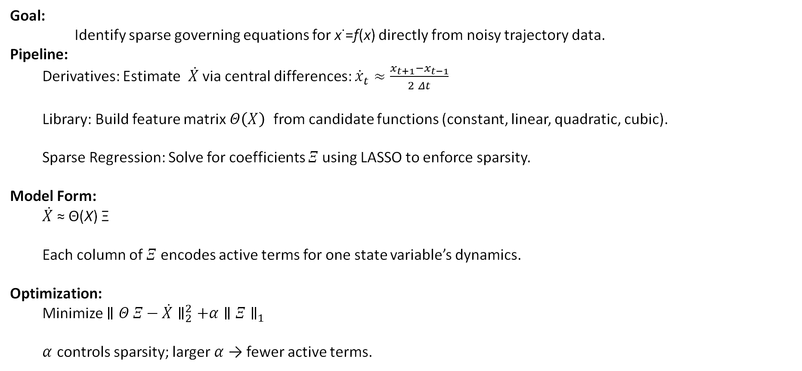
SINDy Methodology Overview
Goal:
Identify sparse governing equations for x˙=f(x) directly from noisy trajectory data.
Pipeline:
Derivatives: Estimate $\dot{X}$ via central differences: ${\dot{x}}_{t}≈\frac{x_{t+1}−x_{t−1}}{2 Δt}$
Library: Build feature matrix $Θ\left(X\right)$ from candidate functions (constant, linear, quadratic, cubic).
Sparse Regression: Solve for coefficients $Ξ$using LASSO to enforce sparsity.
Model Form:
$\dot{X}$ ≈ Θ(X) Ξ
Each column of $Ξ$ encodes active terms for one state variable’s dynamics.
Optimization:
Minimize $∥Θ Ξ−\dot{X}∥_{2}^{2}+α∥Ξ∥_{1}$
$α$ controls sparsity; larger $α$ → fewer active terms.

Slide 13
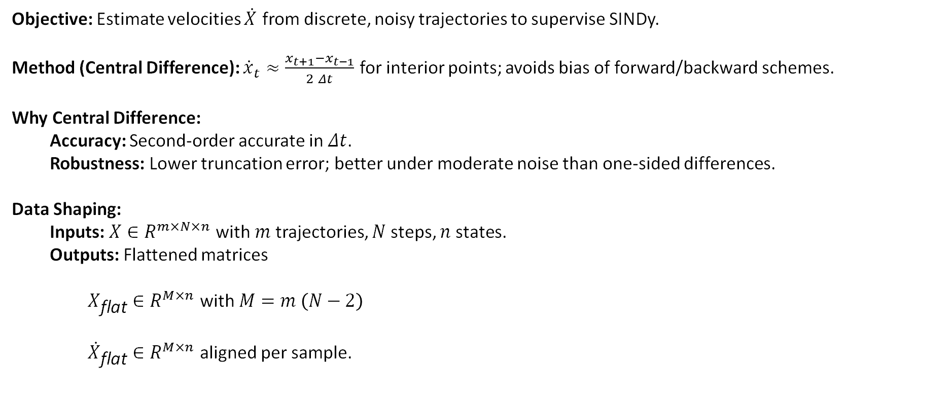
Step 1 - Derivative Estimation
Objective: Estimate velocities $\dot{X}$ from discrete, noisy trajectories to supervise SINDy.
Method (Central Difference): ${\dot{x}}_{t}≈\frac{x_{t+1}−x_{t−1}}{2 Δt}$ for interior points; avoids bias of forward/backward schemes.
Why Central Difference:
Accuracy: Second-order accurate in $Δt$.
Robustness: Lower truncation error; better under moderate noise than one-sided differences.
Data Shaping:
Inputs: $X∈R^{m×N×n}$ with $m$ trajectories, $N$ steps, $n$ states.
Outputs: Flattened matrices
$X_{\text{flat}}∈R^{M×n}$ with $M=m \left(N−2\right)$
${\dot{X}}_{\text{flat}}∈R^{M×n}$ aligned per sample.

Slide 14
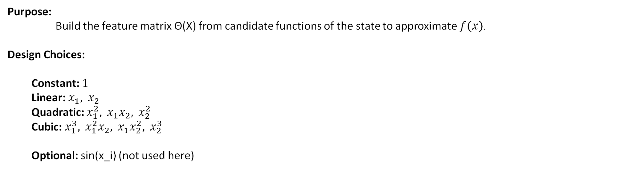
Step 2 - Library Construction
Purpose:
Build the feature matrix Θ(X) from candidate functions of the state to approximate $f\left(x\right)$.
Design Choices:
Constant: $1$
Linear: $x_{1}, x_{2}$
Quadratic: $x_{1}^{2}, x_{1}x_{2}, x_{2}^{2}$
Cubic: $x_{1}^{3}, x_{1}^{2}x_{2}, x_{1}x_{2}^{2}, x_{2}^{3}$
Optional: sin(x_i) (not used here)

Slide 15
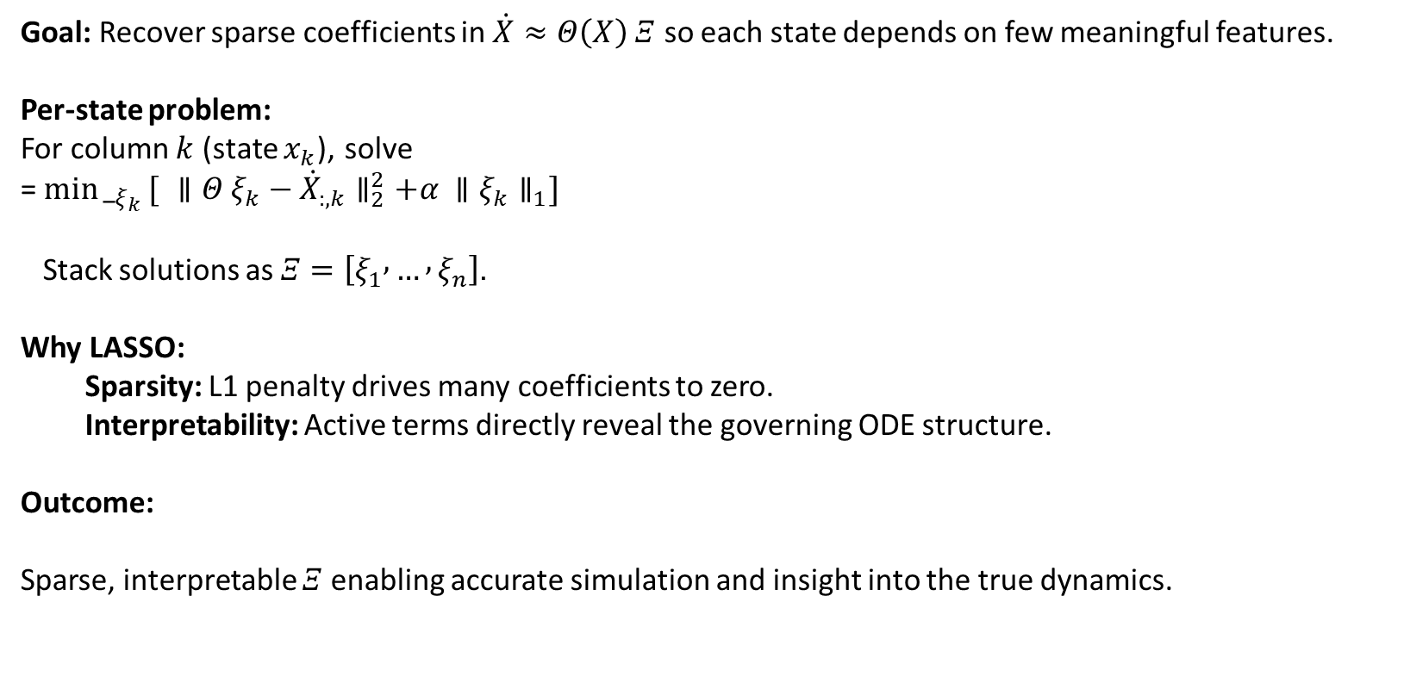
Step 3 - Sparse Regression (LASSO)
Goal: Recover sparse coefficients in $\dot{X}≈Θ\left(X\right) Ξ$ so each state depends on few meaningful features.
Per-state problem:
For column $k$ (state $x_{k}$), solve
=${\min{_}}_{ξ_{k}}[ ∥Θ ξ_{k}−{\dot{X}}_{:,k}∥_{2}^{2}+α ∥ξ_{k}∥_{1}]$
Stack solutions as $Ξ=\left[ξ_{1} , … , ξ_{n}\right]$.
Why LASSO:
Sparsity: L1 penalty drives many coefficients to zero.
Interpretability: Active terms directly reveal the governing ODE structure.
Outcome:
Sparse, interpretable $Ξ$ enabling accurate simulation and insight into the true dynamics.

Slide 16
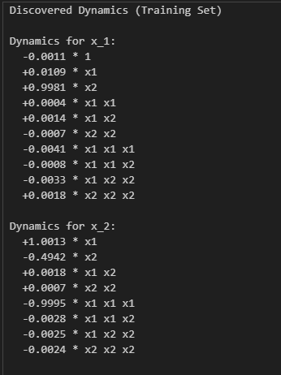
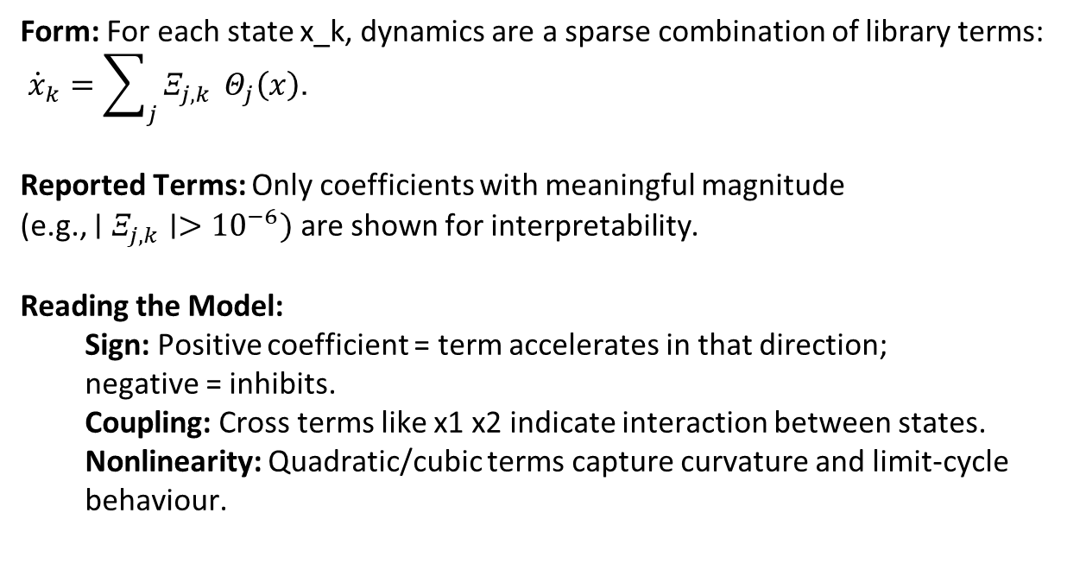
Discovered Equations
Form: For each state x_k, dynamics are a sparse combination of library terms:
${\dot{x}}_{k}=\sum_{j}{Ξ_{j,k}} Θ_{j}\left(x\right)$.
Reported Terms: Only coefficients with meaningful magnitude
(e.g., $∣Ξ_{j,k}∣>{10}^{−6})$ are shown for interpretability.
Reading the Model:
Sign: Positive coefficient = term accelerates in that direction;
negative = inhibits.
Coupling: Cross terms like x1 x2 indicate interaction between states.
Nonlinearity: Quadratic/cubic terms capture curvature and limit-cycle behaviour.

Slide 17
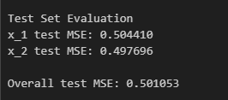
Model Validation - Test Set Performance
Per-state test MSE (x1, x2):
Measures how well the sparse regression (Theta @ Xi) predicts instantaneous derivatives ẋ on held-out samples.
These indicate moderate error in derivative prediction under noise.
Derivative MSE (test set):
For each state k: predict ẋ_pred = Theta_test @ Xi[:, k].
Compute MSE_k = mean((ẋ_true[:, k] − ẋ_pred)²).
Report per-state and the mean across states.

Slide 18
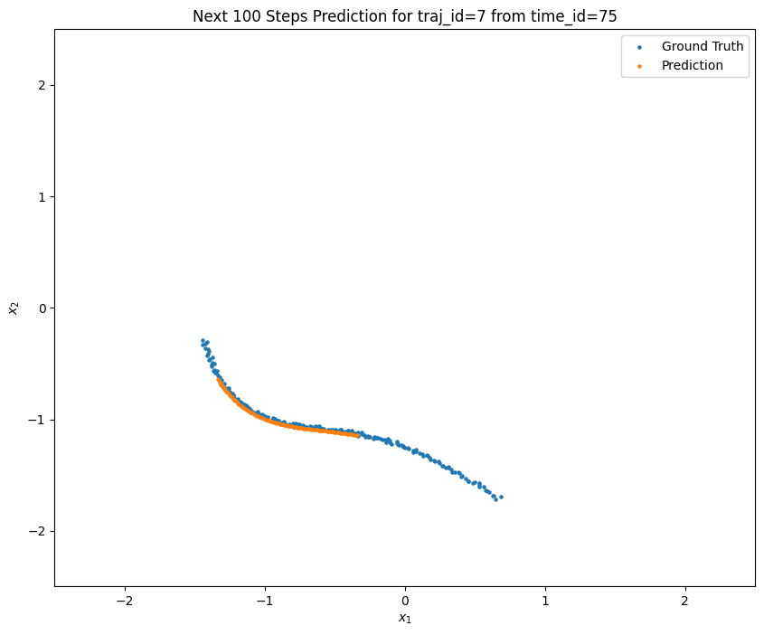
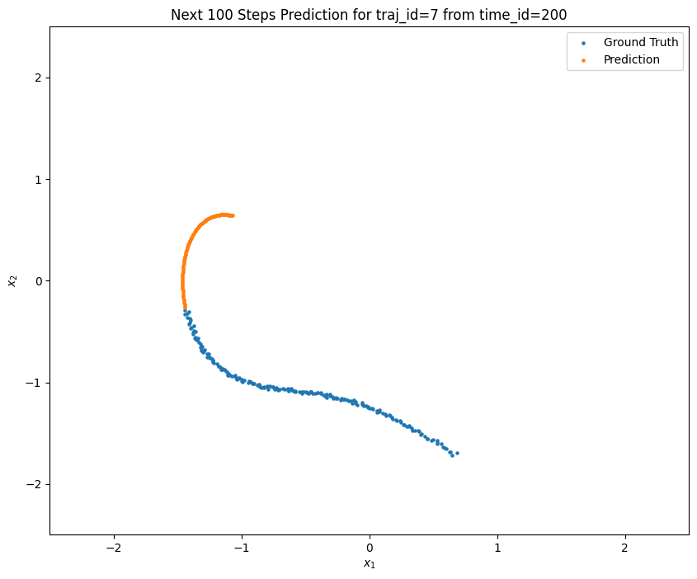
Forward Predictions

Slide 19
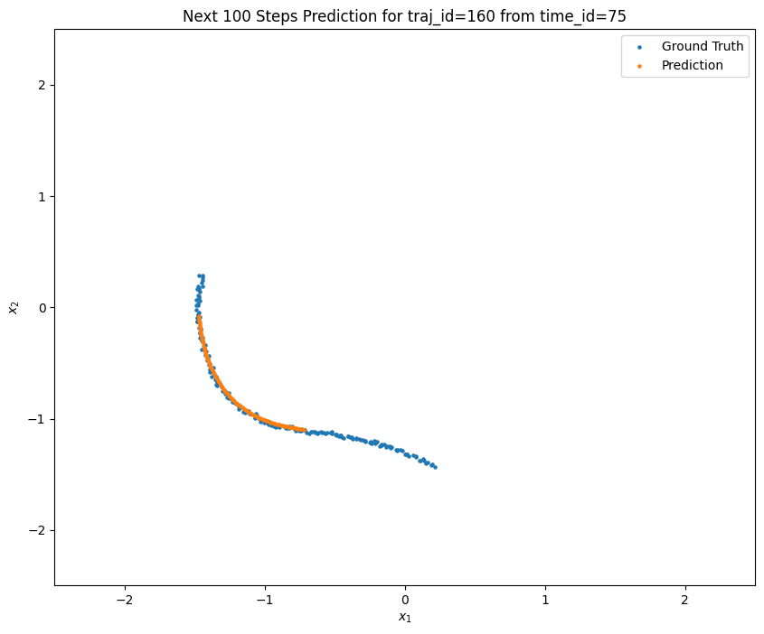
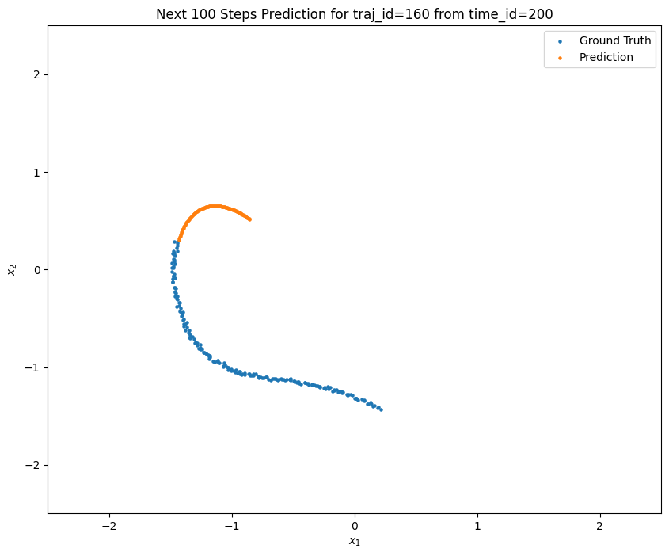
Forward Predictions

Slide 20
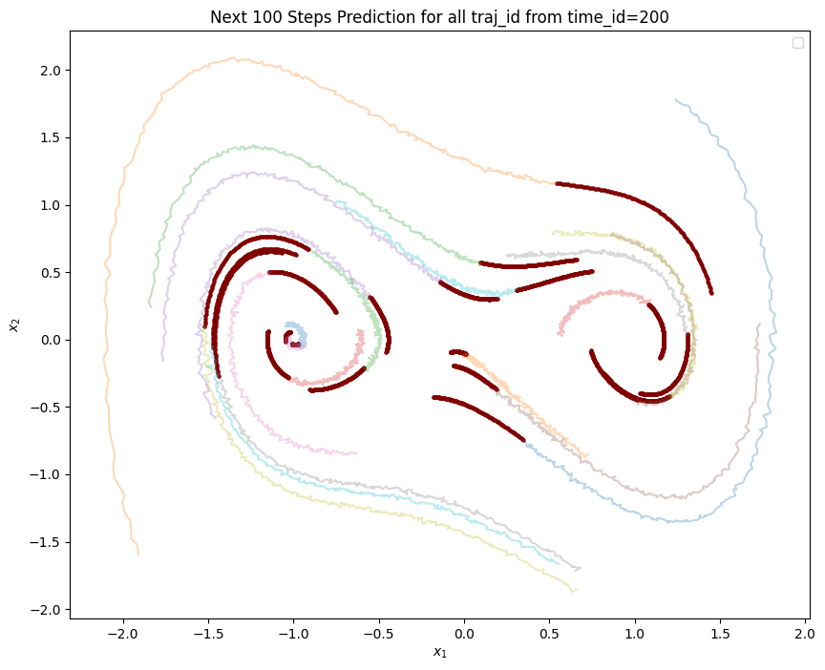
Predictions for certain trajectories

Slide 21
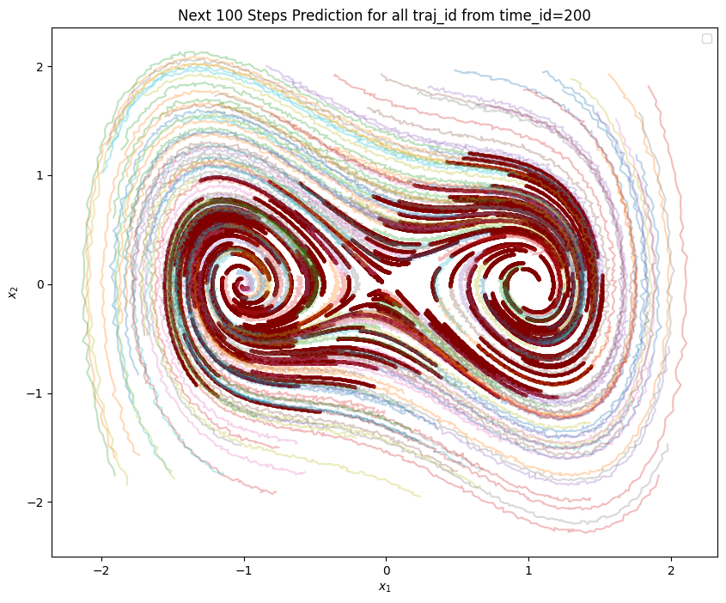
Predictions of the System after N=200

Slide 22
Model Validation – Test Overall Performance
Mean trajectory MSE: 0.00029191414088577033
This MSE is computed by comparing true vs. predicted trajectories over a 100-step horizon.
We used 20 randomly selected initial conditions not seen during training of this model.
We observe that the average error remains very low despite noisy real data.
The result indicates that the learned SINDy model generalizes well and does not overfit.
Hence, it confirms that the discovered ODE closely captures the underlying system dynamics.

Slide 23
Conclusion
The SINDy framework successfully discovered a simple, interpretable ODE from raw trajectory data.
The learned model reproduced the system’s nonlinear, inward-spiraling dynamics with high accuracy.
Forward predictions closely matched the true trajectories across multiple unseen initial conditions.
The low mean trajectory MSE (approx. 0.00029) confirms strong predictive performance and good generalization.
This demonstrates the effectiveness of sparse regression methods in recovering governing equations directly from data.

Slide 24
We are now open to questions. Thank you ☺

