Slide 1
AWS Artifact
By Nimesh Dash

Slide 2
What is AWS Artifact?
AWS Artifact is a service that provides on-demand access to AWS compliance reports and agreements.

Slide 3
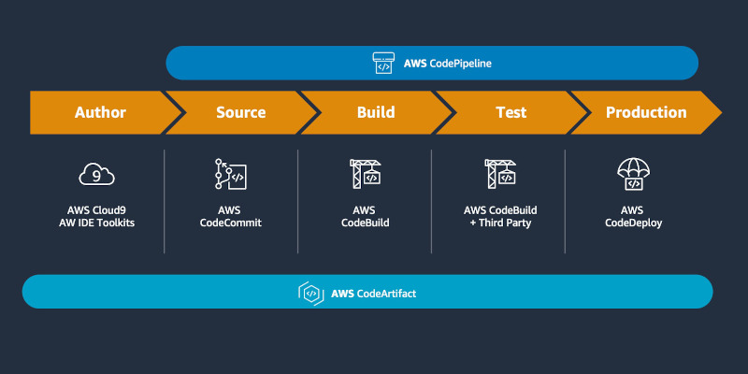
Images of AWS Artifact

Slide 4
Working Principle of AWS Artifact
AWS Artifact allows users to download compliance reports and manage agreements with AWS.

Slide 5
Use Cases of AWS Artifact
1. Compliance and audit readiness
2. Regulatory documentation
3. Security certifications management
4. Risk management

Slide 6
Key Features of AWS Artifact
1. On-demand access to compliance reports
2. Secure and private document access
3. Continuous report updates
4. Regulatory compliance tracking

Slide 7
Benefits of AWS Artifact
1. Simplifies compliance processes
2. Enhances security and transparency
3. Provides audit-ready documentation
4. Ensures regulatory adherence

Slide 8
How AWS Artifact Works
1. Access the AWS Artifact console
2. Browse available compliance reports
3. Download required documents
4. Review and share with stakeholders

Slide 9
AWS Artifact Integration
AWS Artifact integrates with security and compliance tools to streamline audit and compliance management.

Slide 10
Conclusion
AWS Artifact is a valuable tool for organizations to manage compliance documentation and regulatory requirements efficiently.

