Slide 1
AWS Key Management Service (KMS) By Nimesh Dash

Slide 2
What is AWS KMS?
AWS Key Management Service (KMS) is a Secure and Scalable Key Management Service by AWS.
AWS KMS is a managed service that enables you to create, control, and manage cryptographic keys used for encryption and decryption.

Slide 3
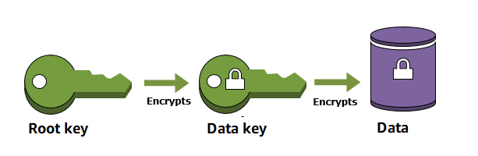
AWS KMS Architecture
When you encrypt data, you need to protect your encryption key. If you encrypt your key, you need to protect its encryption key. Eventually, you must protect the highest-level encryption key (known as a Root Key) in the hierarchy that protects your data. That's where AWS KMS comes in.

Slide 4
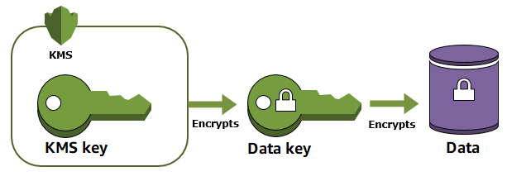
AWS KMS Architecture
AWS KMS protects your Root Keys. KMS keys are created, managed, used, and deleted entirely within AWS KMS. They never leave the service unencrypted. To use or manage your KMS keys, you call AWS KMS.

Slide 5
How AWS KMS Works
AWS KMS uses Hardware Security Modules (HSMs) to protect keys, ensuring secure key generation and encryption processes.
AWS KMS integrates with various AWS services, offering centralized key-management for data security.

Slide 6
Use Cases of AWS KMS
1. Encrypting data at rest
2. Securing application secrets
3. Managing cryptographic operations
4. Enforcing compliance and security policies

Slide 7
Key Features of AWS KMS
1. Centralized key management
2. Integration with AWS services
3. Fine-grained access control
4. Automated key rotation
5. Auditing via AWS CloudTrail

Slide 8
Benefits of AWS KMS
1. Enhanced security with HSMs
2. Scalability and high availability
3. Simplified compliance management
4. Cost-effective key management

Slide 9
AWS KMS Integration
AWS KMS works with S3, RDS, EBS, Lambda, and many other AWS services for seamless encryption and decryption.

Slide 10
Conclusion
AWS KMS is a powerful service for managing encryption keys securely and efficiently within the AWS cloud environment.

