Slide 1
AWS Budgets: Managing Cloud Costs Effectively
By Nimesh DasH

Slide 2
What is AWS Budgets?
AWS Budgets is a cost management service provided by AWS.
Allows users to set custom cost and usage budgets.
Helps in tracking spending and optimizing cloud expenses.

Slide 3
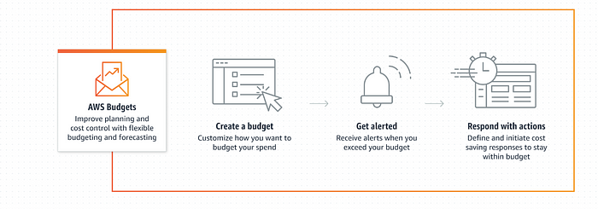
Architecture of AWS Budgets

Slide 4
Working Principle of AWS Budgets
Users define budgets based on cost, usage, or reservations.
AWS continuously monitors expenses in real-time.
Sends alerts when spending exceeds predefined thresholds.
Integrates with AWS Cost Explorer for deeper analysis.

Slide 5
Use Cases of AWS Budgets
Monitoring AWS usage and spending for organizations.
Controlling costs in multi-account AWS environments.
Setting up proactive alerts for cost overruns.
Managing Reserved Instance and Savings Plan utilization.

Slide 6
Key Features of AWS Budgets
Customizable cost, usage, and reservation budgets.
Automated alerts via email and SNS notifications.
Forecasting based on historical spending trends.
Integration with AWS Cost Explorer and AWS Organizations.

Slide 7
Benefits of AWS Budgets
Prevents unexpected cost overruns.
Improves financial planning and accountability.
Enhances cost transparency across teams.
Provides real-time insights for proactive management.

Slide 8
AWS Budgets vs. AWS Cost Explorer
AWS Budgets: Focuses on cost control with predefined budgets.
AWS Cost Explorer: Provides detailed spend analysis and trends.
Combining both enhances financial governance in AWS.

Slide 9
Case Study / Success Story
A notable AWS Budgets success story is where a large e-commerce company used the service to proactively manage cloud costs by setting custom budgets for different departments, receiving alerts when nearing thresholds, and ultimately achieving significant cost savings by identifying and addressing areas of excessive usage, particularly during peak shopping seasons, allowing them to optimize resource allocation and avoid unexpected bills.

Slide 10
Conclusion
AWS Budgets is a powerful tool that helps organizations manage their AWS spending by allowing them to set custom budgets and receive alerts when they are exceeded.

